Slide 1

Manipal Hackathon 2026
Team Name: Avatar
Track: Culture And Community
Problem Statement:”Build A Community From Zero:The Fellaride Butterfly Effect”
Solution Title:”FellaFlywheel-community activation and intelligence”
Team Members:Gireesh V Pai,H V Varun Prabhu,Sanvi Anil Kalnad,Deepthi Dongre,Nihal H G

Slide 2
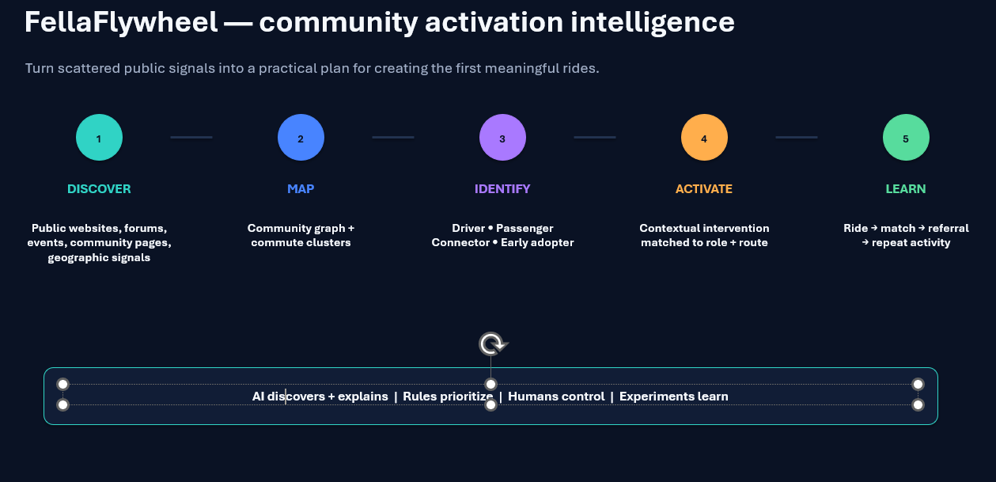
Solution

Slide 3
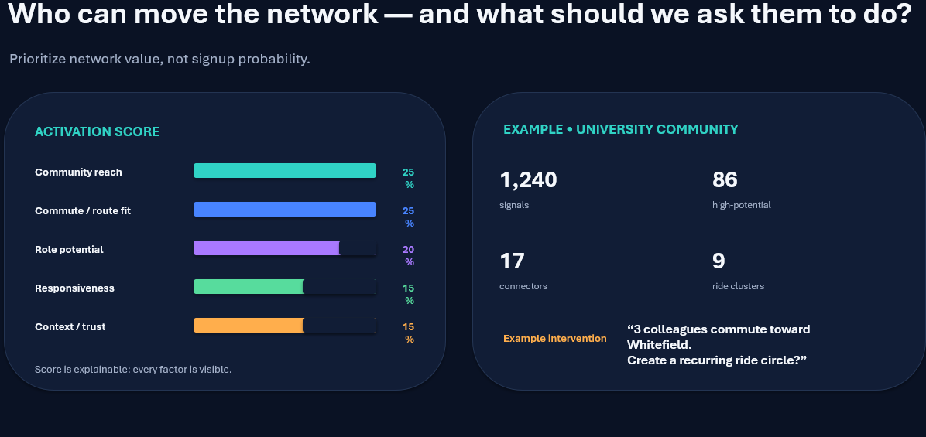
Technical Implementation

Slide 4
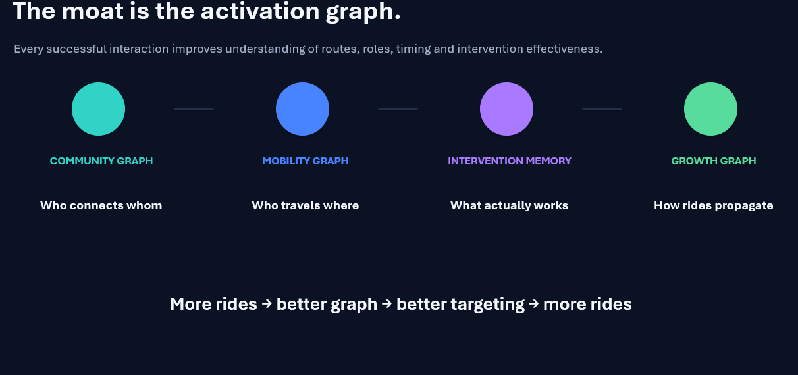
Feasibility

Slide 5
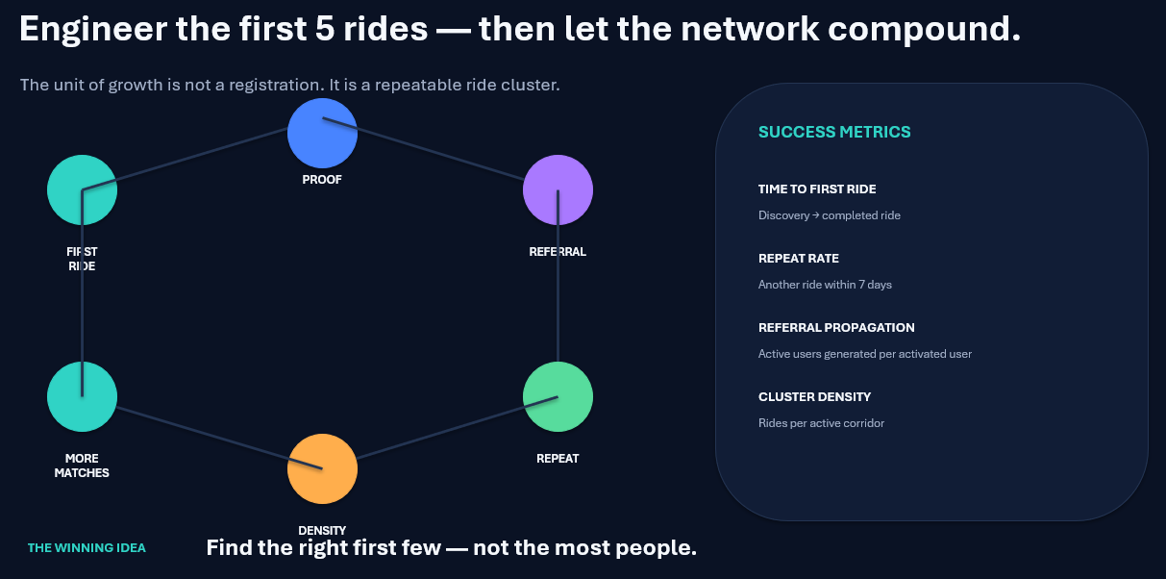
Business Strategy

