Slide 1

CXS( CREDITED EXTENSIBLE STREAM)
Boddu Giresh , K.Lokesh
CHIPWEAVE TECHNOLOGIES PVT LTD

Slide 2

ABOUT THE CXS STREAMING INTERFACE PROTOCOL
CXS is a high-speed, low-latency, streaming interface protocol mainly used for die-to-die communication, NoC connectivity, and chiplet architectures. It is designed to move large amounts of data efficiently between blocks, IPs.
MAIN GOALS OF CXS
High bandwidth with scalable data width (32 to 1024 bits)
Low latency, minimal overhead
Supports packetized and raw streaming data
Supports flow control, backpressure, credits
Designed for multi-die / chiplet interconnects
Works with high-speed PHY (like BoW, UCIe, proprietary interfaces)

Slide 3

Credit Extensible Stream (CXS) is a high-speed data transfer protocol that uses “credits” from the receiver to control how much data the transmitter can send.
The CXS protocol can be used for any point-to-point packetized communication that can support sharing a common CXS link between different protocols.
Specifically optimized for wide interfaces.
The availability of a wide interface permits merging of multiple packets into a single transfer.
We use it to avoid overflow, maintain reliable data transfer, and support very high bandwidth communication between chips or modules.
he primary use case for a CXS interface is to transport packets between an on-chip interconnect and PCIe controller.
Data transfer in CXS is unidirectional, so it is typical to have a pair of CXS interfaces between communicating blocks.

Slide 4
Protocol operation
A single instance of the interface has one Transmitter (TX) connected to one Receiver (RX).
The data is sent in one direction.
The data that is transferred in one cycle is known as a flit. A packet can occupy one or more flits.

Slide 5
Clock and reset
The following rules apply to the clock and reset:
All input signals are sampled on the rising edge of CLK.
All output signal changes can only occur after the rising edge of CLK.
There must be no combinatorial paths between input and output signals on an interface.
The reset signal RESETn is active-LOW and can be asserted asynchronously, but deassertion can only be synchronous with a rising edge of CLK.
During reset the following control signals, if present, must be deasserted:
CXSVALID
CXSCRDGNT
CXSCRDRTN
CXSACTIVEREQ
CXSACTIVEACK
CXSDEACTHINT

Slide 6
Credit exchange mechanism
The Transmitter transfers data by driving CXSDATA, placing packet control information on CXSCNTL, and asserting the CXSVALID signal.
Flow control on the interface is implemented through a credit exchange mechanism. The rules of the credit mechanism are:
Data can only be sent when the Transmitter has at least one credit from the Receiver.
When the interface is reset or first activated, the Transmitter has no credits and therefore cannot send data across the interface.
Credits are transferred to the Transmitter using the CXSCRDGNT signal.
When the CXSCRDGNT signal is asserted, one credit is transferred to the Transmitter every cycle. Each credit permits one flit of data transfer.
The Receiver must guarantee that it can receive one flit of data for each credit that it grants.
The Transmitter sends one flit of data for each cycle when the CXSVALID signal is asserted, which consumes one credit.

Slide 7
Credit exchange mechanism
The maximum number of credits that a Receiver can grant a Transmitter is specified using the CXS_MAX_CREDIT property.
If the interface is configurable, the Transmitter must be able to track up to CXS_MAX_CREDIT number of credits.
If the interface is not configurable, the Transmitter must be able to track 15 credits.
A Transmitter cannot use a credit to send a flit until the cycle after the CXSCRDGNT signal is asserted.
Optionally, credits can be returned to the Receiver without a flit transfer, using the CXSCRDRTN signal.When the CXSCRDRTN signal is asserted, one credit is returned to the Receiver every cycle.
The CXSCRDRTN and CXSVALID signals must not be asserted in the same cycle.

Slide 8
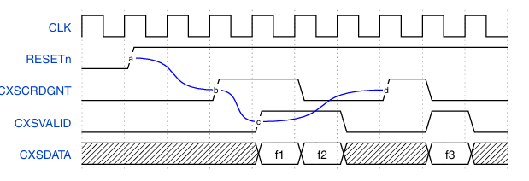
Credit exchange mechanism
An example of flit transfers on a channel is shown in Figure. In this example, the receiver has two credits available.
At reset, the transmitter has no credits.
One credit is issued by the receiver at b and a second one in the next cycle.
One credit is used by the transmitter at c to transfer flit f1 and one is used to transfer flit f2 in the next cycle. A credit is reissued by the receiver at d.

Slide 9

MANDATORY AND OPTIONAL CXS SIGNALS
Signal Name | Width | Optional | Property | Description
CLK | 1 | No | — | External clock signal.
RESETn | 1 | No | — | External active-low reset.
CXSVALID | 1 | No | — | Indicates that the current cycle contains a valid data flit.
CXSDATA | 8 to 2048 | No | CXSDATAFLITWIDTH | Data flit being transmitted (width depends on implementation).
CXSCNTL | 0, 14, 18, 22, 27, 33, 36, 44 | Depends | CXSCNTLWIDTH | Contains start/end/error information for packets. If width = 0, this signal is not present.
CXSLAST | 1 | Yes | CXS_LAST | Indicates that a packet boundary occurs and new flits may follow in the next cycle.
CXSPRCLTYPE | 3 | Yes | CXS_PROTOCOL_TYPE | Specifies the protocol type of the flit.
CXSCRDGNT | 1 | No | — | Grants a single credit to the transmitter (credit-based flow control).
CXSCRDRTN | 1 | Yes | CXSLINKCONTROL | Returns a credit to the receiver.
CXSACTIVEREQ | 1 | Yes | CXSLINKCONTROL | Link activation/deactivation request.
CXSACTIVEACK | 1 | Yes | CXSLINKCONTROL | Acknowledges link activation/deactivation.
CXSDEACTHINT | 1 | Yes | CXSLINKCONTROL | Indicates receiver wishes to deactivate the link.

Slide 10
CXS PACKETS
The data that is transmitted on the CXS interface is organized into packets. When the property CXSMAXPKTPERFLIT is greater than 1, there can be multiple packets per flit. This chapter describes how multiple packets are packed into a CXS flit. In CCIX or PCIe terminology, this is a Transaction Layer Packet (TLP).
The CXS packets are described in the following sections
Packet Position Constraints
Packet Control Signal
Packet Size Constraints
Packet Examples

Slide 11

PACKET POSITION CONSTRAINTS
CXSMAXPKTPERFLIT specifies the maximum number of packets that can have bytes in a flit. There can be up to CXSMAXPKTPERFLIT new packets starting in a flit, and up to CXSMAXPKTPERFLIT packets ending in a flit. This defines the maximum packets per flit, including any packet started in previous flits and any packet started in this flit which will be completed in subsequent flits.
When CXSMAXPKTPERFLIT is 1:
• Packets start on the first byte of CXSDATA.
• Packets end on the last byte of CXSDATA.
• Packets do not span across multiple flits
When CXSMAXPKTPERFLIT is greater than 1:
• The first byte of a packet must be placed on an aligned 16-byte boundary.
• Subsequent bytes of the packet occupy subsequent bytes of the flit.
• Packets can end on any four-byte aligned boundary.
• The packet that starts at a byte position will occupy every subsequent byte in that flit until the packet ends or the flit ends.
• If there are remaining bytes in the packet when the flit ends, that packet will start at byte[0] of the next flit and occupy every subsequent byte position until the packet ends or the flit ends.
• When a packet ends within a flit, the remaining bytes in the flit can be unused.
• Any packet in a flit must begin at the first available 16-byte boundary relative to the start of the flit or the ending of a previous packet

Slide 12
PACKET CONTROL SIGNAL
The control fields of a CXS packet are signaled using CXSCNTL. This section describes the fields and positioning within the CXSCNTL signal
PACKET CONTROL FIELDS
The CXSCNTL signal contains five fields. The widths of each field, and therefore the bit position of each field, vary with the properties of the interface
1.START Field
Indicates how many packets start in the current flit.
Width = CXSMAXPKTPERFLIT.
Rule: If START[N] = 1, then all lower bits START[N-1:0] must be 1.
Example (CXSMAXPKTPERFLIT = 4):
START[0] = 1 → at least 1 packet starts
START[1] = 1 → at least 2 packets start
START[2] = 1 → at least 3 packets start
START[3] = 1 → at least 4 packets start

Slide 13
2.START[N]PTR (Start Pointer)
Array of pointers for packet start positions inside the flit.
Pointer valid only if matching START[N] = 1.
All packet starts are 16-byte aligned.
Pointer width = log₂(CXSDATAFLITWIDTH / 128) bits.
Actual start byte = (START[N]PTR << 4).
Pointers must be monotonically increasing
(START1PTR > START0PTR).
3.END
Indicates how many packets end in this flit.
Width = CXSMAXPKTPERFLIT.
Rule: If END[N] = 1, all lower bits END[N-1:0] must be 1.
Example (CXSMAXPKTPERFLIT = 4):
END[0] = 1 → 1 packet ends
END[1] = 1 → 2 packets end
END[2] = 1 → 3 packets end
END[3] = 1 → 4 packets end

Slide 14
4.ENDERROR
Indicates error on packets ending in this flit.
Width = same as END.
ENDERROR[N] = 1 → Nth ending packet has error.
Rule: If ENDERROR[N] = 1, then END[N] must be 1.
5.END[N]PTR (End Pointer)
Pointer to the last 4 bytes of packet ending in this flit.
Valid only if END[N] = 1.
All packet ends are 4-byte aligned.
Pointer width = log₂(CXSDATAFLITWIDTH / 32) bits.
Pointers must be monotonically increasing
(END1PTR > END0PTR).

Slide 15
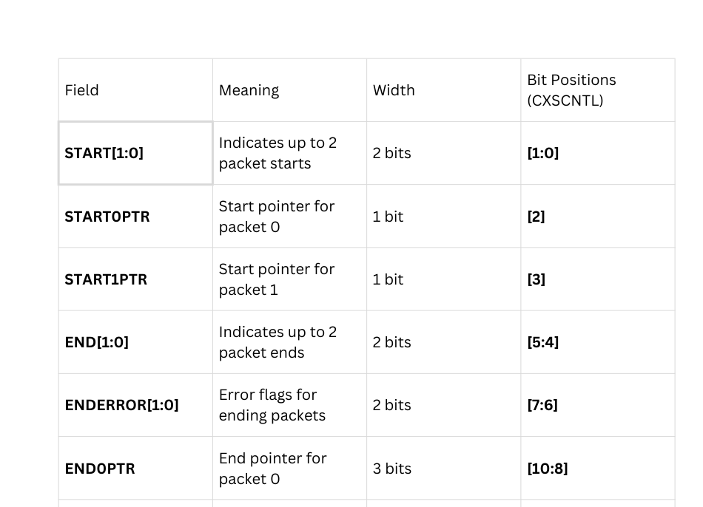
PACKET CONTROL FIELD STRUCTURE
CXSMAXPKTPERFLIT = 2, CXSDATAFLITWIDTH = 256

Slide 16
13
12
11
10
9
8
7
6
5
4
3
2
1
0
END ERROR
END
s1p
s0p
start
END1PTR
END0PTR
PACKET SIZE CONSTRAINTS
A CXS interface transmits packets of data that meet the following requirements:
• At least 4 bytes in size
• A multiple of 4 bytes in size
• No upper limit on packet size

Slide 17

INTERFACE CONTROL WITH EXPLICIT CREDIT RETURN
A CXS interface can be optionally configured to include signaling for activation and deactivation, using the CXSLINKCONTROL property. The property can be set to None or Explicit_Credit_Return. When the CXSLINKCONTROL property is set to None, there are no signals for interface activation and deactivation. This setting requires that the Receiver must always send credits when they are available, and the Transmitter must always be able to receive them.
SIGNALS FOR LINK CONTROL USING EXPLICIT CREDIT RETURN
CXSCRDRTN – Credit Return
Direction: Transmitter → Receiver
Returned when transmitter does NOT use a previously granted credit
Can be asserted only when CXSVALID = 0
Helps receiver reuse credits early and maintain flow control efficiency
CXSACTIVEREQ – Link Activation Request
Direction: Transmitter → Receiver
Used to request activation or deactivation of the CXS link
Initiates link state transitions (STOP → ACTIVATE → RUN)

Slide 18

CXSACTIVEACK – Link Activation Acknowledge
Direction: Receiver → Transmitter
Confirms the transmitter's activation/deactivation request
Ensures both sides remain in the same link state
CXSDEACTHINT – Deactivation Hint
Direction: Receiver → Transmitter
Receiver indicates it would like the link to be deactivated soon
Used for power saving or idle-time optimization
Does not force deactivation — transmitter decides when safe

Slide 19

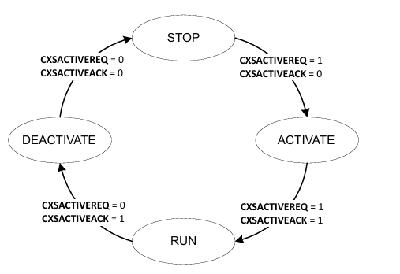
REQUEST AND ACKNOWLEDGMENT HANDSHAKING
Request and acknowledge handshaking uses CXSACTIVEREQ and CXSACTIVEACK as primary signals.
FOUR STATES ARE DEFINED FOR THE INTERFACE OPERATION:
stop state
Active state
Run state
Deactive State

Slide 20

THANK YOU

