Slide 1
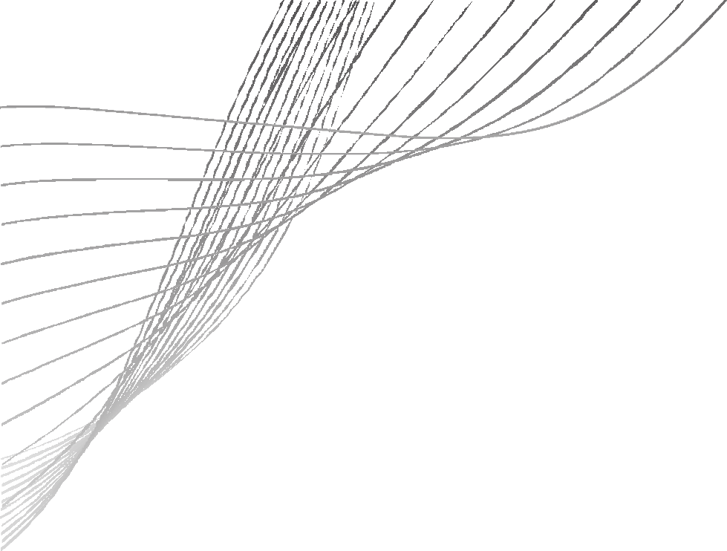
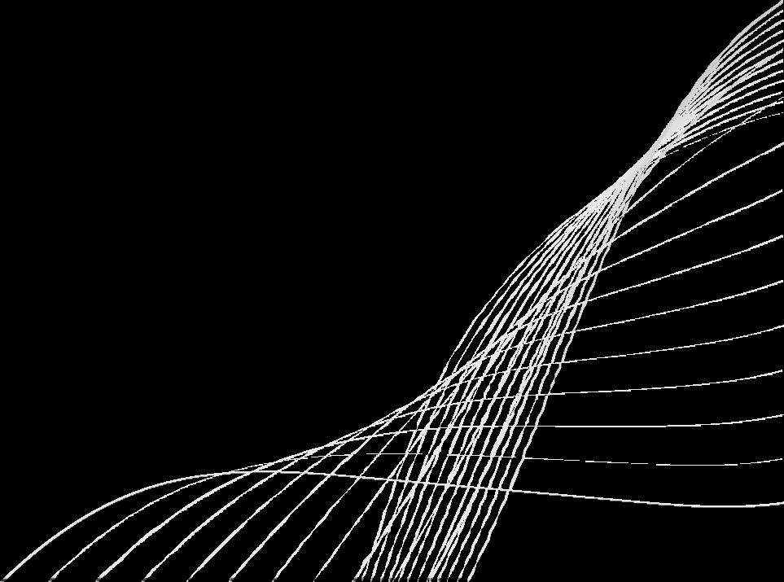
AXI PROTOCOL
Boddu giresh chipweave technologies pvt ltd

Slide 2

CONTENTS
Introduction to AXI features in AXI AXIchannels Interface&interconnect AXI signals
hand shake &burst transaction request attributes
01

Slide 3
INTRODUCTION TO AXI
1.
Advance extensible interface it is a part of AMBA protocols it provides high perfomance ,high speed,high frequency protcol compared to APB/AHB
it is also supports a pipelined transcations
2.
02

Slide 4
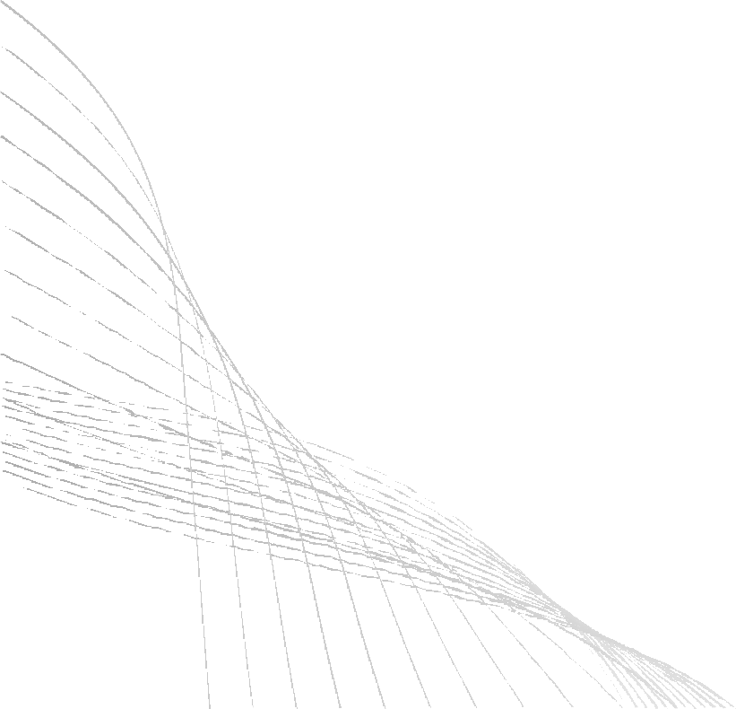
AXI FEATURES
Seperate Read/Write channels
High band width and low latency
Burst transactions
in order and out of order transactions 5. handshakeing mechanism
support out-standing and non-out standing transactions
pipelined transactions
04

Slide 5
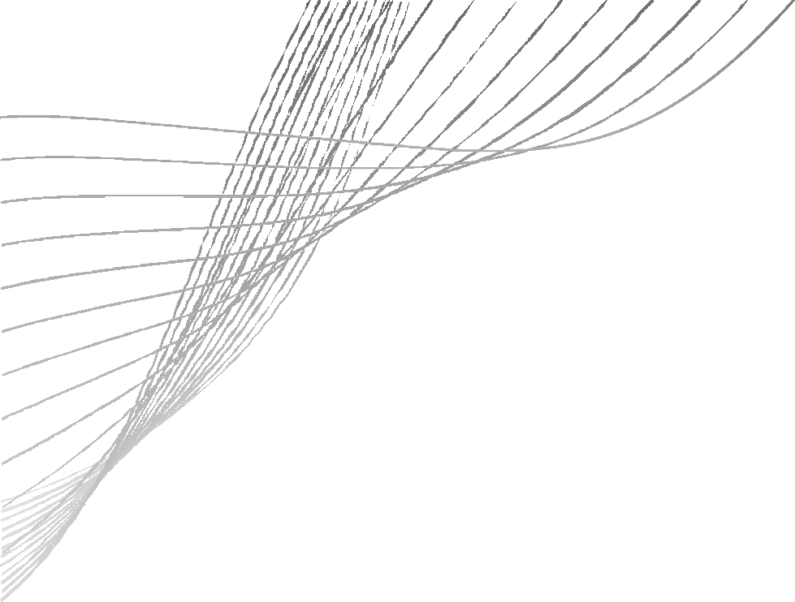

AXI CHANNELS
Write address channel (AW) Write data channel(W) Write response channel(B) Read address channel(AR) Read data channel(R)
05

Slide 6
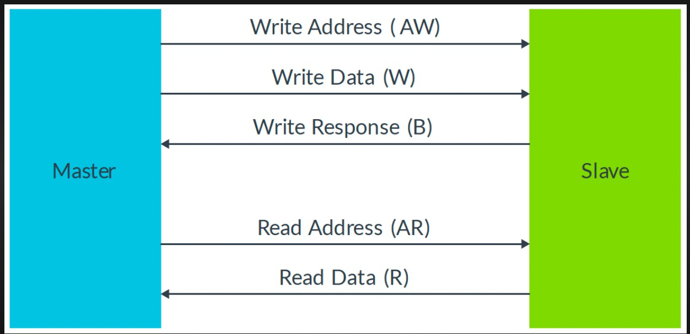
AXI CHANNELS
06

Slide 7
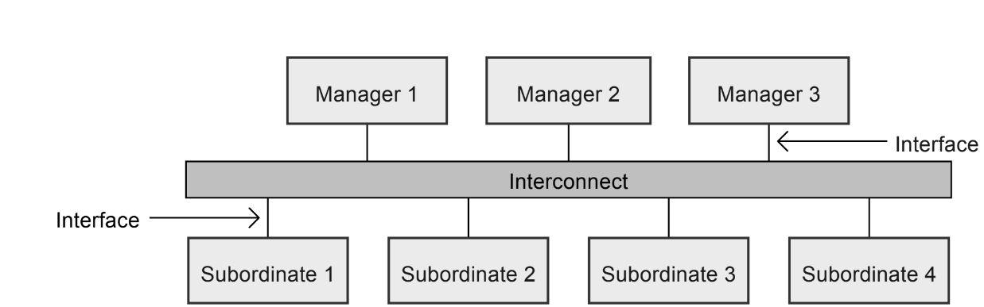
INTERFACE&INTERCONNECT
a typical systems contents serval managers and subordinates connected together form of interconnect.
07

Slide 8
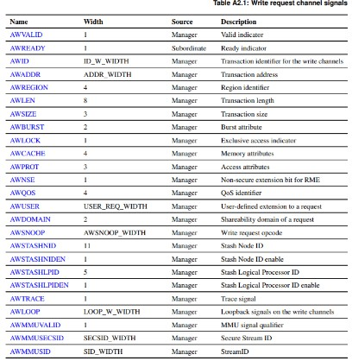
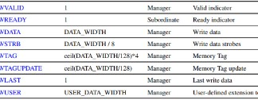
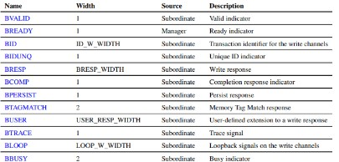
SIGNALS WRITE CHANNEL
08

Slide 9
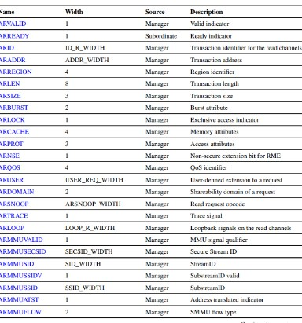
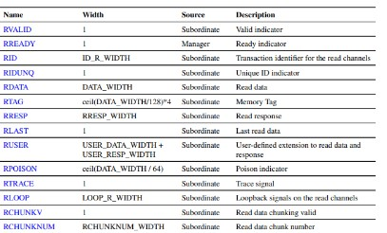
SIGNALS OF READ CHANNEL
09

Slide 10
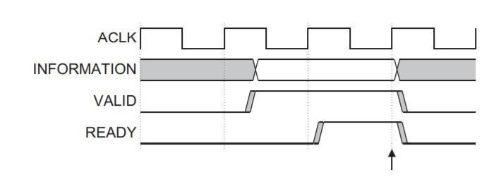
HANDSHAKE MECHANISM
10

Slide 11
BURST TRANSACTION
Burst means sending multiple data beats in a single address
There are 3 types of burst
Fixed
Increment
wrap

Slide 12
FIXED:
The burst is used for repeat access to the simplification
The address is same for every transfer in the burst
The length of the burst can be upto 16 transfers

Slide 13
INCREMENT:
The address is keep increasing for every transfer
Increment depend upon the transaction size
WRAPPING:
The address is increase but reaches the limit go back reverse address
The burst length must be 2,4,6,8, or 16 transactions

Slide 14
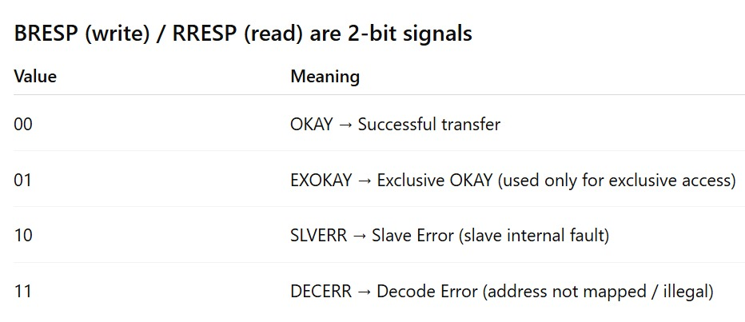
TRANSACTION RESPONCE
Transaction response will be both read and write

Slide 15
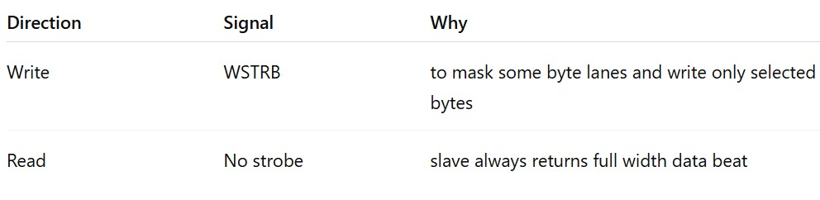
WRITE STROBE:
The write strobe carry that specify with byte of the write data channel contains valid information

Slide 16
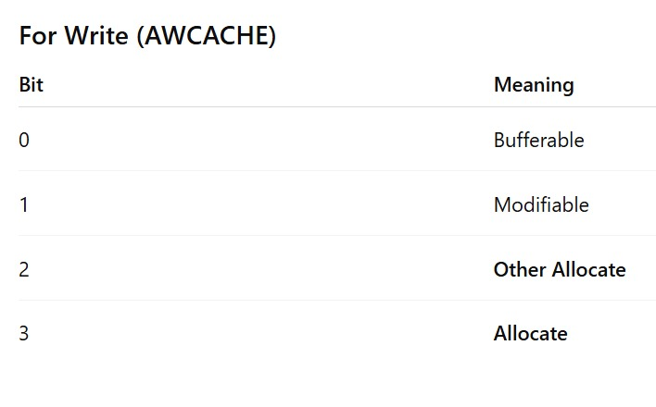
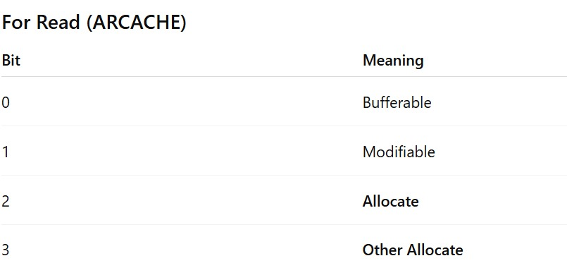
REQUEST ATTRIBUTES:
MEMORY ATTRIBUTES:
The memory attributes are request control and how transaction progress through a system and how caches handle the request

Slide 17
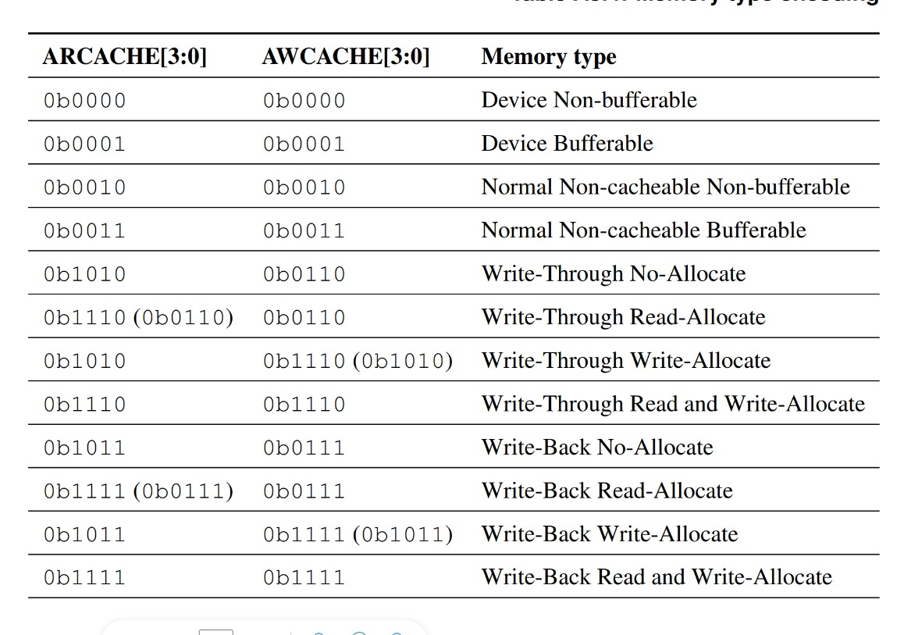
MEMORY TYPES:
The combination of ARCACHE and AWCACHE signal indicate memory type

Slide 18

THANK YOU

