Slide 1

RESET DOMAIN CROSSING
BODDU GIRESH
CHIPWEAVE TECHNOLOGIES PVT LTD
Explore Now
01

Slide 2
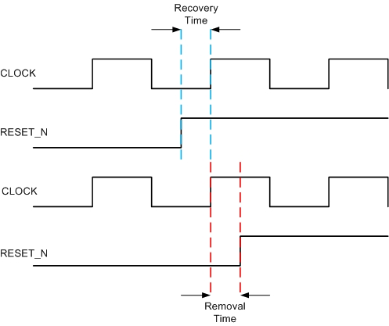
Reset Recovery
Reset Removal
Reset Recovery
Reset how much time stable before passing positive edge of clock
Reset Removal
Reset how much time stable after passing positive edge of clock
02

Slide 3
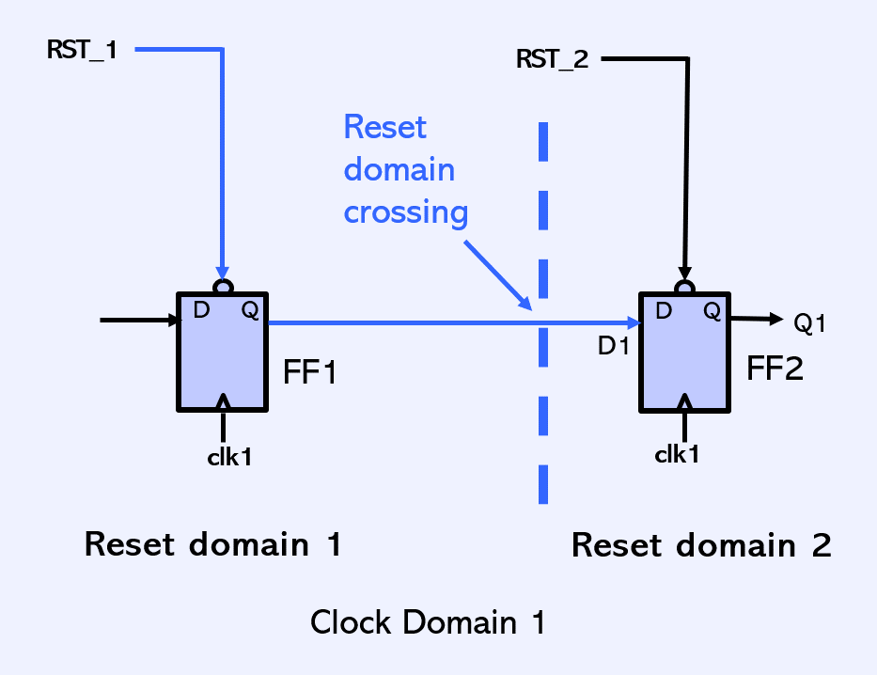
what is RDC ?
Reset Domain crossing(RDC) occurs when one reset domain interact with another reset Domain
even if both flops are using same clock if their resets are different that is an RDC
03

Slide 4
Reset Domain crossing(RDC) occurs when one reset domain interact with another reset Domain
Reset Domain crossing(RDC) occurs when one reset domain interact with another reset Domain
why RDC is important
When the reset of one flip flop de-asserts earlier than another flip flop it can
cause of Metastability, Unknown ,Functional failures
Metastability
Because a flop in reset domain A becomes active while the flop driving it in reset domain B is still held in reset.
Unknown
Because combinational paths may generate invalid values when upstream logic isn’t initialized yet
Functional failures
Design behaves unpredictably during reset release.
04

Slide 5
RDC (RESET DOMAIN CROSSING )TECHNIQUES
to fix this reset domain crossing in these methods
Synchronizer reset
Use handshake or valid signal after reset
Add gating
05

Slide 6
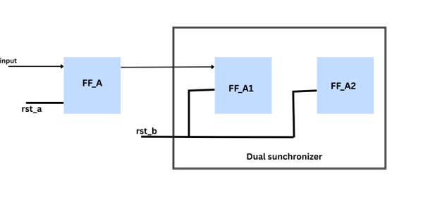
Synchronizer reset
Use two flip-flops to synchronize reset release into clock domain Avoids metastability at reset release
Code
module reset_sync(
input logic clk,
input logic rst_async,
output logic rst_sync);
logic sync1,sync2;
always_ff @(posedge clk or negedge rst_async)
if(!rst_async) sync1 <= 1'b0;
else sync1 <= 1'b1;
always_ff @(posedge clk or negedge rst_async)
if(!rst_async) sync2<= 1'b0;
else sync2 <= sync1;
assign rst_sync = sync2;
endmodule
Service 02
06

Slide 7
Use handshake or valid signal after reset
Here we add valid signal when ever valid is high that time flopa samples flopb
FLOP_A : generates data + valid
FLOP_B : accepts data when valid is high
FLOP_A
always_ff @(posedge clk or negedge rst_n1)
FLOP_A <= (!rst_n1) ? 1'b0 : data in;
a_valid <= (!rst_n1) ? 1'b0 : 1'b1;
FLOP_B
always_ff @(posedge clk or negedge rst_n2)
FLOB_B <= (!rst_n2) ? 1'b0 : a_valid ? FLOP_A : FLOP_B;
07

Slide 8
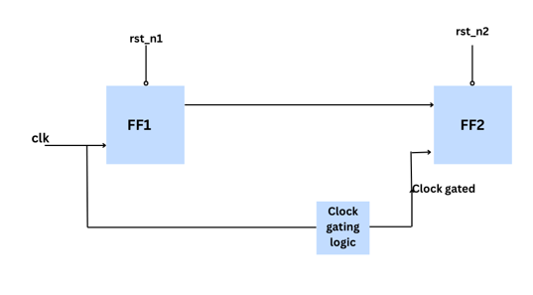
clock gating
When gated clock = 0 → flop does NOT toggle → so it will NOT go metastable.
Reset must de-assert fully first, become stable, and then only the gated clock should be enabled.
After clock resumes, the flop samples clean and stable value → hence NO metastability.
08

Slide 9
Thank
You
09

