Slide 1

DFT
DESIGN FOR TESTABALITY
BODDU GIRESH
CHIPWEAVE TECHNOLOGIES PVT LTD

Slide 2

What is DFT?
DFT = Design For Testability
Set of techniques used to make ICs easier to test after fabrication
Improves controllability and observability of internal nodes
Ensures detection of manufacturing defects
Why DFT is Needed
Chips may contain defects (stuck-at, open, short, delay faults)
Millions of internal nodes cannot be tested directly
Testing cost is very high without DFT
DFT improves test coverage (typically 98–99%+)
Ensures high-quality, reliable silicon

Slide 3
Key DFT Techniques
Scan Design / Scan Chains
ATPG (Automatic Test Pattern Generation)
LBIST (Logic Built-In Self Test)
JTAG / Boundary Scan (IEEE 1149.1)
DFT

Slide 4
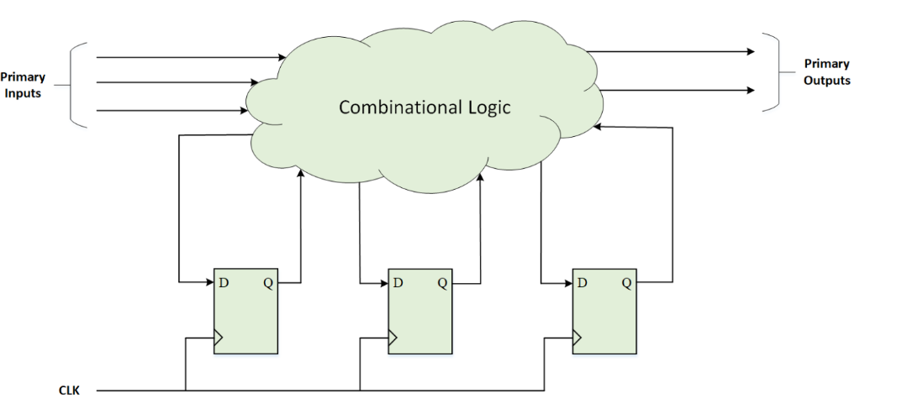
Scan chain and ATPG
Scan is the internal modification of the design’s circuitry to increase its test-ability. ATPG stands for Automatic Test Pattern Generation; as the name suggests, this is basically the generation of test patterns. In other words, we can say that Scan makes the process of pattern generation easier for detection of the faults
.
DFT
PITCH DECK PRESENTATION
A typical sequential circuit (before scan insertion).

Slide 5
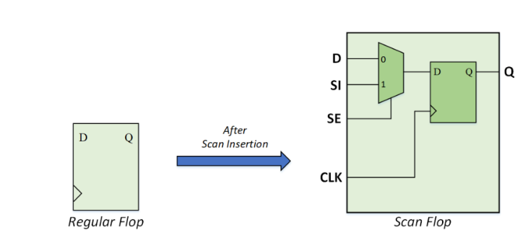
All FFs replaced with Scan Flip-Flops
FFs connected to form scan chains
Operation modes:
Scan Mode: Shift-in / shift-out test data
Functional Mode: Normal logic operation
Enables control/observe of internal registers
Converting Regular Flop to Scan Flop
dft

Slide 6
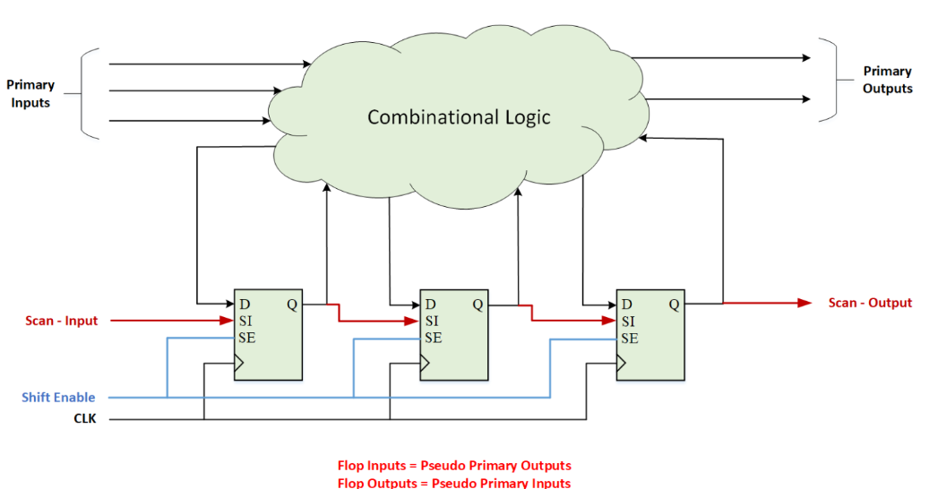
Stitching the Scan Flops to form Scan Chains
DFT
The scan flops are stitched to form scan chain. The number of scan chains depends upon various user inputs like –
Length of scan chain
Clock domain mixing
Power domain mixing
Voltage domain mixing.
.
A typical sequential circuit compatible for Scan and ATPG (after scan insertion)

Slide 7
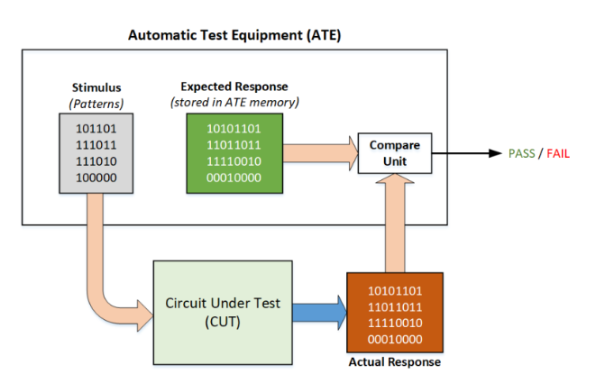
ATPG (Automatic Test Pattern Generation)
Tool generates test vectors automatically
Targets stuck-at, transition, path delay faults
Provides fault coverage report
Patterns used by tester (ATE)
DFT

Slide 8
Logic Built In Self Test (LBIST)
LBIST is a form of built in self-test (BIST) in which the logic inside a chip can be tested on-chip itself without any expensive Automatic Test Equipment (ATE). A BIST engine is built inside the chip and requires only an access mechanism like the Test Access Port(TAP) to start.
The general architecture of an on-chip BIST consists of 3 major components
1. BIST controller
2. TPG (Test Pattern Generator)
3. RA (Response Analyzer)
DFT

Slide 9
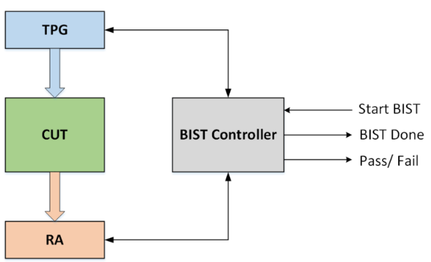
BIST Controller
Coordinates the entire Built-In Self-Test operation by controlling test mode, enabling TPG, and managing response capture.
Generates the control signals for test sequencing (start, stop, shift, capture) and interfaces with memory or logic under test.
TPG (Test Pattern Generator)
Produces deterministic or pseudo-random test vectors using LFSRs, counters, or ROM-based patterns.
Ensures high fault coverage by applying diverse patterns to stimulate the CUT (Circuit Under Test).
RA (Response Analyzer)
Compresses and evaluates the circuit’s output responses, often using a MISR (Multiple Input Signature Register).
Compares the obtained signature with a golden reference to determine pass/fail status automatically.
DFT

Slide 10
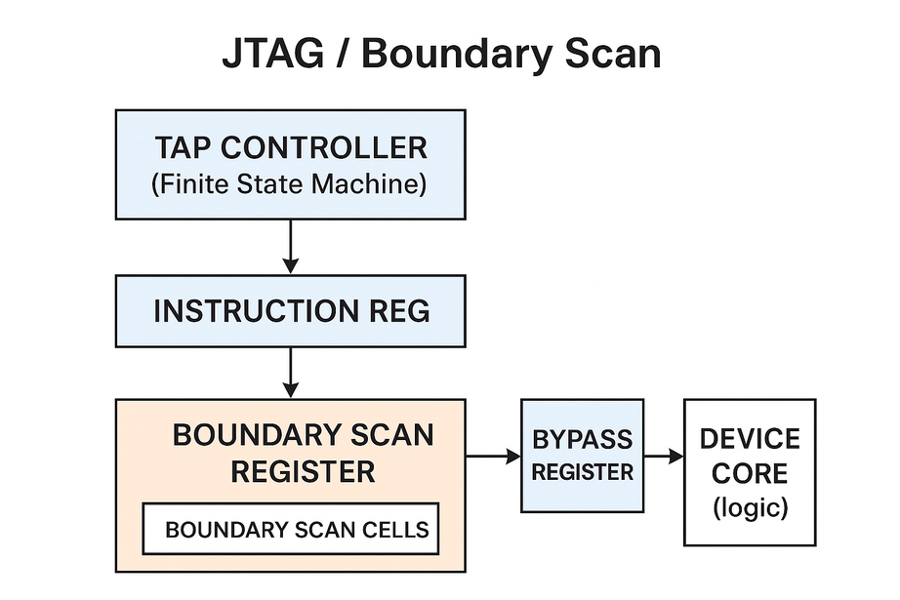
design for testabality
JTAG / Boundary Scan (IEEE 1149.1)
1. TAP Controller
The heart of JTAG(Joint Test Action Group).
A state machine controlling scan operations (shift, capture, update).
2. Instruction Register (IR)
Stores the current JTAG instruction.
Selects which data register (BSR, bypass, IDCODE) is active.
3. Boundary Scan Register (BSR)
A chain of boundary scan cells placed around the chip pins.
Allows you to drive or capture pin values.
4. Boundary Scan Cells
One cell per I/O pin.
Can force outputs OR read inputs for testing board connections.
5. Bypass Register
1-bit register allowing fast scan-through of the chip.
Used when chip is not under test.
6. Chip Core
Normal logic of the IC.
Boundary scan does not disturb normal functionality.

Slide 11
THANKYOU

