Slide 1
FINFET
GIRESH
CHIPWEAVE TECHNOLOGIESPVT LTD

Slide 2
BASICS OF FINFET
it is Type of Multi Gate MOSFET.
It is widely used over planar CMOS FET.
Fin is channel in between source and drain
FinFET can have two or four or more Fins
It gives following advantages over FET
□ Area of performance
□ Lower Leakage power
□ Low voltage operation
□ It has better control over current

Slide 3
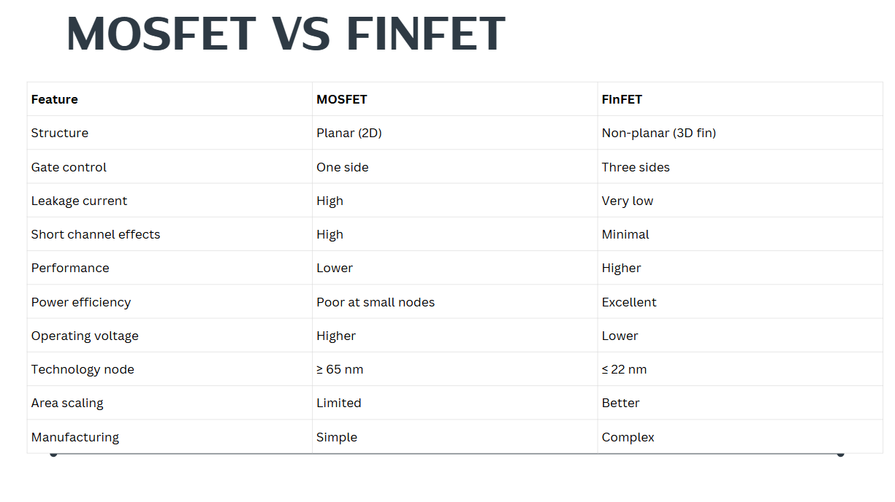
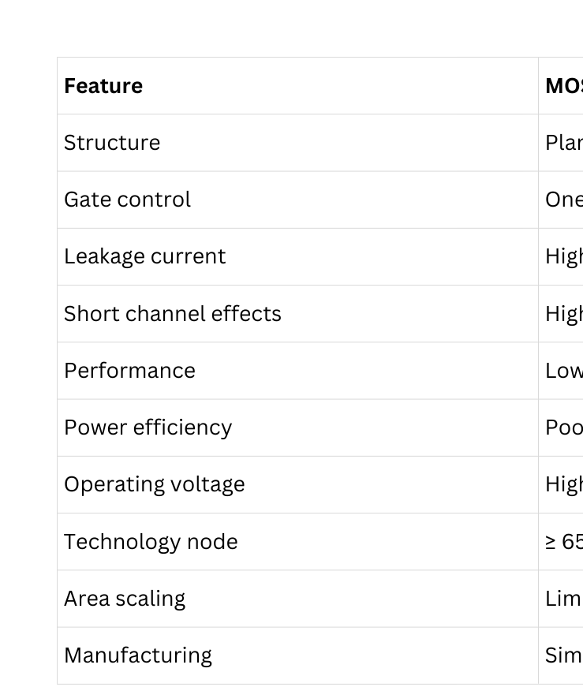
MOSFET VS FGINFET

Slide 4
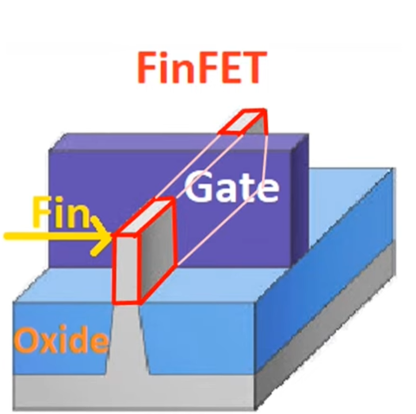
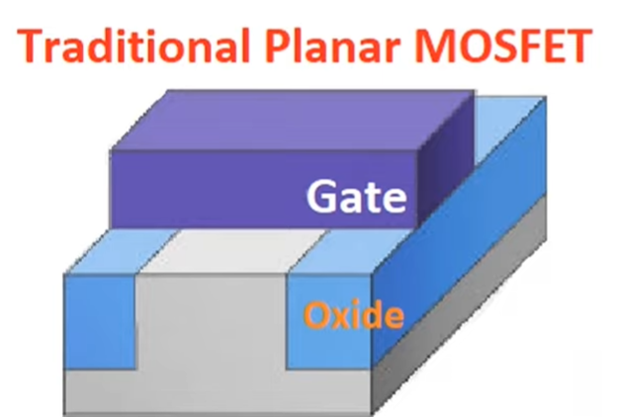
STRUCTURE OF FINFET

Slide 5
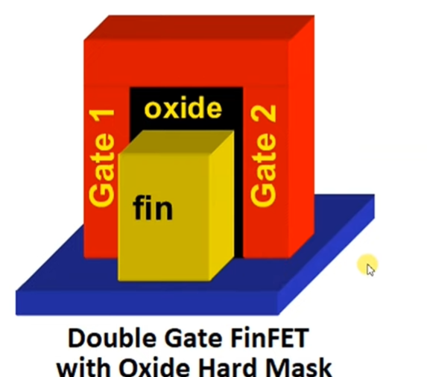
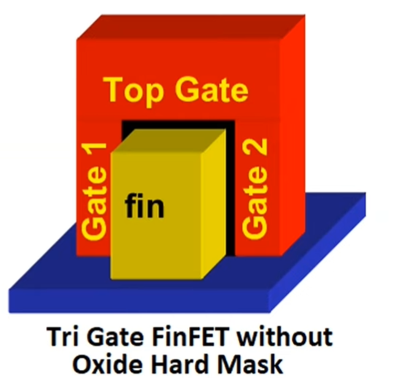
DOUBLE AND TRI GATE FINFET
• Two gates control the fin from both sides
• Better channel control than single-gate MOSFET
• Reduced leakage and improved performance
• Three gates control the fin (top and two sides)
• Excellent electrostatic control over channel
• Further reduction in leakage and power consumption

Slide 6
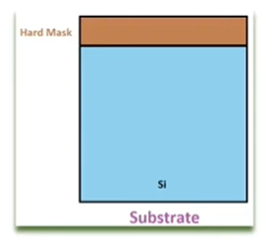
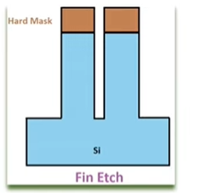
FABRICATION PROCESS OF FINFET
Substrate: In fabrication process, 1st lightly doped P type substrate is fabricated and hard mask is fabricated over the substrate.
Fin Etch: Then by a highly an isotropic process fins are formed

Slide 7
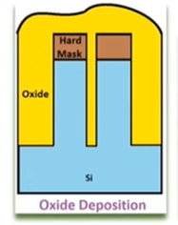
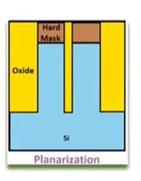
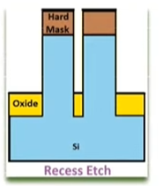
FABRICATION PROCESS OF FINFET
• Oxide Deposition : Over Fins oxide layers are formed to isolate the fins.
• Planarization: It is planarized by chemical mechanical polishing process.
Recess Etch : By this process excess oxide is etched.

Slide 8
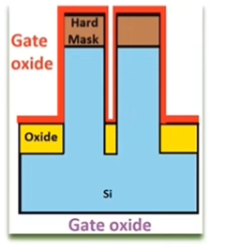
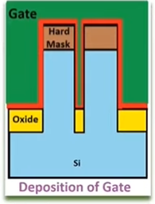
FABRICATION PROCESS OF FINFET
Gate Oxide : To isolate the channel from the gate by thermal oxidation process gate oxide is deposited over the fins.
• Deposition of the Gate : highly doped N+ poly silicon gate layer is formed and deposited over fins.

Slide 9
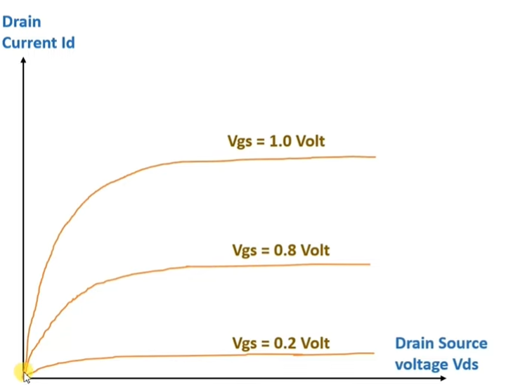
CHARACTERISTICS OF FINFET
• Drain Current will increase with respect to Vgs (Gate source voltage).
• Initially, Id will increase with increase in Vds (Drain to source voltage), after that FinFET enters into saturation region where Id current will be constant.

Slide 10
ADVANTAGES OF FIN FET
• Lower Power consumption
• Operates at low voltage
• Operating Speed is higher
• Static leakage current is reduced up to 90%
• Compact

Slide 11
DISADVANTAGES OF FIN FET
Fabrication cost is higher than CMOS circuit.
Controlling Fin Depth is difficult.
APPLICATIONS OF FIN FET
Used in Microprocessor
Used in Microcontroller
Used in Smart phone
Used in Compact chip

Slide 12
Thank You

