Slide 1
Ecosystem Simulator

Slide 2
Contents
Theory
Advantage/disadvantage
Patterns applied
  Abstract Factory
  Strategy
  Observer
  MVC

Slide 3
Theory
Take advantage of method intersects(Rectangle)
TRUE

Slide 4
Advantage
Switch between 2 environments
When “intersects”, they’re not interact immediately, they use Observer theory
With each case, they use Strategy to run Algorithm

Slide 5
Disadvantage
Hard to handle exception
Not full functionality in real world

Slide 6
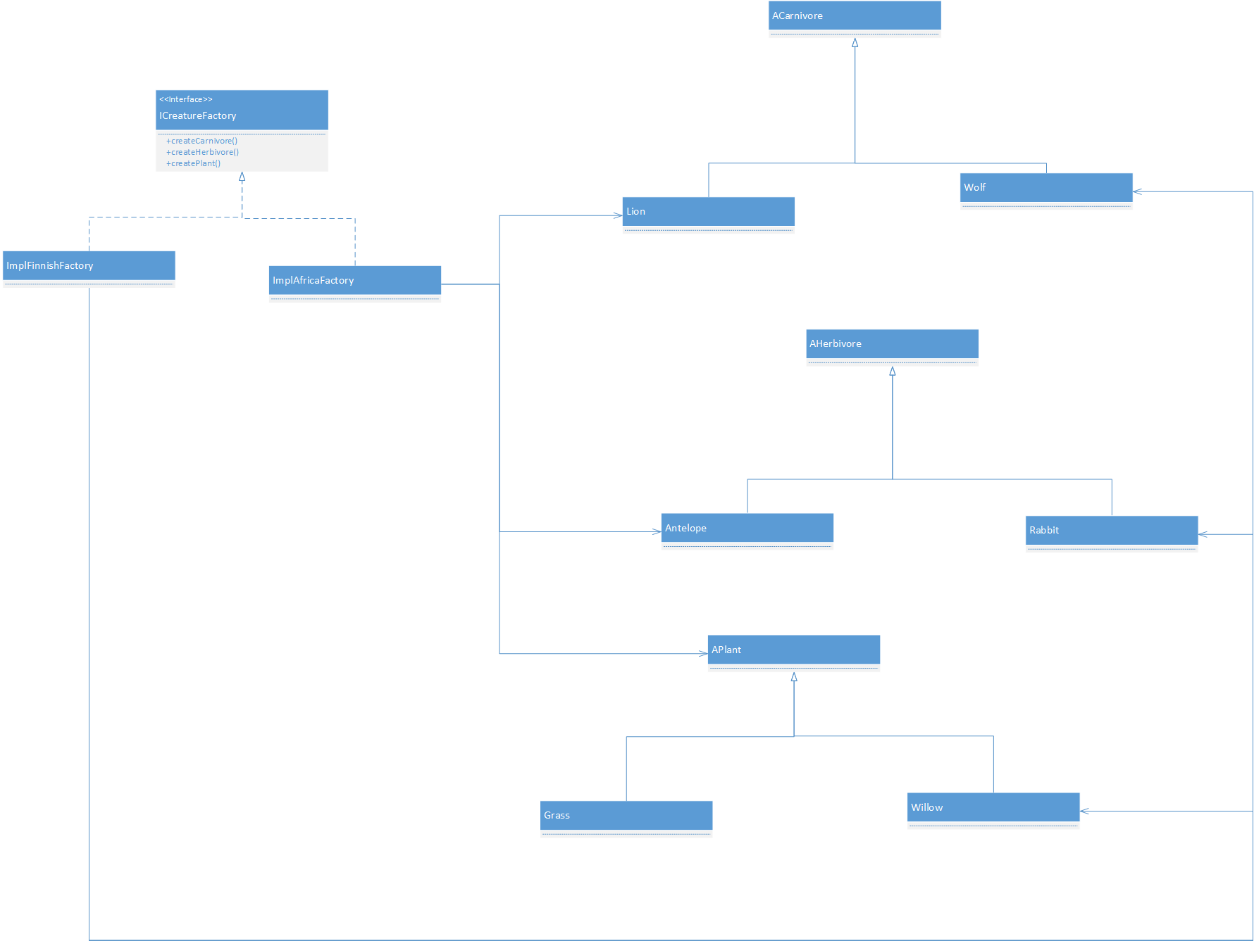
Patterns Applied
Abstract Factory

Slide 7
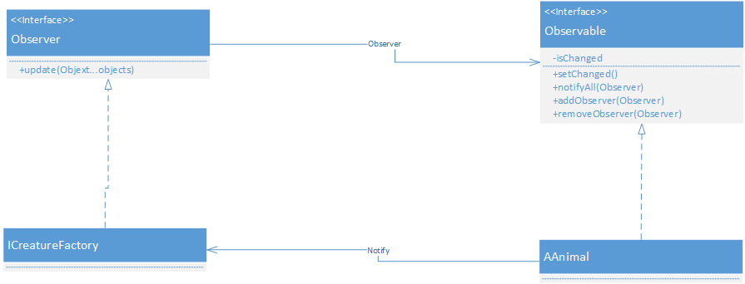
Observer
Observer

Slide 8
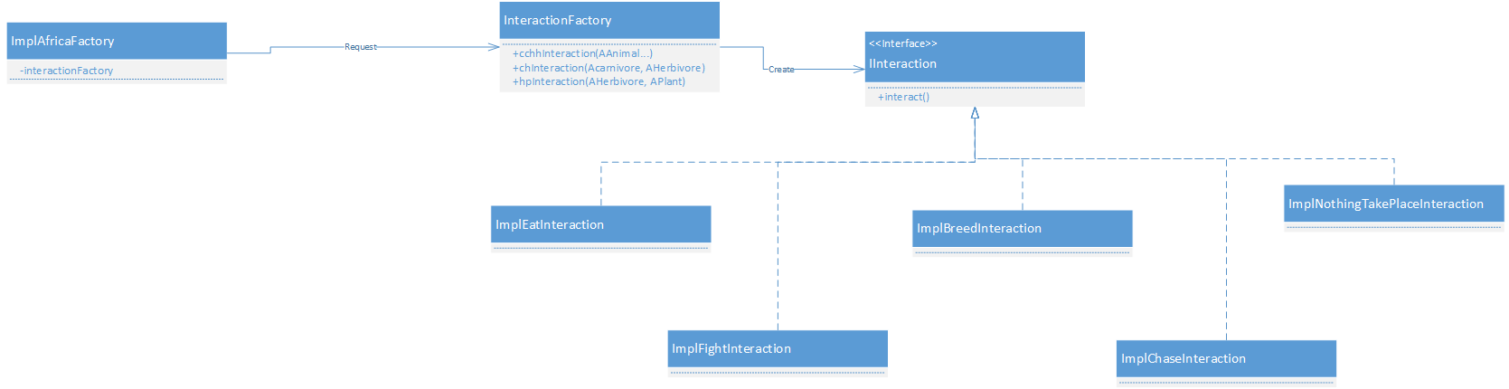
Strategy
Strategy

Slide 9
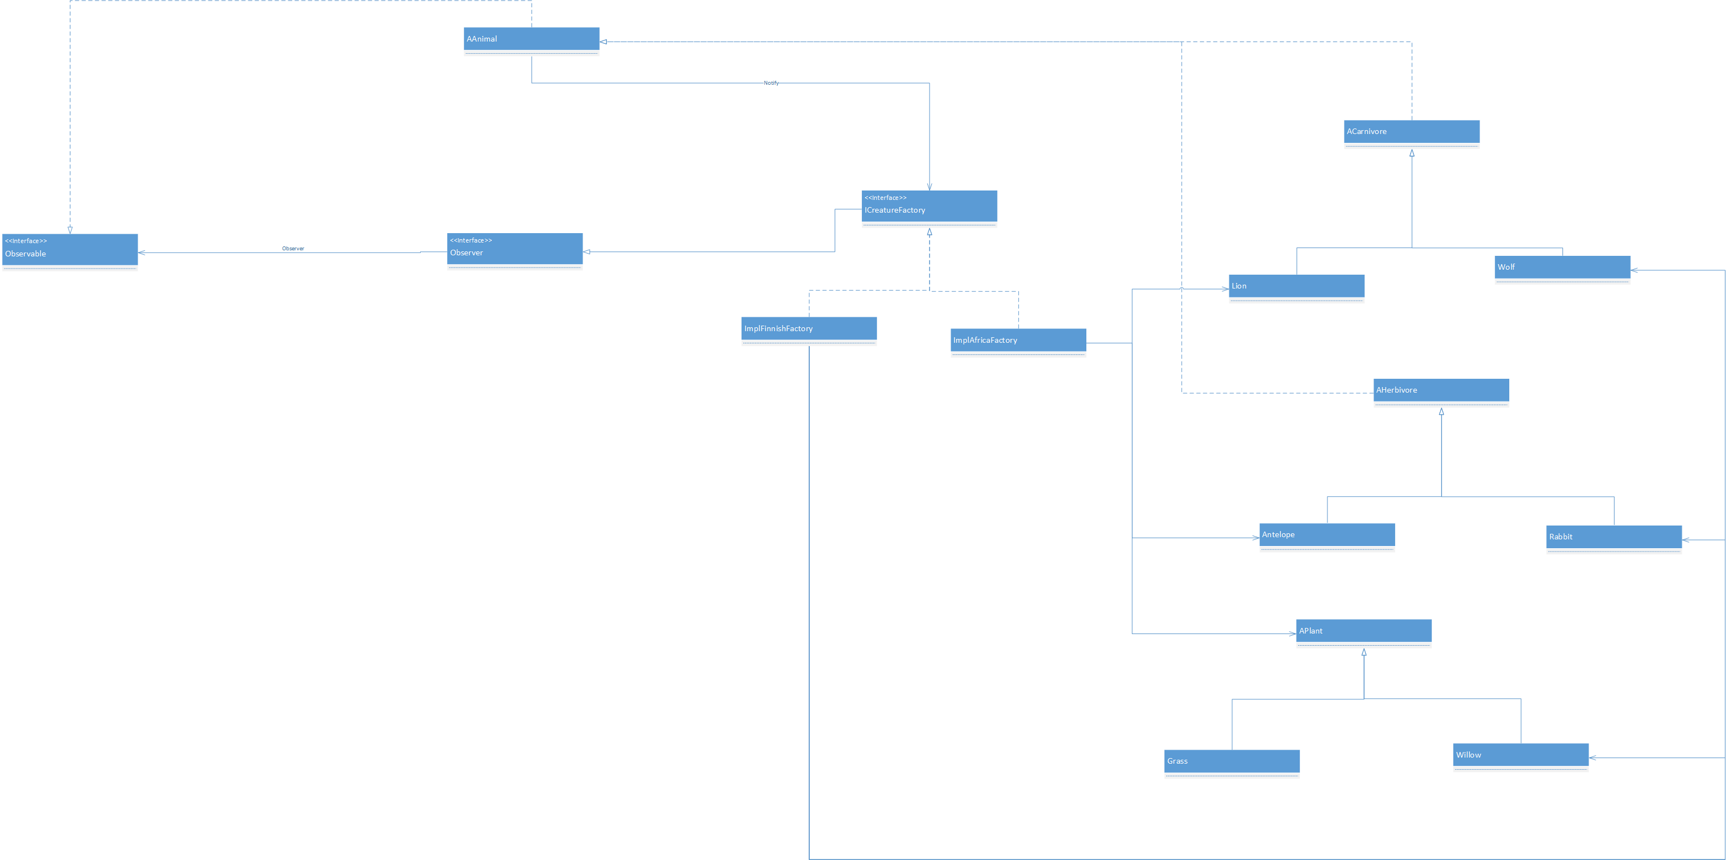
MVC
MVC

