Slide 1

iCare Chatbot

Slide 2

About us
Our company offers software solutions for healthcare facilities
Our Chatbot facilitates the communication with the customers.

Slide 3
Ontology

Slide 4
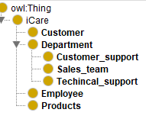
Class diagram

Slide 5
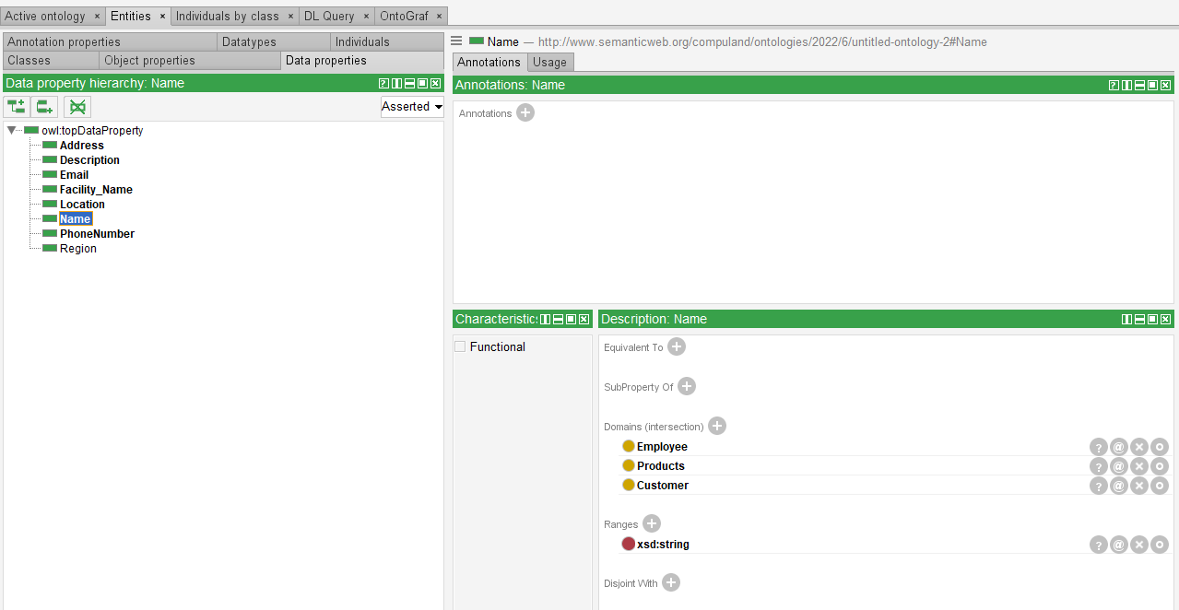
Data Properties Diagram

Slide 6
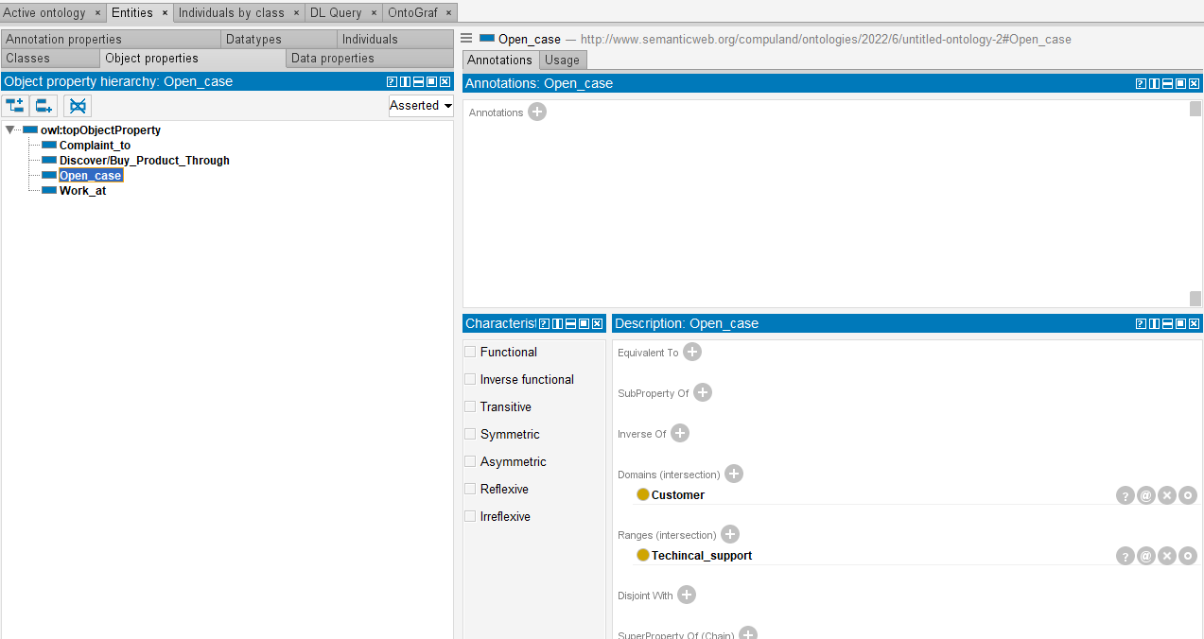
Object Attributes Diagram

Slide 7
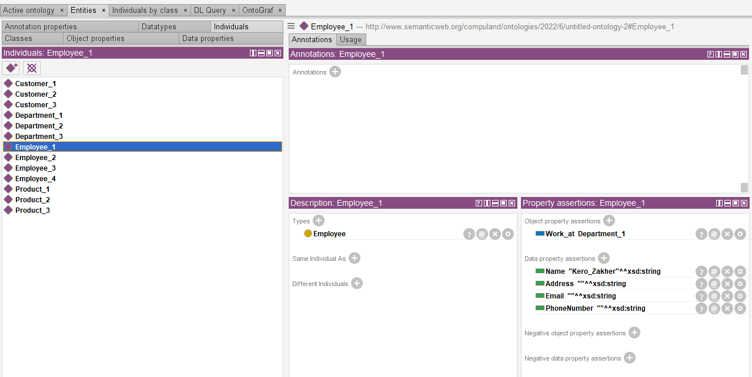
Individuals Diagram

Slide 8
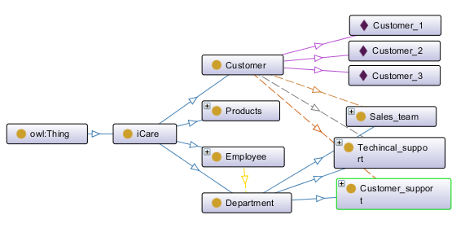
Architecture

Slide 9

Competency Questions
How to solve the problem of not receiving images?
How to diagnose patient exam?
What are the features of your system?
How to reach sales team?
I need to make a complaint?
How to solve the problem of integration?

Slide 10
Test Cases

Slide 11
Report a technical issue in images
Test Case:
How to solve the issue of not receiving images?
Doctors can't see the exams on iPACS.
The connection between the Modality and PACS is stopped.
Modalities can't send to PACS
PACS stopped working.
PACS is down.

Slide 12
Report a technical issue in diagnostic tool
Test Case:
How to diagnose patient exams?
How to use the software?
From where I can open the exam?
How to find the diagnostic tools?
How to open iPACS?
What are the instructions for diagnosis?

Slide 13
Ask about our products, or about a definite product
Test Case:
What are the features of the system?
How is the software important?
What are the uses of your products?
I want to know more info about your products.
How can your products be useful?
What are your products?

Slide 14
Ask for contacting one of sales representatives
Test Case:
Is there any email for the sales department?
How to reach the sales team contact?
Send me the sales contacts.
I need to contact sales Department.
Email of the sales department.

Slide 15
File a complaint against definite employee in technical support department or sales department
Test Case:
I am upset from the service
I want to file a complaint
I want to make a complaint
Complain to someone
I have a complaint

Slide 16
Report a technical issue in integration
Test Case:
I have an integration issue
The connection between Broker and PACS is stopped
The appointment cannot be shown on the software
The HIS messages can't reach the system.
The broker is stopped
How to Solve the Problem of integration?

Slide 17
Training

Slide 18
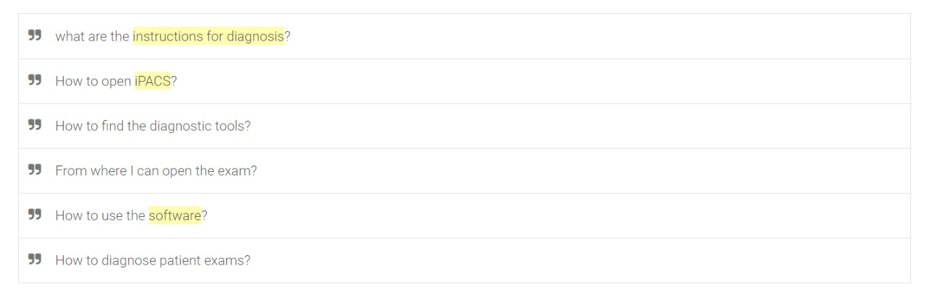
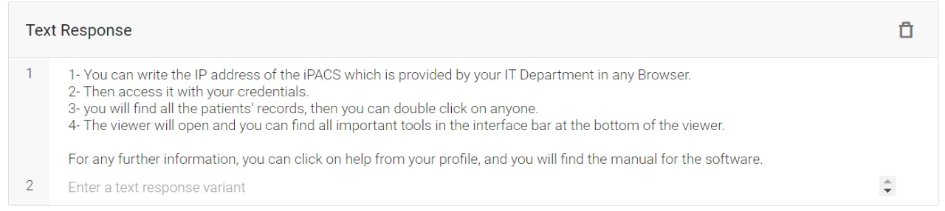
Training phrases examples:
Text response examples:

Slide 19
Evaluation

Slide 20
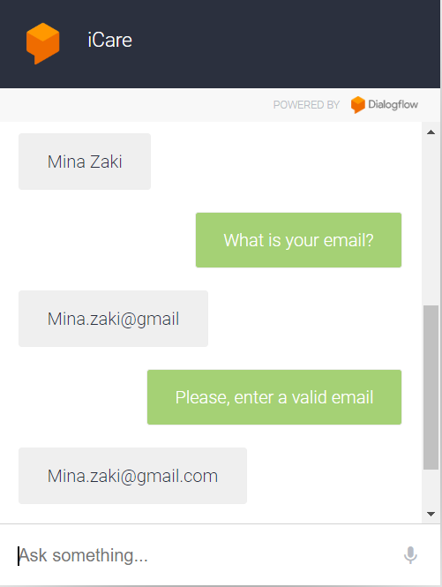
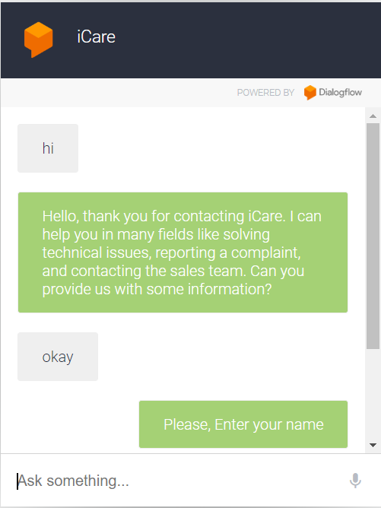
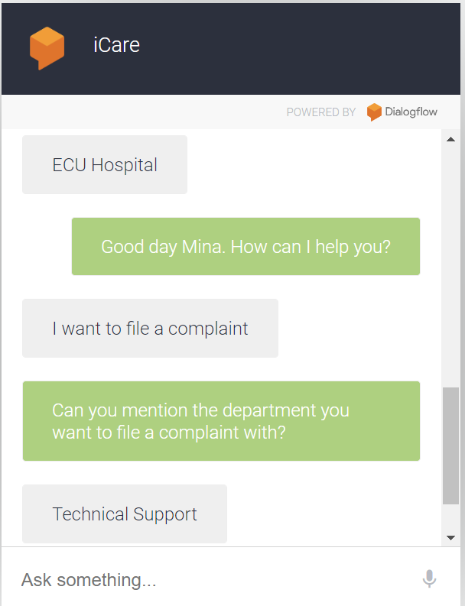
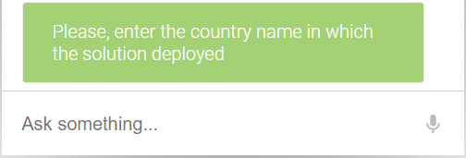

Slide 21
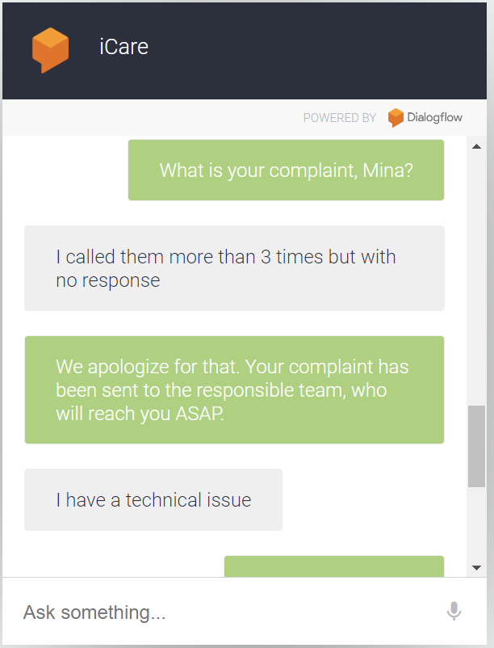
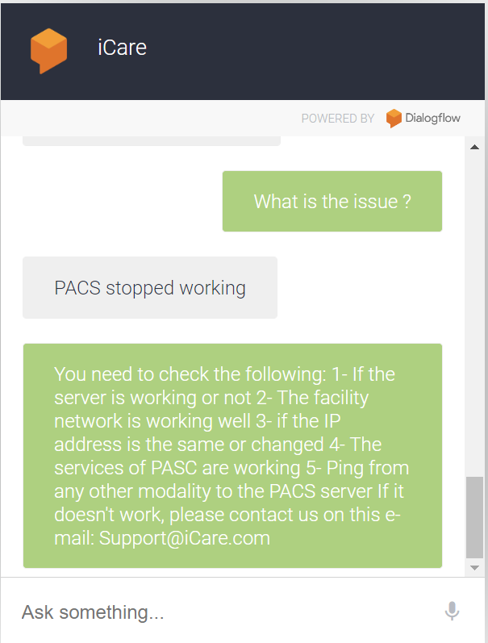
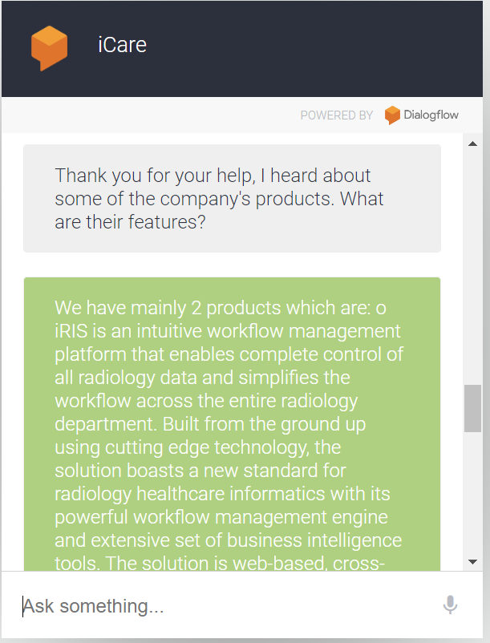

Slide 22
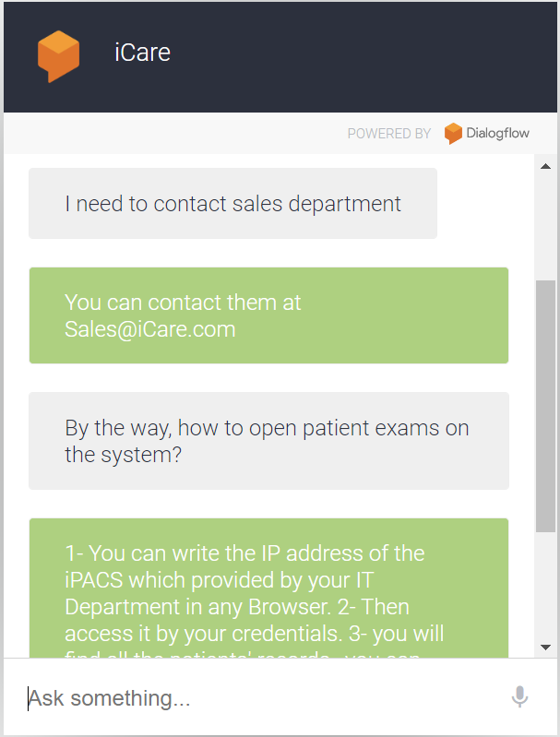
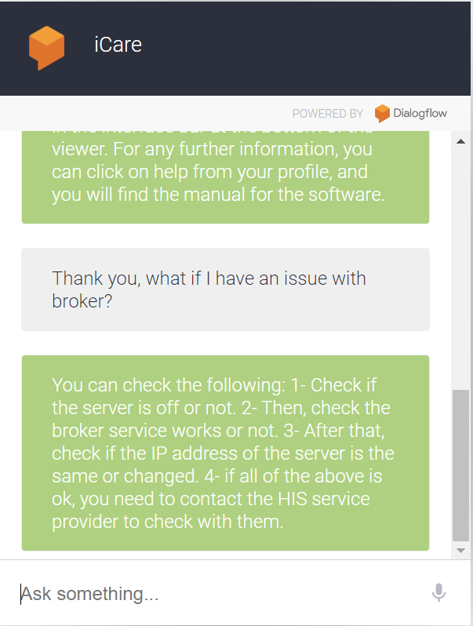

Slide 23

Evaluate us
You can try our chatbot through this link. (“ChatBot Link”)

