Slide 1
GIRIPRASADH S
(2021506023)
Department of Information Technology
MIT Campus.
NM ID: 023461BA9E715649D4A4B9DA041E6383
Final Project

Slide 2
PROJECT TITLE
Traffic Sign Recognition
(Using CNN And Keras In Python)
04/04/2024 NM PROJECT

Slide 3


AGENDA
PROBLEM STATEMENT
PROJECT OVERVIEW
END USERS
SOLUTION AND VALUE PROPOSITION
WOW FACTOR OF THE SOLUTION
MODELLING
RESULTS
3/21/2024 Annual Review

Slide 4

PROBLEM STATEMENT
In this era of Artificial Intelligence, humans are becoming more dependent on technology. With the enhanced technology, multinational companies like Google, Tesla, Uber, Ford, Audi, Toyota, Mercedes-Benz, and many more are working on automating vehicles. They are trying to make more accurate autonomous or driverless vehicles.
Self-driving cars, where the vehicle itself behaves like a driver and does not need any human guidance to run on the road.
Developing a robust and efficient system for automatic traffic sign recognition using convolutional neural networks (CNNs) implemented in Python with the Keras framework. The system detects and classifies various types of traffic signs from input images captured by cameras mounted on vehicles or roadside infrastructure.

Slide 5

PROJECT OVERVIEW
The "Traffic Signs Recognition using CNN and Keras in Python" project aims to develop a robust system for automatic traffic sign recognition using convolutional neural networks (CNNs) implemented in Python with the Keras framework.
Through data collection, preprocessing, model architecture design, training, and evaluation, the project seeks to create a CNN model capable of accurately detecting and classifying various types of traffic signs from input images.
The expected outcomes include a trained model, Python code with documentation, evaluation metrics, and potentially a user-friendly interface.
Successful implementation of this project can significantly enhance road safety and traffic management by enabling automated detection and recognition of traffic signs in real-world scenarios, with applications in autonomous vehicles, driver assistance systems, and traffic monitoring.

Slide 6

WHO ARE THE END USERS?
1. Autonomous vehicle manufacturers
2. Driver assistance system providers
3. Transportation authorities and agencies
4. Smart city initiatives
5. Road safety organizations
6. Commercial fleet operators
7. Driverless Vehicles.
3/21/2024 Annual Review

Slide 7

SOLUTION AND ITS VALUE PROPOSITION
Solution:
The "Traffic Signs Recognition using CNN and Keras in Python" project develops a robust system for automatic traffic sign recognition using CNNs implemented with Keras. It covers data collection, preprocessing, model training, and evaluation.
Through comprehensive data collection, preprocessing, model architecture design, training, and evaluation, the project aims to create a CNN model capable of accurately detecting and classifying various types of traffic signs from input images.
Additionally, the project may include the development of a user-friendly interface for seamless interaction with the system.
Value Proposition:
Precision
Efficiency
Ease of Use
Safety Boost
5. Innovation

Slide 8

THE WOW IN YOUR SOLUTION
The "wow" factor in our solution lies in its seamless integration of advanced CNN technology with everyday transportation needs, offering lightning-fast recognition crucial for autonomous driving and driver assistance systems, while maintaining robustness and reliability in diverse real-world conditions.
Our user-friendly interface ensures accessibility for all users, while seamless integration with existing infrastructure facilitates widespread adoption.
Continuous improvement processes ensure relevance and compliance with regulations fosters trust and acceptance, ultimately revolutionizing traffic sign recognition and enhancing road safety for all.
3/21/2024 Annual Review

Slide 9
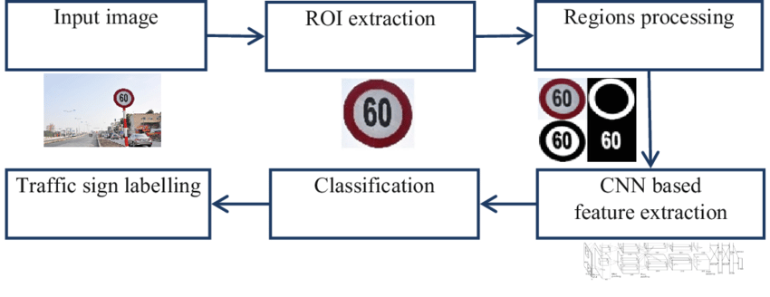
MODELLING

Slide 10
DEMO VIDEO
https://drive.google.com/file/d/1r_8nNze2MZKQHLxJAy1Rn7lkeLTZ9OOQ/view?usp=sharing

Slide 11
RESULTS
The result of the project is a fully functional traffic sign recognition system leveraging convolutional neural networks (CNNs) in Python with the Keras framework.
It accurately detects and classifies traffic signs from input images, achieving high accuracy, real-time performance, and robustness across varying environmental conditions.
The project delivers a trained CNN model, accompanied by Python code, documentation, and evaluation metrics showcasing its effectiveness.
Additionally, it may include a user-friendly interface and deployment guidelines for seamless integration into applications like autonomous vehicles and driver assistance systems.
Ultimately, the project contributes to enhancing road safety, traffic management, and transportation efficiency.

Slide 12
CONCLUSION
In summary, the project successfully created a robust traffic sign recognition system using CNNs and Keras in Python.
The system accurately detects and classifies traffic signs in real-time, even in challenging conditions.
This achievement offers significant potential for enhancing road safety and transportation efficiency in various applications, including autonomous vehicles and driver assistance systems.
Ongoing improvements and compliance with regulations ensure the system's relevance and reliability moving forward.

