Slide 1
Prediction of the network attacks by finding the best accuracy using Supervised machine learning algorithm

Slide 2
ABSTRACT
Generally, to create data for the IDS, it is necessary to set the real working environment to explore all the possibilities of attacks, which is expensive. Software to detect network intrusions protects a computer network from unauthorized users, including perhaps insiders. The intrusion detector learning task is to build a predictive model (i.e. a classifier) capable of distinguishing between "bad" connections, called intrusions or attacks, and "good" normal connections.
To prevent this problem in network sectors have to predict whether the connection is attacked or not from KDDCup99 dataset using machine learning techniques. The aim is to investigate machine learning based techniques for better packet connection transfers forecasting by prediction results in best accuracy.
To propose a machine learning-based method to accurately predict the DOS, R2L, UU2R, Probe and overall attacks by prediction results in the form of best accuracy from comparing supervise classification machine learning algorithms. Additionally, to compare and discuss the performance of various machine learning algorithms from the given dataset with evaluation classification report, identify the confusion matrix and to categorizing data from priority and the result shows that the effectiveness of the proposed machine learning algorithm technique can be compared with best accuracy with precision, Recall and F1 Score.

Slide 3
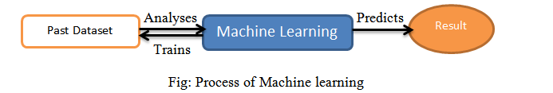
Domain overview
Machine learning is a type of artificial intelligence (AI) that provides computers with the ability to learn without being explicitly programmed. Machine learning focuses on the development of Computer Programs that can change when exposed to new data.

Slide 4
Dataset Description
The Association for Computing Machinery (ACM) has a special interest group on Knowledge Discovery and Data mining (KDD) 38 (http://www.sigkdd.org/kddcup) which is the most popular professional organization of data miners.
The 1998 DARPA Intrusion Detection Evaluation Program was prepared and managed by MIT Lincoln Labs. The objective was to survey and evaluate research in intrusion detection. A standard set of data to be audited, which includes a wide variety of intrusions simulated in a military network environment, was provided. The 1999 KDD intrusion detection contest uses a version of this dataset.

Slide 5
Classification Of Attacks
The data set in KDD Cup99 have normal and 22 attack type data with 41 features. All generated traffic patterns end with a label either as ‘normal’ or any type of ‘attack’.
There are varieties of attacks which are entering into the network over a period of time and the attacks are classified into the following four main classes.
Denial of Service (DoS)
User to Root (U2R)
Remote to User (R2L)
Probing
Attacks fall into four main categories:
DOS: denial-of-service, e.g. syn flood;
R2L: unauthorized access from a remote machine, e.g. guessing password;
U2R: unauthorized access to local superuser (root) privileges, e.g., various "buffer overflow" attacks;
probing: surveillance and other probing, e.g., port scanning.

Slide 6
Denial of Service
Denial of Service is a class of attacks where an attacker makes some computing or memory resource too busy or too full to handle legitimate requests, denying legitimate users access to a machine. The different ways to launch a DoS attack are
by abusing the computer’s legitimate features
by targeting the implementation bugs
by exploiting the misconfiguration of the systems
DoS attacks are classified based on the services that an attacker renders unavailable to legitimate users.
User to Root
In User to Root attack, an attacker starts with access to a normal user account on the system and gains root access. Regular programming mistakes and environment assumption give a attacker the opportunity to exploit the vulnerability of root access.

Slide 7
Remote to User
In Remote to User attack, an attacker sends packets to a machine
over a network that exploits the machine’s vulnerability to gain local access as a user illegally. There are different types of R2L attacks and the most common attack in this class is done by using social engineering.
Probing
Probing is a class of attacks where an attacker scans a network to gather information in order to find known vulnerabilities. An attacker with a map of machines and services that are available on a network can manipulate the information to look for exploits.
There are different types of probes: some of them abuse the computer’s legitimate features and some of them use social engineering techniques. This class of attacks is the most common because it requires very little technical expertise.

Slide 8
Overall network attack types
Dos | R2L | U2R | Probe
Back Neptune Land Pod Smurf Teardrop Apache2 Mail bomb Process table UDP Storm | FTP Write Multihop Phf Spy Warezclient Warezmaster Imap Guess password http tunnel named send mail snmpget attack snmp guess worm xlock xsnoop | Load mosule Rerl Rootkit Buffer overflow Ps Sql attack xterm | Ip sweep Nmap Satan Port sweep Msscan saint

Slide 9
Scope:
The scope of this project is to investigate a dataset of network connection attacks records using machine learning technique. To identifying attacks is more difficult. we try to reduce this risk factor behind selecting to transfer the packets of connections.
Project Goals
Exploration data analysis of variable identification
Exploration data analysis of Uni-variate, bi-variate and multi-variate
Method of Outlier detection with feature engineering
Pre-processing the given dataset
Splitting the test and training dataset
Comparing algorithm to predict the result based on the best accuracy

Slide 10
Overview of the system
This helps all others department to carried out other formalities. It have to find Accuracy of the training dataset, Accuracy of the testing dataset, Specification, False Positive rate, precision and recall by comparing algorithm using python code. The following Involvement steps are,
Define a problem
Preparing data
Evaluating algorithms
Improving results
Predicting results

Slide 11
Environmental Requirements:
1. Software Requirements:
Operating System : Windows
Tool : Anaconda with Jupyter Notebook
2. Hardware requirements:
Processor : Pentium IV/III
Hard disk : minimum 80 GB
RAM : minimum 2 GB

Slide 12
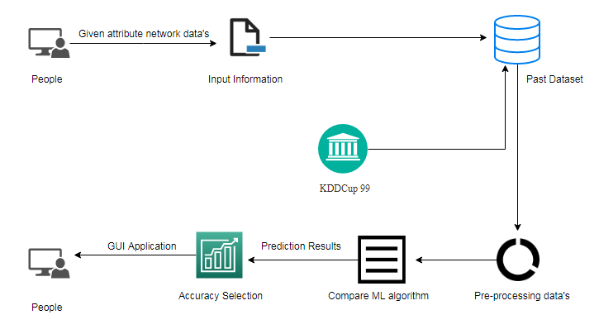
Design architecture:

Slide 13
Modules:
Data validation process by each attack (Module-01)
Performance measurements of DoS attacks (Module-02)
Performance measurements of R2L attacks (Module-03)
Performance measurements of U2R attacks (Module-04)
Performance measurements of Probe attacks (Module-05)
Performance measurements of overall network attacks (Module-06)
GUI based prediction results of Network attacks (Module-07)

Slide 14
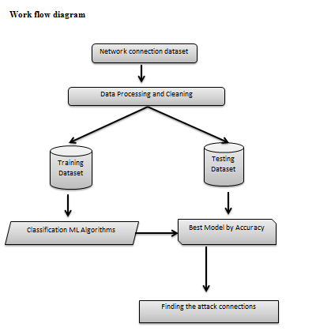

Slide 15
Training the Dataset:
The first line imports iris data set which is already predefined in sklearn module and raw data set is basically a table which contains information about various varieties.
For example, to import any algorithm and train_test_split class from sklearn and numpy module for use in this program.
To encapsulate load_data() method in data_dataset variable. Further divide the dataset into training data and test data using train_test_split method. The X prefix in variable denotes the feature values and y prefix denotes target values.
This method divides dataset into training and test data randomly in ratio of 67:33 / 70:30. Then we encapsulate any algorithm.
In the next line, we fit our training data into this algorithm so that computer can get trained using this data. Now the training part is complete.
Testing the Dataset:
Now, the dimensions of new features in a numpy array called ‘n’ and it want to predict the species of this features and to do using the predict method which takes this array as input and spits out predicted target value as output.
So, the predicted target value comes out to be 0. Finally to find the test score which is the ratio of no. of predictions found correct and total predictions made and finding accuracy score method which basically compares the actual values of the test set with the predicted values.

Slide 16
Comparing Algorithm with prediction in the form of best accuracy result:
It is important to compare the performance of multiple different machine learning algorithms consistently and it will discover to create a test harness to compare multiple different machine learning algorithms in Python with scikit-learn. It can use this test harness as a template on your own machine learning problems and add more and different algorithms to compare. Each model will have different performance characteristics. Using resampling methods like cross validation, you can get an estimate for how accurate each model may be on unseen data.
The key to a fair comparison of machine learning algorithms is ensuring that each algorithm is evaluated in the same way on the same data and it can achieve this by forcing each algorithm to be evaluated on a consistent test harness.
In the example below 5 different algorithms are compared:
Logistic Regression
Random Forest
K-Nearest Neighbors
Decision tree
Support Vector Machines
Naive Bayes

Slide 17
Used Python Packages:
sklearn:
In python, sklearn is a machine learning package which include a lot of ML algorithms.
Here, we are using some of its modules like train_test_split, DecisionTreeClassifier or Logistic Regression and accuracy_score.
NumPy:
It is a numeric python module which provides fast maths functions for calculations.
It is used to read data in numpy arrays and for manipulation purpose.
Pandas:
Used to read and write different files.
Data manipulation can be done easily with data frames.
Matplotlib:
Data visualization is a useful way to help with identify the patterns from given dataset.
Data manipulation can be done easily with data frames.

Slide 18
Performance measurements of ML algorithm:
DoS Attack Prediction:
R2L Attack Prediction:
Parameters | LR | DT | RF | SVC | KNN | NB
Precision | 1 | 1 | 1 | 0.97 | 1 | 0.96
Recall | 1 | 1 | 1 | 1 | 1 | 1
F1-Score | 1 | 1 | 1 | 0.99 | 1 | 0.98
Sensitivity | 0.99 | 0.99 | 0.99 | 0.99 | 0.99 | 0.99
Specificity | 0.99 | 0.99 | 0.99 | 0.99 | 0.99 | 0.99
Accuracy (%) | 99.94 | 99.96 | 99.97 | 99.55 | 99.97 | 99.26
Parameters | LR | DT | RF | SVC | KNN | NB
Precision | 0.99 | 0.99 | 0.99 | 0.99 | 0.99 | 1
Recall | 0.99 | 0.99 | 0.99 | 0.99 | 0.99 | 0.98
F1-Score | 0.99 | 0.99 | 0.99 | 0.99 | 0.99 | 0.99
Sensitivity | 0.99 | 0.99 | 0.99 | 0.99 | 0.99 | 0.97
Specificity | 0.69 | 0.70 | 0.67 | 0.67 | 0.65 | 0.97
Accuracy (%) | 98.68 | 98.61 | 98.6 | 98.67 | 98.61 | 97.55

Slide 19
U2R Attack Prediction:
Probe Attack Prediction:
Parameters | LR | DT | RF | SVC | KNN | NB
Precision | 1 | 1 | 1 | 1 | 1 | 1
Recall | 1 | 1 | 1 | 1 | 1 | 1
F1-Score | 1 | 1 | 1 | 1 | 1 | 1
Sensitivity | 1 | 1 | 1 | 1 | 1 | 1
Specificity | 1 | 0 | 0 | 0 | 0 | 1
Accuracy (%) | 100 | 99.99 | 99.99 | 99.99 | 99.99 | 100
Parameters | LR | DT | RF | SVC | KNN | NB
Precision | 1 | 1 | 1 | 1 | 1 | 1
Recall | 1 | 1 | 1 | 1 | 1 | 0.99
F1-Score | 1 | 1 | 1 | 1 | 1 | 1
Sensitivity | 0.99 | 0.99 | 0.99 | 0.99 | 0.99 | 0.99
Specificity | 0.98 | 0.98 | 0.97 | 0.90 | 0.98 | 1
Accuracy (%) | 99.89 | 99.9 | 99.90 | 99.82 | 99.90 | 99.11

Slide 20
Overall Network Attack Prediction:
Highest accuracy for overall Network attack is Random Forest algorithm
Parameters | LR | DT | RF | SVC | KNN | NB
Precision | 0.85 | 0.93 | 0.93 | 0.89 | 0.93 | 0.84
Recall | 1 | 0.95 | 0.95 | 0.94 | 0.94 | 1
F1-Score | 0.92 | 0.94 | 0.94 | 0.92 | 0.93 | 0.91
Sensitivity | 0.99 | 0.94 | 0.94 | 0.94 | 0.94 | 0.99
Specificity | 0.97 | 0.98 | 0.98 | 0.98 | 0.98 | 0.97
Accuracy (%) | 97.78 | 98.4 | 98.44 | 97.80 | 98.32 | 97.61

Slide 21
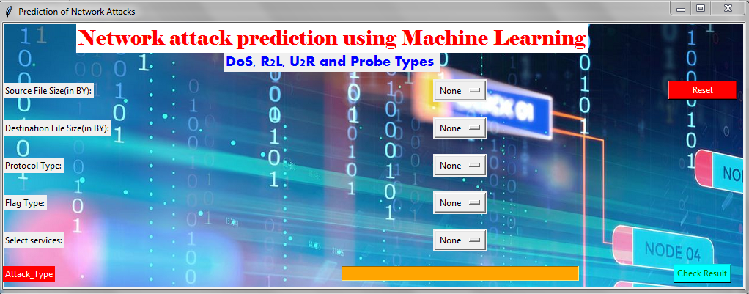
OUTPUT SCREENSHOTS:
INPUT:

Slide 22

OUTPUT:
Test-01:

Slide 23

Test-02:

Slide 24
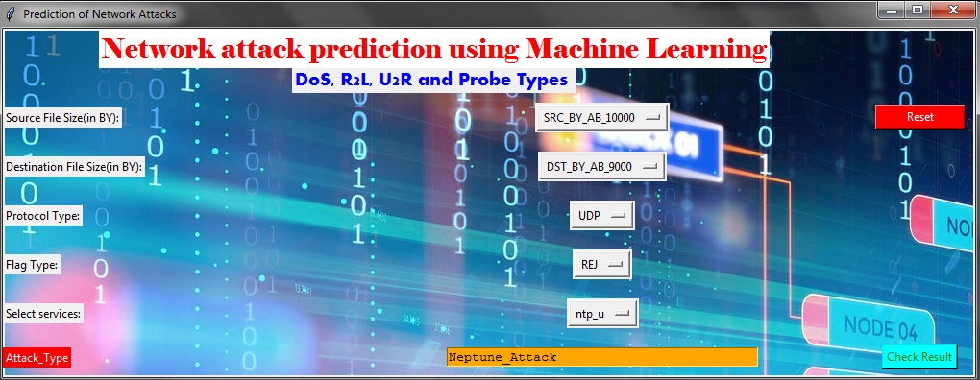
Test-03:

Slide 25
Conclusion
The analytical process started from data cleaning and processing, missing value, exploratory analysis and finally model building and evaluation. The best accuracy on public test set is higher accuracy score is random forest algorithm (98.44%) by comparing each algorithm with type of all network attacks for future prediction results by finding best connections.
This brings some of the following insights about diagnose the network attack of each new connection. To presented a prediction model with the aid of artificial intelligence to improve over human accuracy and provide with the scope of early detection. It can be inferred from this model that, area analysis and use of machine learning technique is useful in developing prediction models that can helps to network sectors reduce the long process of diagnosis and eradicate any human error.
Future Work
Network sector want to automate the detecting the attacks of packet transfers from eligibility process (real time) based on the connection detail.
To automate this process by show the prediction result in web application or desktop application.
To optimize the work to implement in Artificial Intelligence environment.

