Slide 1

SOFTWARE TESTING
Presented by
Akila Shaik

Slide 2

INTRODUCTION
It is the process used to identify the correctness, completeness and quality of developed computer software.
It is the process of executing a program/application under positive and negative conditions by manual or automated means. It checks for the :-
Specification
Functionality
Performance

Slide 3



OBJECTIVES
Uncover as many as errors (or bugs) as possible in a given product.
Demonstrate a given software product matching its requirement
specifications.
Validate the quality of a software testing using the minimum cost
and efforts.
Generate high quality test cases, perform effective tests, and issue correct and helpful problem reports.

Slide 4

Error, Bug, Fault & Failure
Error : It is a human action that produces the incorrect result that produces a fault.
Bug : The presence of error at the time of execution of the software.
Fault : State of software caused by an error.
Failure : Deviation of the software from its expected result. It is an event.

Slide 5
SDLC(Software Development Life Cycle)
Standard model used word wide to develop a software.
A framework that describes the activities performed at each stage of a software development project.
Necessary to ensure the quality of the software.
Logical steps taken to develop a software product.

Slide 6

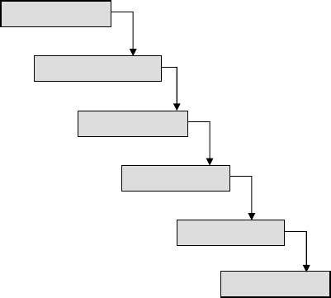
Classical Waterfall Model
Feasibility Study
Requirements Analysis & Specification
Design
Coding & Unit Testing
Integration & System Testing
Maintenance
It is the oldest and most widely used model in the field of software development.

Slide 7
Testing Life Cycle
Project Initiation
Summary Reports
System Study
Analysis
Test Plan
Regression Test
Design Test Cases
Report Defects
Execute Test Cases ( manual /automated )

Slide 8
Test Plan
It is a systematic approach to test a system i.e. software. The plan typically contains a detailed understanding of what the eventual testing workflow will be.

Slide 9
Test Case
It is a specific procedure of testing a particular requirement.
It will include:
Identification of specific requirement tested Test case success/failure criteria
Specific steps to execute test
Test data

Slide 10
Verification vs Validation
Verification: The software should confirm to its specification (Are we building the product right?)
Validation: The software should do what the user really requires (Are we building the right product?)

Slide 11
Testing Methodologies
Black box testing
White box testing

Slide 12
Black box testing
No knowledge of internal program design or code required.
Tests are based on requirements and functionality.
White box testing
Knowledge of the internal program design and code required.
Tests are based on coverage of code statements, branches, paths, conditions.

Slide 13




Black box testing
requirements
output
input
events

Slide 14



White box testing
Test data
Tests
Derives
Component code
Test outputs

Slide 15
Testing Levels
Unit testing
Integration testing
System testing

Slide 16
UNIT TESTING
Tests each module individually.
Follows a white box testing (Logic of the program). Done by developers.

Slide 17
INTEGRATION TESTING
Once all the modules have been unit tested, integration testing is performed.
It is systematic testing.
Produce tests to identify errors associated with interfacing.
Types:
Big Bang Integration testing Top Down Integration testing Bottom Up Integration testing Mixed Integration testing

Slide 18
SYSTEM TESTING
The system as a whole is tested to uncover requirement errors.
Verifies that all system elements work properly and that overall system function and performance has been achieved.
Types:
Alpha Testing Beta Testing
Acceptance Testing Performance Testing

Slide 19
Alpha Testing
It is carried out by the test team within the developing organization .
Beta Testing
It is performed by a selected group of friendly customers.
Acceptance Testing
It is performed by the customer to determine whether to accept or reject the delivery of the system.
Performance Testing
It is carried out to check whether the system meets the nonfunctional requirements identified in the SRS document.

Slide 20
Types of Performance Testing:
Stress Testing Volume Testing Configuration Testing Compatibility Testing Regression Testing Recovery Testing Maintenance Testing
Documentation Testing Usability Testing

Slide 21
DISCUSSION
Stress Testing: Stress testing is a software testing to check stability and reliability of system under load.
Volume Testing:It is a software testing to check system’s performance under huge data volume.
Configuration Testing:The process of testing a system with each of the supported software and hardware configuration.
Compatibility Testing:It is a software testing to check whether software capable of running different hardware.

Slide 22
THANK YOU

