Slide 1
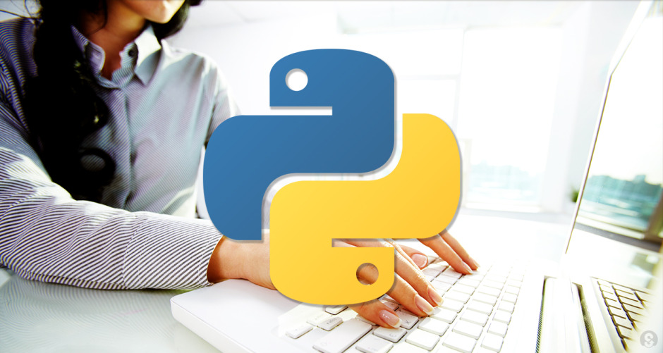
Python programming
Giridhar sripathi

Slide 2
Way to Learn
What
Why
Who
When
How
Where

Slide 3
Agenda
What
What is Python?
What You Should Already Know?
Why
Why Python programming?
Who
Where to find more about Python?
When
How
Where
Who should use Python programming?
Who developed Python?
How to develop Python code ?
How Python is different from other Scripting and programming languages?
When to use Python
Where to do Python programming?
When Python release dates
What we are going to learn in this course?

Slide 4
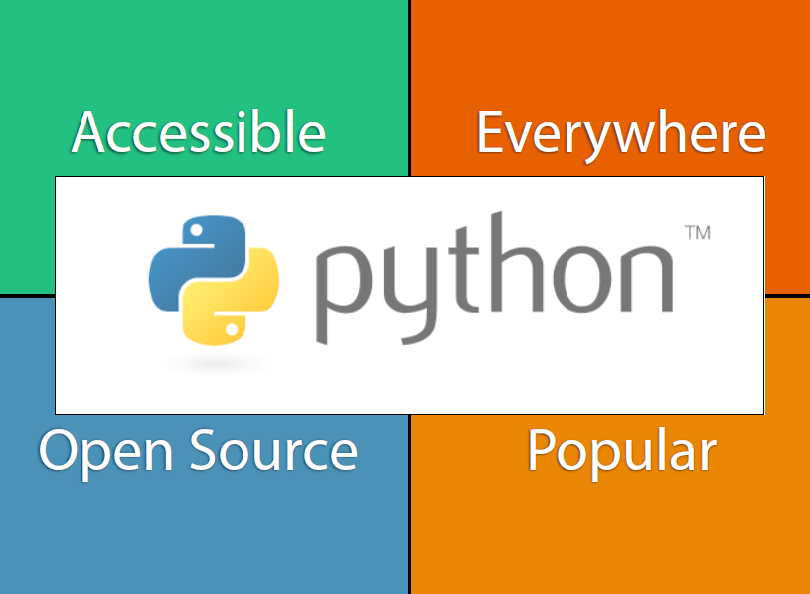

Slide 5
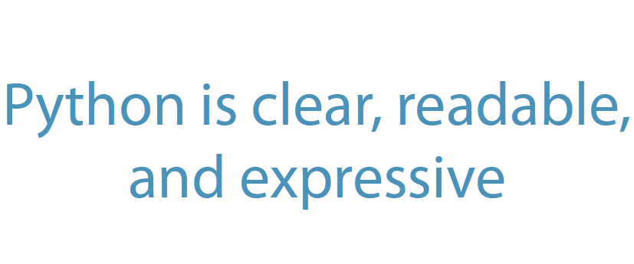

Slide 6
What is Python?
Python is a general-purpose, interpreted, interactive, multiplatform, object-oriented programming language.
It is an ideal language for those, who are new to programming.
Python is a Beginner's Language
Python was initially developed by Guido van Rossum. It was first released in 1991.
Python is open source software.
One of its most visible features is that it does not use semicolons nor brackets.
Python uses indentation instead.
Today, Python is maintained by a large group of volunteers worldwide.

Slide 7
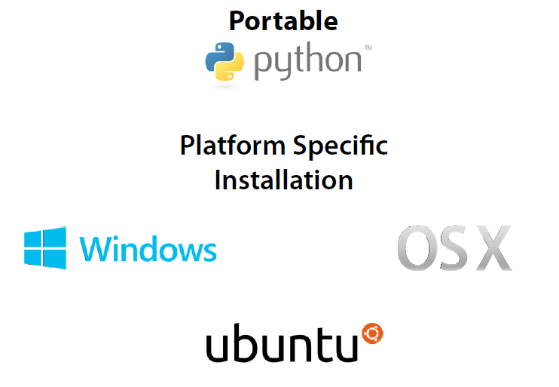

Slide 8
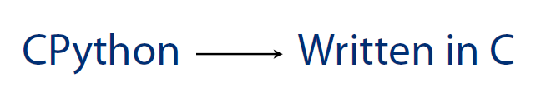
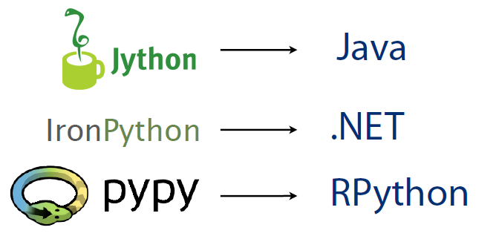
Python Implementations

Slide 9
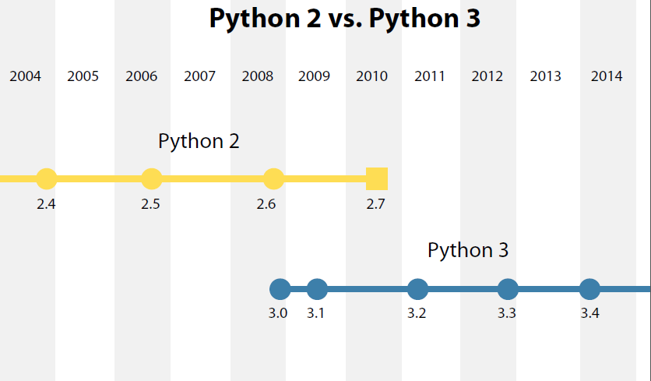
Python versions

Slide 10
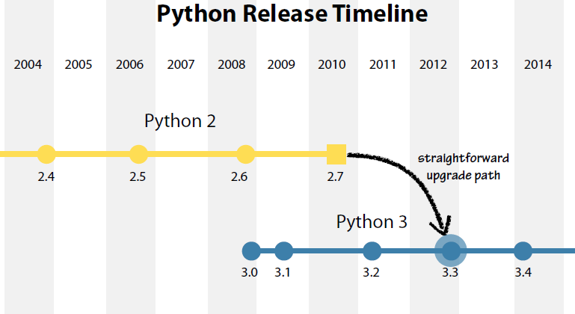
Python versions

Slide 11
Who developed Python?
Python is developed under an OSI-approved open source license, making it freely usable and distributable, even for commercial use.
Python was created in the early 1990s by Guido Van Rossum in Netherlands
Python's license is administered by the Python Software Foundation

Slide 12
Who should use Python?
Software professionals who wish to automate the manual tasks in the areas of database programming,excel programming
Data scientists who wish to do statistical research
Software professionals who wish to develop web applications with Django framewrok
Professionals interested in developing test frameworks, GUI applications,Image processing etc.

Slide 13
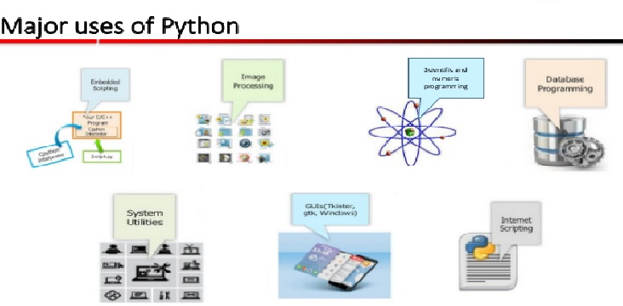
Major uses of Python

Slide 14
What You Should Already Know?
In general prior programming experience is not required.
Python is called as Beginners language.
But it would be helpful if anyone has basic level exposure in any of the languages like C or C++ or Java but not mandatory

Slide 15
Why Python programming?
Easy to learn , Easy to read, Easy to maintain
A broad standard library
Interactive mode
Portable
Clear syntax, better intentation
GUI programming
Scalable

Slide 16
Features
requires less lines of code for any given problem, and is more readable - thus greater productivity.
Python is interpreted langauge.
OO available but not enforced
is cross platform and has a powerful set of libraries

Slide 17
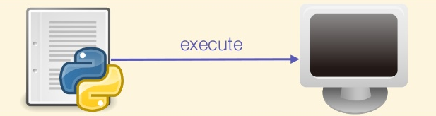
Python script execution

Slide 18
When to use Python?
File processing/data processing
Build large scale web applications
Developing GUI tools
easy-to-maintain
Cross platform programming language
Data analytics/data science/data scientists
Best suitable language in network programming
Code is already available. We have to use it
less code and get more functionality

Slide 19
Python release dates?
Python 1.0 - January 1994.
Python 1.5 - December 31, 1997.
Python 1.6 - September 5, 2000.
Python 2.0 - October 16, 2000.
Python 2.1 - April 17, 2001.
Python 2.2 - December 21, 2001. ...
Python 3.0 - December 3, 2008.
Python 3.1 - June 27, 2009.
Python 3.2 - February 20, 2011.
Python 3.3 - November 13, 2013.
Python 3.5 – April 13, 2015.

Slide 20

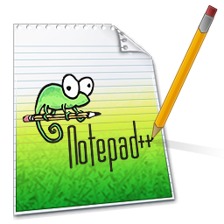




Where to do Python programming?

Slide 21
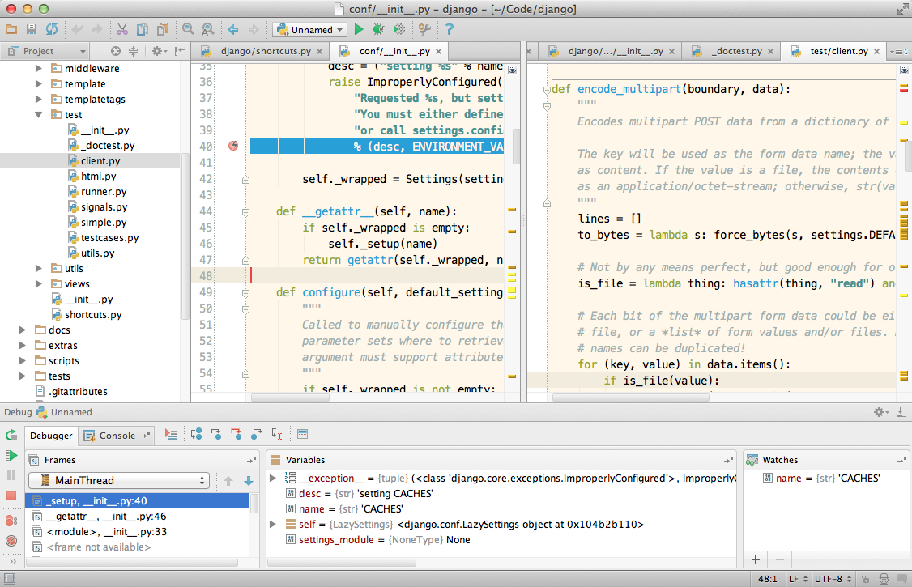
Where to do Python programming?
Pycharm editor

Slide 22
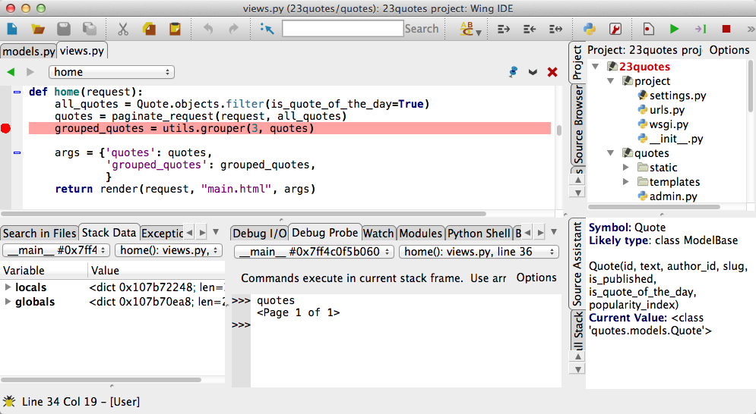
Where to do Python programming?
Pycharm editor
WingIDE

Slide 23
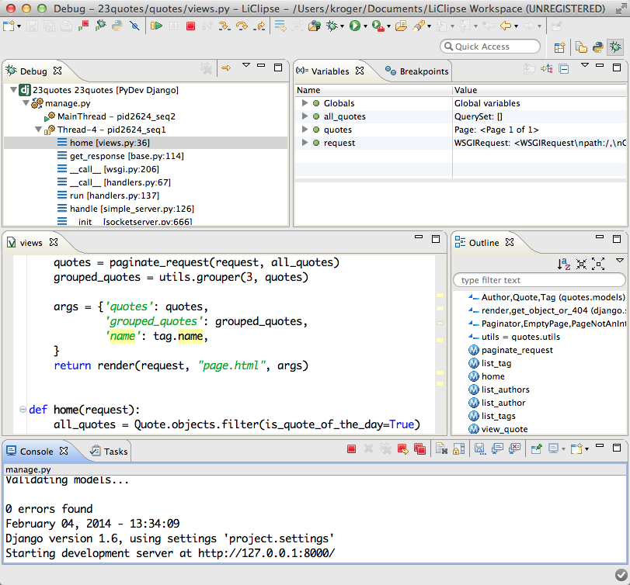
Where to do Python programming?
PyDev IDE

Slide 24
How to develop Python applications?
Step 1 − Open notepad
Step 2 − type as below
print(“hello world”)
Step 3 − save the file with demo.py
Step 4 − Open command prompt
Step 5 – Navigate to path where file is been saved.
Step 6 - python demo.py

Slide 25
Where to find more about Python?
https://python.org/
https://docs.python.org/

Slide 26
Summary
What
What is Python?
What You Should Already Know?
Why
Why Python programming?
Who
Where to find more about Python?
When
How
Where
Who should use Python programming?
Who developed Python?
How to develop Python code ?
How Python is different from other Scripting and programming languages?
When to use Python
Where to do Python programming?
When Python release dates
What we are going to learn in this course?

