Slide 1
Django web framework

Slide 2
What is Django?

Slide 3
Django is a high-level Python web framework that enables rapid development of secure and maintainable websites.
Django takes care of much of the hassle of web development, so you can focus on writing your app without needing to reinvent the wheel.
It is free and open source, has a thriving and active community, great documentation, and many options for free and paid-for support.

Slide 4
Django helps you write software that is:

Slide 5
Complete
Versatile
Secure
Scalable
Maintainable
Portable

Slide 6
Where did it come from?
Django was initially developed between 2003 and 2005 by a web team who were responsible for creating and maintaining newspaper websites.
Django has continued to grow and improve, from its first milestone release (1.0) in September 2008 through to the recently-released version 3.1 (2020).
Each release has added new functionality and bug fixes, ranging from support for new types of databases, template engines

Slide 7
How popular is Django?
Based on the number of high profile sites that use Django, the number of people contributing to the codebase, and the number of people providing both free and paid for support, then yes, Django is a popular framework!
High-profile sites that use Django include: Disqus, Instagram, Knight Foundation, MacArthur Foundation, Mozilla, National Geographic, Open Knowledge Foundation, Pinterest, and Open Stack

Slide 8
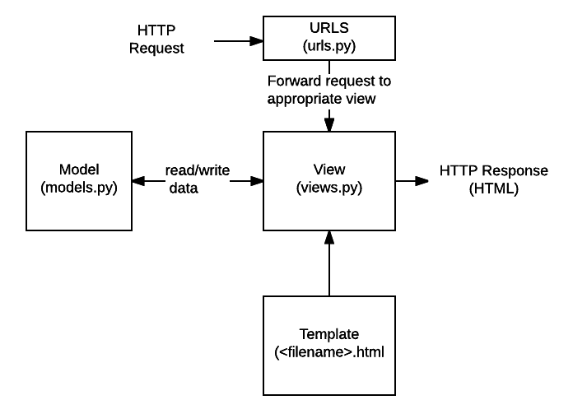
What does Django code look like?

Slide 9
What does Django code look like?
In a traditional data-driven website, a web application waits for HTTP requests from the web browser.
When a request is received the application works out what is needed based on the URL and possibly information in POST data or GET data.
Depending on what is required it may then read or write information from a database or perform other tasks required to satisfy the request.

Slide 10
URLS
While it is possible to process requests from every single URL via a single function, it is much more maintainable to write a separate view function to handle each resource.
A URL mapper is used to redirect HTTP requests to the appropriate view based on the request URL.
The URL mapper can also match particular patterns of strings or digits that appear in a URL and pass these to a view function as data.

Slide 11
View
A view is a request handler function, which receives HTTP requests and returns HTTP responses.
Views access the data needed to satisfy requests via models, and delegate the formatting of the response to templates.

Slide 12
Models
Models are Python objects that define the structure of an application's data, and provide mechanisms to manage (add, modify, delete) and query records in the database.

Slide 13
Templates
A template is a text file defining the structure or layout of a file (such as an HTML page), with placeholders used to represent actual content.
A view can dynamically create an HTML page using an HTML template, populating it with data from a model.
A template can be used to define the structure of any type of file; it doesn't have to be HTML!

Slide 14
Sending the request to the right view (urls.py)
A URL mapper is typically stored in a file named urls.py.
In the example below, the mapper (urlpatterns) defines a list of mappings between routes (specific URL patterns) and corresponding view functions.
If an HTTP Request is received that has a URL matching a specified pattern, then the associated view function will be called and passed the request.

Slide 15
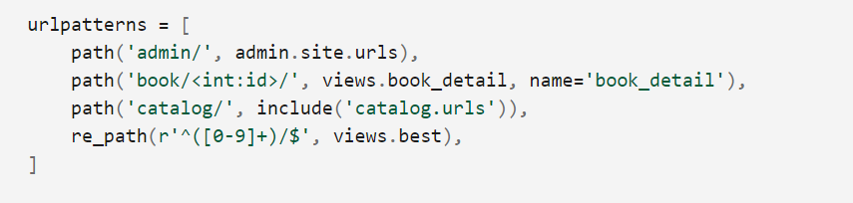

Slide 16
Handling the request (views.py)
Views are the heart of the web application, receiving HTTP requests from web clients and returning HTTP responses.
In between, they marshal the other resources of the framework to access databases, render templates, etc.

Slide 17
Handling the request (views.py)
The example below shows a minimal view function index(), which could have been called by our URL mapper in the previous section.
Like all view functions it receives an HttpRequest object as a parameter (request) and returns an HttpResponse object.

Slide 18
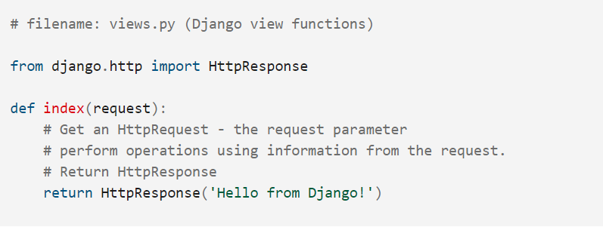

Slide 19
Defining data models (models.py)
Django web applications manage and query data through Python objects referred to as models.
Models define the structure of stored data, including the field types and possibly also their maximum size, default values, selection list options, help text for documentation, label text for forms, etc.

Slide 20
Defining data models (models.py)
The definition of the model is independent of the underlying database — you can choose one of several as part of your project settings.
Once you've chosen what database you want to use, you don't need to talk to it directly at all — you just write your model structure and other code, and Django handles all the "dirty work" of communicating with the database for you.

Slide 21
The code snippet below shows a very simple Django model for a Team object.
The Team class is derived from the django class models.Model.
It defines the team name and team level as character fields and specifies a maximum number of characters to be stored for each record.
The team_level can be one of several values, so we define it as a choice field and provide a mapping between choices to be displayed and data to be stored, along with a default value.

Slide 22
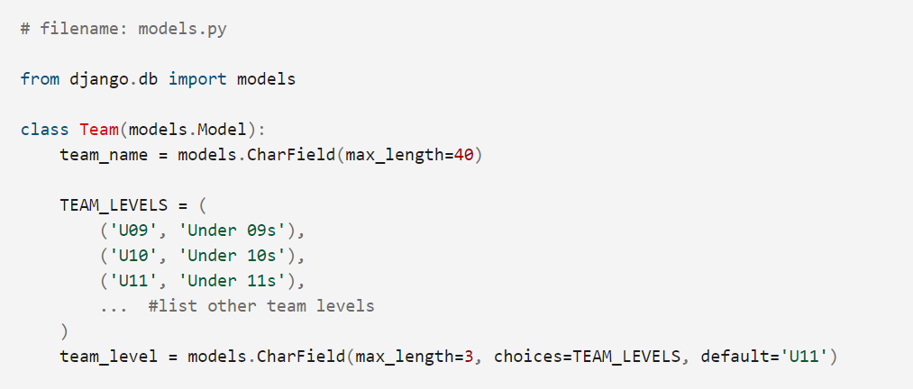

Slide 23
Querying data (views.py)
The Django model provides a simple query API for searching the associated database.
This can match against a number of fields at a time using different criteria (e.g. exact, case-insensitive, greater than, etc.), and can support complex statements (for example, you can specify a search on U11 teams that have a team name that starts with "Fr" or ends with "al").

Slide 24
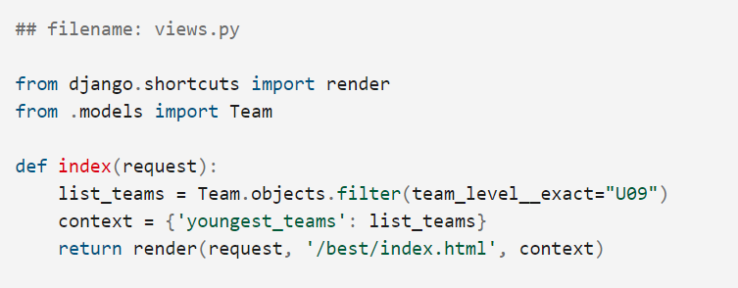

Slide 25
Rendering data (HTML templates)
Template systems allow you to specify the structure of an output document, using placeholders for data that will be filled in when a page is generated.
Templates are often used to create HTML, but can also create other types of document.
Django supports both its native templating system and another popular Python library called Jinja2 out of the box

Slide 26
Rendering data (HTML templates)
The code snippet shows what the HTML template called by the render() function in the previous section might look like.
This template has been written under the assumption that it will have access to a list variable called youngest_teams when it is rendered (this is contained in the context variable inside the render() function above).

Slide 27
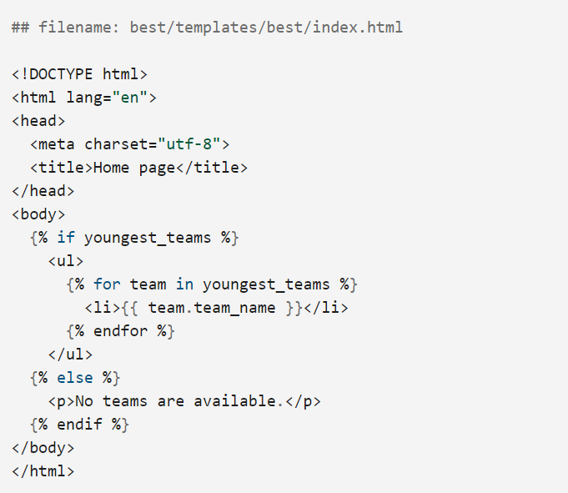

Slide 28
What else can you do?

Slide 29
Forms
User authentication and permissions
Caching
Administration site
Serializing data

