Slide 1

Python programming
Python and MySQL

Slide 2
Agenda
About MySQL
Installation of MySQL(steps provided in description)
Installing pymysql library ( if not installed)
Executing the steps manually in MySQL CLI
Performing select and insert operations
Interview Q n A

Slide 3
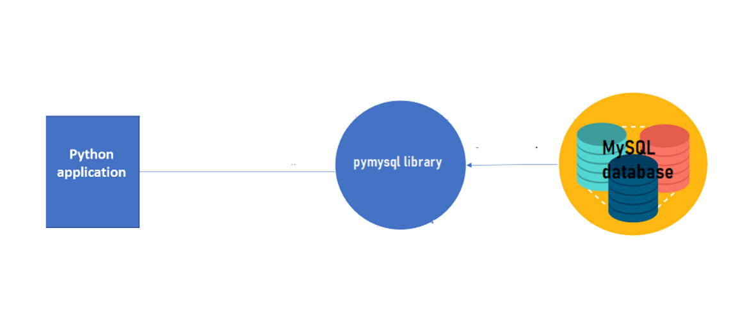

Slide 4



Database
SQLite is included in Python standard distribution.
Very easy to use
Full compatible with SQL Standard
Small Memory and disk footprint
MySQL is the most popular open-source database,
Used in millions of installations
Driver available for Python
Multi-user and clustering
Both open-source and commercial
Oracle is commercial top #1 database
Enterprise grade performance and reliability
Very feature reach and options
Driver available for Python (cx_Oracle)

Slide 5
SQL Language
What is SQL ?
SQL – Structure Query Language
The facto standard ISO/ANSI for querying data to relational databases
Used for SQLite, My SQL, Microsoft SQL, Postgres SQL, Oracle and others
SQL Commands
SQL Query – SELECT
DML – Insert/Update/Delete
DDL – Data Definition Language (Create Table..)

Slide 6
SQL Language
SQL Commands
SELECT column1, column2, ... FROM table_name
WHERE condition;
INSERT INTO table_name VALUES (value1, value2, value3, ...);
UPDATE table_name SET column1 = value1, column2 = value2, ... WHERE condition;
DELETE FROM table_name WHERE condition;

Slide 7
Database Connection
Connect to MySQL database
import pymysql
connection = pymysql.connect(‘localhost‘,3306,’user’,’pass’,’db’)
c = connection.cursor() # open database cursor
c.execute('SELECT * FROM EMP_TABLE', t)
print(c.fetchone())

