Slide 1
Java Date Time
by
Giridhara R M.E.,M.B.A.,
Assistant Professor,
Dept of CSE,
Sri Eshwar College of Engineering

Slide 2
Java Date Time
The Date-Time API uses the calendar system defined in ISO-8601 as the default calendar.
This calendar is based on the Gregorian calendar system and is used globally as the de facto standard for representing date and time.
The core classes in the Date-Time API have names such as LocalDateTime, ZonedDateTime, and OffsetDateTime.
The Date-Time package, java.time, introduced in the Java SE 8.
The Date-Time API uses the Unicode Common Locale Data Repository (CLDR).
The Date-Time API also uses the Time-Zone Database (TZDB).

Slide 3

Date-Time Design Principles
The Date-Time API was developed using several design principles.
Clear
Fluent
Immutable
Extensible

Slide 4
The Date-Time Packages
The Date-Time API consists of the primary package, java.time, and four subpackages:
java.time - The core of the API for representing date and time.
java.time.chrono - The API for representing calendar systems other than the default ISO-8601.
java.time.format - Classes for formatting and parsing dates and times.
java.time.temporal - Extended API, primarily for framework and library writers, allowing interoperations between the date and time classes, querying, and adjustment.
java.time.zone - Classes that support time zones, offsets from time zones, and time zone rules.

Slide 5
Method Naming Conventions
The Date-Time API offers a rich set of methods within a rich set of classes.
There is also standardization regarding the method name prefixes.
Because most of the classes in the Date-Time API are immutable, the API does not include set methods.
The immutable equivalent of a set method is with.
The following table lists the commonly used prefixes:

Slide 6
Method Naming Conventions
Prefix | Method Type | Use
of | static factory | Creates an instance where the factory is primarily validating the input parameters, not converting them.
from | static factory | Converts the input parameters to an instance of the target class, which may involve losing information from the input.
parse | static factory | Parses the input string to produce an instance of the target class.

Slide 7
Method Naming Conventions
Prefix | Method Type | Use
format | instance | Uses the specified formatter to format the values in the temporal object to produce a string.
get | instance | Returns a part of the state of the target object.
is | instance | Queries the state of the target object.
with | instance | Returns a copy of the target object with one element changed.
plus | instance | Returns a copy of the target object with an amount of time added.
minus | instance | Returns a copy of the target object with an amount of time subtracted.

Slide 8
Standard Calendar
There are two basic ways to represent time.
human terms - such as year, month, day, hour, minute and second.
machine time - measures time continuously along a timeline from an origin, called the epoch, in nanosecond resolution.
The Date-Time package provides a rich array of classes for representing date and time which supports both way of representations.
The following table summarizes the temporal-based classes in the java.time package that store date and/or time information, or that can be used to measure an amount of time.

Slide 9
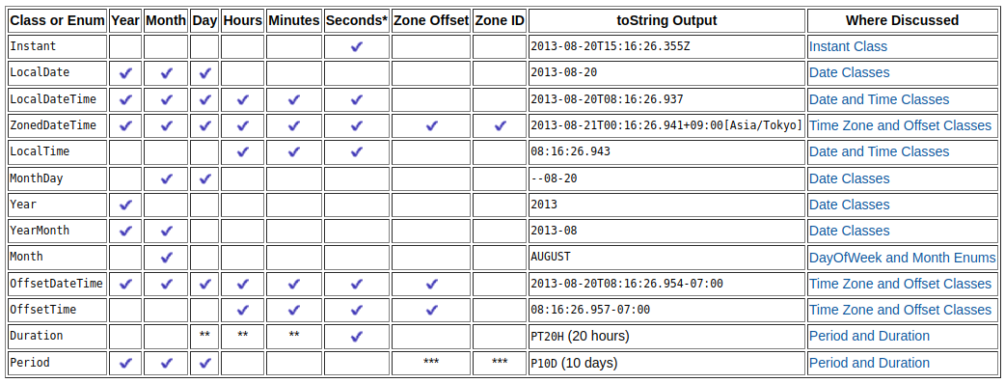
Standard Calendar

Slide 10
DayOfWeek and Month Enums
DayOfWeek
The DayOfWeek enum consists of seven constants that describe the days of the week: MONDAY through SUNDAY.
The integer values of the DayOfWeek constants range from 1 (Monday) through 7 (Sunday).
he following code adds 3 days to "Monday" and prints the result. The output is "THURSDAY":
System.out.printf("%s%n", DayOfWeek.MONDAY.plus(3));

Slide 11
DayOfWeek
By using the getDisplayName(TextStyle, Locale) method, you can retrieve a string to identify the day of the week in the user's locale.
The TextStyle enum enables you to specify what sort of string you want to display: FULL, NARROW (typically a single letter), or SHORT (an abbreviation).
Output :
Monday
M
Mon
Example Program :
DayOfWeek dow = DayOfWeek.MONDAY;
Locale locale = Locale.getDefault();
System.out.println(dow.getDisplayName(TextStyle.FULL, locale));
System.out.println(dow.getDisplayName(TextStyle.NARROW, locale));
System.out.println(dow.getDisplayName(TextStyle.SHORT, locale));

Slide 12
Month
The Month enum includes constants for the twelve months, JANUARY through DECEMBER.
the integer value of each constant corresponds to the ISO range from 1 (January) through 12 (December).
The Month enum also includes a number of methods.
The following line of code uses the maxLength method to print the maximum possible number of days in the month of February.
The output is "29":
System.out.printf("%d%n", Month.FEBRUARY.maxLength());

Slide 13
Month
The Month enum also implements the getDisplayName(TextStyle, Locale) method to retrieve a string to identify the month in the user's locale using the specified TextStyle.
Example Program :
Month month = Month.AUGUST;
Locale locale = Locale.getDefault();
System.out.println(month.getDisplayName(TextStyle.FULL, locale));
System.out.println(month.getDisplayName(TextStyle.NARROW, locale));
System.out.println(month.getDisplayName(TextStyle.SHORT, locale));
Output:
August
A
Aug

Slide 14
Date Classes
LocalDate
YearMonth
MonthDay
Year

Slide 15
LocalDate
A LocalDate represents a year-month-day in the ISO calendar and is useful for representing a date without a time.
The following examples use the of and with methods to create instances of LocalDate:
The getDayOfWeek method returns the day of the week that a particular date falls on. the following line of code returns "MONDAY":
LocalDate date = LocalDate.of(2000, Month.NOVEMBER, 20);
LocalDate nextWed = date.with(TemporalAdjusters.next(
DayOfWeek.WEDNESDAY));
DayOfWeek dotw = LocalDate.of(2012, Month.JULY, 9).getDayOfWeek();

Slide 16
LocalDate
The following example uses a TemporalAdjuster to retrieve the first Wednesday after a specific date.
LocalDate date = LocalDate.of(2000, Month.NOVEMBER, 20);
TemporalAdjuster adj = TemporalAdjusters.
next(DayOfWeek.WEDNESDAY);
LocalDate nextWed = date.with(adj);
System.out.printf("For the date of %s,
the next Wednesday is %s.%n",
date, nextWed);
Output:
For the date of
2000-11-20,
the next
Wednesday is
2000-11-22.

Slide 17
YearMonth
The YearMonth class represents the month of a specific year.
The following example uses the YearMonth.lengthOfMonth() method to determine the number of days for several year and month combinations.
YearMonth date = YearMonth.now();
System.out.printf("%s: %d%n", date, date.lengthOfMonth());
YearMonth date2 = YearMonth.of(2010, Month.FEBRUARY);
System.out.printf("%s: %d%n", date2, date2.lengthOfMonth());
YearMonth date3 = YearMonth.of(2012, Month.FEBRUARY);
System.out.printf("%s: %d%n", date3, date3.lengthOfMonth());
Output:
2013-06: 30
2010-02: 28
2012-02: 29

Slide 18
MonthDay
The MonthDay class represents the day of a particular month, such as New Year's Day on January 1.
The following example uses the MonthDay.isValidYear method to determine if February 29 is valid for the year 2010.
The call returns false, confirming that 2010 is not a leap year.
MonthDay date = MonthDay.of(Month.FEBRUARY, 29);
boolean validLeapYear = date.isValidYear(2010);

Slide 19
Year
The Year class represents a year.
The following example uses the Year.isLeap method to determine if the given year is a leap year.
The call returns true, confirming that 2012 is a leap year.
boolean validLeapYear = Year.of(2012).isLeap();

Slide 20
Date and Time Classes
LocalTime
LocalDateTime
Time Zone and Offset Classes
ZoneId and ZoneOffset
The Date-Time Classes
ZonedDateTime
OffsetDateTime
OffsetTime

Slide 21
Instant Class
One of the core classes of the Date-Time API is the Instant class, which represents the start of a nanosecond on the timeline.
This class is useful for generating a time stamp to represent machine time.
A value returned from the Instant class counts time beginning from the first second of January 1, 1970 (1970-01-01T00:00:00Z) also called the EPOCH.
An instant that occurs before the epoch has a negative value, and an instant that occurs after the epoch has a positive value.
The other constants provided by the Instant class are MIN, representing the smallest possible (far past) instant, and MAX, representing the largest (far future) instant.

Slide 22
Java date time classess
Parsing and Formatting
Parsing
Formatting
The Temporal Package
Temporal and TemporalAccessor
ChronoField and IsoFields
ChronoUnit
Temporal Adjuster
Predefined Adjusters
Custom Adjusters

Slide 23
Java date time classess
Temporal Query
Predefined Queries
Custom Queries
Period and Duration
Duration
ChronoUnit
Period
Clock
Non-ISO Date Conversion
Converting to a Non-ISO-Based Date
Converting to an ISO-Based Date

Slide 24


