Slide 1

Amaravati Quantum Valley Hackathon 2025
Problem Statement ID - AQVH916
Problem Statement Title-Maximize returns while minimizing risk (Sharpe ratio) with QAOA
Theme-Quantum Optimization: Portfolio Optimization
PS Category- Software
Team ID- C-17889
Team Name- LBRCE QNOVA

Slide 2

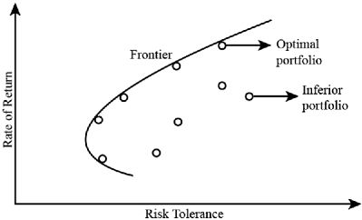
LBRCE QNOVA
Efficient frontier using the quantum computing
Problem Formulation (Efficient Frontier)
Classical Setup:
The goal of portfolio optimization is to find the best allocation of funds across a set of assets
to achieve an optimal balance between risk (variance of portfolio returns) and expected return
Constraints:
Budgets :
No short selling: w≥0
Realistic Constraints:
Real portfolios often require additional real-life constraints, making the problem combinatorial and thus computationally challenging
Cardinality constraint: Choose exactly K assets out of N.
Discrete weights: Investments can only be multiples of fixed steps (e.g., 5% increments).
Sector restrictions: Limits on investments by sector (e.g., maximum 3 stocks in financials).

Slide 3


LBRCE QNOVA
Technical Approach
QUBO Transformation Quantum solvers need a Quadratic Unconstrained Binary Optimization (QUBO) form:
Where:
The QUBO objective becomes:
Risk term:
Return term: , rewards high return
Penalty: ,ensures exactly K assets are chosen. M is a large constant controlling penalty strength.
By encoding portfolio optimization this way, the problem suits quantum techniques for combinatorial optimization.
Mapping QUBO to Quantum Computers
Quantum Approximate Optimization Algorithm (QAOA)
Maps the QUBO problem into a quantum Hamiltonian using Pauli-Z operators.
The quantum circuit alternates between applying:
After p layers, measures the quantum state to sample candidate portfolios.
Classical optimizer fine-tunes angles γ, β to minimize expected cost.
Sweeps over λ to obtain full efficient frontier with quantum solutions.
Quantum Annealing (QA)
Expresses the problem as an Ising model energy function:

Slide 4
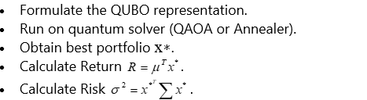
LBRCE QNOVA
Starts in an easy-to-prepare ground state, then slowly morphs the system to the target
Hamiltonian reflecting portfolio optimization.
System settles into low-energy states corresponding to optimal asset selections.
Particularly effective on specialized QA hardware (e.g., D-Wave).
Building the Efficient Frontier
Define a grid of λ values between 0 and 1 controlling risk-return preference.
For each λ:
3. Collect (σ,R) points for all λ.
4. Plot the Quantum Efficient Frontier, showcasing optimal trade-offs.
Why Quantum Computers Help
Classical: Evaluate portfolios sequentially; extremely costly for large combinatorial spaces.
Classical computers cannot handle computation based on huge number of combinations but quantum can
check any number of combinations easier and faster than classical.
Quantum: Use superposition to represent all portfolio possibilities simultaneously.
Quantum interference adjusts probabilities towards good portfolios.

Slide 5
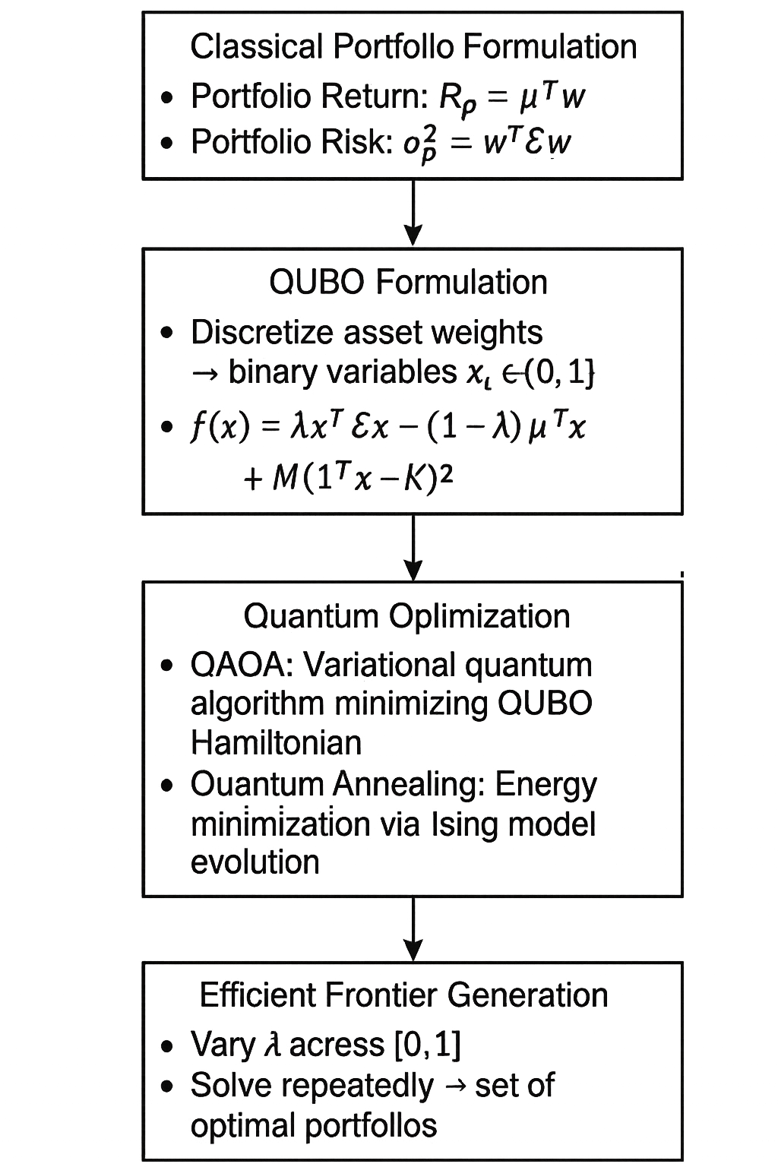
LBRCE QNOVA
IMPACTS & BENEFITS
Impacts
Transforms Portfolio Optimization – Solves complex real-world constraints (sector limits, discrete weights, cardinality) that classical solvers struggle with.
Quantum Advantage – Uses superposition and interference to explore many portfolio combinations simultaneously, reducing computation time.
Industry Shift – Drives adoption of quantum-classical hybrid methods, influencing investment strategies, risk management, and financial research.
Benefits
Better Decision-Making – Provides clearer risk-return trade-offs through a quantum-optimized efficient frontier.
Scalable & Faster – Handles large-scale portfolios with constraints much quicker than classical methods.
Future-Ready – Positions finance for next-gen quantum hardware, giving early adopters a competitive edge.
Required Resources
By considering top 50 (Nifty Companies) for 3 years data and taking O H L C
(open, high, low and close stock).
There will be 252 working days per year for market, considering all these parameters,The feature size is: 252 * 3 * 4 * 50= 1,51,200 features.
Amplitude Encoding
Required Qubits= log, (1,51,200 ) = 17.2 Qubits for features.

Slide 6
LBRCE QNOVA
RESEARCH & REFERNECE
1.Quantum Portfolio Optimization Foundations and Best Practices
"Best practices for portfolio optimization by quantum computing" (Nature Scientific Reports, 2023) https://www.nature.com/articles/s41598-023-45392-w
2.QUBO Formulation and Quantum Algorithms for Portfolio Optimization
"PO-QA: A Framework for Portfolio Optimization using Quantum Annealing" (arXiv, 2024) https://arxiv.org/abs/2407.19857
"Quantum Portfolio Optimizer - A Qiskit Function by Global Data" (IBM Quantum Documentation) https://quantum.cloud.ibm.com/docs/guides/global-data-quantum-optimizer
3.Quantum Approximate Optimization Algorithm (QAOA) and Hybrid Quantum-Classical Techniques
"Short-depth QAOA circuits and quantum annealing" (Nature, 2024) https://www.nature.com/articles/s41534-024-00825-w
"A detailed, end-to-end assessment of a quantum algorithm for portfolio optimization" (AWS & Goldman Sachs, 2023) https://aws.amazon.com/blogs/quantum-computing/a-detailed-end-to-end-assessment-of-a-quantum-algorithm-for-portfolio-optimization-released-by-goldman-sachs-and-aws/
4.Quantum Annealing and Ising Model Approaches
"Portfolio Optimization of 60 Stocks Using Classical and Quantum Algorithms" (D-Wave) https://www.dwavequantum.com/resources/application/portfolio-optimization-of-60-stocks-using-classical-and-quantum-algorithms/

