Slide 1

Lead Scoring Case Study
X Education

Slide 2
Problem Statement
An education company named X Education sells online courses to industry professionals. On any given day, many professionals who are interested in the courses land on their website and browse for courses.
Although X Education gets a lot of leads, its lead conversion rate is very poor. The typical lead conversion rate at X education is around 30%.
An X Education need help to select the most promising leads, i.e. the leads that are most likely to convert into paying customers. The company requires us to build a model wherein you need to assign a lead score to each of the leads such that the customers with higher lead score have a higher conversion chance and the customers with lower lead score have a lower conversion chance. The CEO, in particular, has given a ballpark of the target lead conversion rate to be around 80%.

Slide 3

Approach taken for Solution
Importing libraries and dataset
Data cleaning and data manipulation
Check for imbalanced data
Check for columns with Select value and Impute the data
Check for duplicate data
Check for missing values and impute/drop the columns
Check for outliers and impute data
Exploratory data analysis
Univariate analysis
Bivariate analysis
Data Preparation
Dataset split into Train and Test sets
Feature scaling and Dummy variables and encoding the data
Model Building using RFE and make use of StatsModel
Build logistic regression model and delete the variables which are not useful using the p-value and VIF values
Model Evaluation
Confusion Matrix and ROC curve
Optimal cutoff point for Accuracy Sensitivity and Specificity
Model Prediction on test dataset
Precision and Recall View
Precision and Recall tradeoff
Model Prediction on test dataset

Slide 4
Data collection, cleaning
The dataset used for the problem is “leads.csv” which has 37 columns(features)
5 columns which has more than 40% missing data has been dropped
Asymmetrique Activity Index
Asymmetrique Profile Index
Asymmetrique Activity Score
Asymmetrique Profile Score
Lead Quality
14 columns which are having unique values and highly imbalanced columns has been removed
Prospect ID, Lead Number, Magazine, Receive More Updates About Our Courses, Update me on Supply Chain Content, Get updates on DM Content, I agree to pay the amount through cheque, Do Not Call, Search, Newspaper Article, X Education Forums, Newspaper, Digital Advertisement, Through Recommendations
On few columns the missing values are filled with median or mode accordingly based on datatype of the columns.

Slide 5
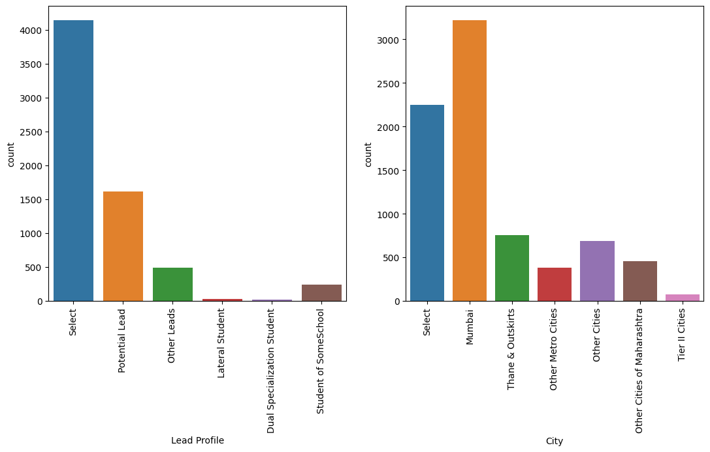
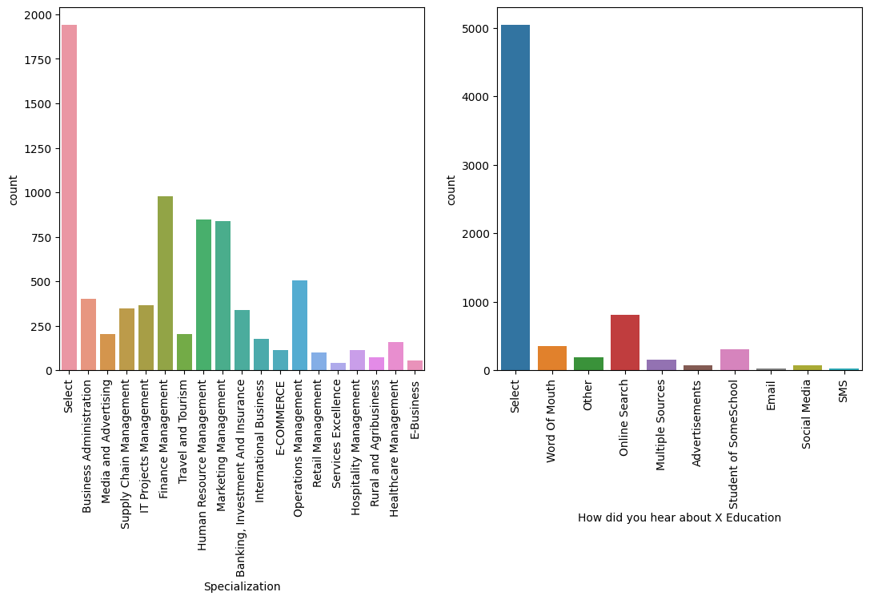
EDA: Handling “Select” value in the columns
The “Select” value is treated as same as NaN. The columns which are having these values are 'Specialization', 'How did you hear about X Education', 'Lead Profile', 'City’
Once the columns are updated, we further performed data missing/imputation treatment to the data
2 columns - 'How did you hear about X Education', 'Lead Profile’, are having more than 40% data are deleted

Slide 6
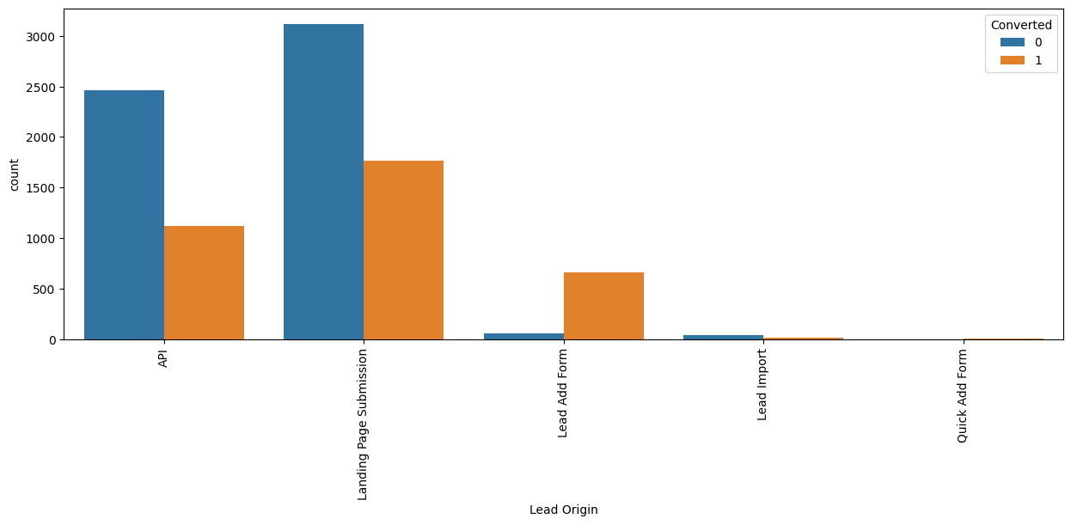
Exploratory Data Analysis: Lead Origin
Most leads are from API and Landing Page Submission
Most converted leads are from "Lead Add Form".
There are negligible leads from “Lead Import” and “Quick Add Form”

Slide 7
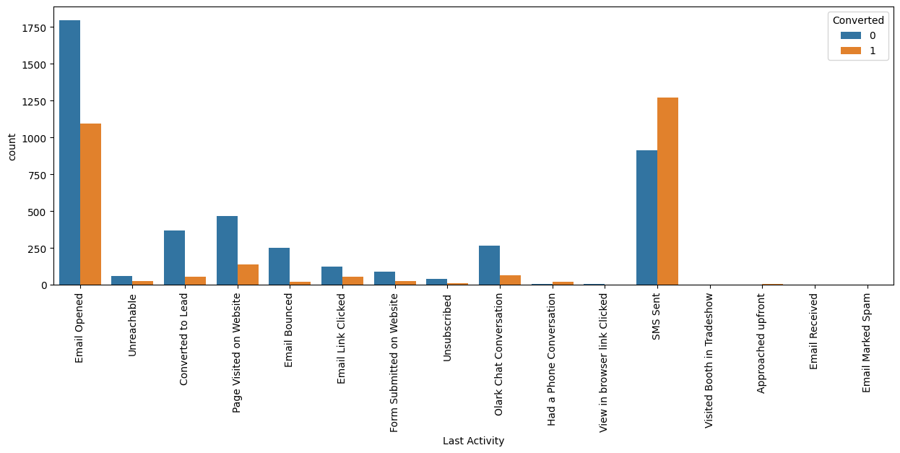
Last Activity
The major converted leads are from "Email Opened" and "SMS sent"
These options can be used efficiently for better converted ratio

Slide 8
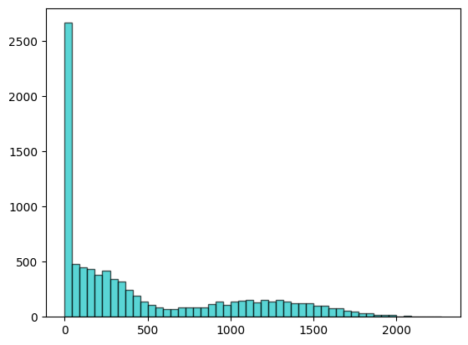
Total Time Spent on Website
Maximum number of the leads are spent less than 45 mins i.e. ~2650 customers
>2000 customers spent between 45 mins and 272 mins

Slide 9
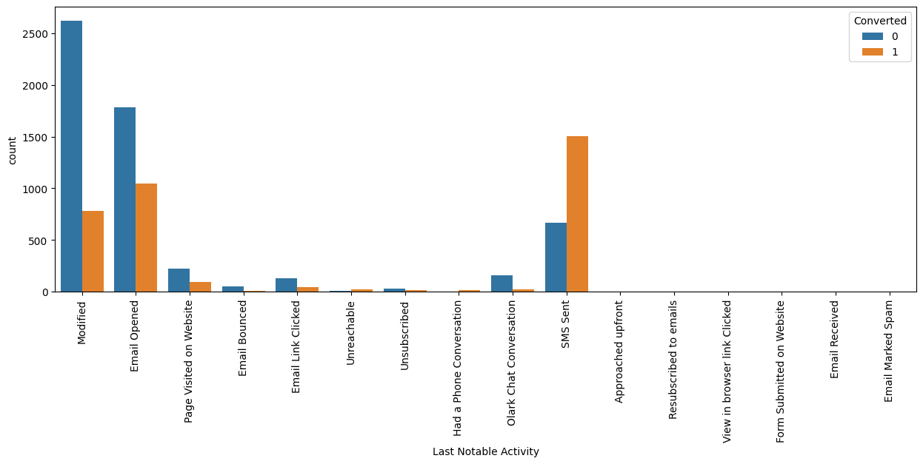
Last Notable Activity
Most of the leads and converted leads are from Modified, Email Opened and SMS sent.
High rate of converted leads are via SMS sent
There are no/negligible leads from Approached upfront, Resubscribed to emails, View in browser link, Form submitted on website, Email received and Email marked as spam

Slide 10
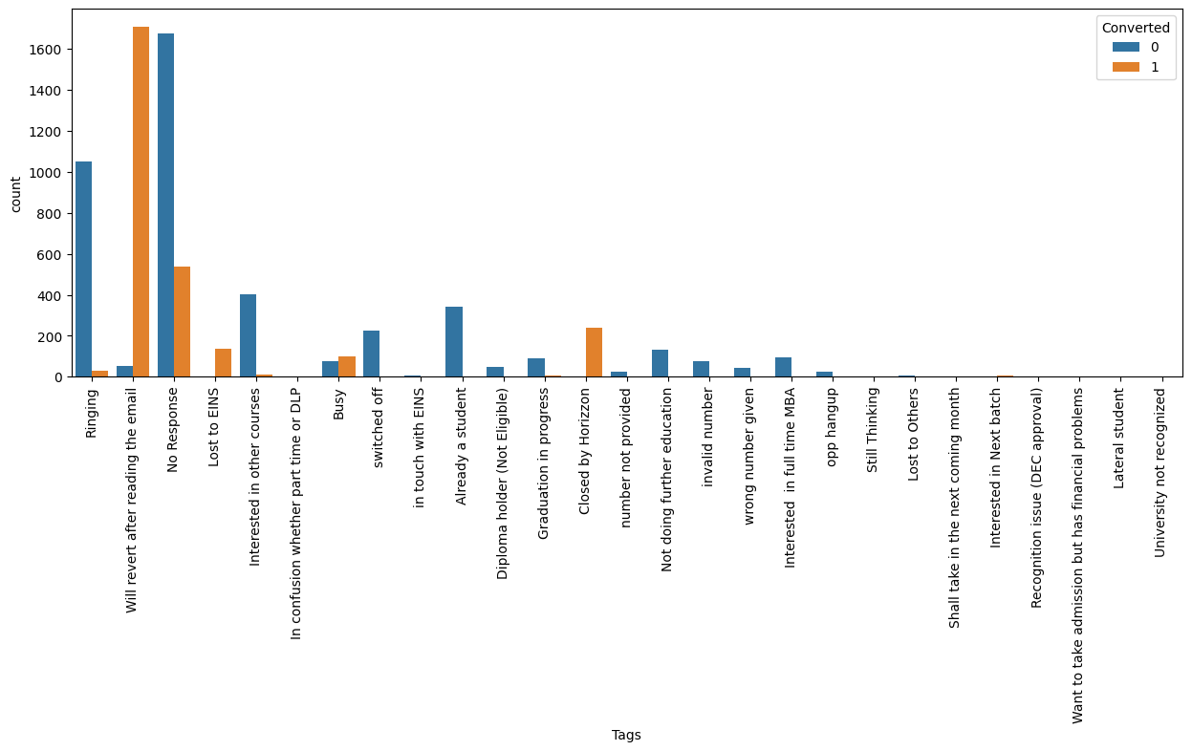
Tags
Most of the converted leads ratio are from the customers who "will revert after reading email", "Closed by Horizzon" and "No Response".
Almost 1000 leads which are received from "Ringing“, the converted ratio is very less.
~200 leads are converted which are from “Lost to EINS”

Slide 11
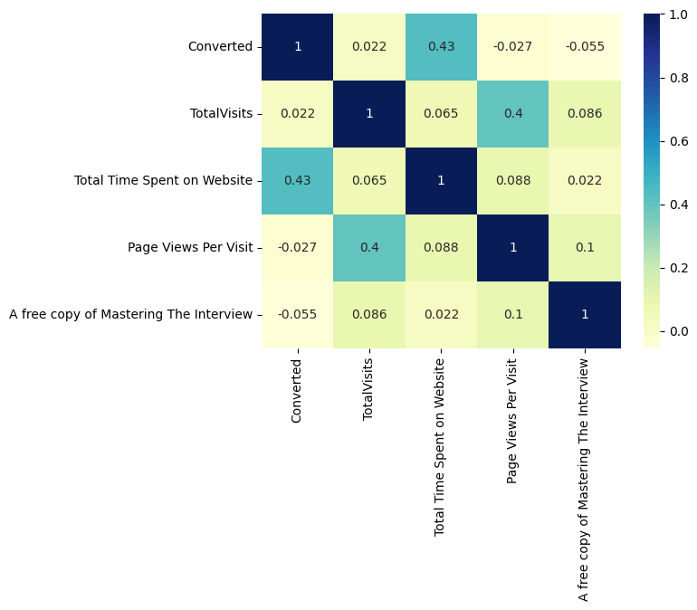
Correlation
There are no strong correlations between the numerical columns.
There is good correlation between "Total time spent on website" and "Converted“
There is good correlation between "Page Views Per Visit" and "TotalVisits"
Least correlation is between Converted and TotalVisits.

Slide 12
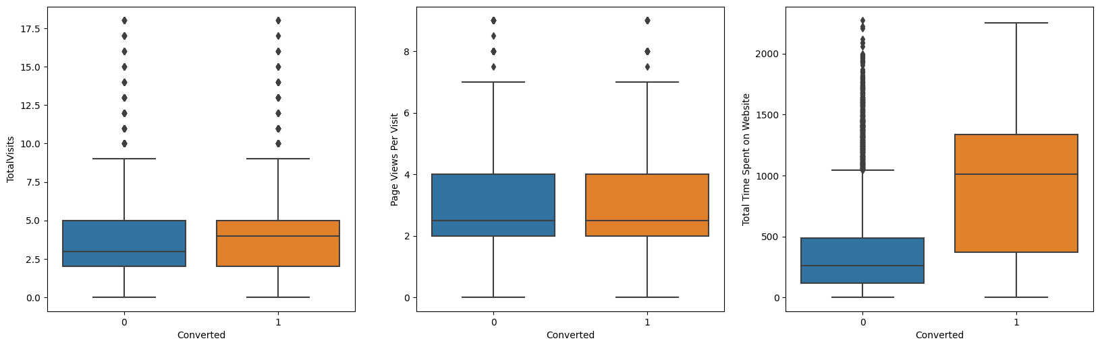
Outliers: Numerical columns analysis
The outliers in the “TotalVisits”, “Page views per visit” & “Total Time spent on website” has been removed. The datapoints which are above 99% and less than 1% has been considered as an outliers in these columns.

Slide 13
Model building
Splitting the dataset into train and test dataset
Scaling numerical columns using StandardScaler
Model building using RFE to find most significant features and use Stats model for analysis
Check VIF for the existing features
Eliminate the variable with high p-value and high VIF value
Rebuild the model after removing the variables which are not useful
Predict the train dataset
Calculate Accuracy, Specificity, Sensitivity using Confusion matrix
Plot ROC curve
Find the optimal cutoff point and adjust the probabilities if required
Predict using test dataset and evaluate metrics - Accuracy, Specificity, Sensitivity
Perform precision and recall tradeoff
Calculate Accuracy, Specificity, Sensitivity using Confusion matrix
Precision and Recall analysis on test dataset predictions.

Slide 14
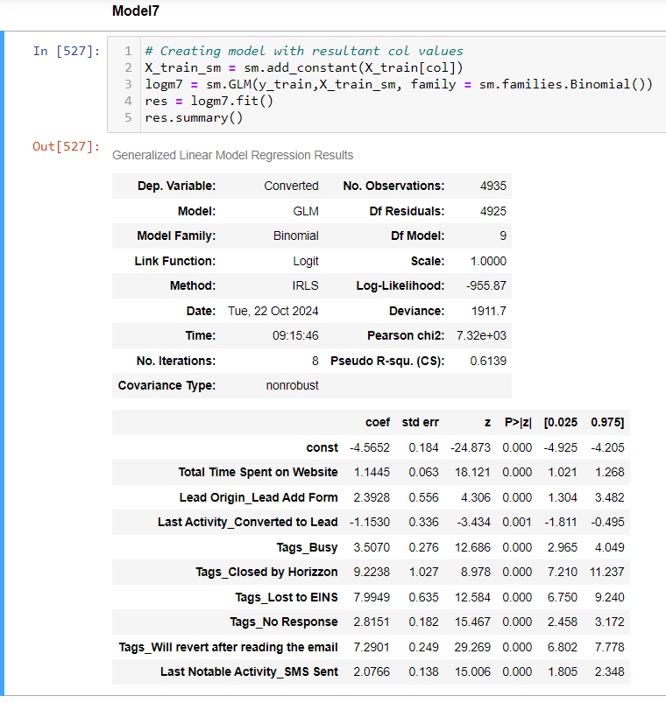
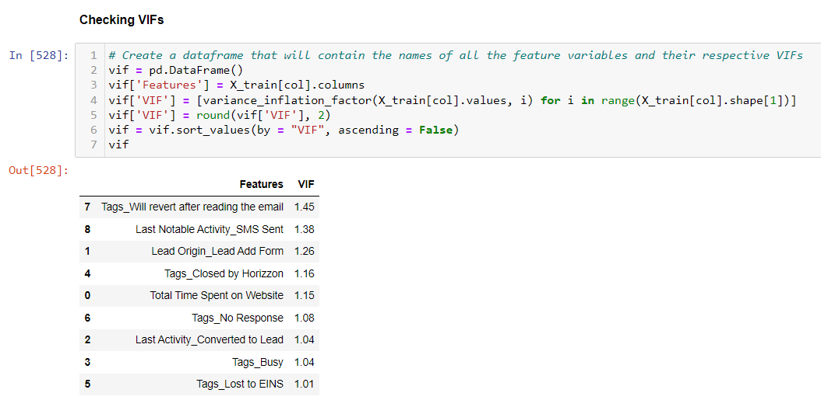
Model building – Final Model

Slide 15
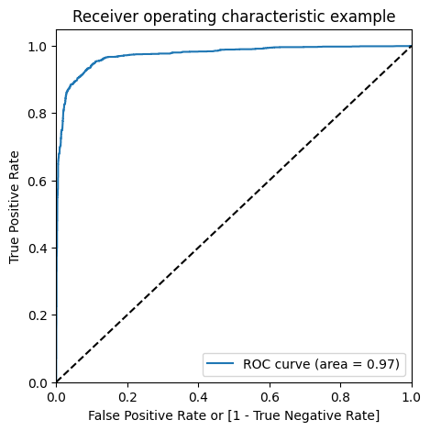
Model building – ROC curve
The area under ROC curve is 0.97

Slide 16
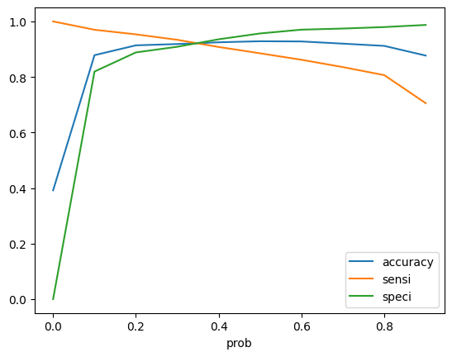
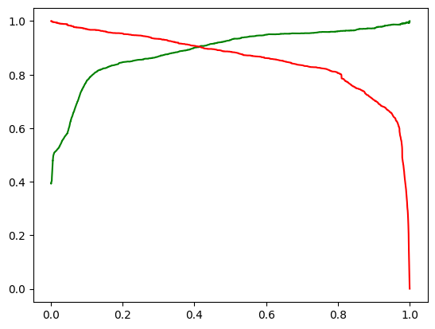
Model Evaluation(Train Dataset)

Slide 17
Model Evaluation (Test Dataset)
Accuracy Sensitivity and Specificity
Accuracy: 91.11% Sensitivity: 88.55% Specificity: 92.67%
Confusion matrix
[ [ 1215, 96 ],
[92 , 712 ] ]
Precision and Recall(After tradeoff)
Precision: 90.21% Recall: 87.18%

Slide 18
Conclusions and Recommendations
To improve the potential lead conversion rate X-Education will have to mainly focus important features responsible for good conversion rate are :-
Total Time Spent on Website: The customers spending more time on website can turn to be potential leads.
Lead Origin_Lead Add Form: Leads who have engaged through 'Lead Add Form' having higher conversion rate so company can focus on it.
Last Activity_Converted to Lead: The last activity by the customer who successfully converted to lead.
Tags_Closed by Horizzon: The converted leads that are closed by Horizzon as they play major role in conversion.

Slide 19

Thanks
Giridhar
Ganesh
Vinay Kumar Sharma
Giridhar Challa
Ganesh Behera
Vinay Kumar Sharma

