Slide 1

Default Payments For Credit Card
Group 4:
Giridhar Reddy Kandala (GXK210021)
Sai Akshay Kontham (SXK190190)
Vishnu Saketh Chanda (VXC210021)
Karthik Kadiyam (KXK210025)
Sai Lakshmi Keerthana Vogireddy (SXK210045)
Anil Teja Yadagani (AXY210011)

Slide 2
Agenda
Business Context
Approach
Data Description
Exploratory Data Analysis
Classifier Evaluation
Conclusion

Slide 3
Business Context
As the financial industry has improved, financial threats are manifesting as a rise in commercial banks' credit risk.
The credit card companies face a huge risk in this case and hence we need to find a way to flag the defaulters.
If we identify potential default accounts early enough, we can minimize losses.
Credit default prediction aims to help financial institutions decide whether to lend to a client or not.

Slide 4
Approach
Data Collection
Data Exploration
Prediction Modelling

Slide 5
Data Description
This dataset contains 30000 data points related to customer information.
The output variable has the information on whether the customer will default the payment for the upcoming month.
Attributes: Limit Balance, Age, Gender, Education, Marriage, Payment Status, Bill Amount.
There are no missing values in the dataset.

Slide 6

Exploratory Data Analysis

Slide 7
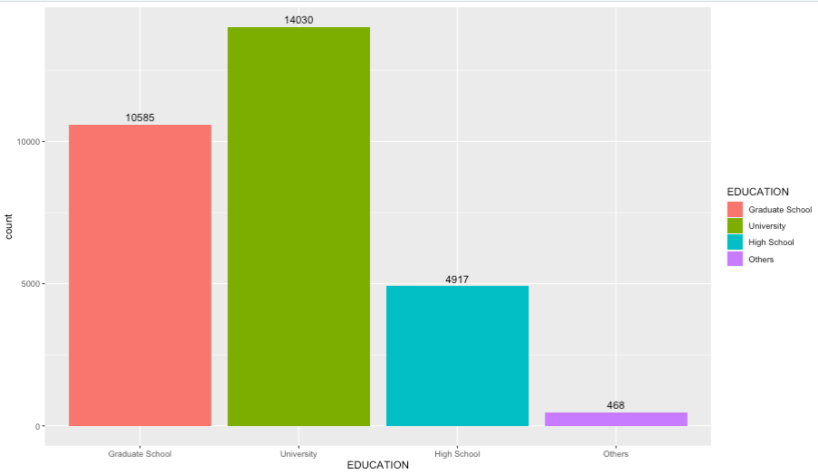
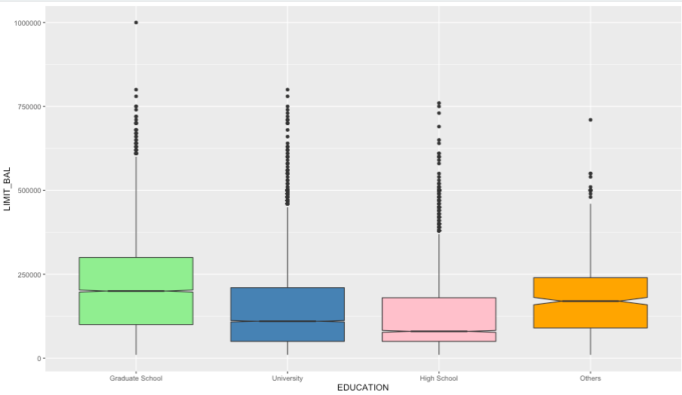
Analyzing customers Education vs Default
We can observe that customers having university degree are more.
It is seen that the limit balance is more for customers with a Graduate Degree.

Slide 8
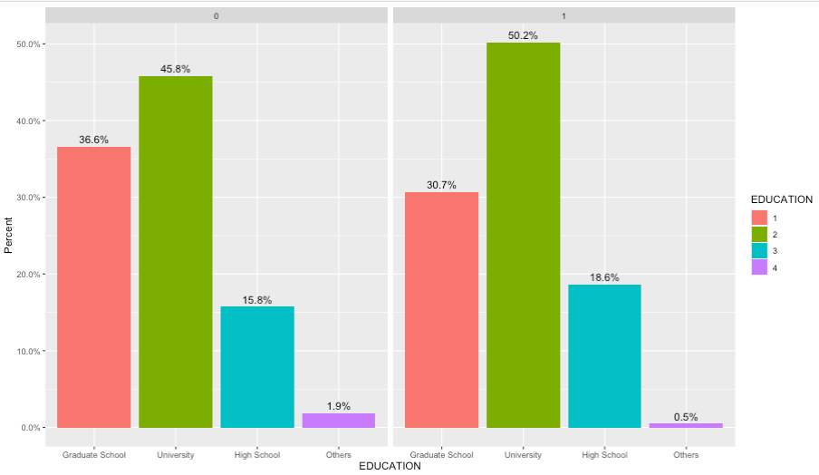
Analyzing customers Education vs Default
We can observe that the default rate is more for customers having a University degree

Slide 9
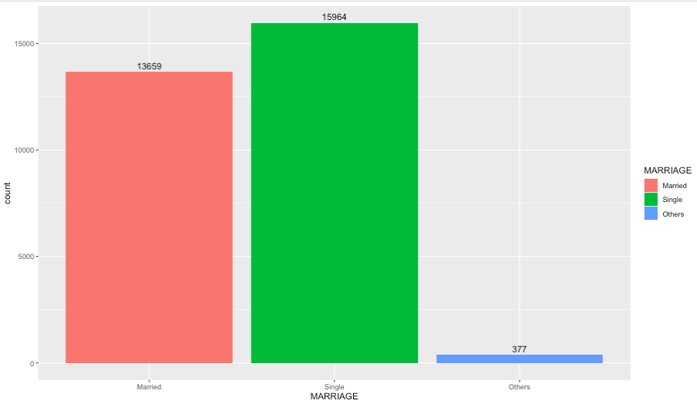
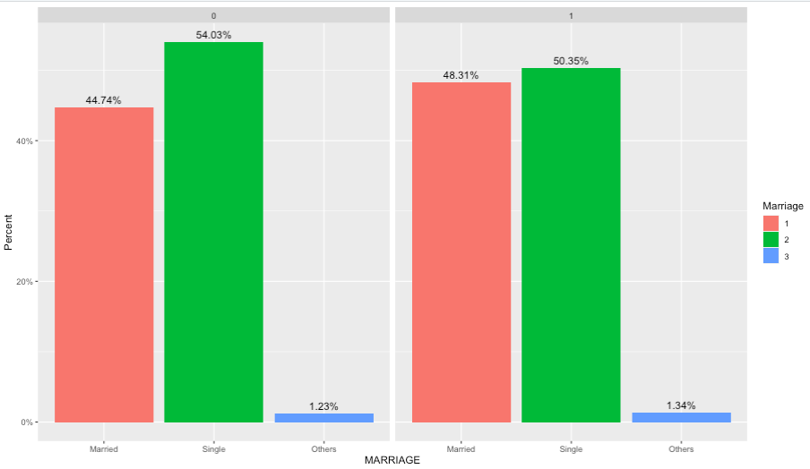
Analyzing customers Marriage vs Default
We see that the customers who are single are greater when compared to married and others combined.
But we can observe that the default rate is similar for customers who are married and single.

Slide 10
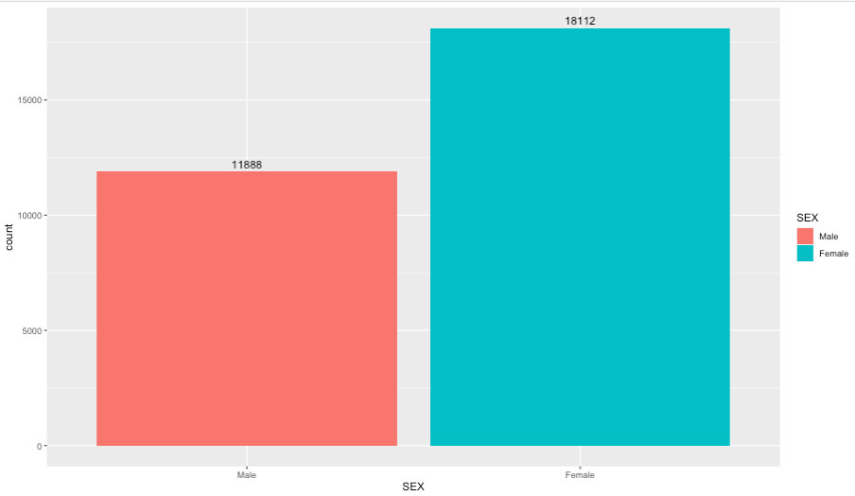
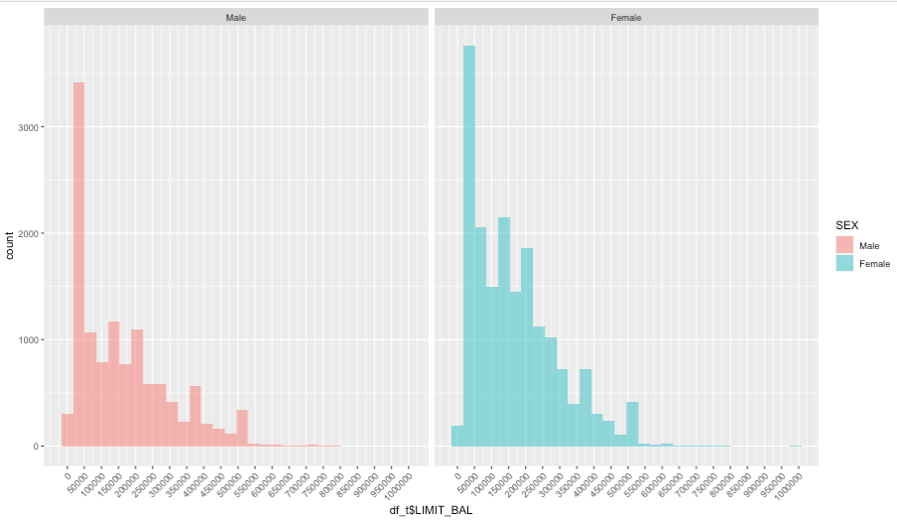
Analyzing customers Gender vs Default
It is seen that Female customers are more when compared to Male customers.
But the pattern in Limit Balance is similar and customers between both segments having a balance below 50000 are more than 3000 customers.

Slide 11
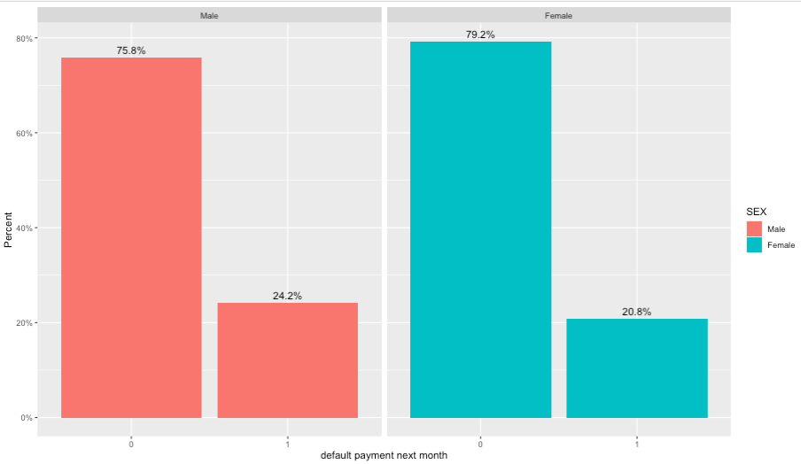
Analyzing customers Gender vs Default
Though the number of female customers is more we can infer that the default rate is greater for male customers.

Slide 12
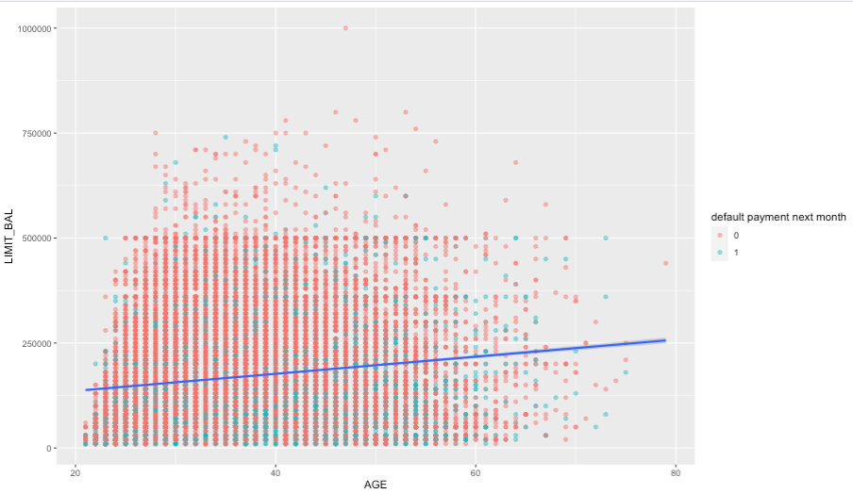
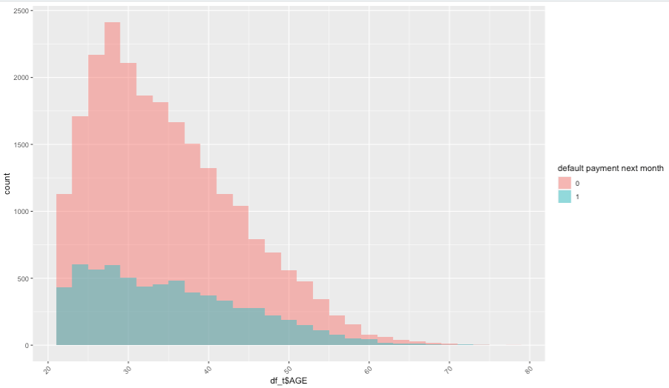
Analyzing customers Age vs Default
We can observe from the trend line that as the age increases the Limit Balance of customers increases gradually.
From the scatter plot we can also infer that people having a limit balance below the trend line are more likely to default.
Both the categories are more populated by customers between the age range of 20-30 years.

Slide 13

Classifier Evaluation
;

Slide 14
Prediction of Default
60% of the dataset has been used for training
Predictors: Limit Balance, Age, Gender, Education, Marriage, Payment Status, and Bill Amount.
Models Utilized:
KNN-Classification
Logistic Regression
Naïve Bayes Classification

Slide 15
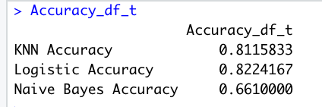
Model Evaluation
Upon evaluating all the three models it is observed that Logistic Regression has an accuracy of 82.2%.
KNN classifier had an accuracy of 81.1%.
The naïve Bayes classifier had the least accuracy of 66.1%.

Slide 16
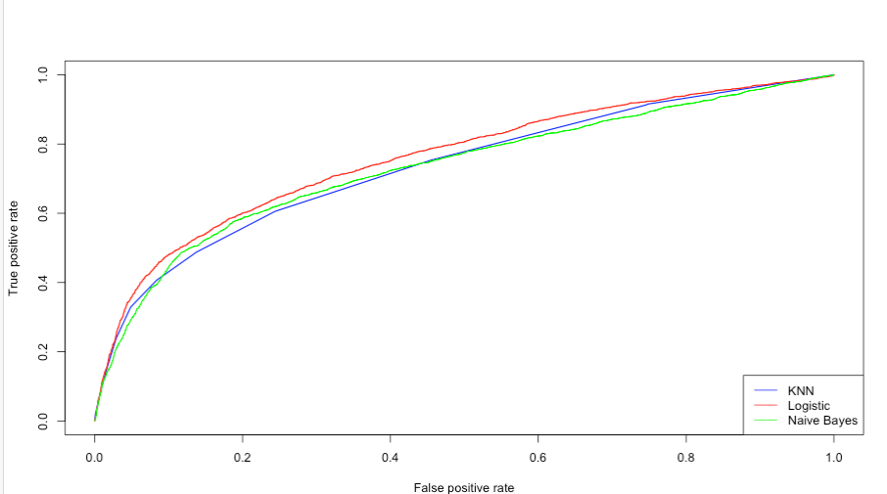
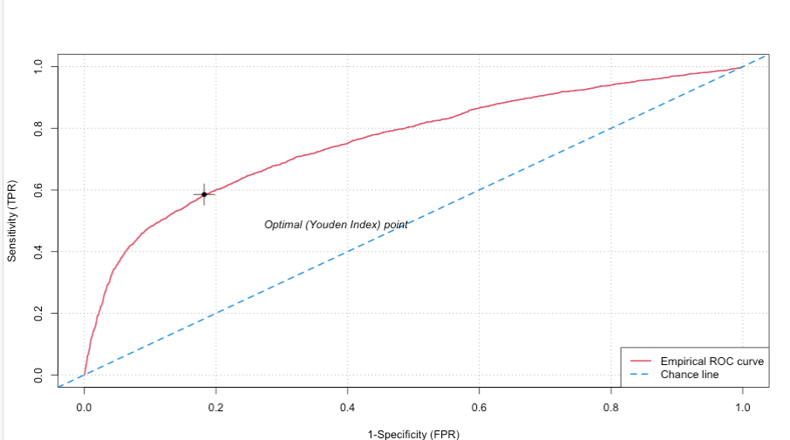
Model Evaluation
The same can be observed from the ROC curves.
It is observed the AUC is highest for the curve related to Logistic Regression.
The AUC corresponding to Logistic Regression is: 75.92%

Slide 17
Scope of Improvement
It would be helpful to collect more demographic data, such as Salary and Credit Score, in order to make more accurate predictions.
In order to segment the customers, conduct cluster analysis and PCA to assist financial institutions in taking the appropriate risk
Addition of data is encouraged as it significantly improves the accuracy of the models.

Slide 18
Summary
The following type of customers who end up defaulting more are:
Customers having a University Degree
Male Customers
Married and Single Customers
Customers who are aged between 20-30
The logistic regression model gives the highest accuracy compared to other models.

Slide 19

Thank You!

