Slide 1
Loops

Slide 2
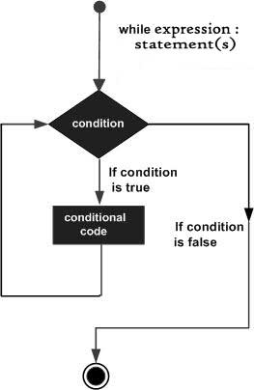
While Loop
A while loop statement in Python programming language repeatedly executes a target statement as long as a given condition is true

Slide 3
Example
count = 0
while (count < 9):
print (‘The count is:', count)
count = count + 1
print “bye!"

Slide 4
Infinite Loop
A loop becomes infinite loop if a condition never becomes FALSE.
You must use caution when using while loops because of the possibility that this condition never resolves to a FALSE value.
count = 1
while (count < 9):
print ('The count is:', count)
# count = count + 1
print “bye!"

Slide 5
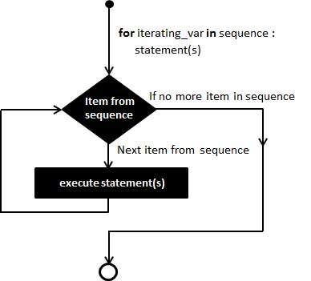
For Loop
For Loop is used to iterate through a Sequence like lists, tuples

Slide 6
Example
#exampl e1
for letter in 'Python':
print ('Current Letter :', letter)

Slide 7
Example 2
#example 2
fruits = ['banana', 'apple', 'mango']
for fruit in fruits:
print (Fruit Name:', letter)

Slide 8
Break Pass and Continue
Break statement Breaks the Loop
Pass statement is a placeholder when you don’t have any statements to write in the suite
Continue Breaks the current iteration and starts next iteration

Slide 9
Else Statement Loop
Python supports to have an else statement associated with a loop statement.
If the else statement is used with a for loop, the else statement is executed when the loop has exhausted iterating the list.
f the else statement is used with a while loop, the else statement is executed when the condition becomes false.

Slide 10
Else statement with For
count = 0
while count < 5:
print count, " is less than 5“
count = count + 1
else:
print count, " is not less than 5"

Slide 11
Else statement with For
numbers=[1,2,3,4,5]
else:
print count, " is not less than 5"

Slide 12
Nesting Loops
for iterating_var in sequence:
for iterating_var in sequence:
statements(s)
statements(s)
while expression:
while expression:
statements(s)
statements(s)

Slide 13
i = 2
while(i < 100):
j = 2
while(j <= (i/j)):
if not(i%j): break
j = j + 1
if (j > i/j) :
print (i, " is prime" )
i = i + 1

