Slide 1
Enterprise Application Integration (EAI)
Ricky Lashock
CS 317
Fall 2010

Slide 2
Overview
What is EAI?
Advantages/Disadvantages
Problems
Software Options

Slide 3
What is EAI
the use of software and computer systems architectural principles to integrate a set of enterprise computer applications.
EAI is the process of linking business applications within a single organization together in order to simplify and automate business processes to the greatest extent possible
Can be Software or Hardware changes.
Optimizing Network Traffic and Server interconnectivity
Source: Wikipedia

Slide 4
Advantages and Disadvantages
Advantages
Real time information access among systems
Streamlines business processes and increase efficiency
Maintains information integrity across multiple systems
Ease of development and maintenance
Source Wikipedia
Disadvantages
High startup and initial development costs.
Requires smart business design, which may not be able to be envisioned with the help of a consulting firm.

Slide 5
Problems of EAI
Most EAI projects usually start off as point-to-point efforts, quickly becoming unmanageable as the number of applications increase.
Requires expect knowledge
Price
Lack of correct setup

Slide 6


EAI Software Options
Microsoft BizTalk Server 2010
Apache Camel

Slide 7
Microsoft BizTalk Server 2010
Quick Facts:
Over 10,000 BizTalk customers worldwide
81% of the Fortune Global 100 use BizTalk
6 of the 8 largest U.S. pharmaceutical companies
4 of the 5 largest electronics parts manufacturers
9 of the 10 largest U.S. telecommunications companies
9 of the 10 largest U.S. Aerospace and Defense Companies
5 of the 8 largest U.S. chemical companies
4 of the 5 largest railroads in the U.S.
9 of the 10 largest insurance companies in the world
Source: Microsoft

Slide 8
BizTalk Support
Business Applications (Siebel, SAP, IFS Applications, JD Edwards, Oracle, Dynamics CRM),
Databases (Microsoft SQL Server, Oracle, DB2)
Other Technologies (Tibco, Java EE)
Microsoft products (Office, InfoPath ,SharePoint) allows user participating in a workflow process.
RFID Supported
Source: Wikipedia/Microsoft

Slide 9
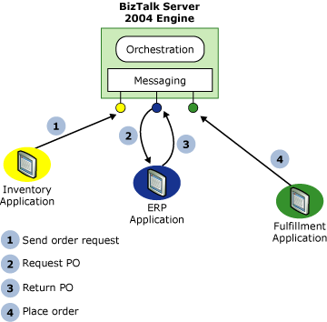
Microsoft BizTalk Server 2010
In this scenario, an inventory application, running on an IBM mainframe, notices that the stock of an item is low and issues a request to order more of that item. The following steps occur:
The request is sent to a BizTalk Server 2010 application.
The BizTalk Server 2010 application requests a purchase order (PO) from the organization's Enterprise Resource Planning (ERP) application.
The ERP application, which might be running on a Unix system, sends back the requested PO.
The BizTalk Server 2010 application informs a fulfillment application, built on Microsoft Windows by using the .NET Framework, that the item should be ordered.
Source: Microsoft

Slide 10
Microsoft BizTalk Server 2010
Cost
Enterprise Edition
$44,228
Standard Edition
$10,138
RFID Enterprise Edition
$5,031
Source: Microsoft

Slide 11
Apache Camel
open source integration framework based on known Enterprise Integration Patterns with powerful Bean Integration
Java API

Slide 12
Apache Camel
Apache Camel can be used as a routing and mediation engine
Apache ServiceMix which is the most popular and powerful distributed open source ESB and JBI container
Apache ActiveMQ which is the most popular and powerful open source message broker
Apache CXF which is a smart web services suite (JAX-WS)
Apache MINA a networking framework
Source: Apache Organization

Slide 13
Apache Camel
Cost
Free
Cross Platform
XML Free
Java-based Configurations

