Slide 1
Movie Recommendation Engine
Netflix Competition Dataset
Girija Ghali, Manel Mahroug, Kevin McCurdy
Notes:
The purpose of this project is to create a movie recommendation engine using Machine Learning. We based our effort on a Netflix competition from the late 2000’s, whose grand prize was $1M. The winning model from 2009 used a large, complicated set of factors, based on statistics for both the users and the films, tied together with fairly simple regression models. (not really ML) Our question is whether a modern ML model can come close to these results.

Slide 2
Data Cleaning and Exploration
Downloaded dataset from:
https://www.kaggle.com/netflix-inc/netflix-prize-data
4 text files converted into a csv file.
Content of file:
-MovieIDs: Range from 1 to 17770 sequentially.
-CustomerIDs: range from 1 to 2649429,
with gaps(480189 users).
-Ratings are on a five star (integral) scale from 1 to 5.
-Dates
Movie title file: MovieIDs and Movie Title
Notes:
First, an overview of the dataset itself. We downloaded the Netflix data from Kaggle, in the format of 4 .csv files. It included ratings on 17,770 movies by over 400k users, rated on a scale from 1 to 5 for each movie. The rows also contained the date that each review was submitted. The main files contained numeric id’s for each film and user. A reference table of movie titles was also provided.
We cleaned the data using Python and Pandas. This involved adding movieID’s to each row, and removing dates. We then used Pandas and Matplotlib to explore the aspects of the dataset.

Slide 3
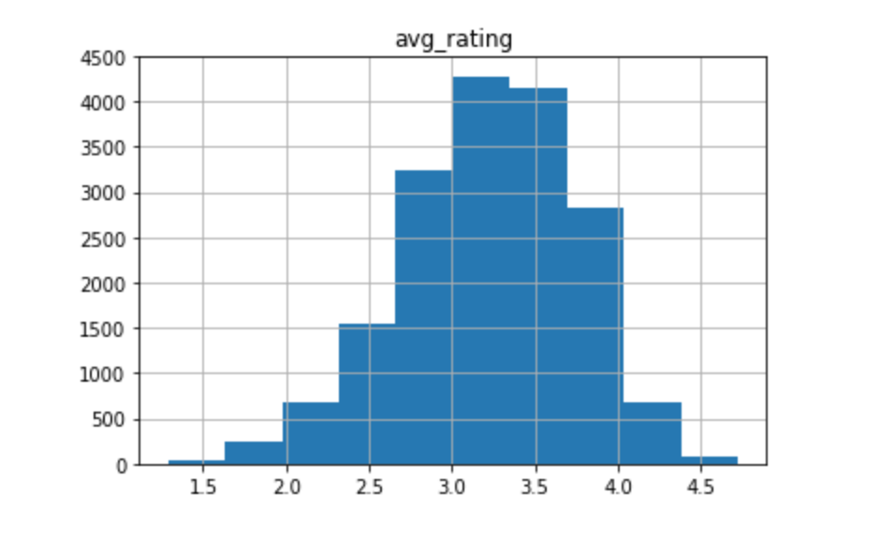
Average Rating of All Movies
Notes:
Overall, the average ratings of the movies tended toward the middle, most films getting around 3 stars. Very few that were universally acclaimed or panned.

Slide 4
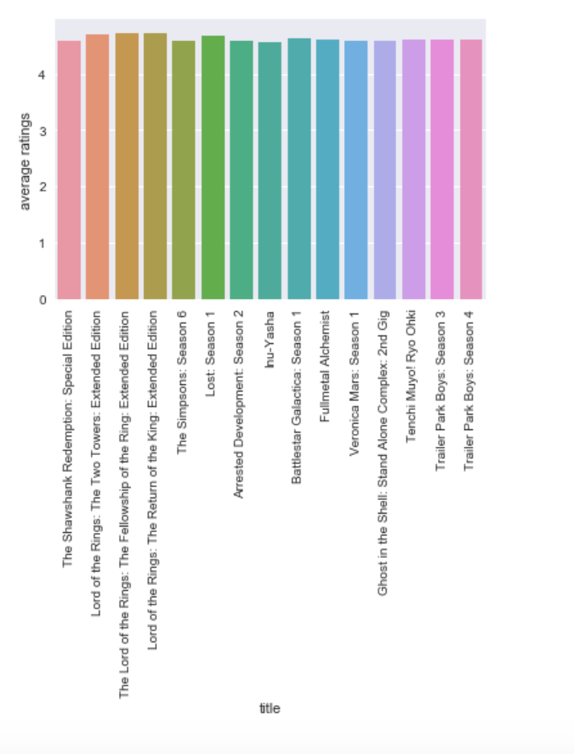
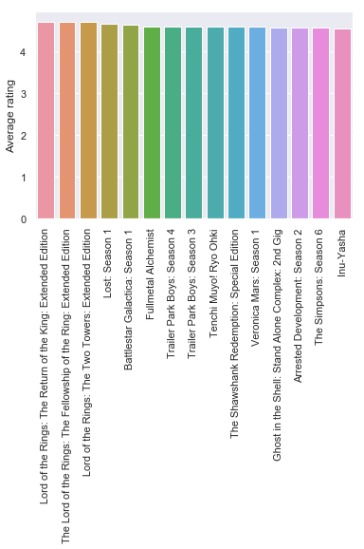
Most Highly Rated Movies
Notes:
Here are the movies that got the highest rating. (LoTR, Shawshank, Trailer Park Boys)

Slide 5
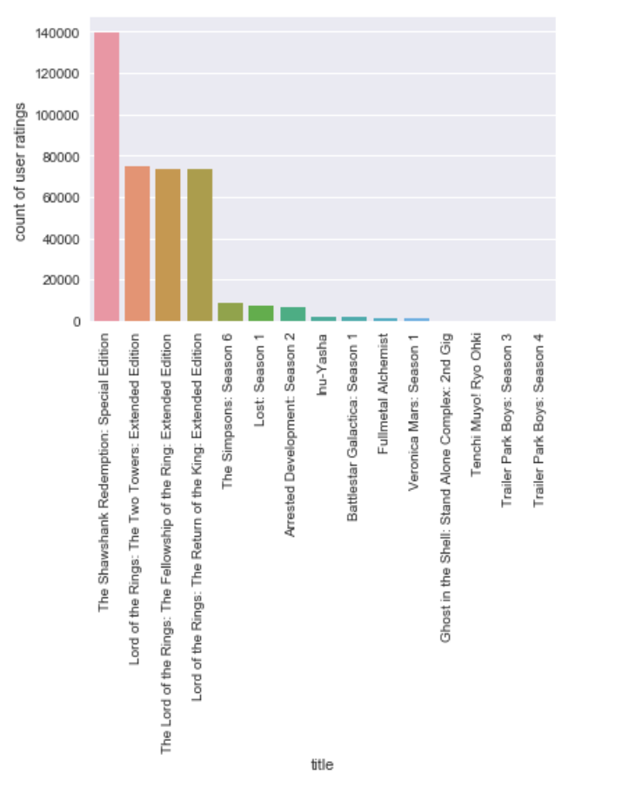
And Their Review Counts
Notes:
And here’s how many times they were reviewed. (note Shawshank, LoTR)

Slide 6
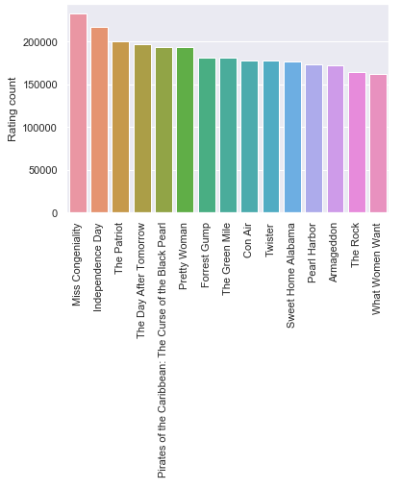
Most Reviewed Movies
Notes:
Here are the movies that got the most reviews overall.

Slide 7
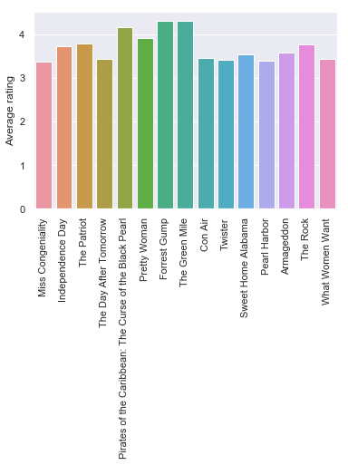
And Their Ratings
Notes:
Most of them average in the 3-4 star range.

Slide 8
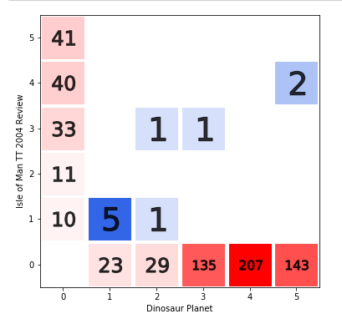
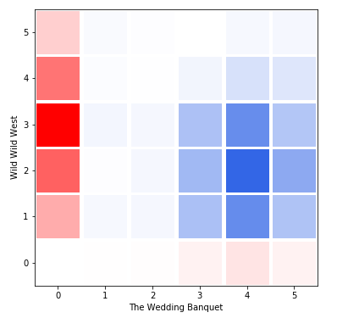
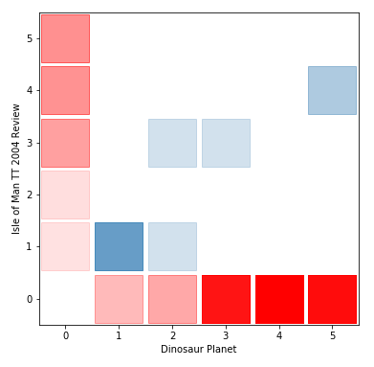
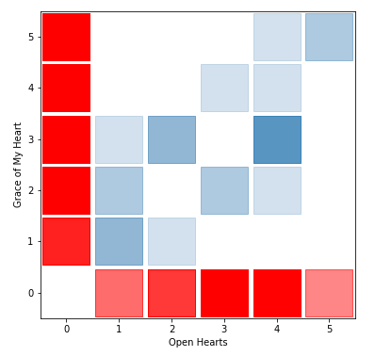
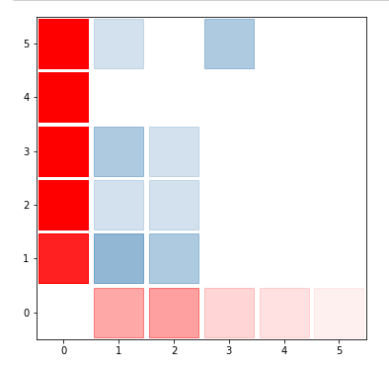
Comparisons of the view counts per user between two movies
Notes:
To get a feel for how viewers of one movie tend to think about another, we made a few comparisons movie-by-movie to determine their mutual rating distribution. As we see, some had a clearly positive correlation (left side), while others clustered around specific ratings regardless of preference for another movie. Strong correlations here may be indicative of movies in a similar genre. Of course, many less-popular movies are very sparse in their mutual viewers, making such metrics difficult.

Slide 9
Machine Learning Algorithm
Collaborative Filtering: Systems that predict the rating or preference that a user would give an item based on past ratings and preferences of other users.
Surprise: a Python scikit building and analyzing recommender systems.
Notes:
For the actual algorithm, we used a ML technique called collaborative filtering, designed to handle this type of user-based prediction. It considers a user’s preferences, along with data from similar users, in order to predict whether that user would like another specific item. We implemented this using the Scikit-Surprise library in Python.

Slide 10
Limitations
Assumptions: Date of movie review was removed. The assumption is that date of review is not impacted by the date of movie release.
Inaccurate predictions for new users
Too large of a dataset- runs into memory issues
Notes:
Of course, there are limitations to our approach and our resources. First, we decided to assume that date of movie and review were not relevant enough to keep. The original winning team did take these into account in their algorithm, but we feel it safe to assume that the dates of both release and review have little effect on the user’s viewing experience and subsequent rating.
While the model does a good job of predicting preferences of users already in the database, it does a performs poorly with submissions of “new” users; always recommending the same top movies regardless of input.
Not helping this is the amount of time and memory these calculations require. We originally planned to compare results using both Surprise and Fast.ai, but the latter took so long to calculate (>1 day) that we couldn’t test it. For the Surprise dataset we had to ignore data for 80% of the movies just to get the model to compute reasonably; even then, the dump file almost 900 MB, making it useless for deployment on the web (given Heroku & Git’s limits).

Slide 11
Results – Test Set of Users
User 722473:
'Hook', 'Crazy/Beautiful', 'Dummy', 'Gladiator', 'Harry Potter and the Prisoner of Azkaban', 'A Cry in the Dark', 'Shakespeare in Love', 'Close Encounters of the Third Kind', 'La Bamba', 'Looney Tunes: Reality Check!’
User 1499529:
'Jerry Maguire', 'Fast Times at Ridgemont High', 'Chocolat', 'Lord of the Rings: The Fellowship of the Ring', 'Duck Soup', 'Raiders of the Lost Ark', 'Field of Dreams', 'Big', 'The Hand that Rocks the Cradle', 'Tears of the Sun'
Notes:
When running the initial train/test set, we got a believable variety of predictions for our input users (for example, these two). However, when testing the model on the front-end, our results were a lot more homogenous.

