Slide 1
Movie Recommendation Engine
Netflix Competition Dataset

Slide 2
Data Cleaning and Exploration
Downloaded dataset from:
https://www.kaggle.com/netflix-inc/netflix-prize-data
Converted text files into csv
Content of file:
Number of Movies 17770
Number of Users 480189
Range of Ratings 1 to 5
Average Rating 3.604289964420661

Slide 3
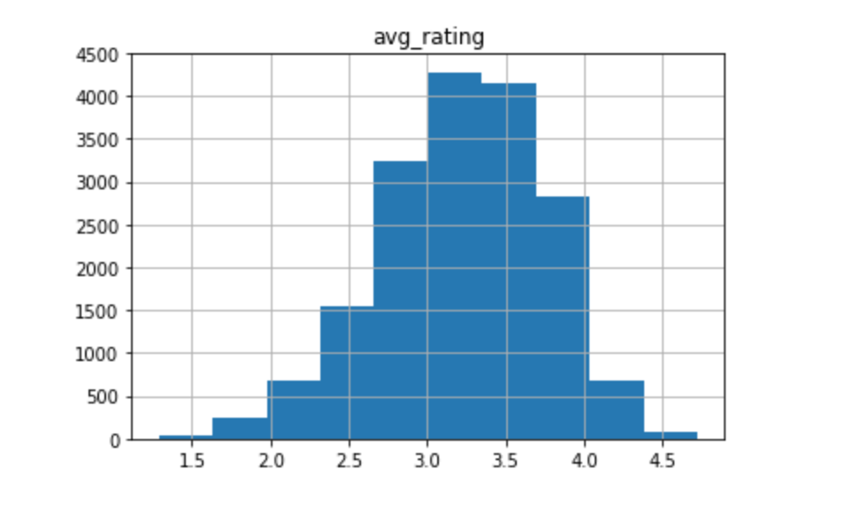
Average Rating of All Movies

Slide 4
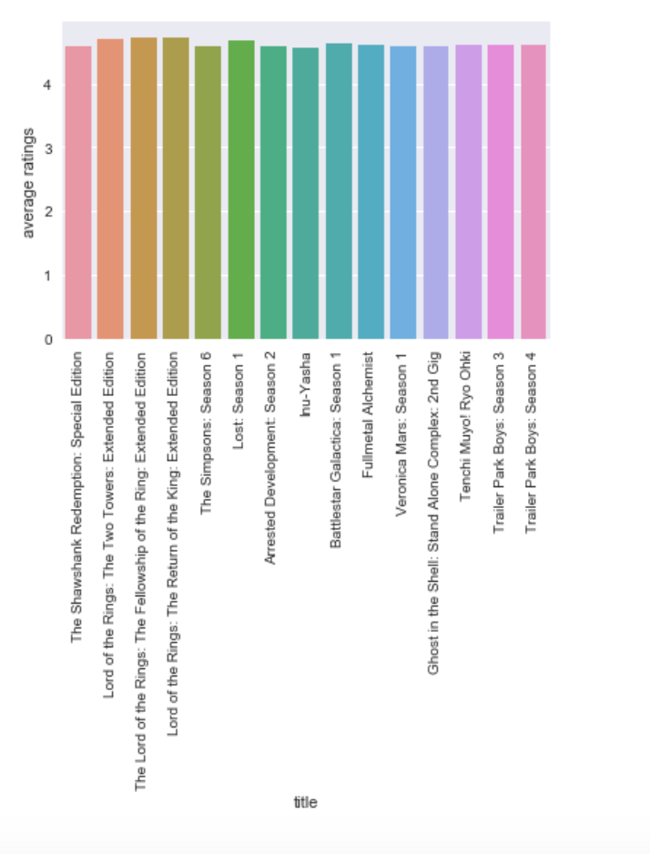
Most Highly Rated Movies

Slide 5
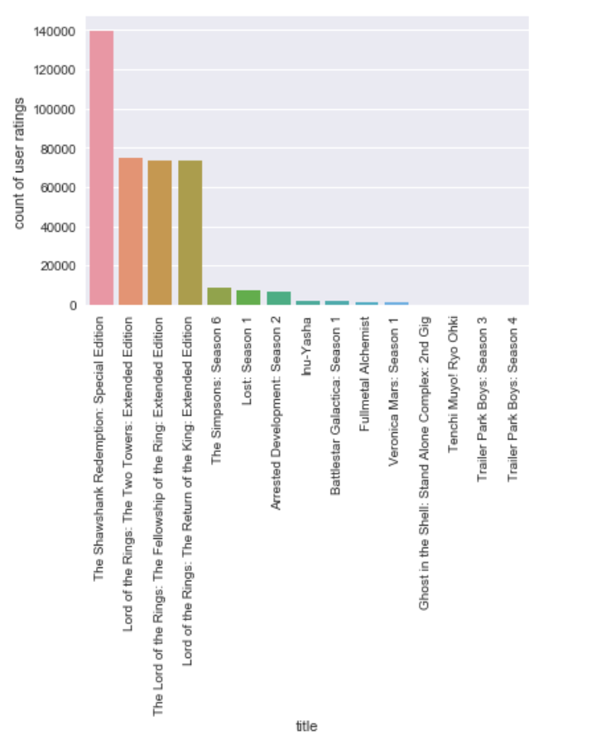
Most Reviewed Movies

Slide 6
Machine Learning Algorithm
Collaborative Filtering: Systems that predict the rating or preference that a user would give an item based on past ratings and preferences of other users.
Surprise: a Python scikit building and analyzing recommender systems.

Slide 7
Limitations
Assumptions: Date of movie review was removed. The assumption is that date of review is not impacted by the date of movie release.
Inaccurate predications for new users
Too large of a dataset- runs into memory issues

