Slide 1
Movie Recommendation Engine
Netflix Competition Dataset

Slide 2
Data Cleaning and Exploration
Downloaded dataset from:
https://www.kaggle.com/netflix-inc/netflix-prize-data
4 text files converted into a csv file.
Content of file:
-MovieIDs: Range from 1 to 17770 sequentially.
-CustomerIDs: range from 1 to 2649429,
with gaps(480189 users).
-Ratings are on a five star (integral) scale from 1 to 5.
-Dates
Movie title file: MovieIDs and Movie Title

Slide 3
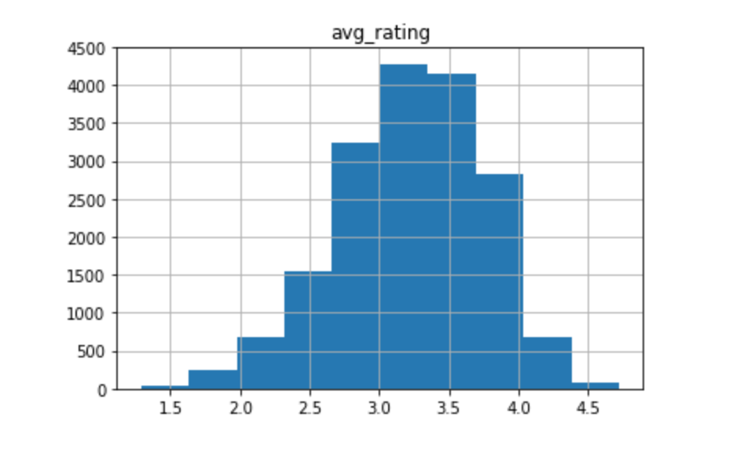
Average Rating of All Movies

Slide 4
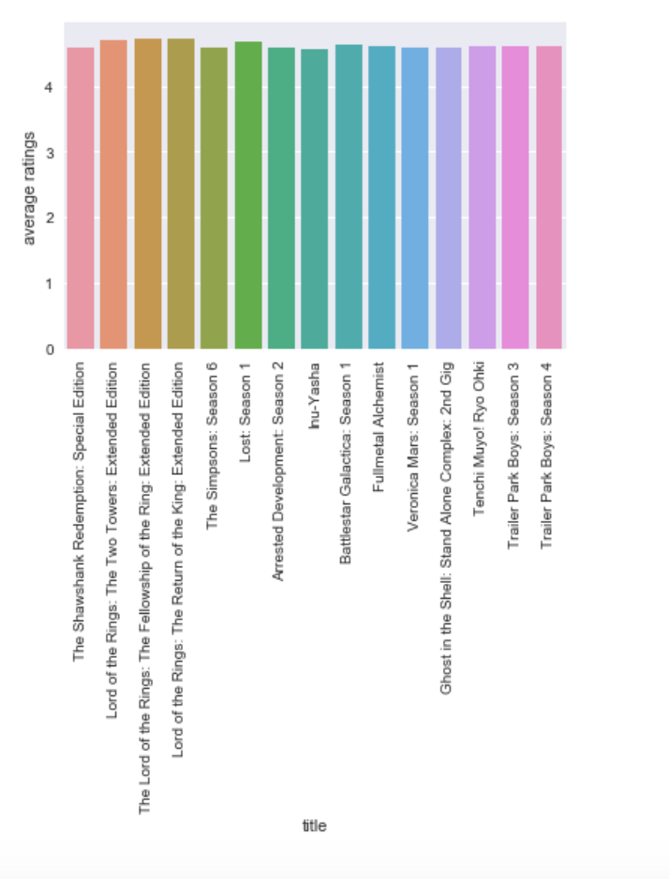
Most Highly Rated Movies

Slide 5
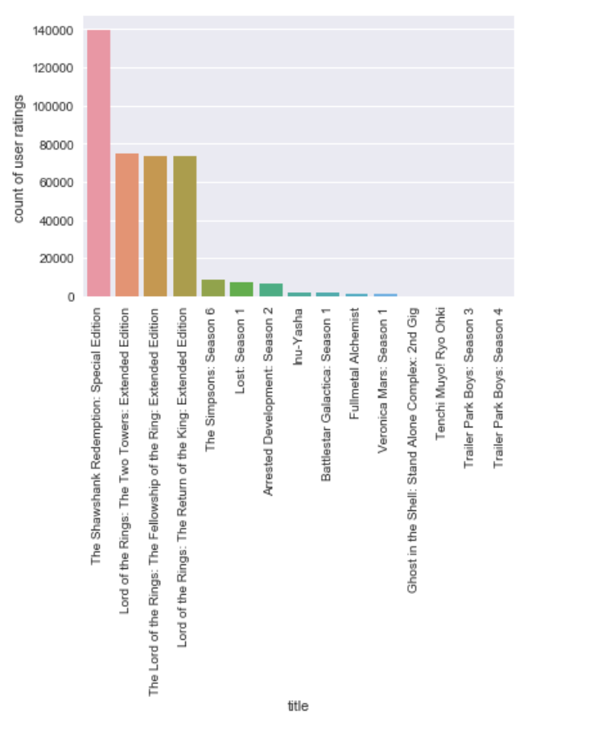
Most Reviewed Movies

Slide 6
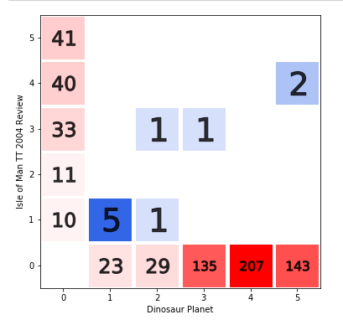
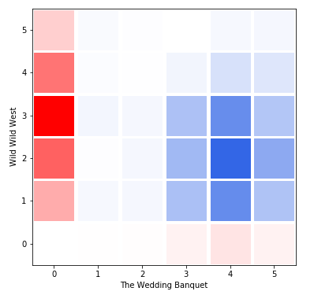
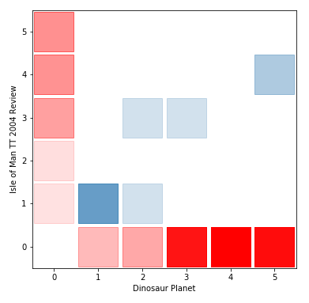
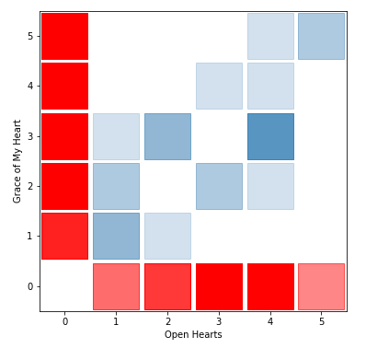
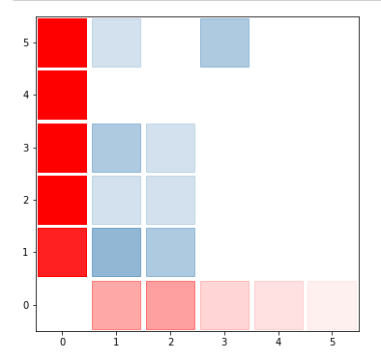
Comparisons of the view counts per user between two movies

Slide 7
Machine Learning Algorithm
Collaborative Filtering: Systems that predict the rating or preference that a user would give an item based on past ratings and preferences of other users.
Surprise: a Python scikit building and analyzing recommender systems.

Slide 8
Limitations
Assumptions: Date of movie review was removed. The assumption is that date of review is not impacted by the date of movie release.
Inaccurate predictions for new users
Too large of a dataset- runs into memory issues

