Slide 1
Evaluation Metrics for Time Series

Slide 2
Evaluation Metrics for Time Series
Mean Forecast Error(MFE)
Mean Absolute Error(MAE)
Mean Absolute Percentage Error(MAPE)
Mean Square Error(MSE)
Root Mean Square Error(RMSE)

Slide 3
Mean Forecast Error(MFE)
Mean Forecast Error shows deviation of the forecast from the actual demand.
This is the mean of the sum of all the differences between the actual values and forecasted values.
Let’s consider 10 data points
-2, -4, 3, 8, -3, -8, 1, -1, 5, -5
Sum of errors = 0

Slide 4
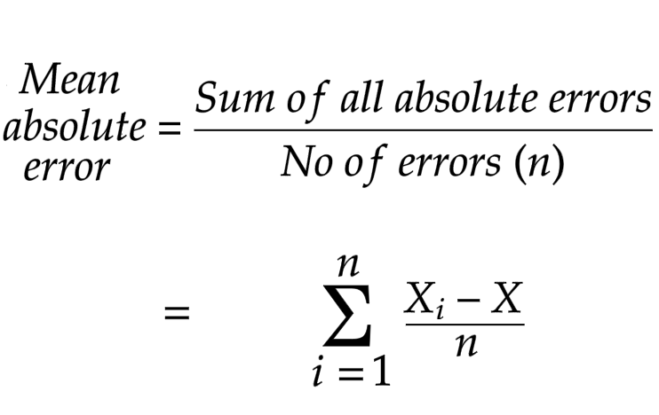
Mean Absolute Error(MAE)
Mean Absolute Error takes the absolute values of the differences between actual values and forecasted values.

Slide 5
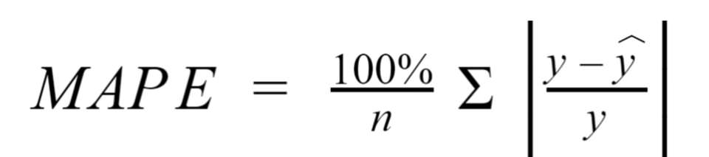
Mean Absolute Percentage Error(MAPE)
Mean Absolute Percentage Error calculates the percentage of mean absolute error to get a clear idea of how much the forecasted values deviates from the actual values.

Slide 6
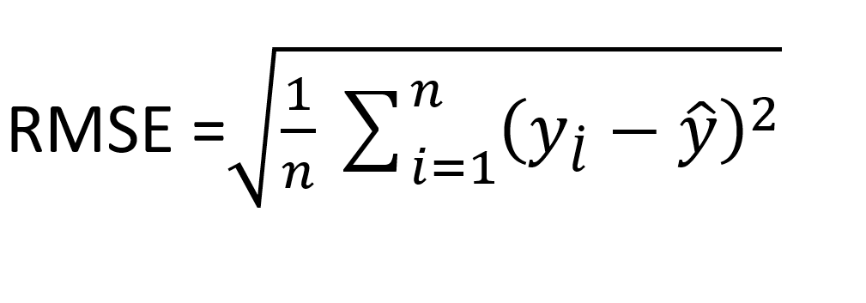
Root Mean Square Error(RMSE)
Root Mean Square Error is equal to the root of the Mean Square error in order to bring error value to the same dimension.

Slide 7
Simple Exponential Smoothing

Slide 8

Simple Exponential Smoothing
Simple Exponential Smoothing is performed using the following formula
Where a, b, c are the weights
a<b<c….<l, l is the greatest of all.

Slide 9
Simple Exponential Smoothing
Level at the point t is:
L(t) = α*y(t) + (1- α)*y(t-1)
Where,
Y(t) denotes the recent observation
L(t-1) denotes the previous observation
and 0< α< 1

Slide 10
Holt and Holt Winter Exponential Smoothing

Slide 11
Holt Exponential Smoothing
Holt’s Exponential Smoothing captures the level and trend of time series in the forecasting.
The Forecast Equation is:
y(t+1) = l(t) +b(t)
where l(t) is the level component and b(t) is the trend component.

Slide 12
The Trend Component
The trend component is calculated as:
b(t) = β(l(t) - l(t-1)) + (1-β)b(t-1)
Where, β is the smoothing parameter for trend.

Slide 13
Holt’s Winter Exponential Smoothing
Holt’s Winter Exponential Smoothing captures all level, trend and seasonality.
The forecast equation is:
y(t+1) = l(t)+b(t)+s(t+1-m)
Where m is the number of times a
season repeats in a time period.

