Slide 1

CAFE MANAGEMENT SYSTEM
GAYATHRI DEVI P M (RA2311026020004)
GIRIJESH S (RA2311026020008)
RAMA MK (RA2311026020014)
RESHWANTH S (RA2311026020035)

Slide 2

Abstract
The Cafe Management System is a console-driven Java application backed by MySQL that replaces handwritten tickets and scattered spreadsheets with a single, menu-driven workflow. It covers the essential operational domains of a small café which includes customers, products, orders, billing, and reporting The purpose is to provide a predictable, low-cost alternative to paper processes that can run on shared café or lab laptops without additional licenses or specialized hardware.
01

Slide 3
Problem
Statement
Small and medium-sized cafés often rely on manual methods like handwritten order slips and spreadsheets, which are time-consuming, error-prone, and hard to scale, leading to inaccurate billing, misplaced orders, poor inventory tracking, and delayed reporting. While commercial point-of-sale systems offer advanced features, they are expensive and difficult to customize, making them unsuitable for small businesses. The Cafe Management System provides a cost-effective, database-driven solution that automates core café operations, improves accuracy and efficiency, and supports future enhancements such as graphical interfaces, analytics, and payment integration.
02

Slide 4

By replacing manual record keeping and spreadsheet-based tracking, the system minimizes human errors, speeds up daily tasks, improves inventory visibility, and enhances overall service efficiency. The solution is cost-effective, requires minimal hardware and training, and is designed to support future enhancements such as graphical user interfaces, advanced analytics, payment gateway integration, and multi-branch support.
Proposed Solution
The proposed solution is a console-based Cafe Management System developed using Java and MySQL that automates essential café operations including customer management, product cataloguing, order processing, billing, and basic reporting through a unified, menu-driven interface. The system follows a layered architecture that separates user interaction, business logic, and database access, ensuring better maintainability, reliability, and scalability. JDBC is used to enable secure and efficient communication with the MySQL database, while prepared statements and transaction handling maintain data integrity and prevent inconsistencies during order and billing operations.
03

Slide 5
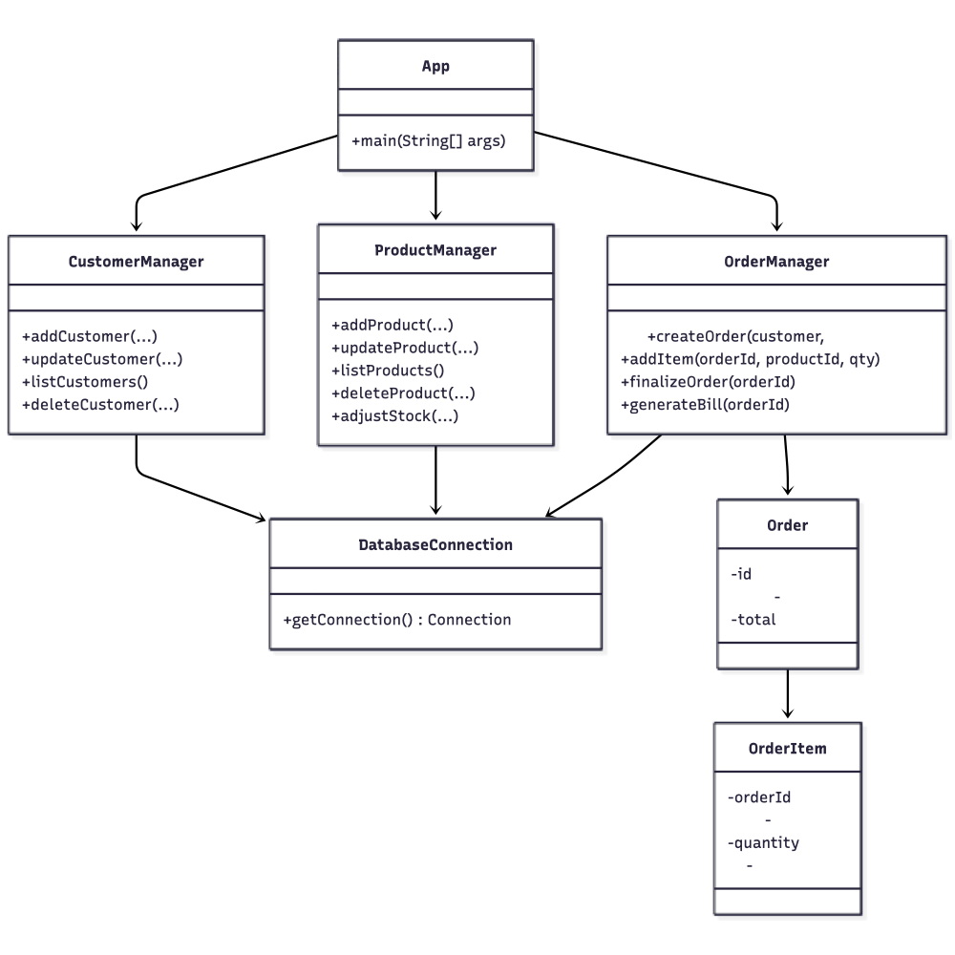
ER Diagram
-
04

Slide 6
05
The Cafe Management System employs a clean layered architecture that ensures maintainability and code clarity. At the presentation layer, the CLI interface provides intuitive menu-driven navigation through App.java, which delegates operations to specialized manager classes. The business logic layer consists of three core managers—CustomerManager, ProductManager, and OrderManager—each responsible for their domain's operations and validation rules, such as enforcing positive pricing and preventing invalid entries.
These managers communicate with the MySQL database using JDBC prepared statements, which safeguard against SQL injection attacks while maintaining efficient data access. The relational database schema connects four normalized tables through foreign key relationships: customers store contact information, products maintain the café's menu catalog, orders track customer transactions, and order_items link products to specific orders. This separation of concerns enables independent modifications The architecture delivers both simplicity for small-scale deployment and the structural foundation necessary for future enhancements.
System Design

Slide 7
Tech Stack
Programming Language: Java 17
Database: MySQL 8.0
Connectivity: JDBC (Java Database Connectivity)
Build & Dependency Management: Maven
Development Environment: Visual Studio Code
Version Control: Git
06

Slide 8
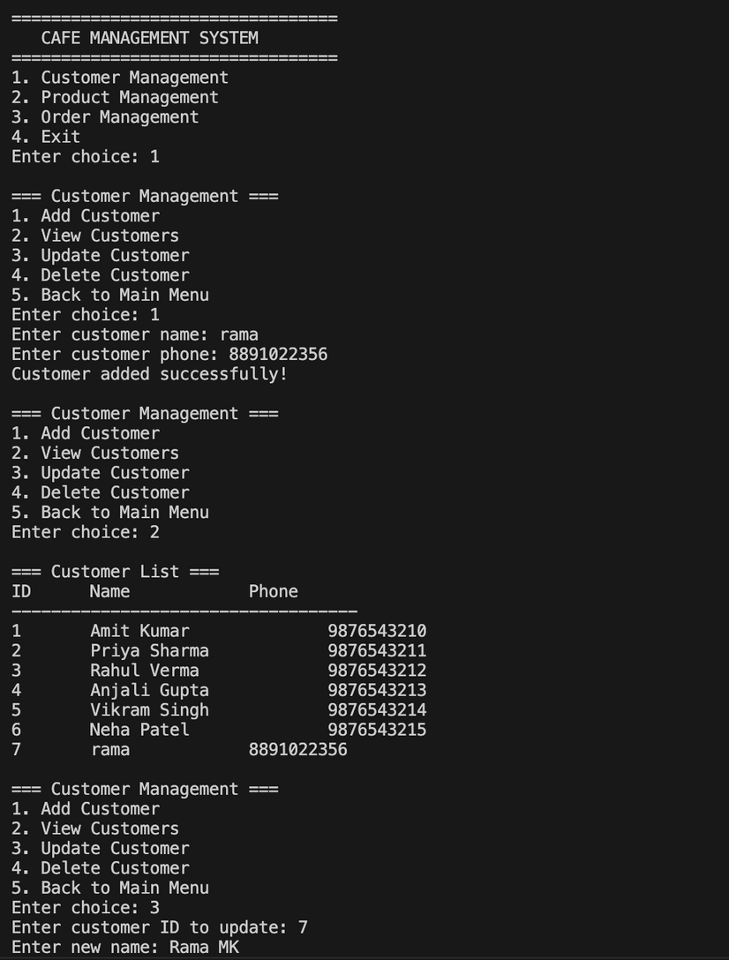
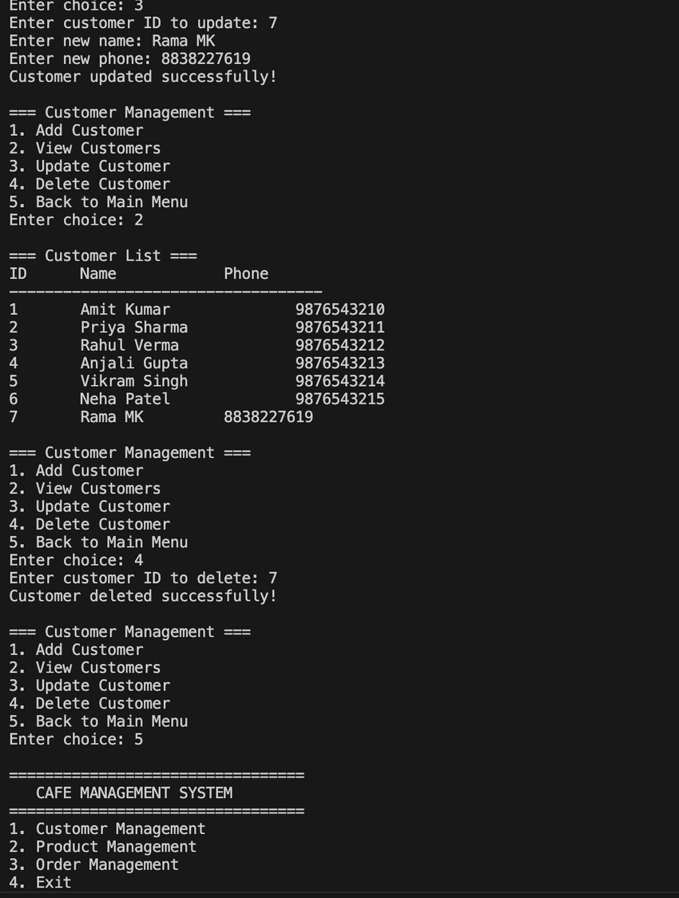
07
Results & Output

Slide 9
Conclusion and Future Enhancement
In the future, the system can be enhanced by introducing a graphical or web-based user interface for better usability, integrating secure payment gateways and customer loyalty programs, incorporating machine learning-based analytics for demand forecasting and sales insights, and extending support for multi-outlet café management to enable scalability.
The Cafe Management System successfully transforms traditional manual café operations into a well-structured and fully automated process, improving accuracy, efficiency, and reliability. The project demonstrates the effective application of software engineering principles such as modular design, layered architecture, and proper database management using Java and MySQL. By organizing customer, product, and order data in a centralized system, the application reduces human errors and speeds up daily operations.
08

