Slide 1
Loan Collection Assistant
An AI-assisted collections workflow prototype — rules engine, AI drafting, and human-in-the-loop approval
Girish Nehete
Fintech & AI for Business — Portfolio Project

Slide 2
The problem with manual loan collections
!
Volume outpaces manual review
P2P
Discretion erodes policy
A bank's overdue book can run to thousands of accounts. Officers can't individually assess every case for next steps.
Agents can quietly re-extend a broken promise-to-pay again and again, delaying escalation that policy actually requires.
§
Compliance risk in communication
⏱
Slow, inconsistent reporting
A reminder that drifts into “legal action” language too early breaches RBI fair-practice expectations.
Bureau (CIBIL) reporting gaps and delayed NAB reclassification go unnoticed without a systematic check.
2

Slide 3
Current process vs. AI-assisted process
TODAY — fully manual
WITH THE ASSISTANT
Officer manually scans the overdue list every morning
Reminders sent on a fixed schedule, same tone for everyone
Agent calls, records P2P manually, judgment on when to escalate
Escalation decided case-by-case, inconsistently
Bureau reporting checked periodically, not continuously
Rules engine buckets every loan by DPD automatically, every run
AI drafts reminders by severity, reflection catches tone/compliance issues
Hard rule forces escalation after repeated broken P2P — no override
Only genuine judgment calls (5 of 20) reach an officer's queue
Bureau-reporting gaps flagged automatically, nothing missed
3

Slide 4
Where AI acts, and where a human must decide
Stage | AI role | Decision
Reminders & status tracking | Tool use — scheduled, severity-aware drafting | Auto
Promise-to-pay monitoring | Tracks commitments, flags breaks | Auto
Repeated broken promise | Hard rule forces escalation, no agent override | Human-required
Field visit / legal notice | AI prepares the case file only | Human-required
Bureau (CIBIL) reporting | Flags gaps automatically | Auto-flag, human verifies
Write-off | No AI role — committee decision | Human-required
4

Slide 5
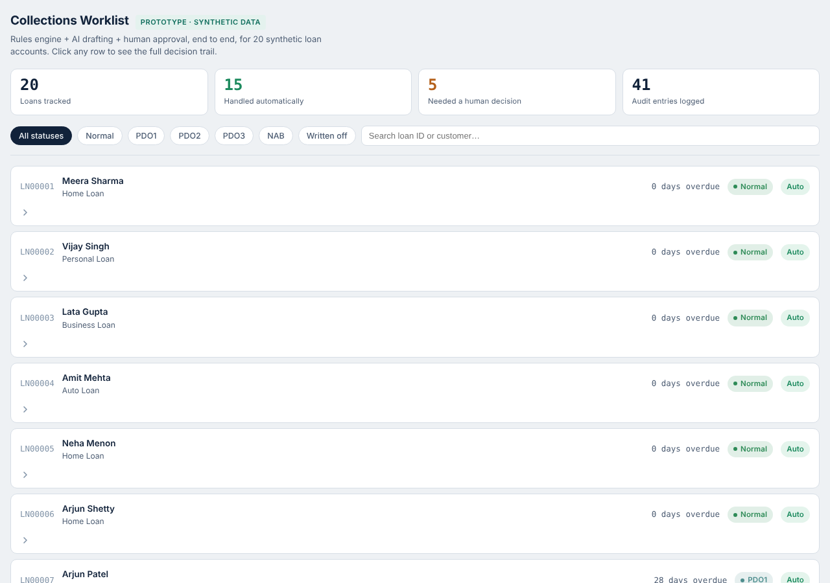
The dashboard — the full loan book at a glance
20 synthetic loans, one worklist.
Summary tiles surface the headline numbers immediately: how many loans, how many cleared automatically, how many needed a person, and how many audit entries back every decision.
Filter by status, search by customer or loan ID, click any row to expand its full story.
5

Slide 6
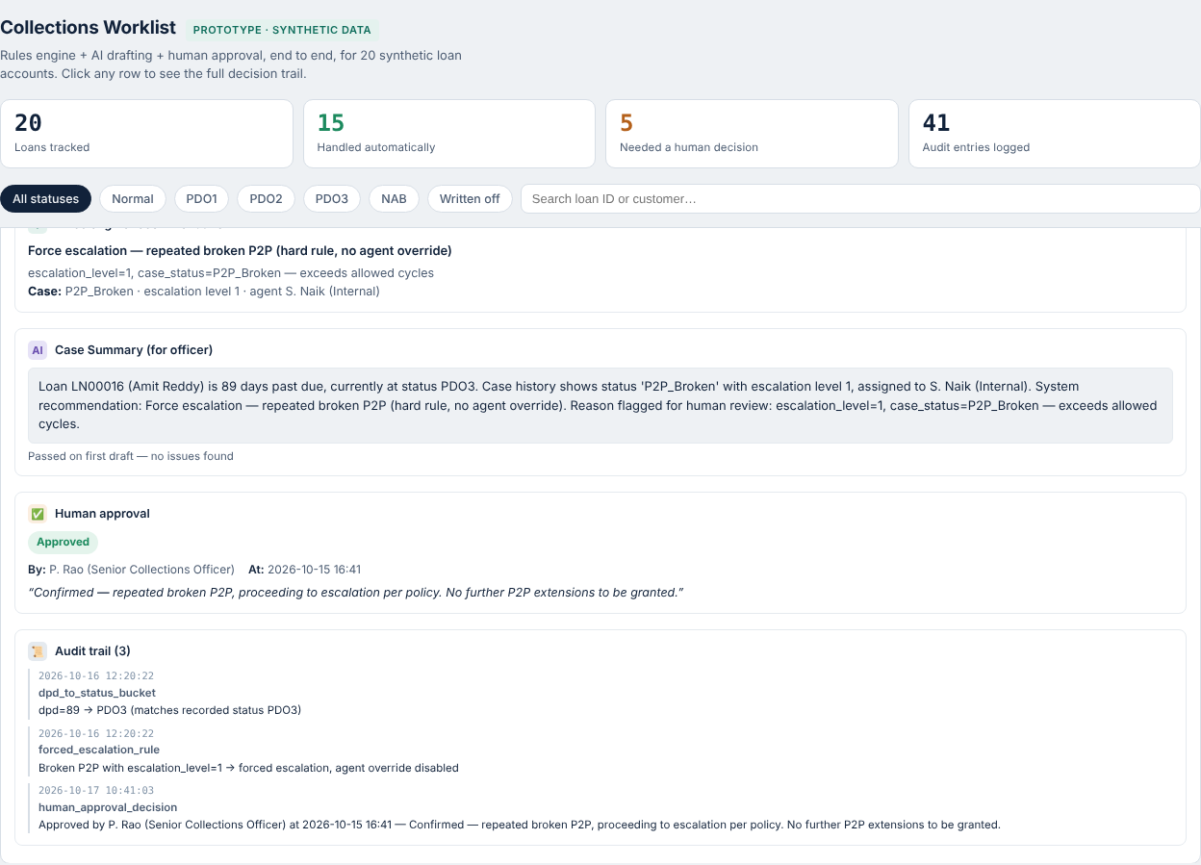
One click reveals the entire decision trail
Loan LN00016 — 89 days overdue
Rule fired: repeated broken promise-to-pay forces escalation, agent override disabled.
AI drafted: a neutral case summary for the reviewing officer.
Human approved: a named officer confirmed the escalation, with a logged comment.
Every step audited: timestamped, traceable, explainable — exactly what a bank's risk team would ask to see.
6

Slide 7
Risks considered, and how the design controls them
Risk | Control built into the prototype
Agents quietly re-extending broken promises | Hard rule forces escalation after policy threshold — no override field exists
AI drafting overly strong or premature language | Reflection step checks every draft; caught “legal action” language at PDO2 and softened it automatically
Decisions with no audit trail | Every rule firing and every human decision is timestamped and logged
Legal/financial actions taken without sign-off | Field visits, legal notices, moratoriums and write-offs are always Human-required, never automatic
Bureau reporting gaps | Engine checks NAB loans against the reporting log and flags any not yet reported
7

Slide 8
What this approach delivers
Illustrative figures from the 20-loan synthetic prototype — directionally what this design achieves at scale
75%
100%
0
1-click
of loans cleared automatically — no officer time spent
of decisions, automatic or human, logged with a reason
broken-promise cycles allowed to bypass policy
trail from rule to recommendation to approval
Why it matters: officers stop triaging the routine 75% and spend their time on the accounts that actually need judgment — the same shift that makes collections both more efficient and more consistent with RBI fair-practice expectations.
8

Slide 9
How it was built
1
Synthetic data
Excel workbook standing in for core banking + LMS: loan contracts, collection cases, payments, bureau log
2
Rules engine
Python encodes the DPD buckets and the hard escalation rule — agentic pattern: planning
3
AI drafting layer
Drafts reminders & case summaries, self-checks tone/compliance — pattern: reflection + revision
4
Approval + audit
Human-required items blocked until a named decision is logged — pattern: human-in-the-loop
5
Dashboard
Browser page joining every layer into one click-through worklist
9

Slide 10
Lessons learned and next steps
LESSONS LEARNED
NEXT STEPS
A hard rule in code is worth more than a soft guideline — it's what actually stops policy erosion
Reflection catches real problems: a draft message genuinely drifted into premature legal language
“Auto” should mean the system acts without approval, not that no human is ever involved
An audit trail turns “trust the AI” into “check the AI” — far more defensible to a risk team
Wire in a live LLM API call in place of the fallback drafter
Add the retention-offer logic for deposit/loan moratorium cases
Build project two: an Account Opening assistant, same 8-step method
Publish both projects on GitHub as a public portfolio
10

