Slide 1

Object Oriented Programming using Python
(Summer Training)
Submitted By :
Name : Pankaj Giri
Registration No. : 12204745

Slide 2


Comprehensive Testing & Assessment Platform with powerful Remote Proctoring abilities. Interactive Online Courses & Internships across a range of domains such as Computer Programming, Artificial Intelligence, Internet of Things, English Language Skills.

Slide 3
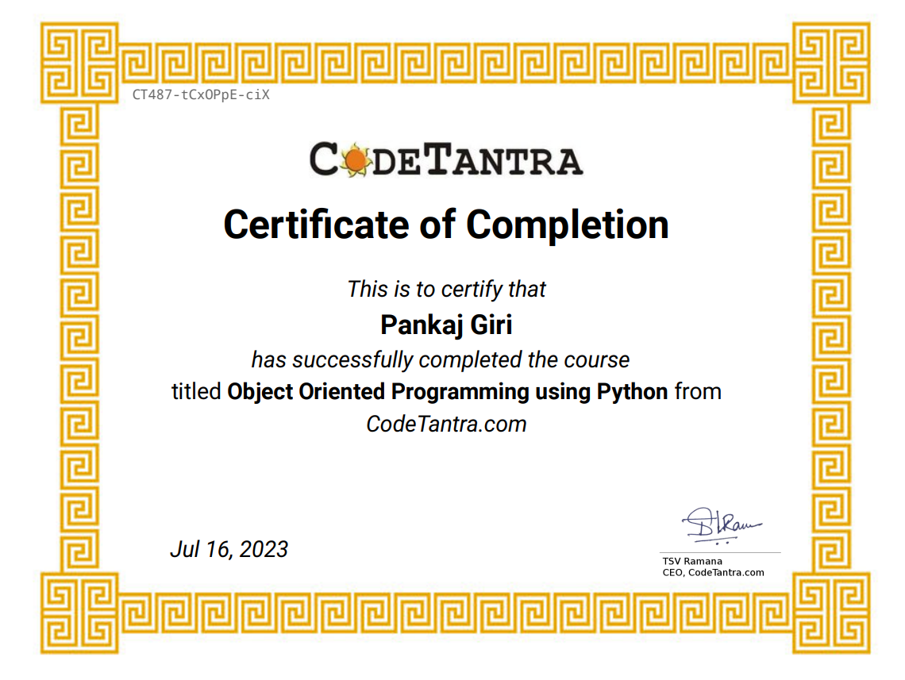

Slide 4
REASON FOR CHOOSE PYTHON
Python works on different platforms (Windows, Mac, Linux, Raspberry Pi, etc).
Easy to understand, learn and use. • Python has a simple syntax similar to the English language.
Requires less lines of code than other programming language.
Can be treated in a procedural way, an object-oriented way or a functional way.

Slide 5

Introduction to python
High Level Programming Language created by Guido Van Rossum.
Object Oriented Programming Language.
Multi-Purpose (Web, GUI, Scripting etc.).

Slide 6

Introduction to python
Interpreted and multi-paradigm programming language.
Strongly and dynamically typed.
Focus on readability and productivity.

Slide 7

OBJECT ORIENTED PROGRAMMING(OOP)
By creating objects to solve a programming problem is known as Object-Oriented Programming.
OOP uses the concept of objects and classes.
Widely used concept to write powerful applications
OOP is very simple in python but also powerful.

Slide 8

LEARNING CONTENTS
Classes &Objects
Strings
Lists
Tuple
Multi-Threading
Dictionary
Inheritance
Exception
Abstract Classes & Interface

Slide 9

PYTHON FEATURES
Easy To Learn
Expressive
High-Level
Free and Open Source
Portable
Object Oriented
Extensible
Embeddable
Interpreted
Large Standard Library
GUI Programming
Dynamically Typed

Slide 10

USES OF PYTHON
Developing desktop GUI applications.
On a server to create web applications and websites.
Software development.
To handle big data and perform complex mathematics.
System scripting.
Rapid prototyping and development .
Database access.

Slide 11
Project
Employee Management System (EMS)
Employee Management System is a application developed to maintain the details of employee working in any organization.
The EMS has been developed to override the problems prevailing in the practicing manual system.
It maintains the personal and official details of the employee.

Slide 12

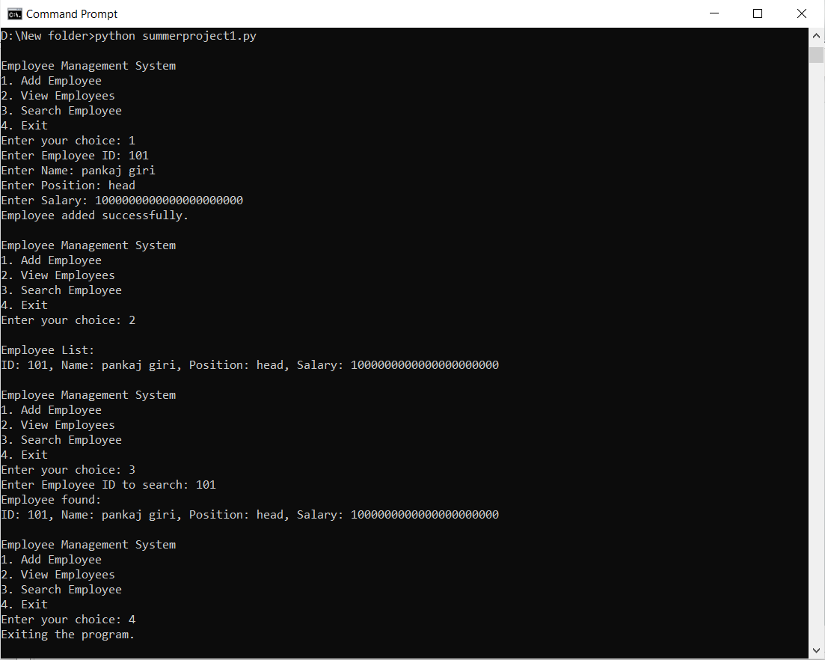
OUTPUT

Slide 13
CONCLUSION
Object Oriented Programming provides very flexible structures for our python program.
Python’s objects and functions are versatile .
The concept of OOP in python focuses on creating reusable code.
Python is awesome!

Slide 14

THANK YOU!

