Slide 1
INTERNSHIPSTUDIO ETHICAL HACKING

Slide 2
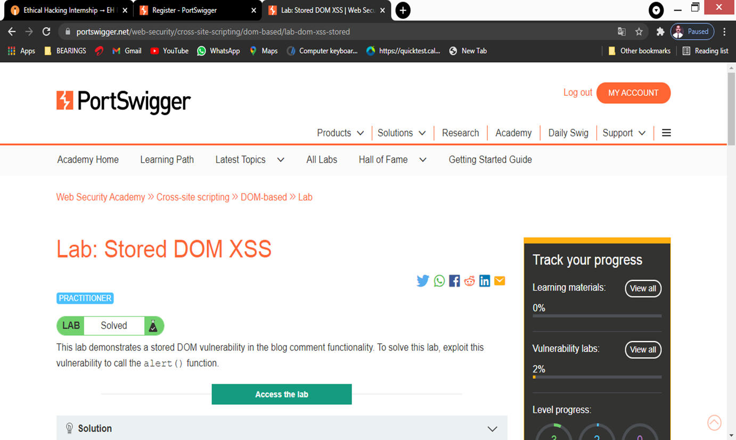
TASK 1

Slide 3
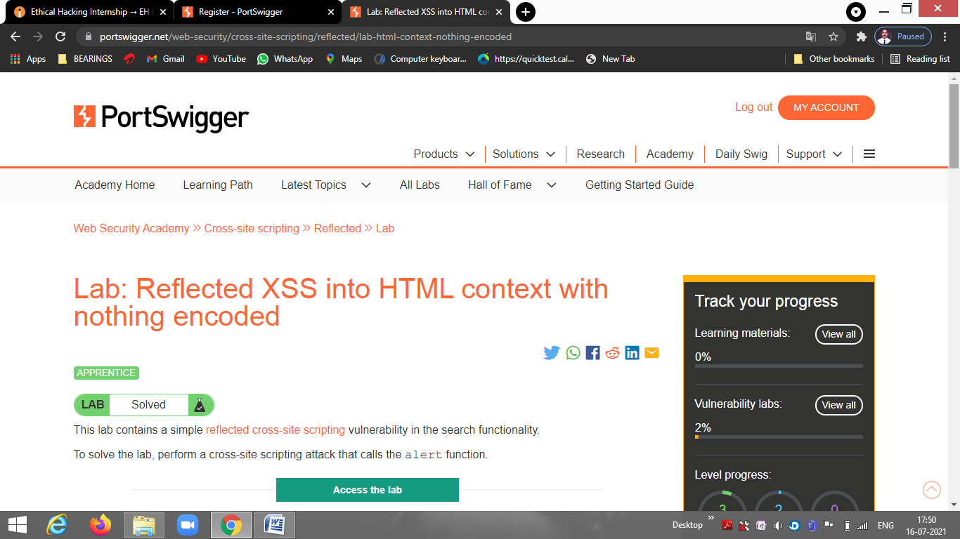

Slide 4
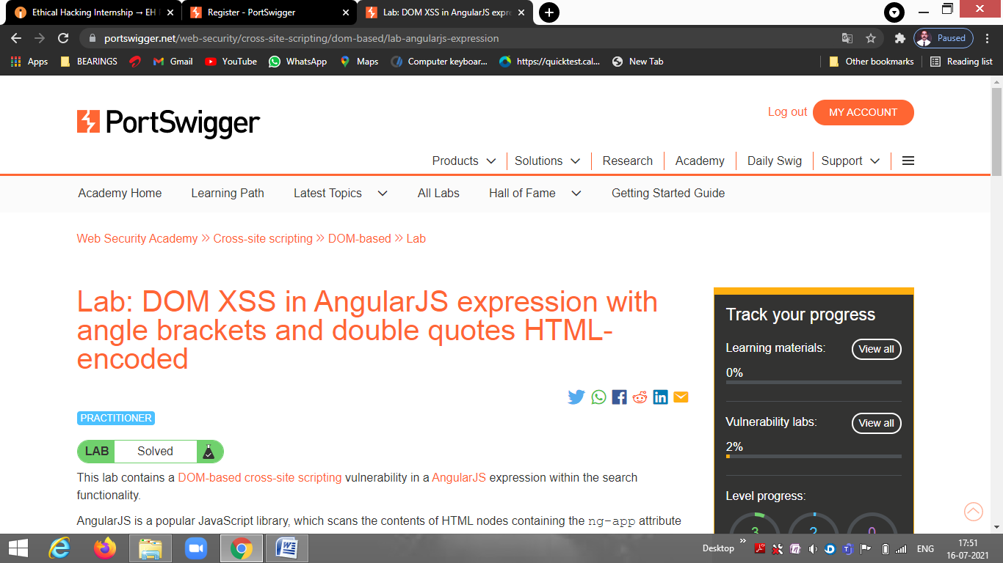

Slide 5
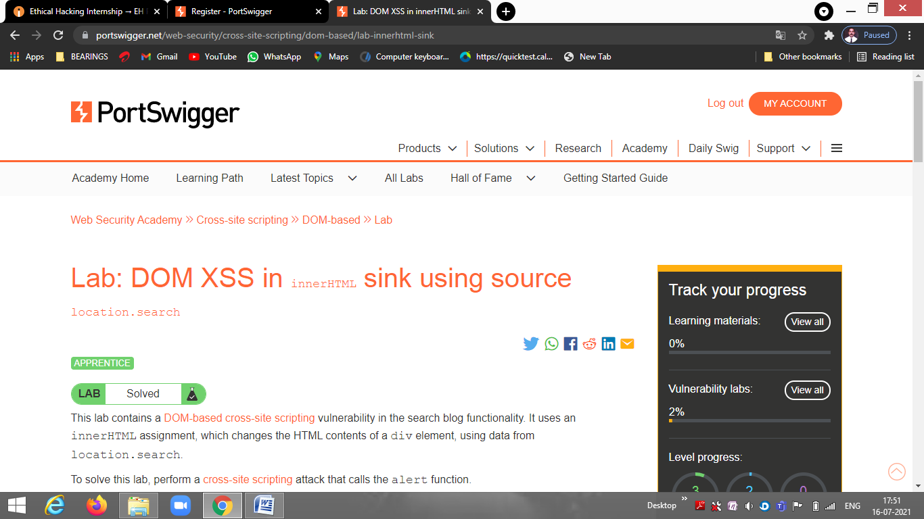

Slide 6
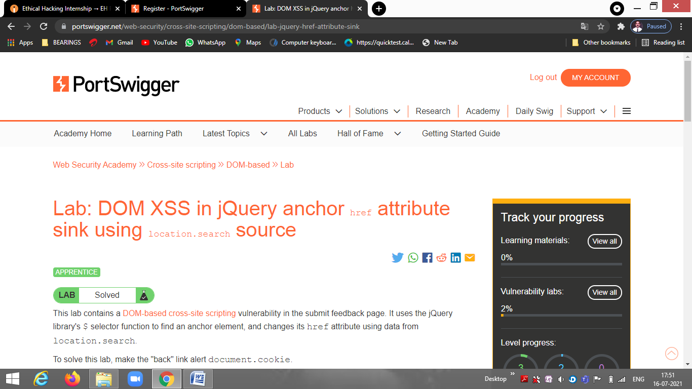

Slide 7
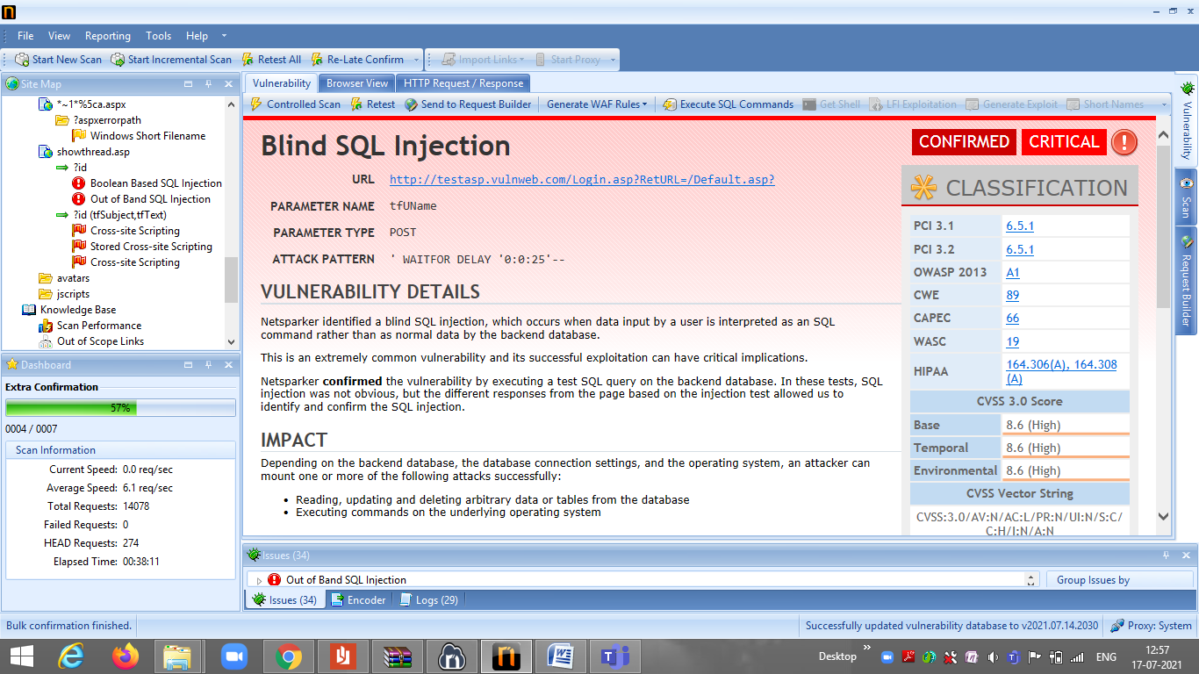
TASK 2

Slide 8
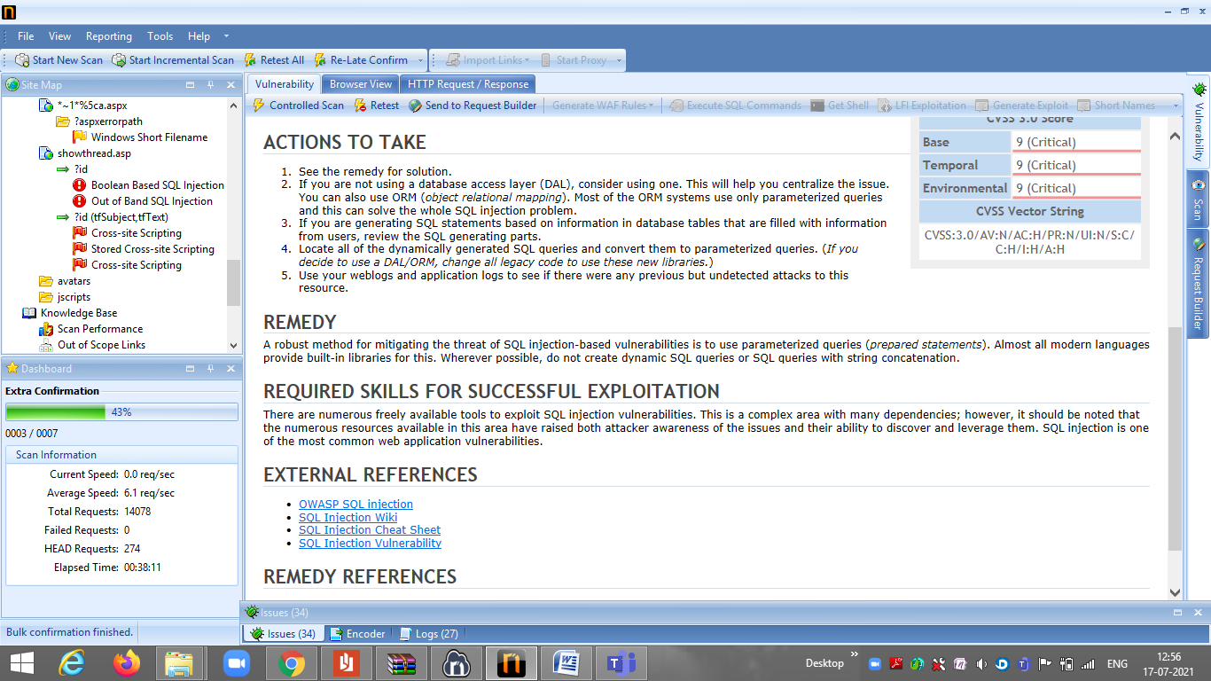

Slide 9
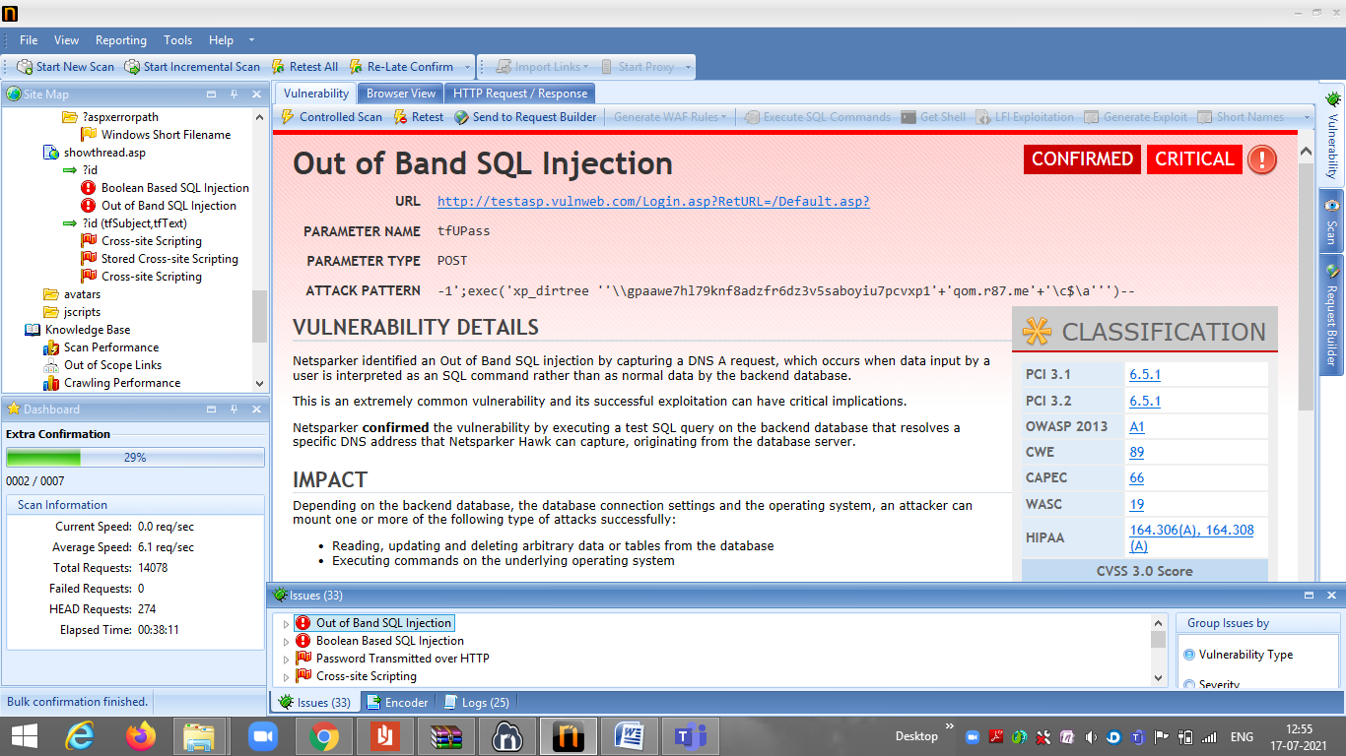

Slide 10
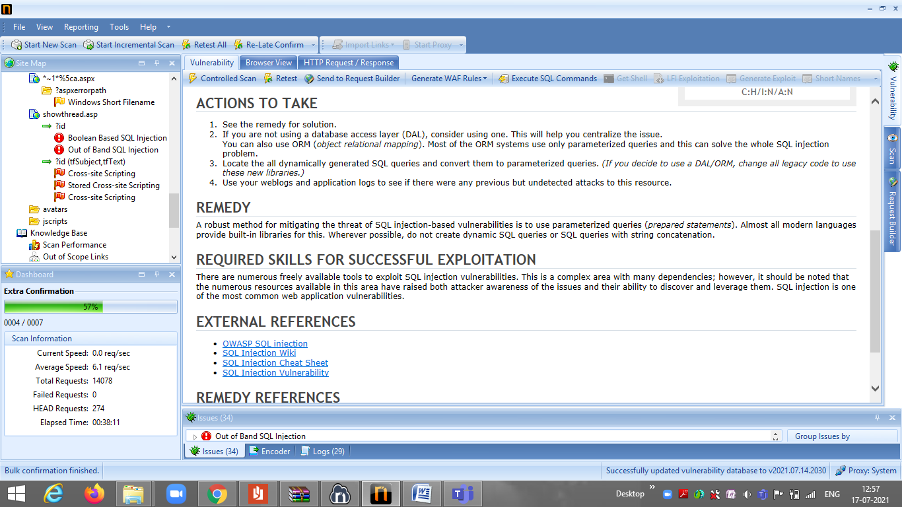

Slide 11
REPORT
Title: Boolean Based SQL Injection
Domain:http://zero.webappsecurity.com/
Steps to reproduce:
Step 1:Open netsparker
Step 2:Add Website you want to search the dialogue box.
Step 3:Define the customzation optiom to scan as per your need.
Step 4:It will start scanning it automatically
Step 5:Choose any one of the critical Vulnerabilities.
Step 6: Write Reports for the vulnerability you wanted to write.

Slide 12
IMPACT:
Depending on the backend database,the database connection settings and the operating system,an attacker can mount the various sttacks successfully like hacker can read,update and delete tables from the database and he can execute commands on the specific operating system.
SUMMARY:
Boolean-Based SQL Injection, which occurs when data input by a user is interpreted as a SQL command rather than as normal data by the backend database.

Slide 13
ATTACKS:
An attacker can execute the commands on that specified operating system.
And he can read,update and delete the data from database.
REMEDIES:
If we are not using a Dal ,the we have to consider the using one. We can use ORM(object relational mapping)
We can use weblogs,application logs to see if there were any previous but undetected attacks to this resource.
We have to locate all dynamically generated sql queries and convert them to parameterized queries.
Below are the screenshots of vulnerabilities

Slide 14
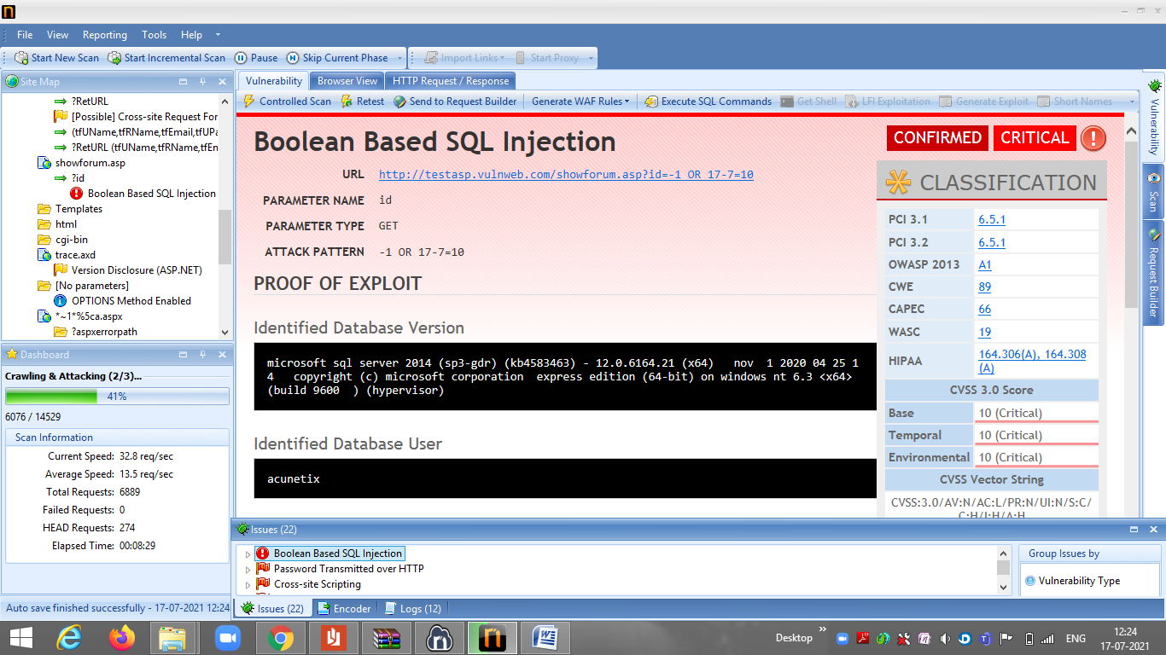

Slide 15
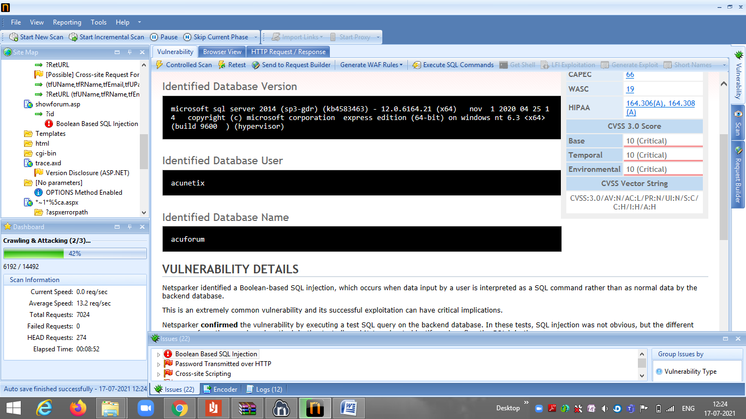

Slide 16
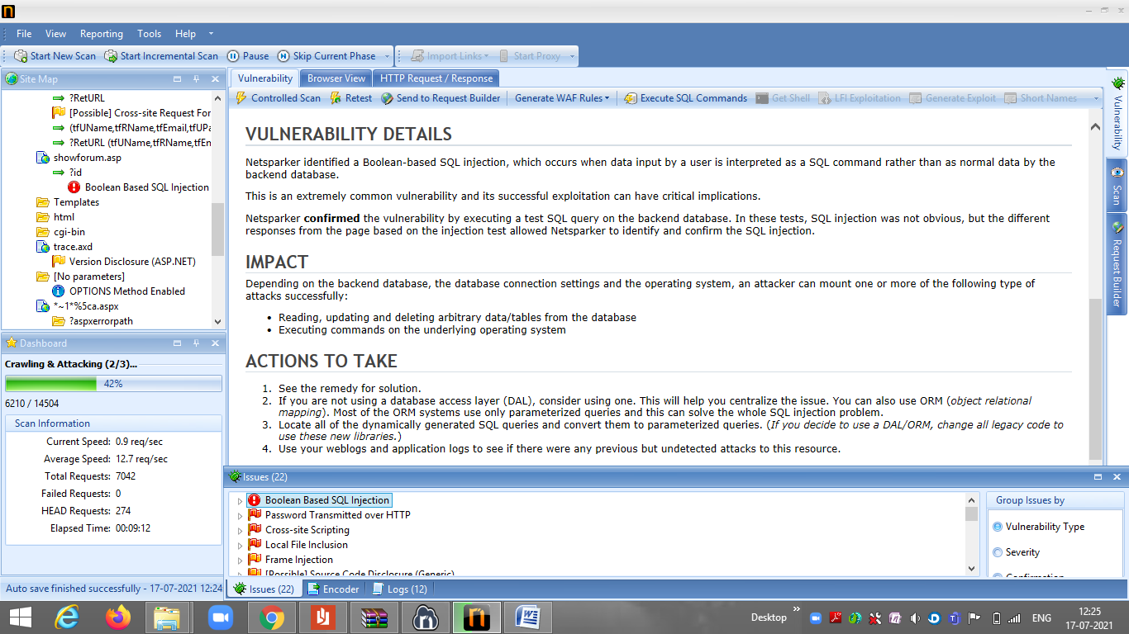

Slide 17
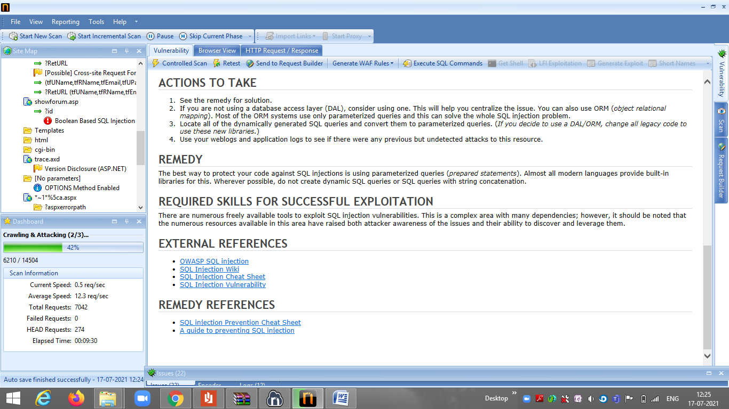

Slide 18
TASK 3 REPORT
Title: Cross Site Scripting
Domain:vulnweb.com
Subdomain: testasp.vulnweb.com
Steps to reproduce:
Step 1: Visit http://testasp.vulnweb.com/
Step 2: On the top menu you will find a search option.
Step 3: Click on it and you will be prompted with the Search box.
Step 4: You can intercept the request in Burp Suite
Step 5: Now you can find different payloads for XSS.
Step 6: Send the request to the intruder and paste all the payloads.
Step 7: Try to find a successful payload for XSS.
Step 8: Prepare a report for it.

Slide 19
Impact: Cross Site Scripting can be harmful for the website. It can lead to leakage of the data.
Remedy: If you want to prevent the vulnerable of cross site scripting then we need to enable noscript in the browser.
Below images are the screenshot of the website which found to be vulnerable.

Slide 20
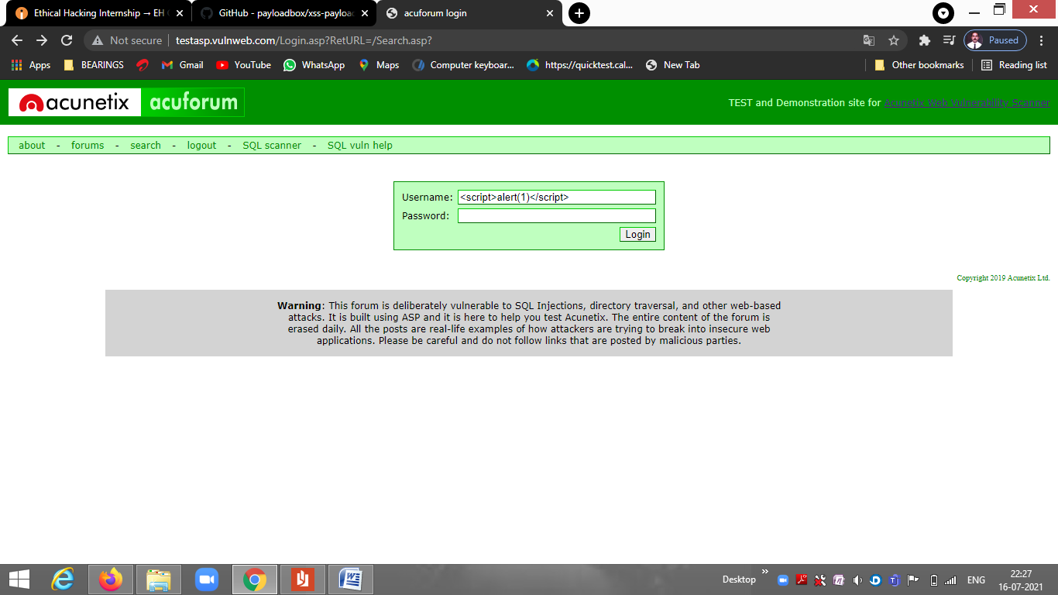

Slide 21
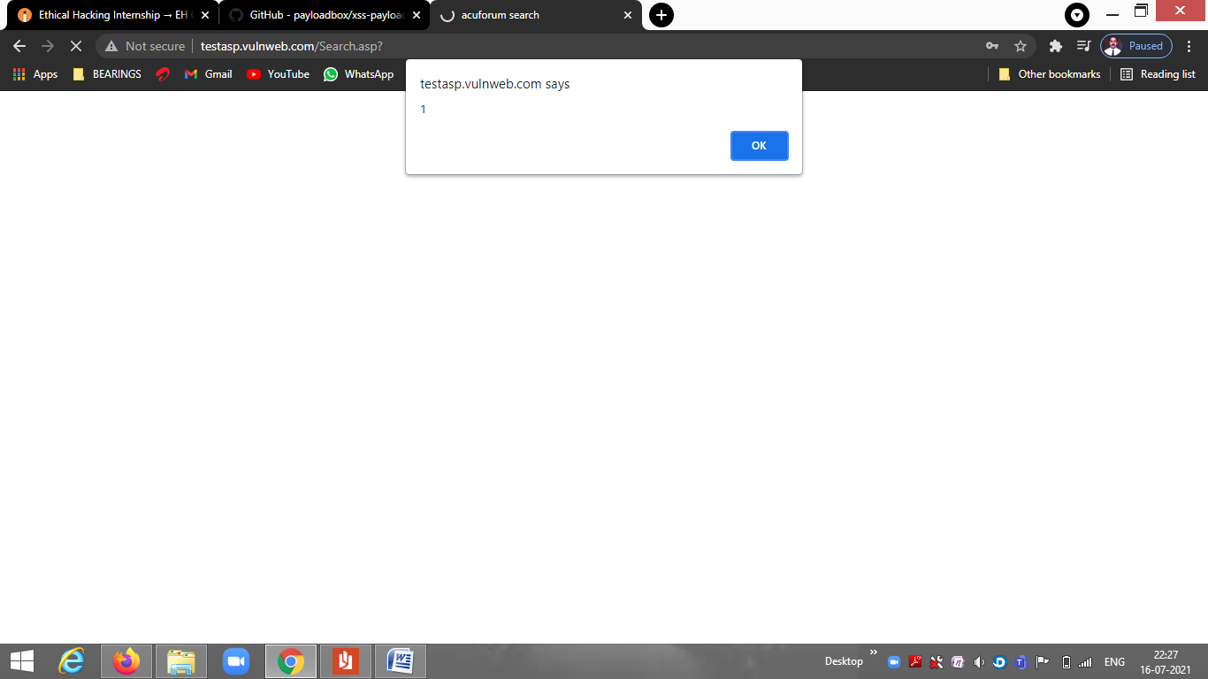

Slide 22
