Slide 1
CompTIA Network+
Network Infrastructure, Topologies and the OSI Model

Slide 2
What is a Network?
Interconnection of 2 or more devices.
Facilitate sharing of data between multiple nodes.

Slide 3
Key Features of Networks
Two or more computer systems linked by transmission media to share information
Networks are built to provide useful services
Sharing data and resources
Email and database applications
Web applications and social networking
Voice and multimedia conferencing
Network boundaries
Local Area Network (LAN)
Wide Area Network (WAN)

Slide 4
Network Infrastructure Implementations
Local Area Network (LAN)
Home network
SOHO (Small Office Home Office)
SME (Small and Medium Sized Enterprise)
Enterprise LAN - a larger network with hundreds or thousands of servers and clients
Campus Area Network (CAN)
Wireless LAN (WLAN)
Wide Area Network (WAN)
Internet
Intranet
Extranet
Metropolitan Area Network (MAN)

Slide 5
Personal Area Network (PAN)
Infrared (IrDA or IR)
4 Mbps up to about 1m or 3 feet
Requires line-of-sight
No longer widely supported
Bluetooth
3 Mbps up to about 10m (30 feet)
BT v3/4 High Speed up to 24 Mbps using an 802.11 radio link
Most PAN devices are based on Bluetooth connectivity
Near Field Communications (NFC)
Works at up to 2” / 6cm at data rates of 106, 212, and 424 Kbps
Used for contactless payment readers
Also used to configure other types of connection and for exchanging information

Slide 6
Network Components
Nodes, stations, and hosts
A node is a device communicating on the network via one or more interfaces
Can include endpoints such as computers
Can include forwarding nodes such as switches and routers
“Station” can be used instead of node when talking about wireless networks
Host typically refers to a computing device (not a switch or a router)
Transmission media - cabled or wireless links between nodes

Slide 7
Network Protocols
Rules for exchanging data
Addressing
Encapsulation
Header
Payload

Slide 8
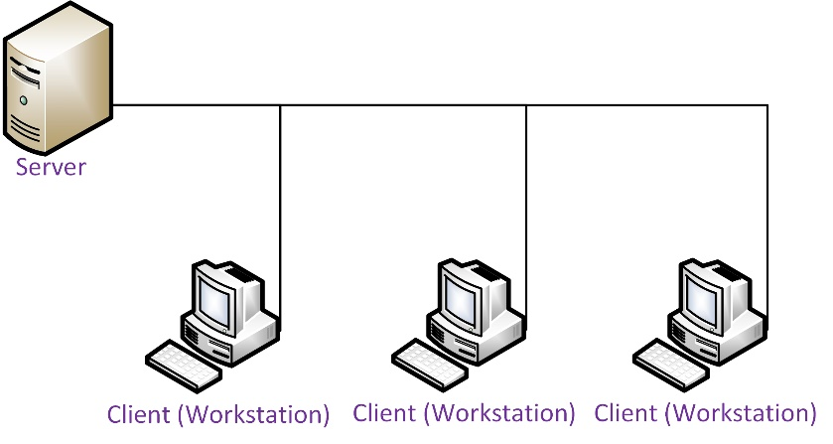
Clients and Servers
Types of server
Network services
File and Print
Application Servers
Messaging
Media
Server networks
Server and clients are distinct
Centralized administration
Scalable

Slide 9
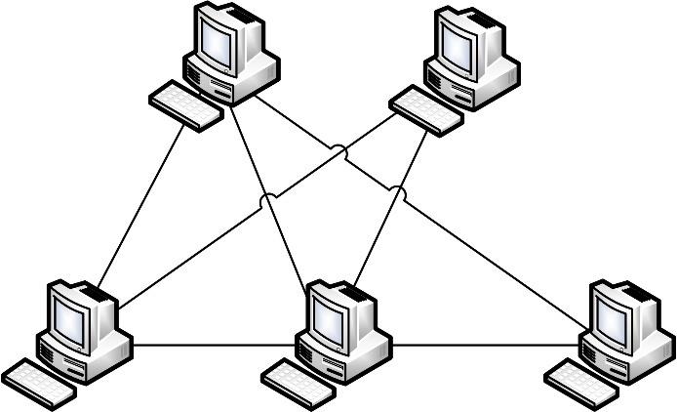
Peer-to-Peer Networks
Machines can be both server and client
Less reliable and more difficult to secure
Easy and cheap to set up but difficult to manage and expand

Slide 10
Network Topologies
Bus
Star
Mesh
Ring
Point-to-Point
Point-to-multipoint

Slide 11
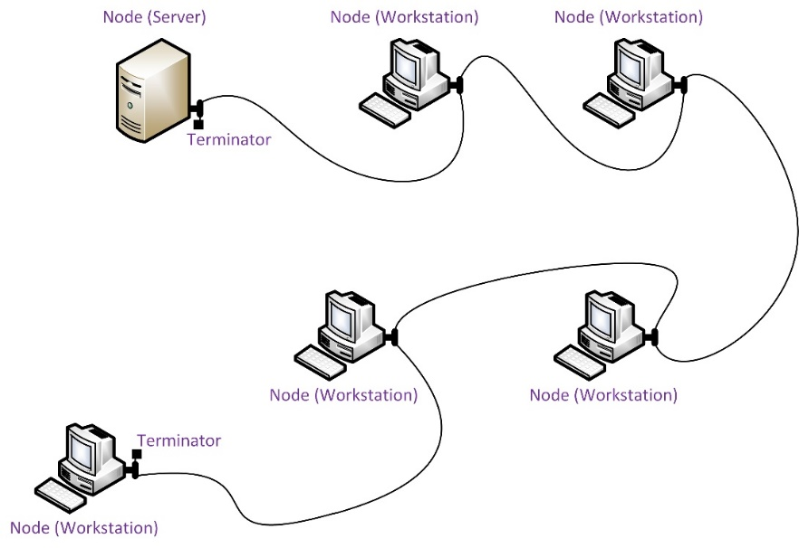
Bus Topology
Nodes attached to same cable segment
Single length of main cable
Multiple lengths of cable connected by repeaters
Shared access to media
Cabled bus is practically obsolete
Moving and adding nodes can cause problems for the whole network
Limited number of nodes
Cable faults cause problems for the whole network

Slide 12
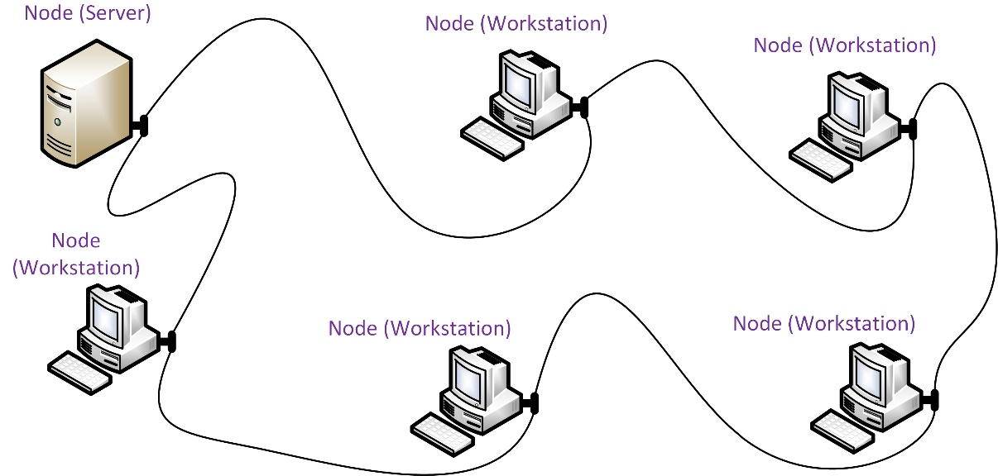
Ring Topology
Nodes are physically wired in a ring (closed loop)
Transmissions travel from node-to-node around the ring until reaching their destination
Transmission received from upstream neighbor
Transmission passed to downstream neighbor
Used on WANs

Slide 13
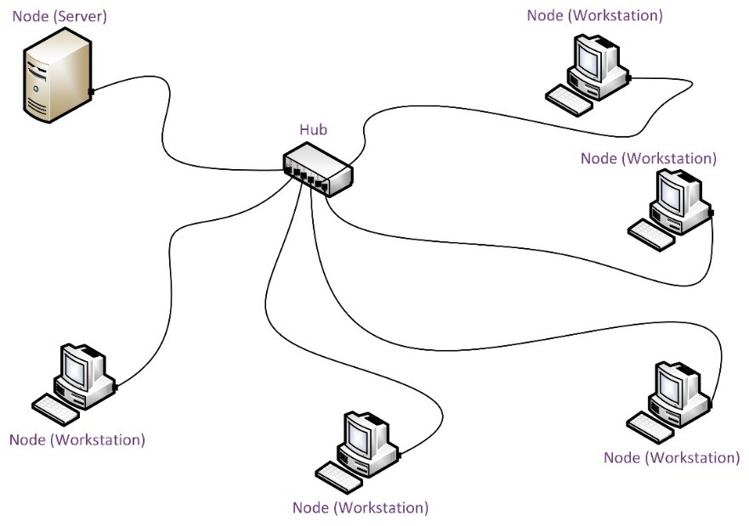
Star Topology
Endpoint nodes connected via a central forwarding node (hub, switch, or router)
Requires more cable but simpler to reconfigure
Cable faults are isolated to each hub port and easier to troubleshoot
Central node can be a single point of failure

Slide 14
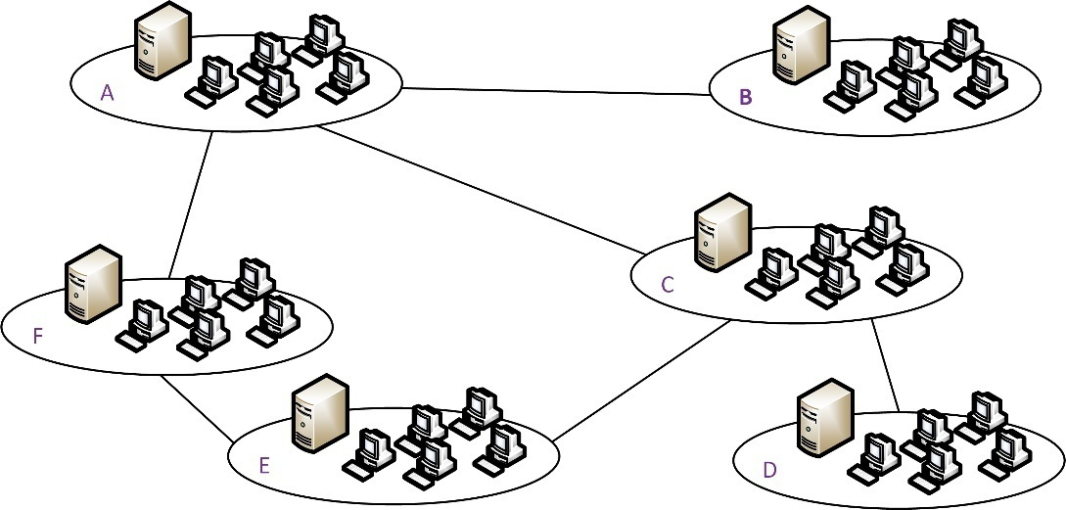
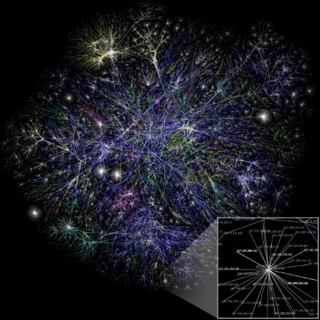
Mesh Topology
Full mesh means that each node is connected to every other node
n(n-1)/2 to calculate number of links required by ‘n’ nodes
Partial mesh more commonly deployed
Fewer physical links required
Nodes relay (route) communications to provide interconnections between all nodes
Provides redundancy and fault tolerance
Architecture of the Internet

Slide 15
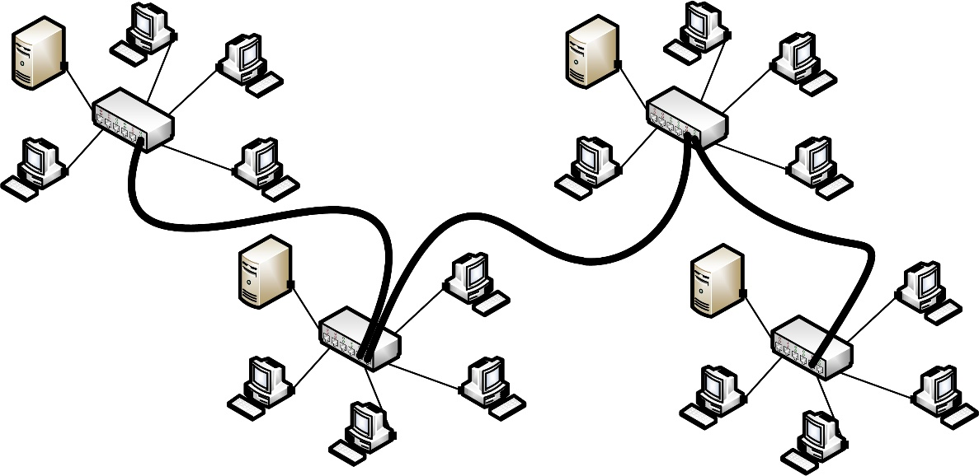
Hybrid Topologies
Different physical and logical topologies
Physical Star – Logical Bus
Star-wired Ring
Combine physical topologies
Tree / star-bus (join multiple star networks via a bus backbone)

Slide 16
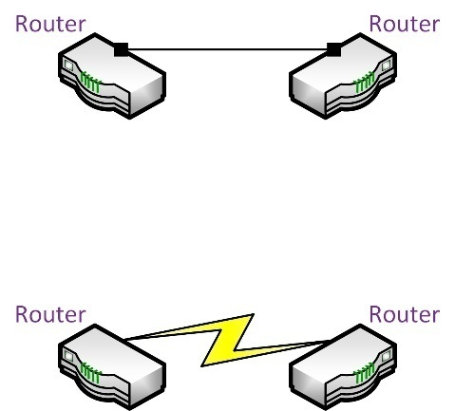
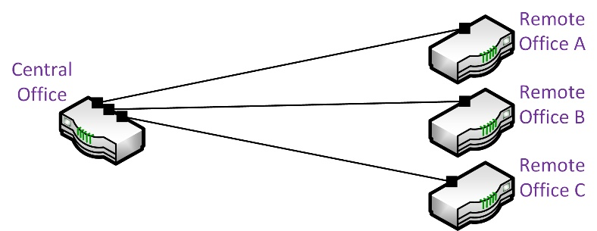
Point-to-Point and Multipoint Links
Point-to-point
One-to-one link
Physical point-to-point link (cable) or logical circuit
Point-to-multipoint
One-to-many link
Remote nodes communicate via a central node rather than establish direct links

Slide 17
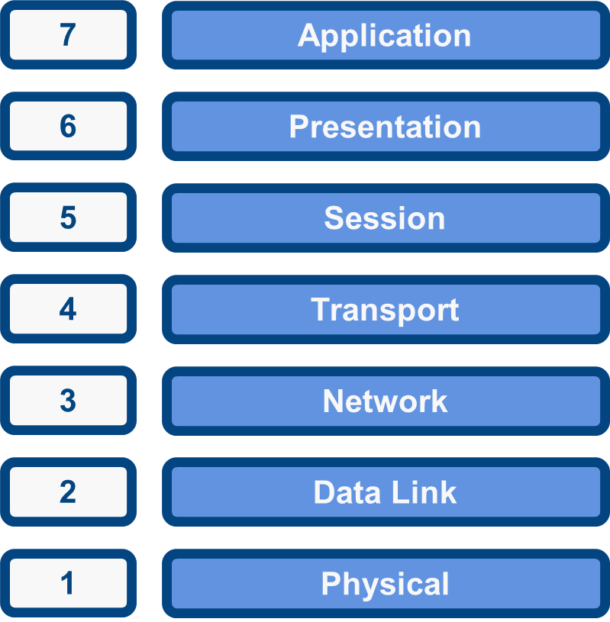
The OSI Model

Slide 18
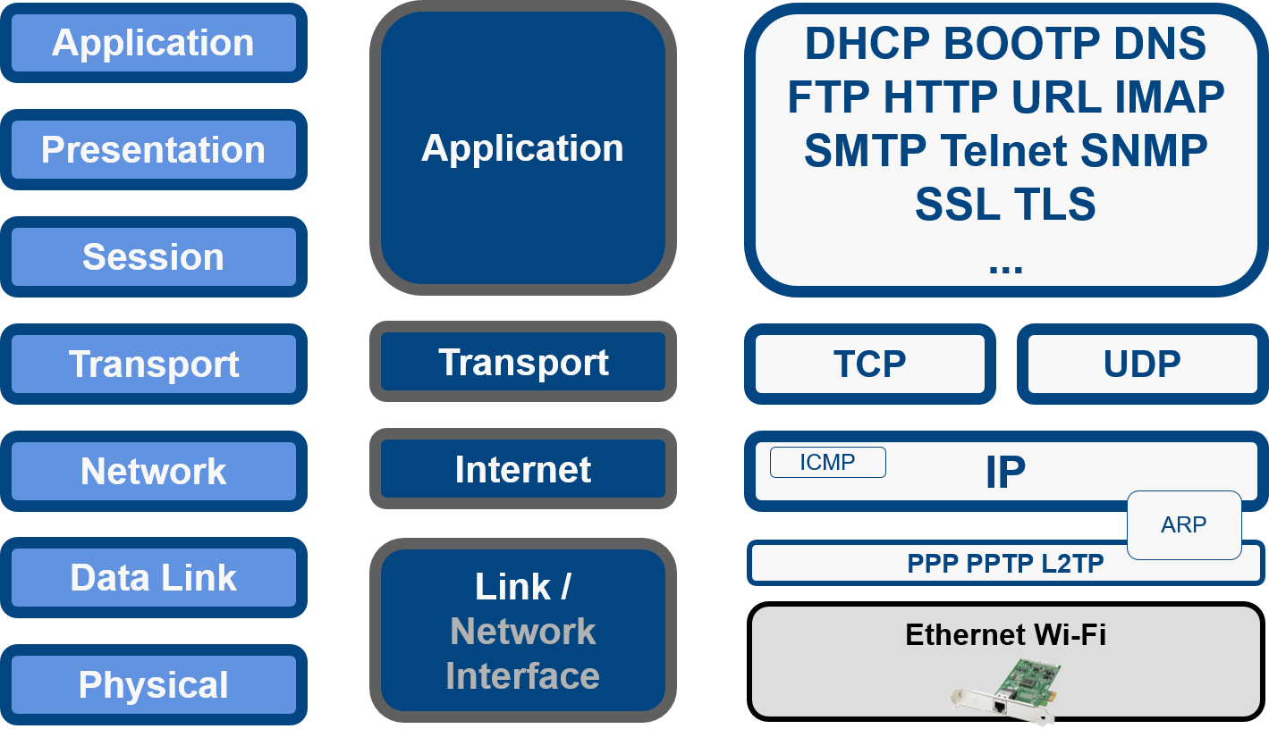
OSI Model and Network Protocols

Slide 19
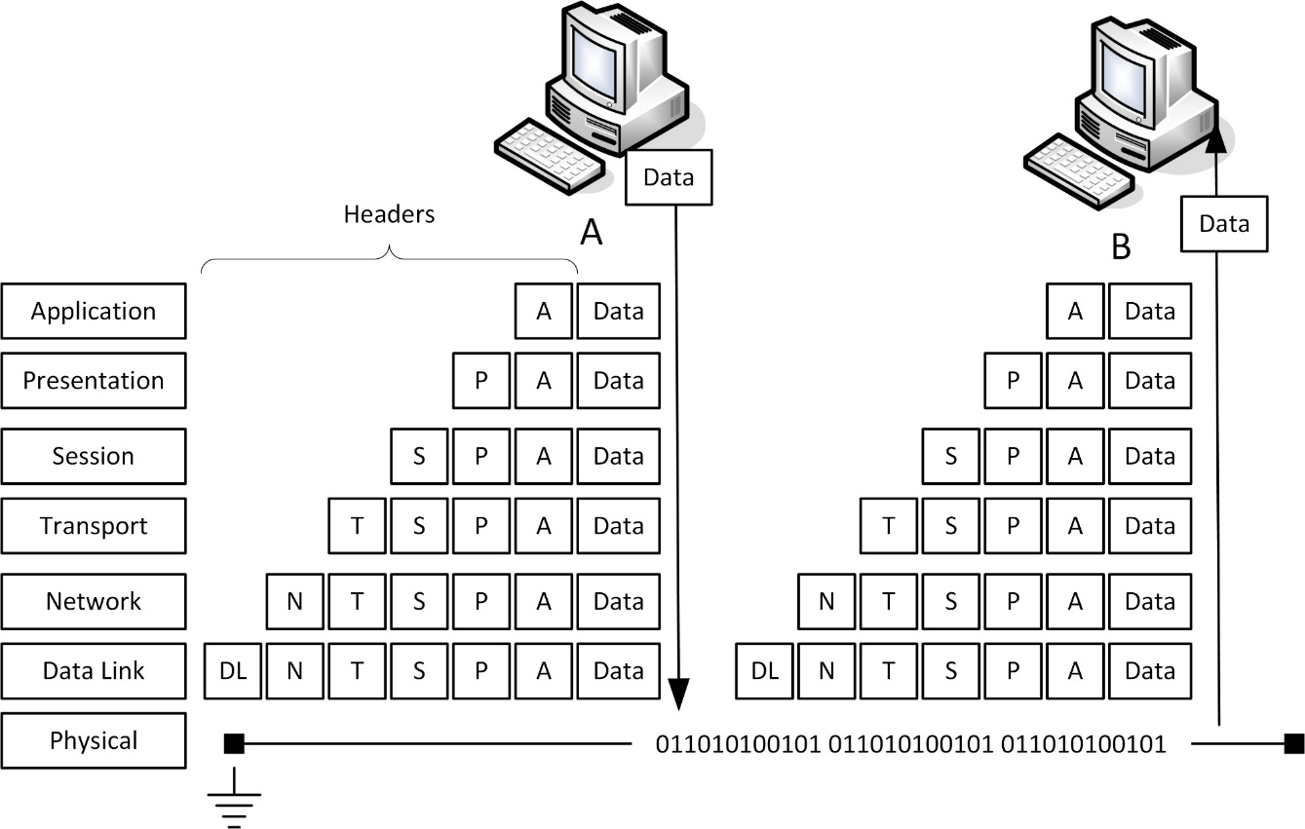
Encapsulation and De-encapsulation

Slide 20
Physical Layer
Physical topology
Mechanical specifications for the network medium
Cable specifications
Connector form factor and pin-outs
Radio transceiver specifications
Signaling (bit transmission / encoding)
Devices
Transceiver
Media converter
Hub / repeater
Modem

Slide 21
Data Link Layer
Organize bits into frames
Destination and source hardware addresses
Media Access Control (MAC) address
Error detection
Flow control

Slide 22
Network Layer
Moving data around a network of networks (internetwork / the Internet)
Logical addressing between networks
Routing
Route discovery
Path selection
Devices
Router
Layer 3 switch
Basic firewall

Slide 23
Transport Layer
UDP vs TCP
Reliable delivery
Connection establishment
Acknowledgements and negative acknowledgments
Segmentation and sequencing
Flow control
Unreliable (connectionless) delivery

Slide 24
Upper Layers
Divisions between “upper” layers less important in “real world” protocols
Session
Identify a sequence of messages belonging to the same “conversation”
Dialog control (simplex, half-duplex, duplex)
Presentation
Compression / decompression / encryption / decryption
Application
Application Programming Interfaces (API) for software programs

