Slide 1
Basic Network Devices
CompTIA Network+ Certification

Slide 2
Objectives
Install and configure hubs, bridges, and switches
Describe the purposes and functions of Virtual LANs (VLAN)
Understand the use of spanning tree to prevent switching loops
Notes:
The number in the bottom right corner of the slides refers back to the page where this topic starts in the course book.

Slide 3
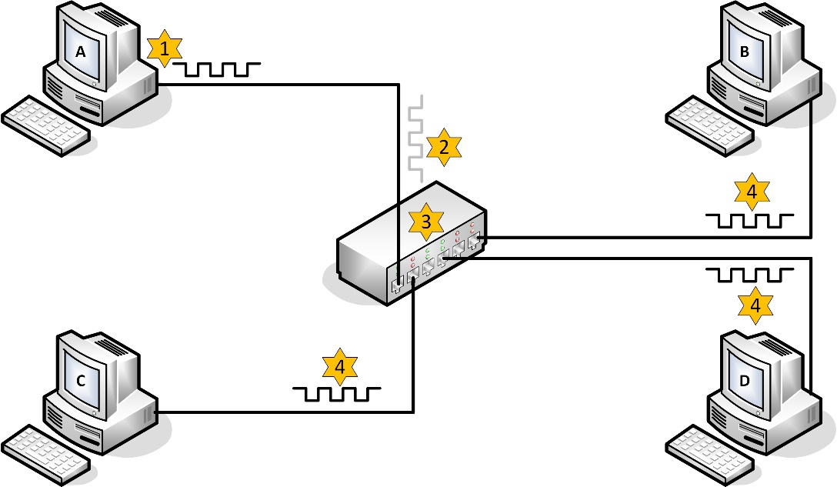
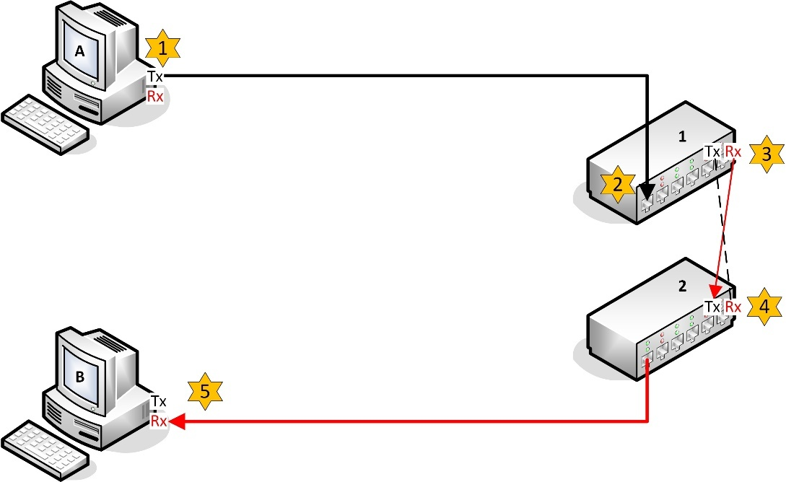
Hubs
Basis of shared Ethernet (physical star – logical bus)
Multiport repeater
Regenerate and repeat an incoming transmission over all ports (except the source port)
All ports in same collision domain

Slide 4
Bridges
Legacy Ethernet devices used to segment networks and reduce contention
Operate at data link layer
Can also join segments using different media (e.g. coax to twisted-pair)

Slide 5
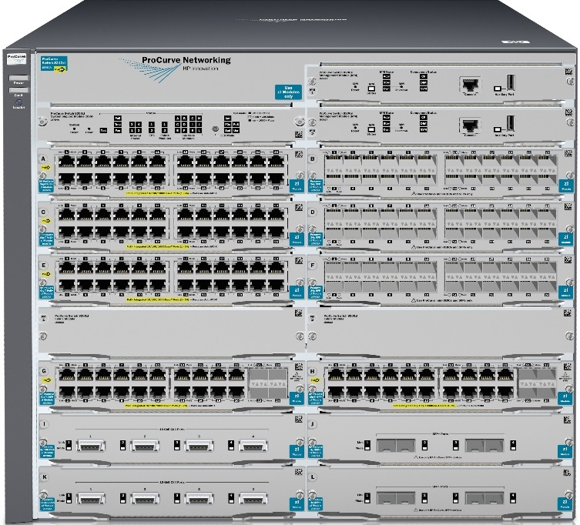
Switches
Basis of switched Ethernet
Replaced hubs and bridges
Microsegmentation
Switch establishes point-to-point links between nodes
The collision domain is reduced to the link between a single node and the switch (i.e. NO collisions are possible if port is configured for full duplex)
MAC address table / Content Addressable Memory (CAM)
Wide range of devices for residential or Small Office Home Office (SOHO) up to enterprise use

Slide 6
Managing Switches
Managed vs unmanaged
Management interface
Console port / Command Line Interface (CLI)
Management port (connect over IP network)
Web interface using HTTP / HTTPS
Virtual terminal over Telnet / SSH (CLI)
Network management (SNMP [Simple Network Management Protocol])
In-band vs out-of-band
Management accounts
Users / passwords configured on each device
AAA (Authentication, Authorization, and Accounting) configuration for centralized account management and authorization

Slide 7
Switch Interface Configuration
Speed and duplex mode
Autonegotiation – switch and adapter negotiate connection parameters (speed / duplex)
IP address assignment
Default gateway

Slide 8
Virtual LANs (VLAN)
Create separate broadcast domains
VLAN assignment
Static (port-based)
Dynamic (assign by host MAC, IP, authentication, etc)
Traffic between VLANs must be routed
Create zones for security / administration

Slide 9
Power over Ethernet (PoE)
Supplies electrical power to devices over Ethernet cable
Suitable for IP phones, wireless access points, thin clients, IP cameras, etc
802.3af – 13W
802.3at – 25W (PoE+)
Supplying device (e.g. switch) is Power Sourcing Equipment
PoE switch is an end-span
Power injector is a mid-span
Mode A (phantom power) and Mode B

Slide 10
Network Devices
Modems
Repeater
NIC
Wireless NIC
Access Point
Firewall

Slide 11
Server Types
DHCP
DNS
DC
Exchange

