Slide 1

Topologies,
Connectors, and
Wiring Standards

Slide 2
OBJECTIVES
Categorize standard cable types and their properties
Identify common connector types
Given a scenario, differentiate and implement appropriate wiring standards
Install components of wiring distribution

Slide 3
PHYSICAL MEDIA
The three types of popular cables used in modern networking designs:
  Coaxial
  Twisted pair
  Fiber optic

Slide 4
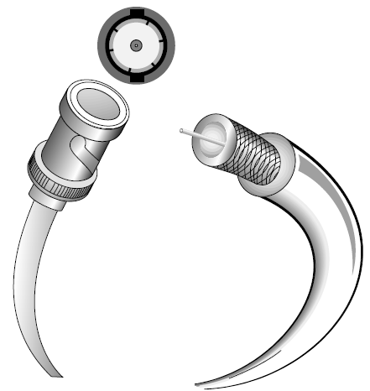
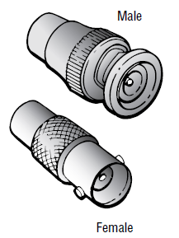
COAXIAL CABLE
Thin Ethernet, also referred to as Thinnet or 10Base-2, is a thin coaxial cable. It is basically the same as thick coaxial cable except it’s only about 1⁄4 in diameter. Thin Ethernet coaxial cable is Radio Grade 58 or just RG-58.

Slide 5
COAXIAL CABLE
Coaxial Cable Specifications
RG Rating | Popular Name | Ethernet Implementation | Type of Cable
RG-58 U | N/A | None | Solid copper
RG-58 A/U | Thinnet | 10Base-2 | Stranded copper
RG-8 | Thicknet | 10Base-5 | Solid copper
RG-59 | Cable television Low cost, short distance | N/A | Solid copper
RG-6 | Cable television, cable modems Longer distances than RG-59; some power implementations | N/A | Solid copper
RG-62 | ARCnet (obsolete) | N/A | Solid/stranded

Slide 6
TWISTED-PAIR CABLE
Twisted-pair cable consists of multiple individually insulated wires that are twisted together in pairs. Sometimes a metallic shield is placed around them; hence the name shielded twisted pair (STP). Cable without outer shielding is called unshielded twisted-pair (UTP), and it’s used in twisted-pair Ethernet (10Base-T, 100Base-TX, 1000Base-TX) networks.

Slide 7
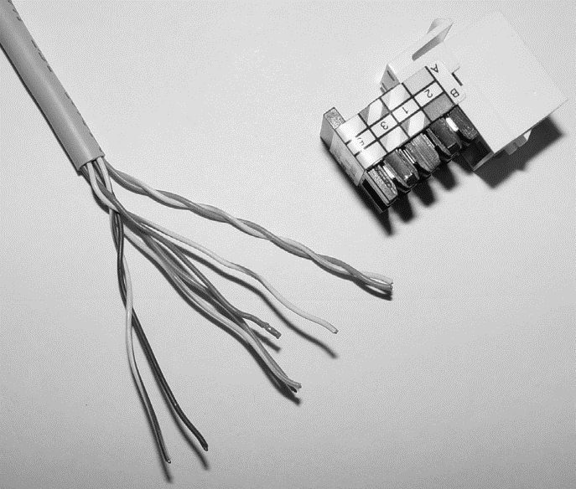
ETHERNET CABLE DESCRIPTIONS
This cable type is the most common today for the following reasons:
  It’s cheaper than other types of cabling.
  It’s easy to work with.
  It allows transmission rates that were impossible 10 years ago.

Slide 8
FIBER-OPTIC CABLE
Here are the pros:
  Is completely immune to EMI and RFI
  Can transmit up to 40 kilometers (about 25 miles)
And here are the cons:
  Is difficult to install
  Is more expensive than twisted-pair
  Troubleshooting equipment is more expensive than twisted-pair test equipment
  Is harder to troubleshoot

Slide 9
SINGLE-MODE FIBER
Single-mode fiber-optic cable (SMF) is a very high-speed, long-distance media that consists of a single strand—sometimes two strands—of fiber glass that carries the signals. Light emitting diodes (LEDs) and laser are the light sources used with SMF.
The light source is transmitted from end to end and pulsed to create communication.

Slide 10
MULTIMODE FIBER
Multimode fiber-optic cable (MMF) also uses light to communicate a signal; but with it, the light is dispersed on numerous paths as it travels through the core and is reflected back. A special material called cladding is used to line the core and focus the light back onto it. MMF provides high bandwidth at high speeds over medium distances (up to about 3,000 feet), but beyond that it can be really inconsistent.

Slide 11
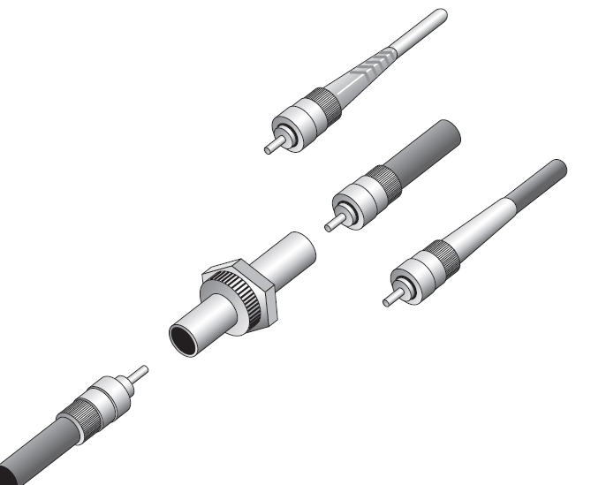
FIBER-OPTIC CONNECTORS
The ST fiber-optic connector (developed by AT&T) is one of the most widely used fiber-optic connectors; it uses a BNC attachment mechanism similar to Thinnet’s that makes connections and disconnections fairly frustration free.

Slide 12
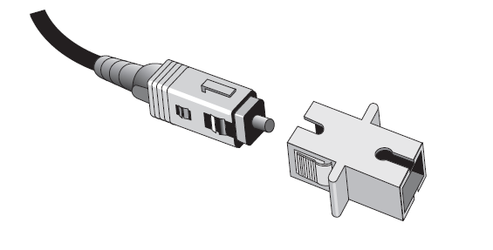
FIBER-OPTIC CONNECTORS
The SC connector is another type of fiber-optic connector. SC connectors are latched—a mechanism holds the connector in securely and prevents it from falling out.

Slide 13

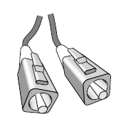
SMALL FORM FACTOR FIBER-OPTIC CONNECTORS
Another cool fiber-optic connector is the small form factor (SFF) connector, which allows more fiber-optic terminations in the same amount of space than its standard-sized counterparts.
The two most popular versions are the mechanical transfer registered jack (MT-RJ or MTRJ), designed by AMP, and the Local Connector (LC), designed by Lucent.

Slide 14
SERIAL CABLES
RS-232
USB

Slide 15
PROPERTIES OF CABLES
Transmission Speeds
Distance
Duplex
Noise Immunity (Security, EMI)
Frequency

Slide 16
WIRING STANDARDS
Straight- through cable (586A)
Crossover cable (586B)
Rolled cable (rollover)
Hardware loopback

Slide 17
SUMMARY
Understanding all those types of wires and cabling, along with their unique capacities, their associated standards, and the right connectors to use with them plus where to place them is integral to having a solid, foundational understanding of the things that make a great network run quickly and reliably.

