Slide 1
Internet Protocol

Slide 2
Binary / Decimal Conversion
Number bases
Place value
Base 10 (Decimal)
Base 2 (Binary)
Converting between binary and decimal

Slide 3
Subnet Masks
IP address represents both a network ID and host ID
A mask is applied to identify the network and host portions
A “1” in the mask means corresponding bit in the address is part of the network ID
“1”s in mask must be contiguous
11111111 11110000 00000000 00000000 – VALID
11111111 00000000 11110000 00000000 - INVALID

Slide 4
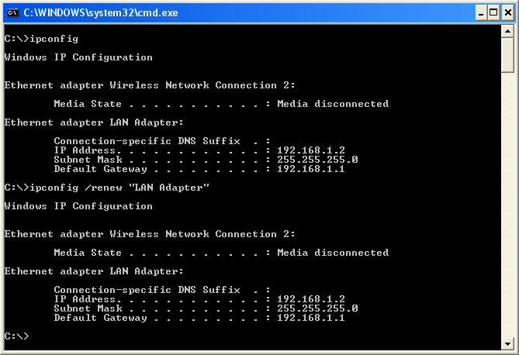
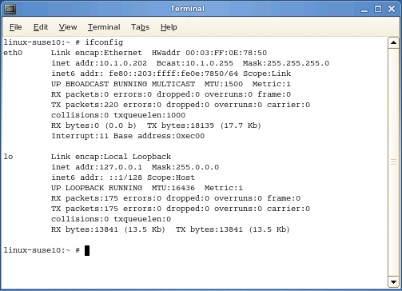
ipconfig / ifconfig

Slide 5
IP Routing Basics
Default gateway
Routing decision
Route selection / route table
Fragmentation

Slide 6
ICMP
Internet Control Message Protocol (ICMP)
Message types
Destination unreachable
Time exceeded
Redirect

Slide 7
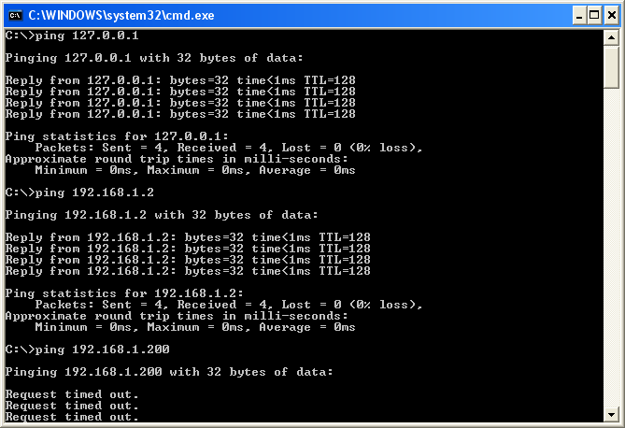
ping
ping IPAddress | HostName
Reply from, round trip time and packet loss
Detect whether a link is slow or experiences packet loss
Use tracert to identify where on the route there is a problem
Destination unreachable
No route to host
Check IP configuration
Check router (default gateway)
No reply / timed out
Host / interface is down
Host cannot route reply
Firewall

Slide 8
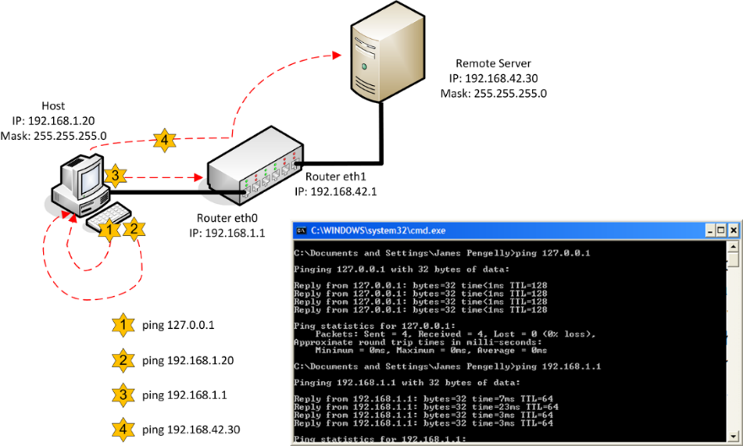
Interpreting ping Output
Ping the loopback address (ping 127.0.0.1)
Ping the host’s IP address
Ping the IP address of the default gateway
Ping the IP address of a remote host

