Slide 1
IP ADDRESSING
Distinguish unicast, broadcast, and multicast addressing
Understand IP addressing schemes, including address classes, subnetting, classless addressing, and supernetting/CIDR
Identify address ranges for private networks
Configure an IP address scheme for a private network
Notes:
The number in the bottom right corner of the slides refers back to the page where this topic starts in the course book.

Slide 2
BROADCAST, MULTICAST, AND UNICAST
Unicast (one-to-one)
Broadcast (one-to-all)
Multicast (one-to-many or many-to-many)

Slide 3
Difference between Ipv4 & ipv6
Ipv4
32 bit
Numerical (Decimal)
192.168.10.1
Unicast, Multicast, Broadcast
Use in Local public users
Less secure then IPv6
IPv6
128 bits
Alphabetica+Numerical (Hexa-Decimal)
20af:fe5c:5e44:0000:00af:c3a0:adfc:fc80
Unicast, Multicast, Broadcast, Any cast
All Research org.
High Secure

Slide 4
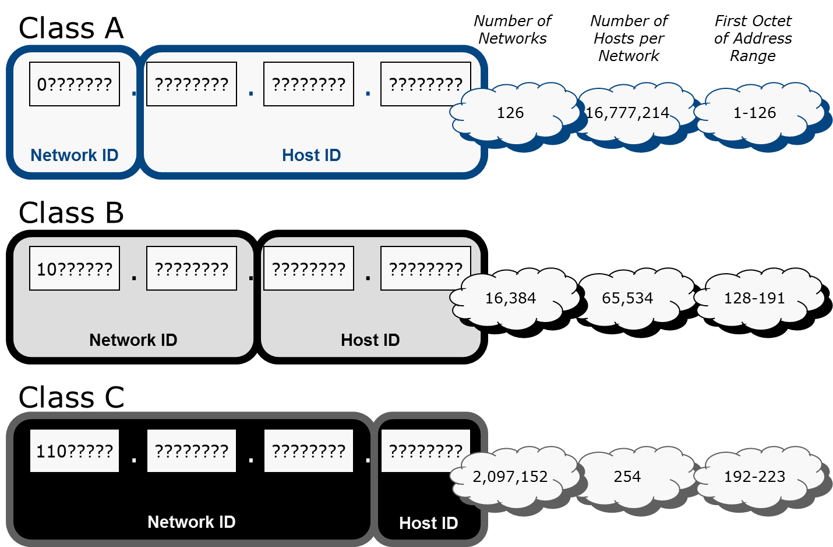
CLASSFUL ADDRESSING

Slide 5
CLASS D AND CLASS E ADDRESSES
Class D
Multicast addresses
224.0.0.0 through 239.255.255.255
Class E
Experimental / reserved
240.0.0.0 through 255.255.255.255

Slide 6
PRIVATE ADDRESSING
Address ranges not routable over the Internet
10.0.0.0 to 10.255.255.255
172.16.0.0 to 172.31.255.255
192.168.0.0 to 192.168.255.255
169.254.0.0 to 169.254.255.255
Used by hosts for link-local autoconfiguration / Automatic Private IP Addressing (APIPA)
Hosts on the private network must use some mechanism to access the Internet
Network Address Translation (NAT)
Proxy

Slide 7
SUBNETWORKS
Split up broadcast domains
Reduce broadcast traffic to improve performance
Implement VLANs at layer 2
Map each VLAN to a logical subnet ID
Identify physically distinct networks as logically separate
Join segments with different topologies (Ethernet and Token Ring)
Map each segment to separate logical subnet IDs
Assign subnet ID to each WAN link
Create logically distinct zones for security and administration

Slide 8
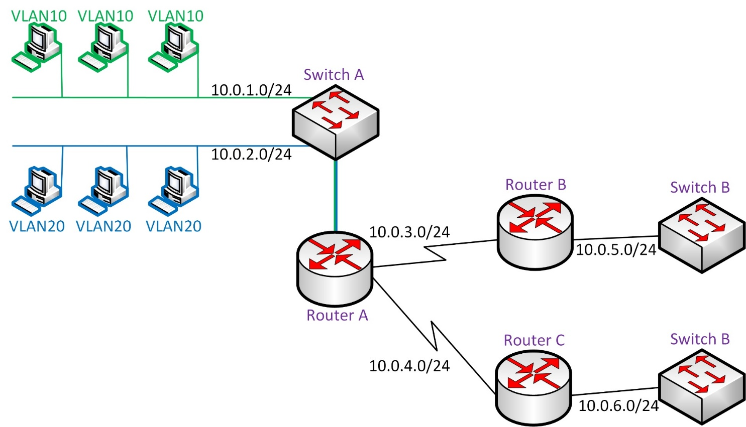
SUBNET DESIGN EXAMPLE

Slide 9
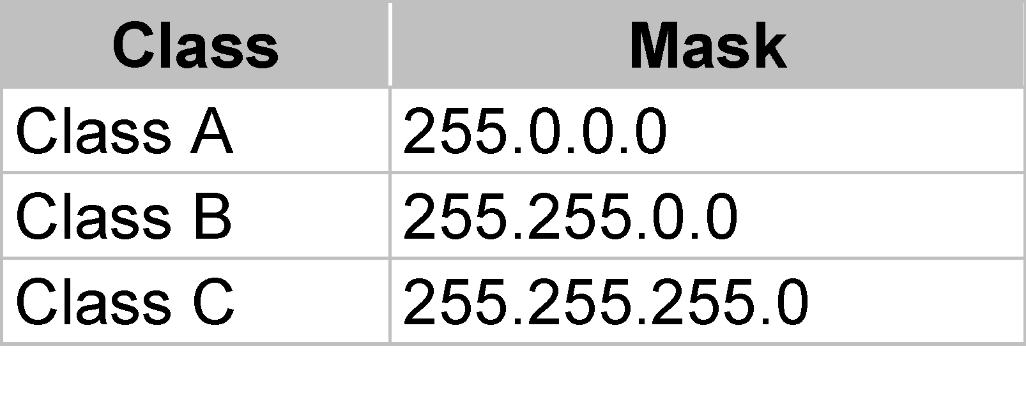
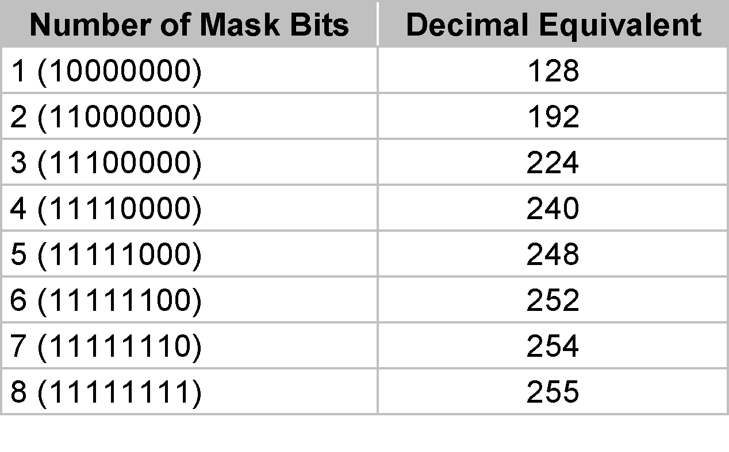
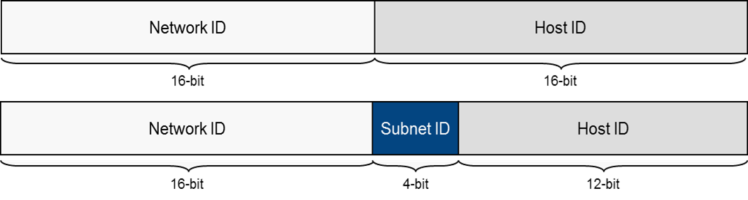
SUBNETTING
Default subnet masks
Aligned along octet boundaries
Use old class terminology
Custom subnet masks
Modify a default mask
Allocate host bits to extra mask bits

Slide 10
CLASSLESS ADDRESSING
Forget about address classes and octet boundaries and assign a network prefix
Network prefix can still be represented as subnet mask
Alternatively the prefix can be written in slash notation
/nn – number of bits in the mask
More compact and easy to understand
New (unofficial) meaning for address “classes”
Class A network = /8
Class B network = /16
Class C network = /24

Slide 11
PLANNING AN IPV4 ADDRESSING SCHEME (1)
Consider
Whether you need a public or private addressing scheme
How many networks you need
How many subnetworks you need
How many hosts per subnet
Addressing Rules
Network ID cannot be 127
Network and / or host IDs cannot be all 255 (all 1s in binary)
Network and / or host ID cannot be 0 (all zeros in binary)
Host ID must be unique in the subnet
Network ID must be unique
On the Internet (if using a public addressing scheme)
On your internal system of networks (if using a private addressing scheme)

Slide 12
PLANNING AN IPV4 ADDRESSING SCHEME (2)
Work out how many subnets are needed
Must be a power of 2
Exponent (the value of “^{n}” in 2^{n}) is the number of bits to add to the default network prefix
Check that subnets allow for sufficient hosts (2^{n}-2 where “^{n}” is number of host bits)
Work out the subnets - deduct the least significant octet in the mask from 256
Work out the next subnet ID - the lowest subnet value higher
Work out the host ranges for each subnet
Take the subnet address and add a binary 1 to it for the first host
Take the next subnet ID and deduct two binary digits from it

