Slide 1

Case Study On EV sales Data Analysis
Created by :
Girish Ingale and Amey Ghodpage
Under Guidance:
Vrushali Sarwan Mam

Slide 2

Introduction!
The project is about electric vehicle data analysis with the help of SQL. In this, we are exploring different aspects of ev sales took place in Washington DC..

Slide 3
20,004
No. of rows of data we used for the analysis

Slide 4
Maps
Washington DC , USA

Slide 5
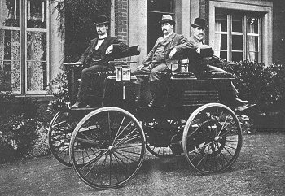
The first Ev
Around 1832, Robert Anderson develops the first crude electric vehicle, but it isn't until the 1870s or later that electric cars become practical. Pictured here is an electric vehicle built by an English inventor in 1884.

Slide 6
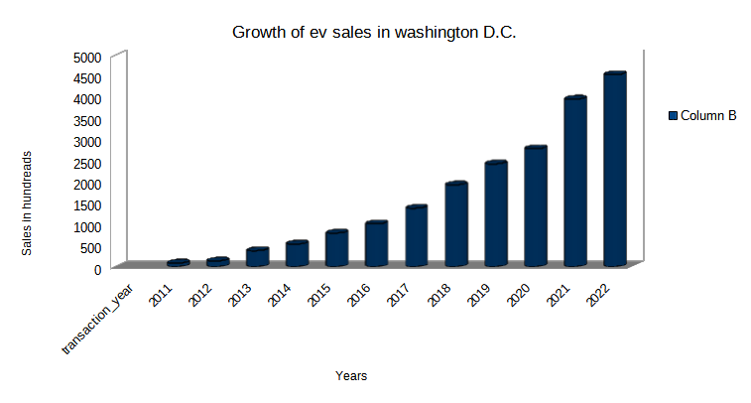
Growth of ev sales over the years
From the given data we sorted the data according to sales of evs on the basis of years

Slide 7
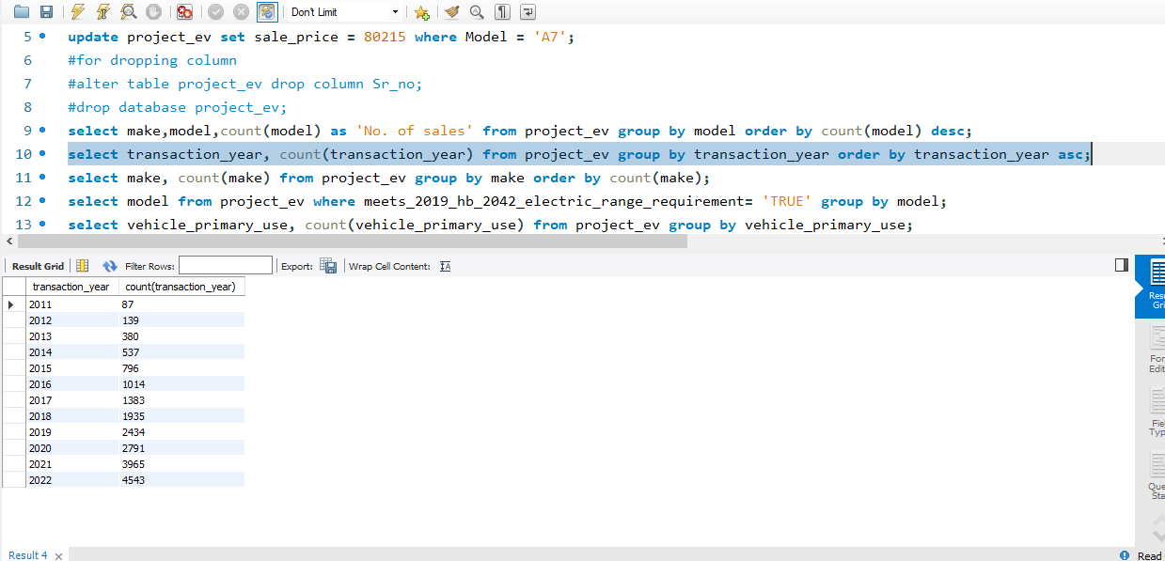
Command used
.
For that we used group by and order by for filtering and ordering the data

Slide 8
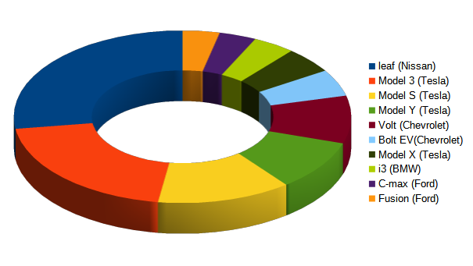
Most Popular Models
.
The most popular models whose sales took place in the span of the 2011-22
Are listed here
As we can see here Nissan leaf is the most popular car beside the popularity of the tesla brand

Slide 9
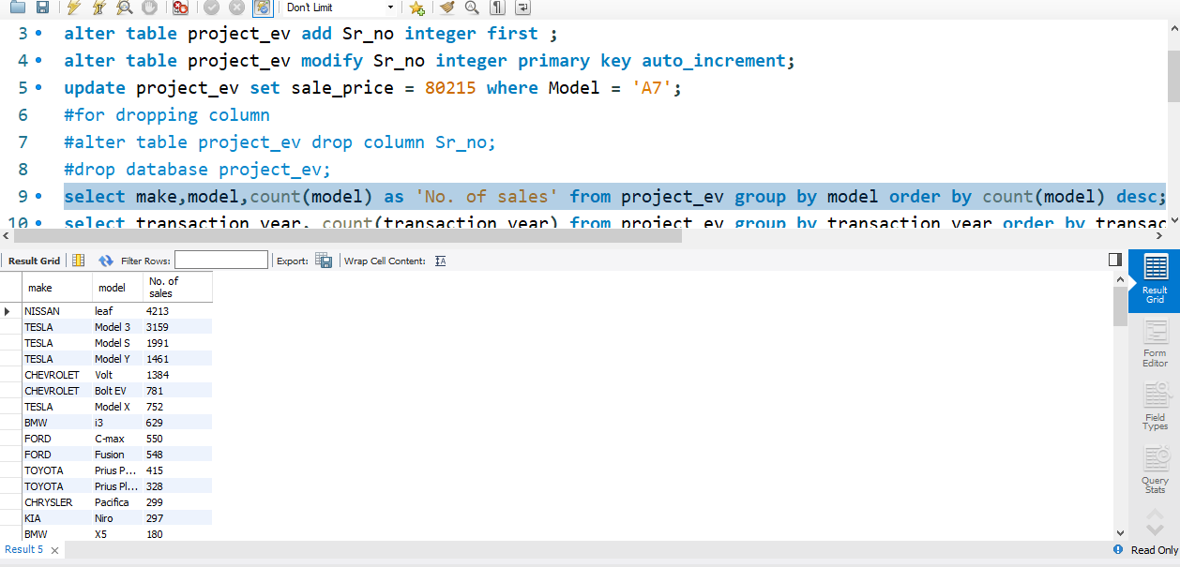
Commands used
.
.
For that we used select, group by and and order by functions
As we can see the nissan leaf is the most popular car with sales around 4000.

Slide 10
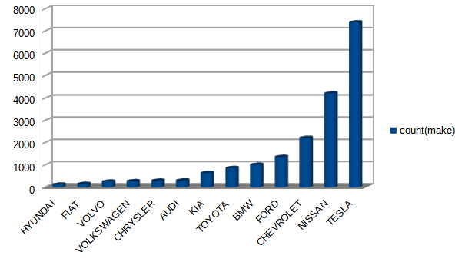
Most popular Car Company
.
.
For finding which is the most popular car company we filtered and sorted the data on the basis of sales and companies respectively
As we can see tesla is the most popular brand followed by nissan cheverlet , ford as a market leader
To Show the model of EV cars in count(model).

Slide 11
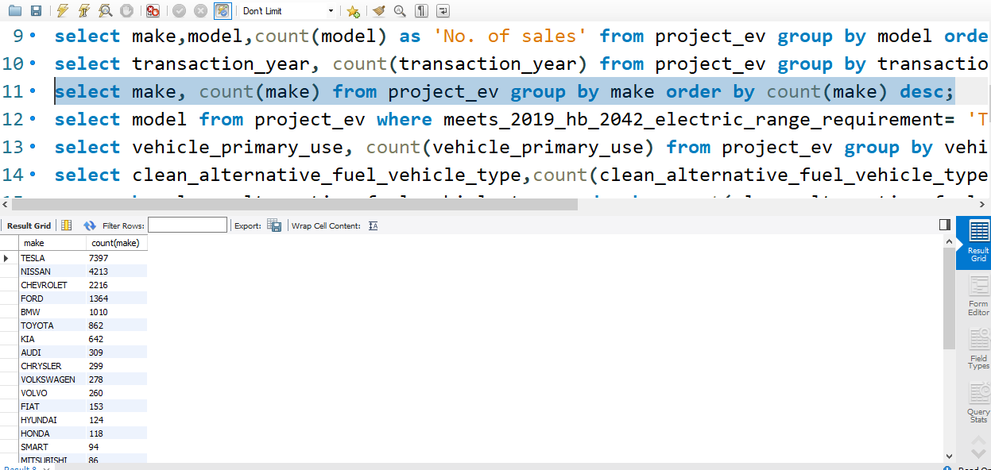
Command used
.
.
For this we used group by , order by and count functions for filtering and sorting the data

Slide 12
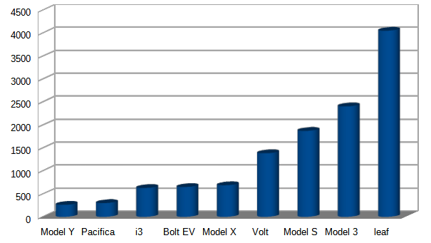
Passes 2019 HB regulations
Here is the graph about which car company make cars which meets 2019 HB regulations about subsidies for evs

Slide 13
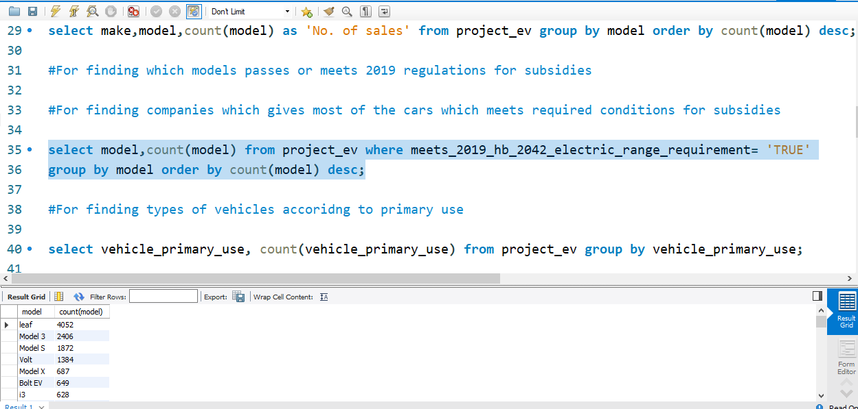
Commands used
For finding which models meets subsidised cars we use count
Function, where clause, group by and order by functions.

Slide 14

Best ev with best range
Audi A7
Range -: 405

Slide 15
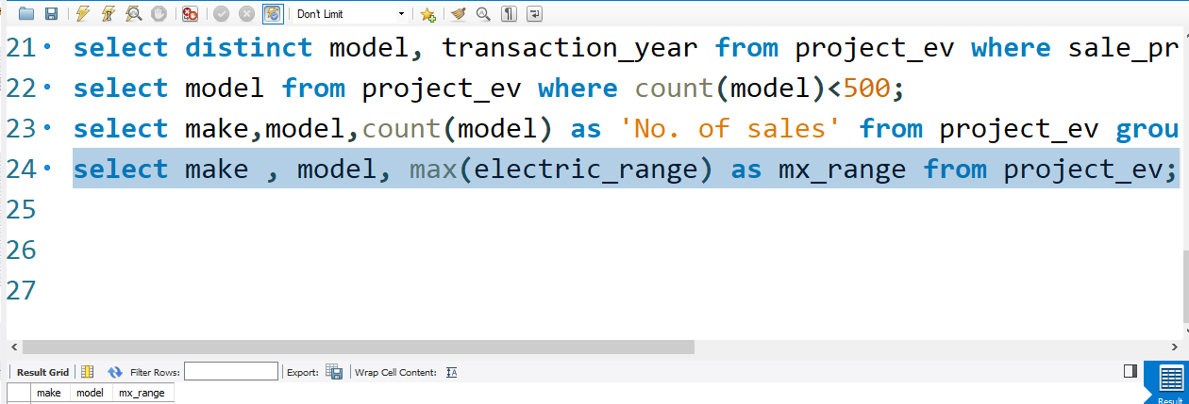
Command used
You can copy&paste graphs from Excel and Google Sheets
We Used max function and anti aliasing function for filtering the data and naming the field name

Slide 16
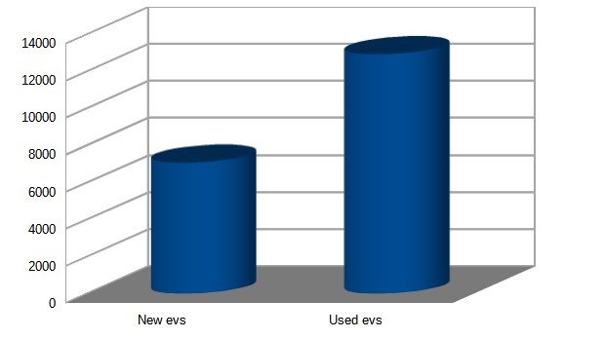
New vs Used evs
Here we can see that purchase of used evs quite high! In-fact it is 50% greater than the purchases of the new evs!

Slide 17
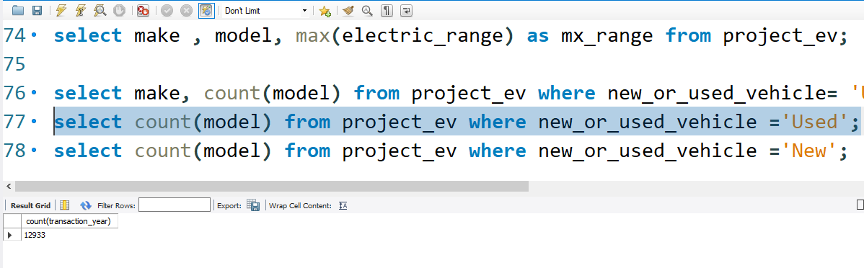
Command used
For that we used count function and where clause.

Slide 18
Thanks!
Any questions?
You can find me at:
ameyghodpage@gmail.com
girishingale9764@outlook.com

