Slide 1
EQS TC Trades
TC Actions revamp approach
- Girish Patwardhan

Slide 2
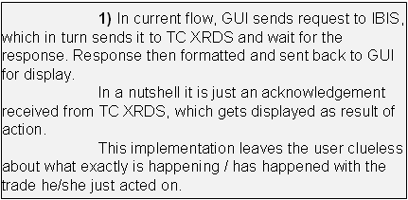
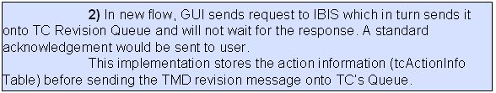


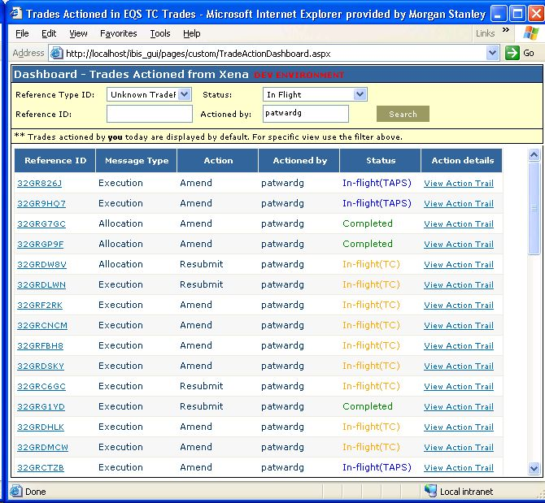
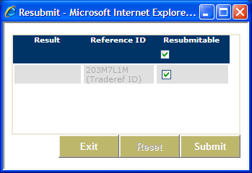



EQS TC Trades
Revision Queue
Ibis
services
xrds
tcActionInfo
TC
IBIS Queue

