Slide 1
Job Category: Software Engineering
Business Unit: Asset & Wealth Management

Slide 2
Requirements
Secure and High-Quality Code Developmen
Develop and maintain secure, high-quality production code using Spring (Java) or React (JS/TS).
Ensure code adheres to architecture and design patterns and meets all design constraints.
Architecture
HLD
LLD
Coding Standards and setup
Implementations
Code Walk through
Demo
Report & Monitoring
Any questions?

Slide 3
Planning-Execution

Slide 4
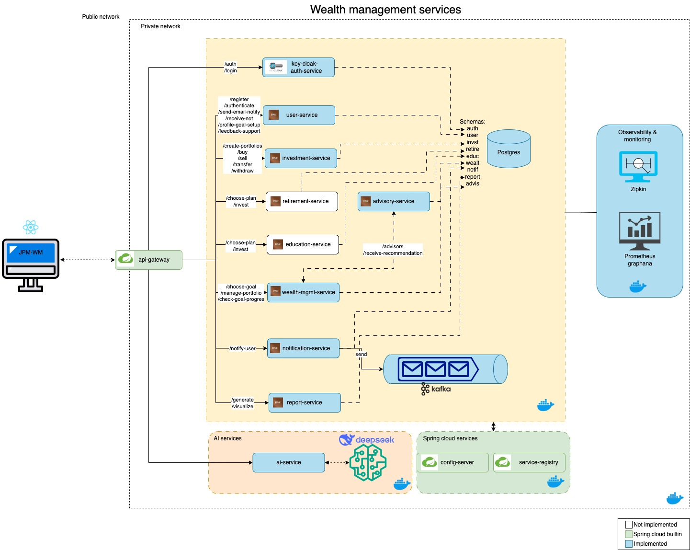
Architecture

Slide 5
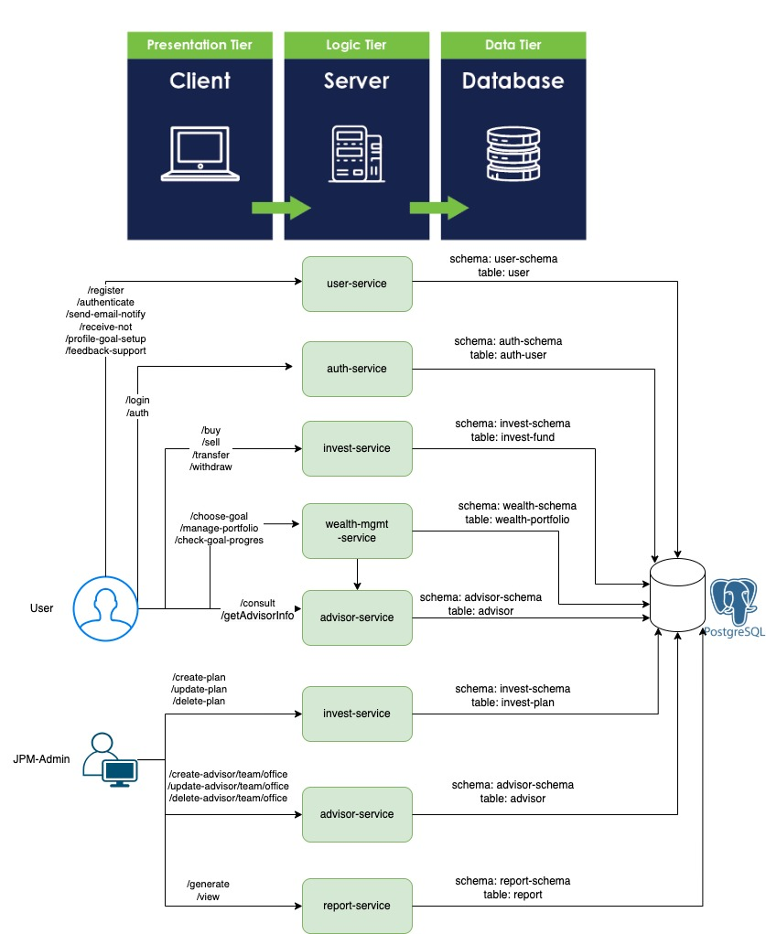
Low level design

Slide 6
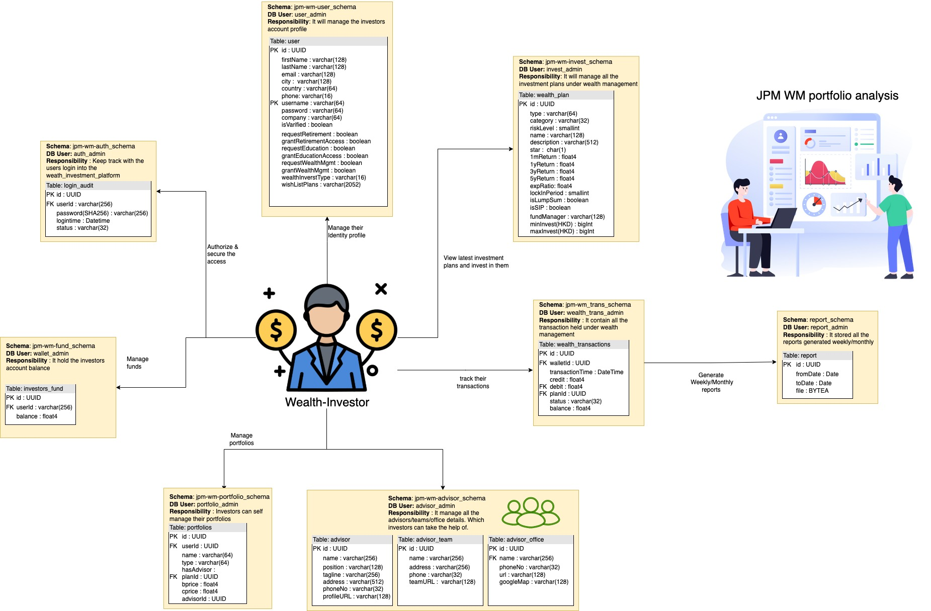
Data design

Slide 7
Implementations

Slide 8
Demo:

Slide 9
Reports

Slide 10
Monitoring

Slide 11
Thank you

