Slide 1
Virtual Dressing Room Using OpenCv
Batch No: 20CSEA013
Team Members :
M. Yamini (17K61A05F0)
Ch. Jahnavi Naga (17K61A0517)
P. Girish Kumar (17K61A05F9)
S. Farookh (17K61A05A5)
Supervisor:
Mr K. Sandeep M.Tech
Associate Professor
Computer Science and Engineering

Slide 2
Contents
Abstract
Analysis
Module Split-up & Gantt chart
Problem Statement
Aim and Objective of Project
Literature Review
Architecture diagram,Use Case diagram, Data Flow diagram
Module detail explanation
Experiment Result
Result Analysis
Conclusion and scope for Future work
Contribution of the candidate
References

Slide 3
Abstract
Today, with the advancement of technologies, the usage of online shopping which is also known as e-shopping has been growing rapidly nowadays. This advancement in e-shopping had driven the shopping revolution in which the customers are able to purchase the costumes anywhere and at any time. Besides its advantages of online shopping, it also has disadvantages which includes that it is difficult for the customers to try the items on especially when it comes to clothing. Hence, a virtual dressing room using AR is developed to allow the customers to visualize how the selected attire or costume fits their body without wearing physically. This is aimed to improve customers shopping experience by allowing them to visualize different costumes to check for size, fit or style. In the development of Augmented Reality, the human body detection and motion tracking and are integrated in order to fit the selected costume on to the user body virtually by tracking the user body movements through the camera which is attached to the laptop. The body skeleton-joint positions are recognized, detected and tracked using the pose estimation model. In addition to it the body and the garment measurements are also analyzed and interpreted to help in seamless fitting the selected costume on to the human body.

Slide 4
Analysis
METHODOLOGY
The proposed system is a web application for Virtual Dressing Room.In this we need to detect body parts of target human body and we need to transfer things according to suitable body parts.
So, for body part detection we were used haar cascade dataset.
Using the cascade trainer gui is value of feature is computed using concept of integral images (it would select best value of feature among this by using adaboost classifier).
They are like convolution kernels. haar features are relevant feature for object detection and non-relevant features are discarded by adaboost algorithm.
There are steps involved in the process of training haar cascade.
The body and garments measurements are also analysed and interpreted to help in seamlessly fitting the virtual garments to the body.
The superimposed virtual garments movements will be detected and tracked to follow the real-time human body movements through camera.
the virtual garments are superimposed over the human body to create an illusion of wearing clothing,display on the laptop.

Slide 5
Module Split-up
Detecting and Sizing the Body
Face Detection
Image Masking
Edge Detection
Scaling of Attire
Proposed Application

Slide 6
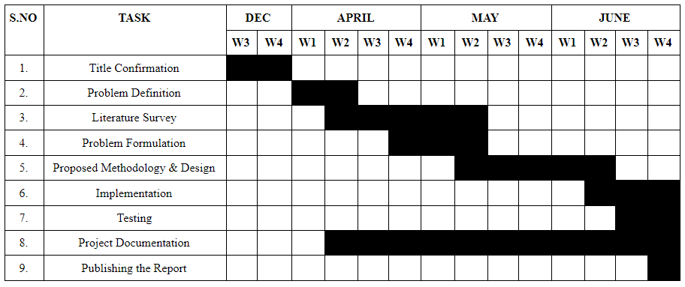
Gantt Chart

Slide 7
Problem Statement
The problem is trying the clothes and getting an idea of how it fits while shopping. The person will search and choose the clothes and takes help of the assistant to assist how the selected one fits him. After selecting the cloth, he/she manually tries it in trial room and seeks the help from the assistant to judge how the selected one fits. This is time consuming and effort consuming job for the user as well as for the assistant. Furthermore, some of the customers may prefer to shop in-store in order to buy clothes so that they can know whether the clothing fits them or not. However, in popular clothing stores, the trial rooms are usually full and there will be a long queue. Customers have to wait for a long time to try on clothes. In fact, customers may choose online shopping or instore shopping depending upon their demands. However, both the ways are unable to achieve the goal of the customer to check whether the selected costume fits or not. Therefore, a virtual dressing room is proposed in this project in order to help the customers to fulfill their shopping goals.

Slide 8
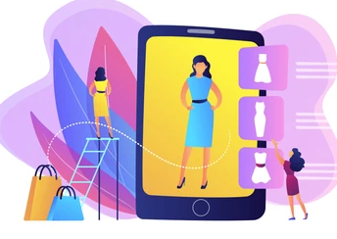
Aim and Objective of Project
With most of the things shifting to virtual mode and competitors trying to get ahead of one, other textile industries took a hit during these tough times.
With a Virtual Dressing Room, every small textile shops can help their customers to an online trial Room without being afraid of contracting the disease.
The advantage of using this method would be the reduction of time and effort spent in trying out the clothes physically.
So, our main objective is to build an interactive and highly realistic virtual machine on which the user can try clothes without wearing it actually and reduce the effort from both the assistant and the customer.

Slide 9
Literature Review

Slide 10
S.No | Author and Year | Proposed Algorithm | Comments / Merits | Demerits
1. | Amit Thakur,Suraj Virkar,Prof.Jyoti Gaikwad, in 2020. | Gaussian filter, Canny edge detection, freeman’s codification, scaling. | The user will get an idea of how the attire fits without manually trying. | The system will not provide any cloth size recommendations.
2. | Saurabh Botre, Sushant Chaudhari, Shamla Mantri, in 2014. | Image processing using mirror. | In this system when compared to other technologies like augmented reality markers or real-time motion capturing techniques no expensive configurations and time-consuming build-ups are required. | The system gives accurate results only when the position of the user is stable means the user should not move towards and away from the camera when focusing.
3. | Zambare Triveni V, Keskar Ankita D, Shinde Prajakta S, Deo Juilee V, Prof.Ratnaraj Kumar, in 2018. | Laplacian filter and then edge detection. | Dressing process takes only a few assumptions and manual intervention for various styles of clothes, making it possible for dressing in a virtual dressing room. | Due to the complex issues on the technique used the simulation performance is difficult to meet the real-time need of clothes animation.

Slide 11
4. | Nikki Singh, Sagar Murade, Prem Lone, Vikas Mulaje, in 2017 | Detection and sizing of the costumers body, detection of reference points based on face detection and upper body points(the shoulder points),and superimposition of the clothing over the customers image. | Less costing and dependency over heavy and huge costing hardware components or peripherals. | Number of functionalities provided to the interface are less as per requirements of the users.
5. | Ting Liu; LingZhi Li; XiWen Zhang el, in 2017 | Skeletal tracking algorithm of Kinect V2. | Kinect V2 can detect and track users’ bodies more quickly and accurately. | The disadvantages are that the user should be apart from the machine to maintain a particular distance.
6. | Zhonghua Wu, Guosheng Lin, Qingyi Tao, Jianfei Cai , in 2018 | 1.Pose Aligned Network (PAN) 2.Texture Refinement Network (TRN) 3.Fitting Network (FTN) | More accurate pose estimationThe generated results from different stages of M2E-TON model. | Networks tend to treat this head pattern as the head of the human instead of the clothing region.
7. | Ari Kusumaningsih and EkoMulyantoYuniarno, in 2017 | Depth sensor Kinect to detect the movement of their body, then body tracking to the attached dress. | The distance of objects from the Kinect and to compose a “depth map” of the image. | Lighting conditions affected the depth map.

Slide 12
8. | Srinivasan K. and Vivek S, in 2017 | Laplacian filter and then edge detection. | The wide choice of online availability with the assistance of feeling how clothes would look. | No provision for 3D viewing and sensitivity to light conditions.
9. | Reizo NAKAMURA and Masaki IZUTSU,in 2013 | Depth sensor Kinect to detect the movement of their body. | Size estimated using the distance data of the number of frames that can be retrieved from two Kinect. Reasons to use two Kinect, this is for improving the accuracy by using the information obtained from the other. | As use of multiple Kinect’s improves accuracy but increases cost also
10. | Ayushi Gahlot and PurviAgarwal,in 2016 | Kinect sensor capturing of the three dimensions information of scene and also find out user actions by recovering the depth image info and real- time skeletal pursuit. | The Kinect Technology interacts with the Human Body for pose estimation | Action predictions are the main purpose. Pose estimitation is done but not used for any purpose
11. | UmutGultepe and UgurGudukbay.in 2014 | scaling method | Depth sensor data is used in the filtering room. Adjust the size. | Quality of measurement is low. Provides additional data of room which is of no use

Slide 13
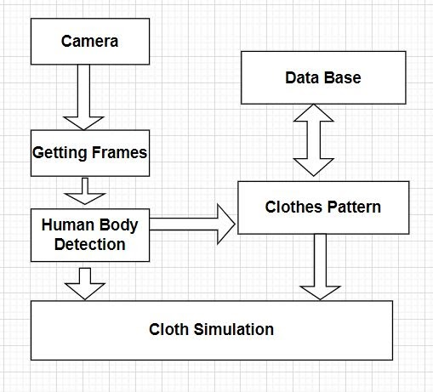
Architecture diagram

Slide 14
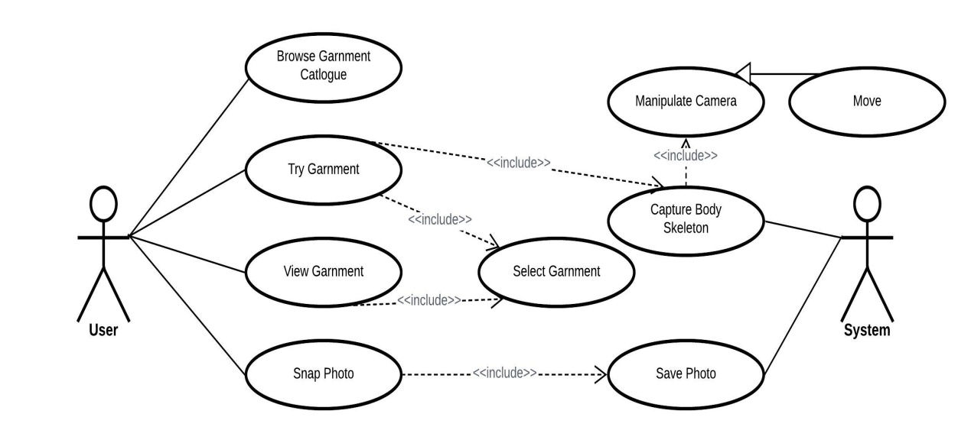
Use Case diagram

Slide 15
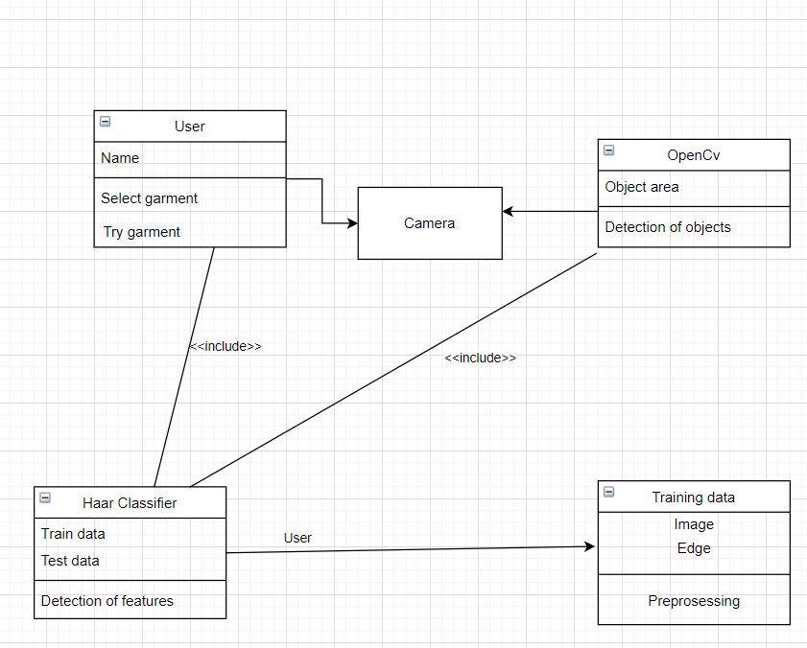
Class diagram

Slide 16
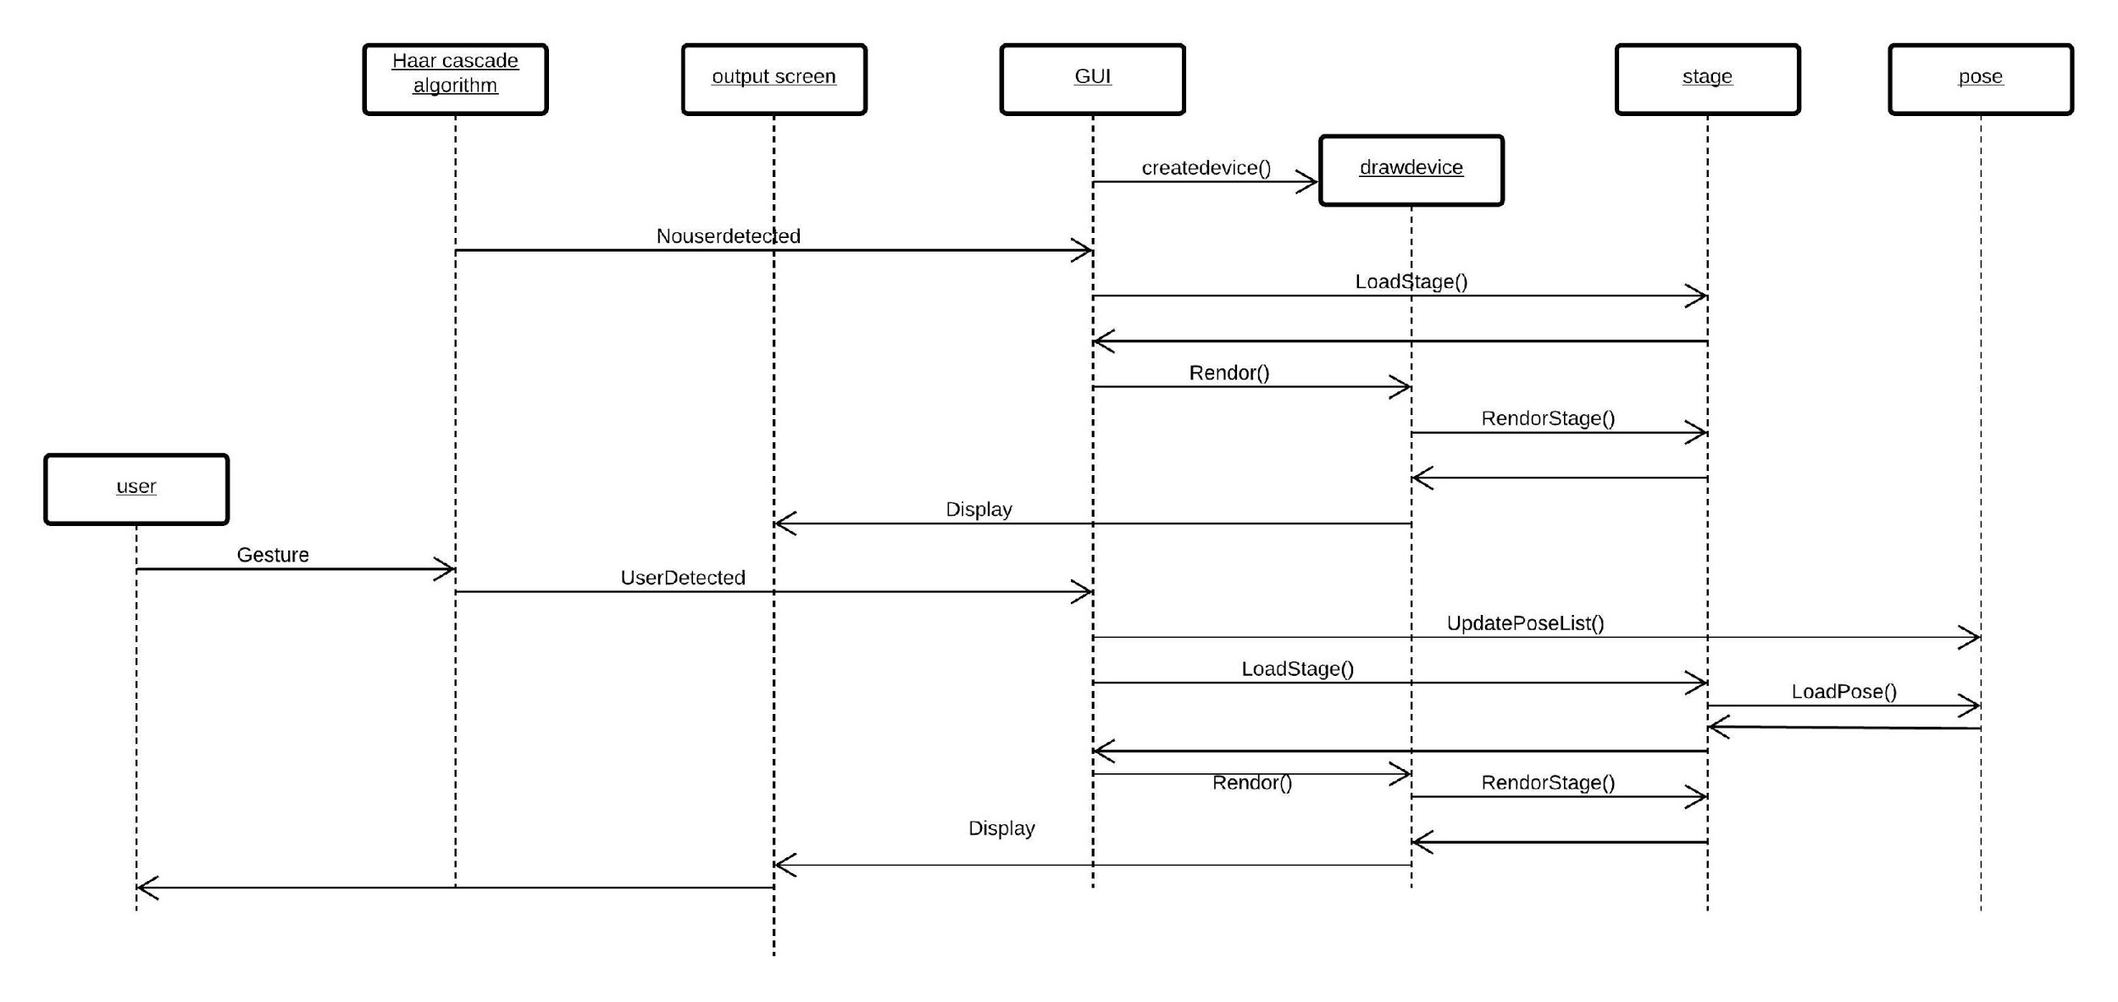
Sequence diagram

Slide 17
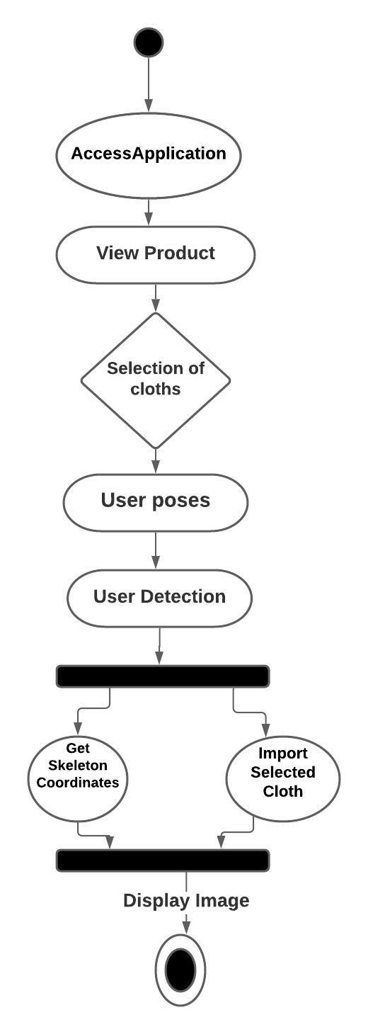
Activity Diagram

Slide 18
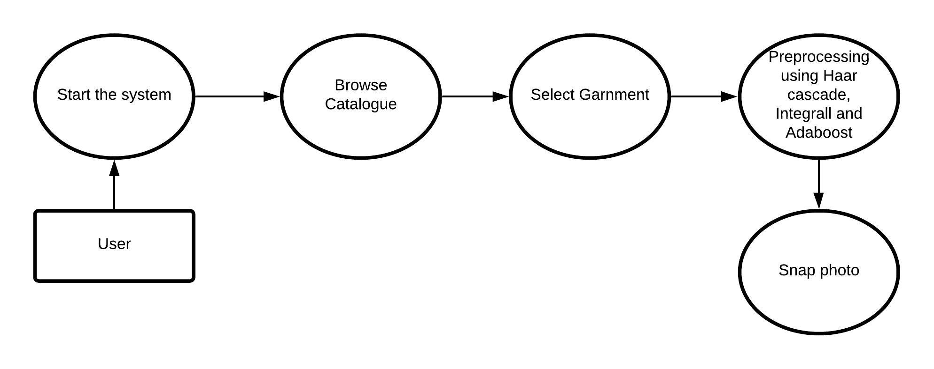
Data Flow diagram

Slide 19
Module detail explanation
1 Detecting and Sizing the Body:
The first step in the proposed Online Virtual Trial Room is to find out the shape, head or neck depending on what you wear to identify points. The terms used are used to determine where they can display a particular fabric or decoration. To determine body composition, we used a number of techniques: i) Delay filtering, Haar Cascade algorithm and ii) Movement detection or bone detection in which multiple frames were analyzed for any movement. However, the results were unreliable and insufficient to obtain reliable points of wear.
The idea is to set the user in front of the camera and hold him at the beginning at a predetermined distance. The algorithm extracts points from the shoulders and abdomen. To measure the distance between these points and to know the distance from user to camera, user size can be determined. When an image (video frame) is detected, the Haar Cascade algorithm is used only to detect body image. Haar Cascade algorithm is an Object Detection Algorithm that is used to identify the image in real-time image or video. Object Detection using Haar feature-based cascade classifiers is an effective object detection method proposed by Paul Viola and Michael Jones in their paper, "Rapid Object Detection using a Boosted Cascade of Simple Features" in 2001.It is also known’s as Viola–Jones object detection framework. It can be trained to detect a variety of object classes; it was motivated primarily by the problem of face detection. This algorithm is implemented in OpenCV as cvHaarDetectObjects ().

Slide 20
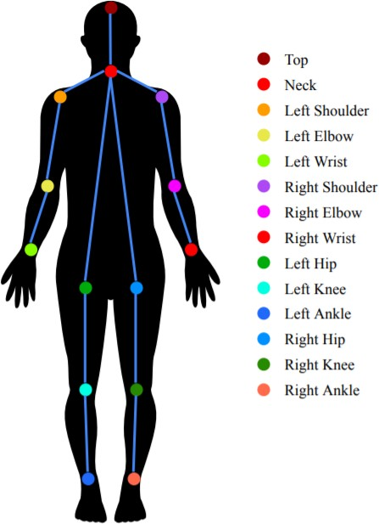
There are three methods, they are
1. Robust object detection rates in real times:
a. “Integral Image” representation allows fast feature computation
b. AdaBoost(adaptive boosting) -based classifier training classifier training procedure
c. Classifier cascade allows fast rejection of non-face images
2. Use rectangular features instead of pixels:
Features = Weak Classifiers
3. Each round selects the optimal feature given:
– Previous selected features
– Exponential Loss
Three major contributions/phases of the algorithm:
Feature extraction
Classification using boosting
Multi-scale detection algorithm
Feature extraction and feature evaluation.
Rectangular features are used, with a new image representation their calculation is very fast. Classifier training and feature selection using a slight variation of a method called AdaBoost. A combination of simple classifiers is very effective.

Slide 21
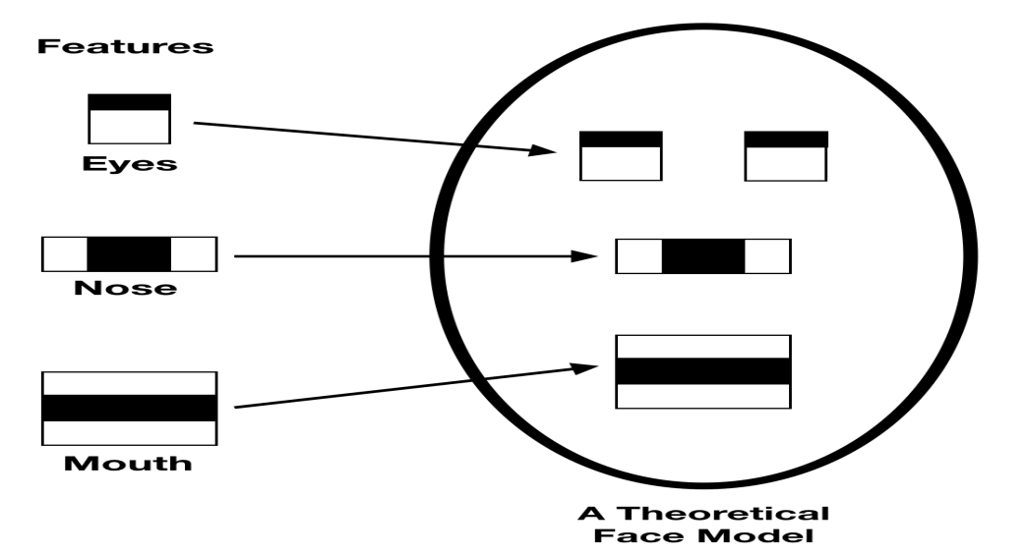
2 Face Detection:
When a user comes to the front of the screen, finding the user can understand able structure that will be face-to-face. So, to get a face, we use Haar class-class Cascade classifiers. In haar differentiation instead of using pixel values ​​of intensity, it uses a change in comparative values ​​between adjacent pixel groups. Thereafter a distinct contrast between the pixel groups is used to determine the light associated with the dark areas in the image. It is a method of machine learning. Therefore, the efficiency of the algorithm cascade function is trained from many negative and constructive images. Many negative images (facial images) and positive images (facial images) are displayed in the separator to train us so that we can extract features from it. The purpose of using OpenCV makes it easy as it comes with pre-programmed items for faces, eyes, smiles etc. It comes with a trainer and a detector; we can train it with our classifier easily to get any object discovery. When it finds a match, it returns the Rect (x, y, w, h) which means left, top, bottom and right link.

Slide 22
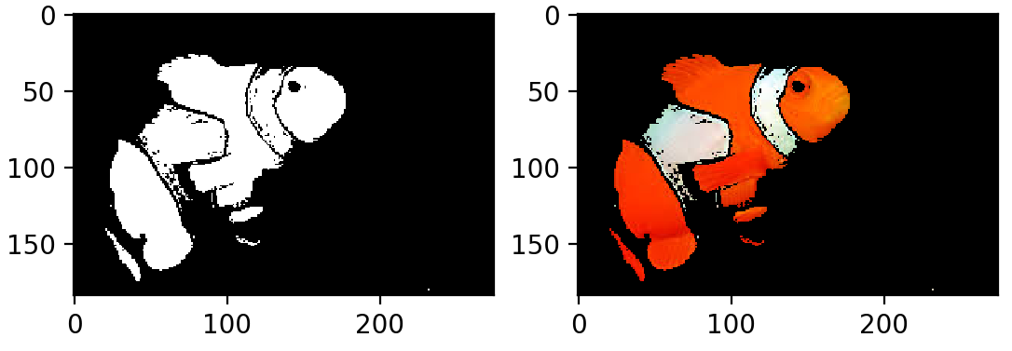
3.Image Masking:
In this case the hidden image has some of its pixel values ​​set to zero. In an image where the pixel intensity is zero automatically the pixel size of the hidden image to be set will be set to a background value of normally zero. Or define the mask the ROI of each slide used. If necessary, the face mask can be controlled by a slide-over slide on the basis of ROI tools. In the ROI toolkit, masking performance does not affect a piece other than ROI.
Using image as a mask:In this simply the image masked has some of its pixel intensity values set to zero. In the image wherever the pixel intensity value is zero automatically the pixel intensity of the resulting masked image will be set to the background value which is normally zero.
b. Using ROI as a mask:To define the mask the ROIs for each slice is used. If required, masking can be controlled on slice by slice basis in ROI toolkit. In ROI toolkit, masking operations does not affect a slice without ROI.

Slide 23
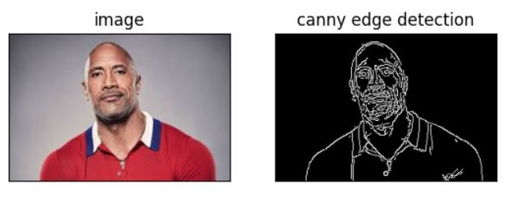
4.Edge Detection
There are various ways to get an edge, in this project we have used the Canny Edge detection process. To make this method of finding the edge using Gaussia filters. These filters cut sound from digital image to prevent any false detection by the processor. This does the job of smoothing out and minimizing the noise effect in the processor's image performance. With this image stabilization gradients are not available. The edges of the image can point to various shapes such as horizontal, vertical and diagonal edges, so this algorithm uses four filters to find all sorts of edges in a blurred image. After this procedure a non-high pressure is applied to make the edge thinner. This pressure causes the edge pixels to be accurate towards the actual edges. Also, some pixels can be caused by noise, and with such pixels we apply a double limit to it.

Slide 24
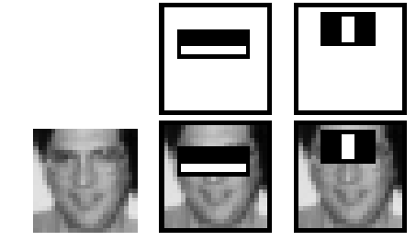
5.Scaling of Attire
Scaling means increasing image size depending on the conditions. As when the user is walking in front of the screen, he has to change the size of the garment and place it on the body accordingly. When the user is straight to the screen the image size should be increased depending on the user but the actual dimensions of the garment should not increase. Suppose a person tries on an S-size line, as when walking in front of a screen the size of the screen should not change M or L. This is done by measuring.

Slide 25
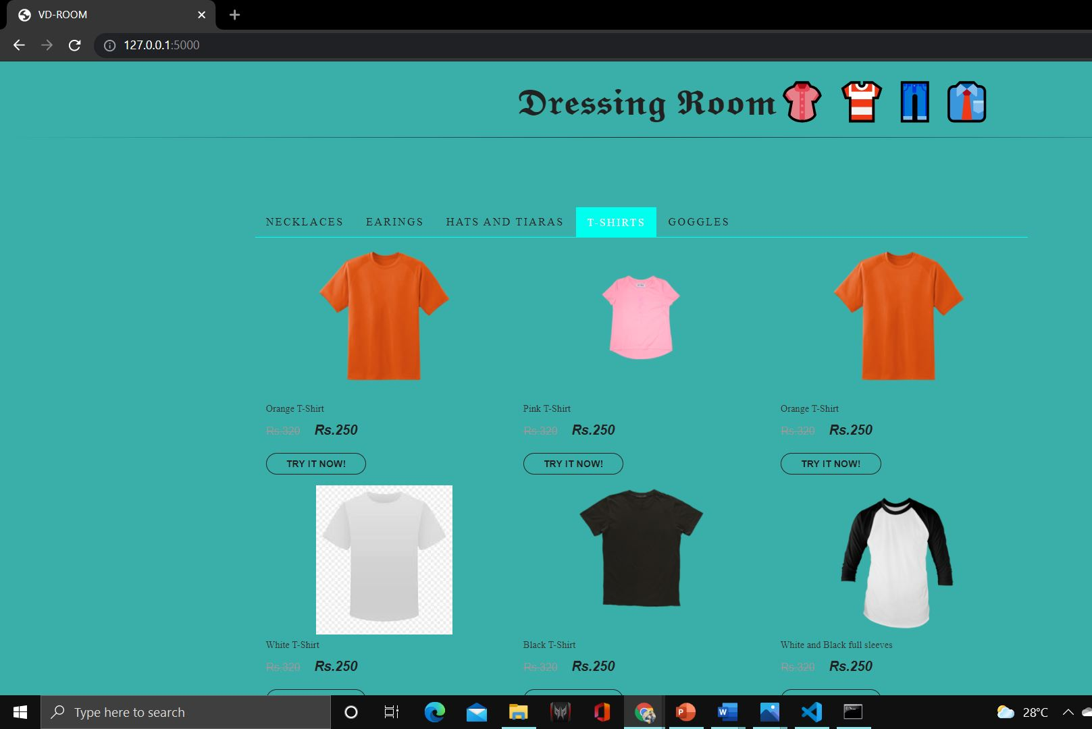
6.Proposed Application
The application is built with the Python Flask Web Application Interface. The user can view clothing and other clothing items on the website and choose to purchase or try on clothing. If the user wants to try the wearable online, they will have to click on the 'Switch View' button. This will run the Tryon script. With OpenCV the video is captured with the device's camera and a photo of the garment is inserted neatly into the user's body in real time. If the user likes the costume, then they can choose to buy it or continue to look for more wearable on the website as an offline store.

Slide 26
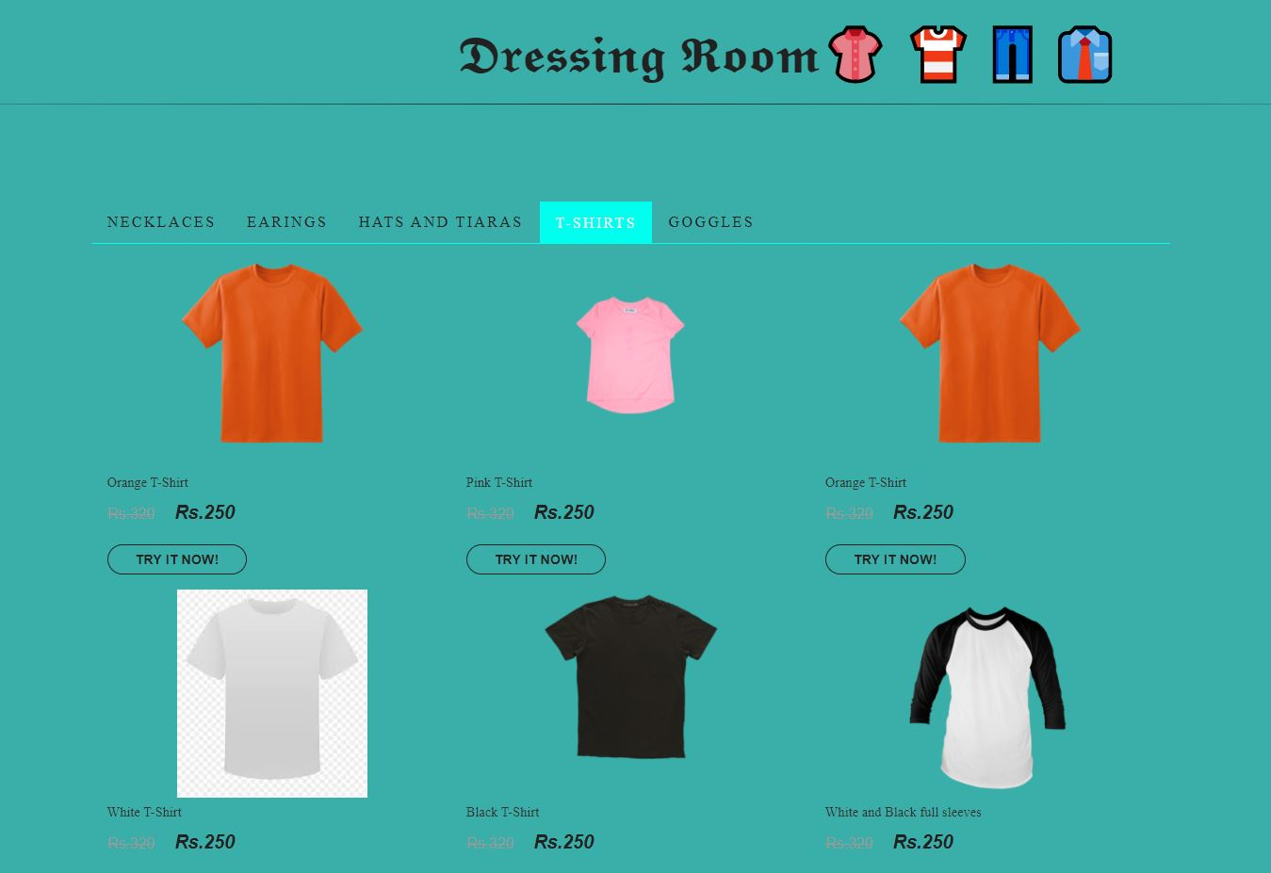
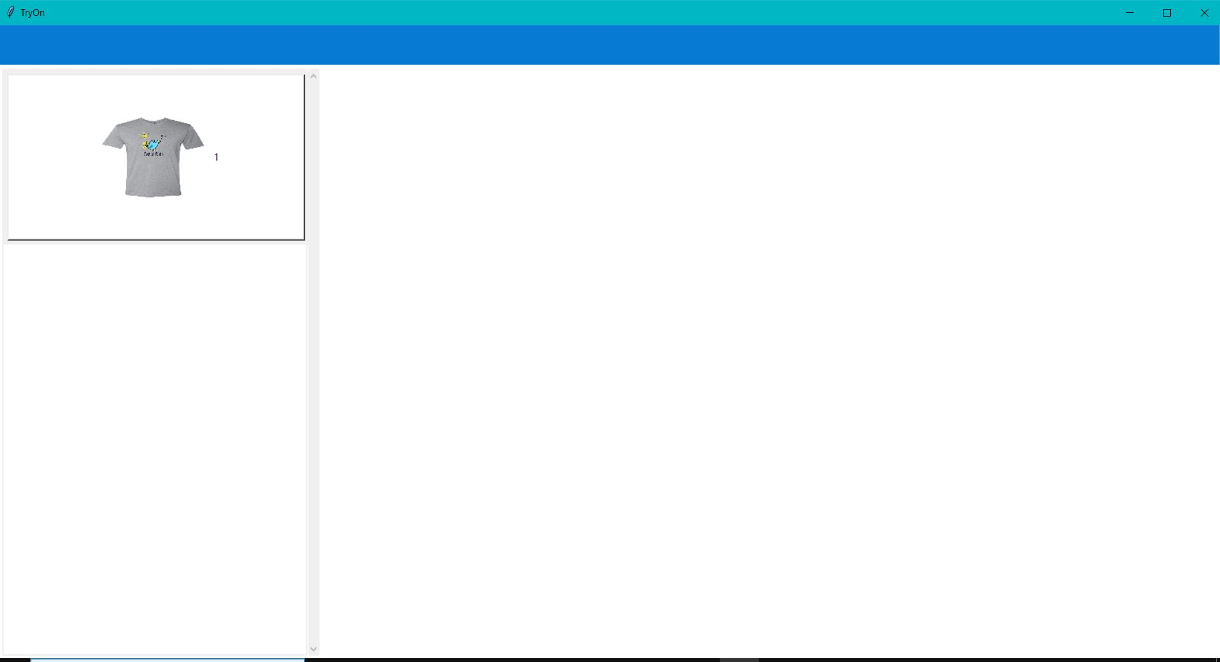
Experiment Result
As the first step the user has to open the command prompt and execute the file
and the file must be saved with .py extension. Then the default URL will be obtained which they need to be copy and get pasted in the browser. Then the new website gets opened where the user can select the required costume like shirt or eye glasses etc.

Slide 27
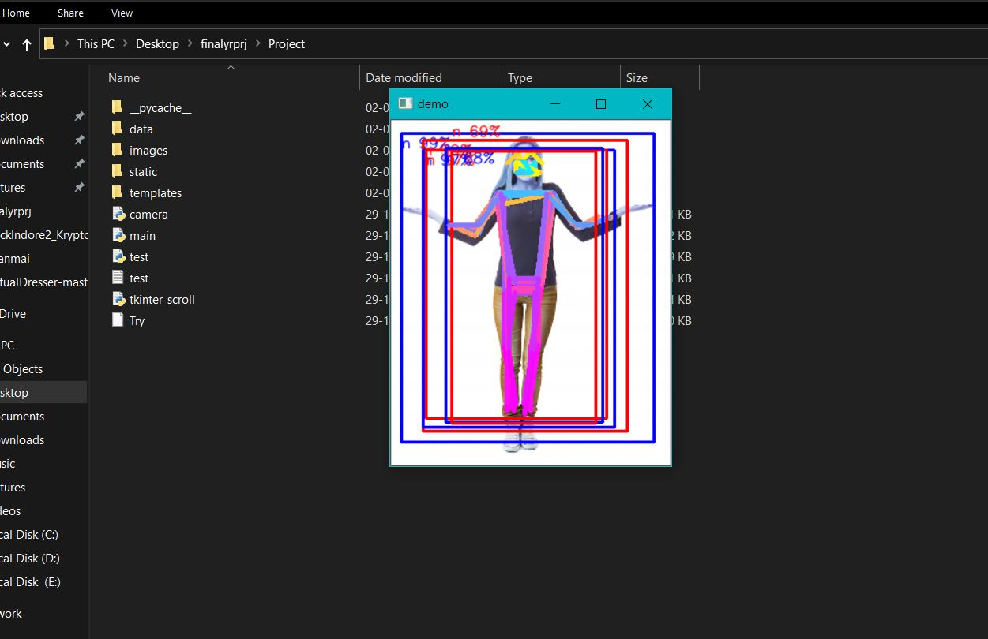
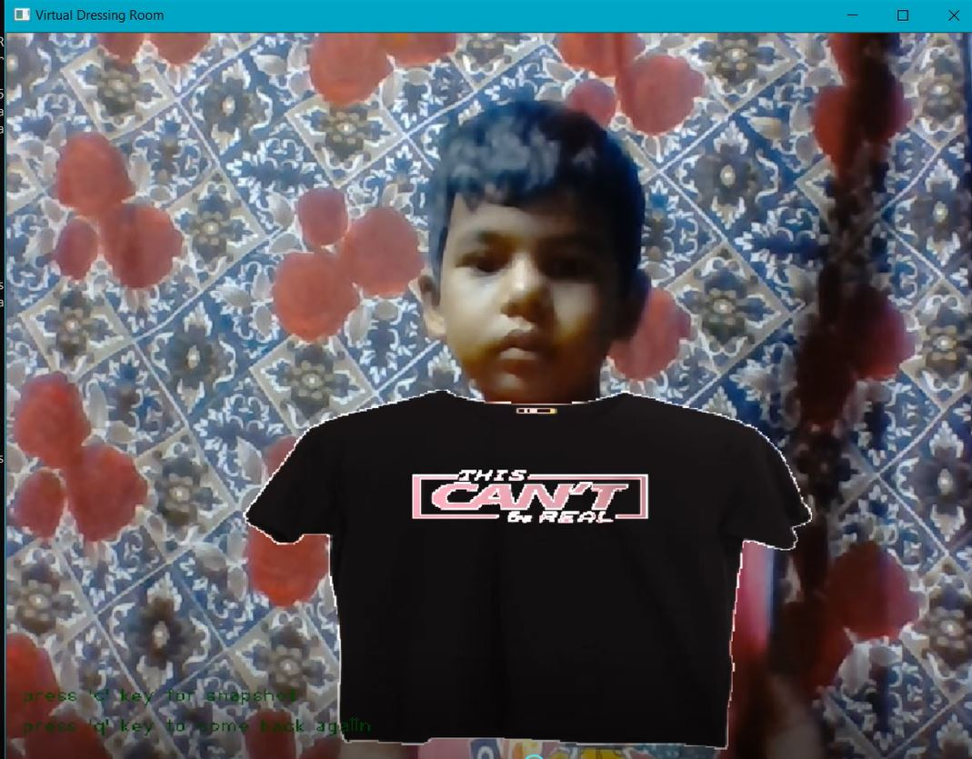
Then he can click on Tryon. After that new window will be opened which consists of two segments where one segment shows the selected costume and one segment displaying the user movements. Then it asks for pose estimation and after capturing the user image the pre-processing. It will be done and the selected costume will be superimposed on to the user image. So that the user will get an idea of how the selected costume fits him by seeing the superimposed image

Slide 28

This Technology can be very widely used by online shopping applications or websites. This idea can further be improvised by making the user try 3D clothes which can be viewed from different angles. After the COVID-19 pandemic, the scenario will be very different, offline stores will limit trials. During those times this technology will be very useful.

Slide 29
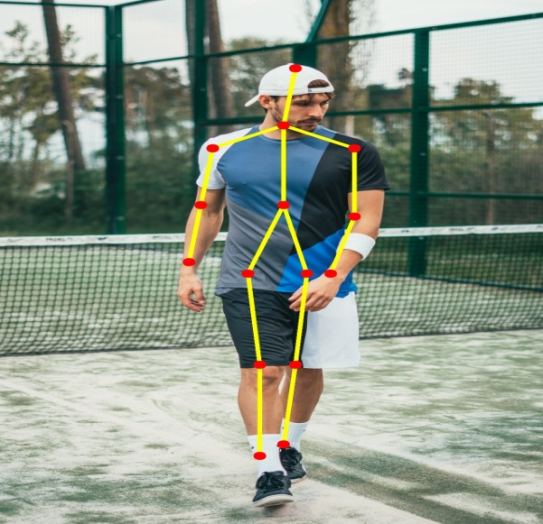
Result Analysis
1.Detect body skeleton joint positions in simple background
The system displays the detected body skeleton joint positions based on the pose estimation result returned by the pose estimation model. Based on the real-time video of body in simple background, the application is able to recognize, detect and track the body. In this case, it proves that the model has a good accuracy in recognizing, detecting and tracking body skeleton joint positions.

Slide 30
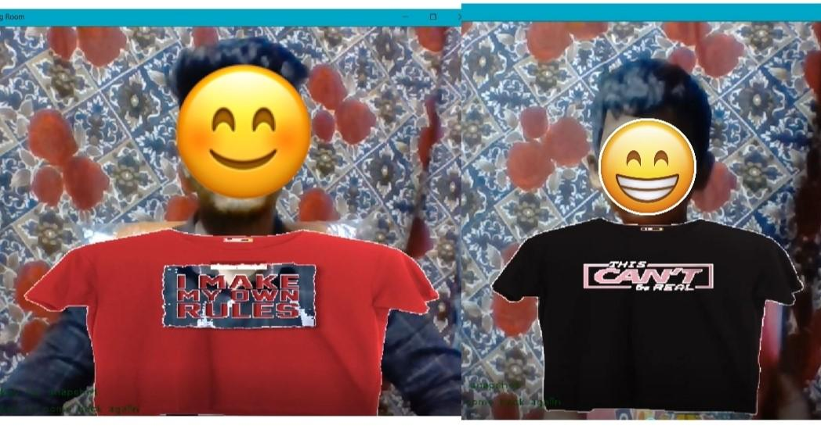
2.Fit Dress onto User body on Virtual
The system superimposes the virtual garment over the body after successfully extracted the body skeleton joint positions. Based on the real-time video of body in simple background, the application is able to fit the virtual garment onto the detected body in an appropriate way. In this case, it proves that the application succeeds in presenting the visualisation of wearing garment for user. the body is surrounded with other different objects, the application is still able to superimpose the virtual garment over the detected body in a correct way. As a result, it proves that the application is successful in enabling user to be virtually appeared like wearing clothing on the camera preview interface.

Slide 31
Conclusion
The problem is trying and wearing clothes while shopping. One should look for and choose clothes and keep in mind that the helper will help him. After choosing a dress, she will try inside the changing room to make her decision. This requires time and effort on both the assistant and the client. The suggested solution to this problem is to use Virtual Routes that serve as a virtual dressing room.
It is used to find a person's body and this data is then used to give a picture of clothes on the user's body, thus eliminating the need for physical effort on clothes thus helping to save time. We conclude that this is a very time-consuming task. This visual aid is used by any non-technical person. It does not require a lot of technical knowledge. Therefore, it is useful. So a nice addition to the fabric store. All in all, a well-designed dressing room seems to be a great solution for a quick and accurate experiment of fabrics almost.
FutureWork
For future plans, a recommendation plan is introduced to provide wear recommendations based on a user’s purchased history or wish list. Clothes that consumers may buy more should be shown before the impossible to improve customer experience.
In addition, body-splitting technology can be used to maximize many body measurements such as belt, back length shoes, watches etc. Improving the precision of a suitable garment on the body. In addition, after the user has selected the garment to try on her body, details about the size of the garment such as overweight or fit should be shown to inform the user.

Slide 32
Contribution of student
Tasks | M. Yamini (17K61A05F0) | Ch. Jahnavi Naga(17K61A0517) | P. Girish Kumar (17K61A05F9) | S. Farookh (17K61A05A5)
Literature Survey | ✔ | ✔ | ✔ | ✔
Problem Formulation | ✔ | ✔ | ✔ | ✔
coding |  |  | ✔ | ✔
Documentation | ✔ | ✔ | ✔ | ✔
PPT Preparation | ✔ | ✔ | ✔ | ✔

Slide 33
REFERENCES
[1]Amit Thakur1, Suraj Virkar2, Prof.Jyoti Gaikwad; Online Virtual Trial Room Implementation using OpenCV Python&quot;, Volume:07 Issue:05|May 2020.
[2]Saurabh Botre1, Sushant Chaudhari2, Shamla Mantri3,&quot;Virtual Trial Room;,Volume 2 Issue 2, Mar-Apr 2014.
[3]Zambare Triveni V, Keskar Ankita D, Shinde Prajakta S, Deo Juilee V, Prof.Ratnaraj Kumar, “Virtual Dressing View”, Volume No:07, Issue:03 April 2018.
[4]Nikki Singh, Sagar Murade, Prem Lone, Vikas Mulaje;Virtual Trial Room”, Volume No: 1, Issue:04,December2017.
[5]Zhonghua Wu, Guosheng Lin, Qingyi Tao, Jianfei Cai,‘M2E-Try On Net: Fashion from Model to Everyone’, Pages 293–301,in2019.

Slide 34
[6]Ting Liu; LingZhi Li; XiWen Zhang,‘Real-time 3D virtual dressing based on users;
skeletons’,11-13 Nov. 2017.
[7]Ari Kusumaningsihand EkoMulyantoYuniarno, “User Experience Measurement On
Virtual Dressing Room Of Madura Batik Clothes”, IEEE2017.
[8]Srinivasan K. and Vivek S., “Implementation Of Virtual Fitting Room Using Image
Processing” IEEE2017.
[9] Masaki IZUTSU, and Shosiro HATAKEYAMA “Estimation Method of Clothes Size for
Virtual Fitting Room with Kinect Sensor” 978-1-4799-0652-9/13 $31.00 © 2013IEEE.
[10] AyushiGahlot and PurviAgarwal. “Skeleton based Human Action Recognition using
Kinect.”IEEE2016.
[11] UmutGultepe and UgurGudukbay. “Real time virtual fitting with body measurement
and motion smoothing.”IEEE2014.

