Slide 1

Athena Encrypted Chat Program
Engineered by Team OlympuSoft:
Norman Maclennan, BCNS
Gregory LeBlanc, BCNS
Stephen Failla, BCOS

Slide 2
An Introduction To Athena
Centralized instant messaging program
Similar to AIM, ICQ, MSN
Developed in Java for platform compatibility
Client and server messages encrypted with RSA
Local files are encrypted with DES
Integrates a single-window main interface
Easy-to-use and secure communication for home, personal, business use

Slide 3
Athena and Encryption
Message headers encrypted with Server public key
Message contents encrypted with recipient public key
Message is sent to Server where recipient name is processed and message is routed accordingly
Only recipient can read message
Server acts as an abstracting layer between clients

Slide 4
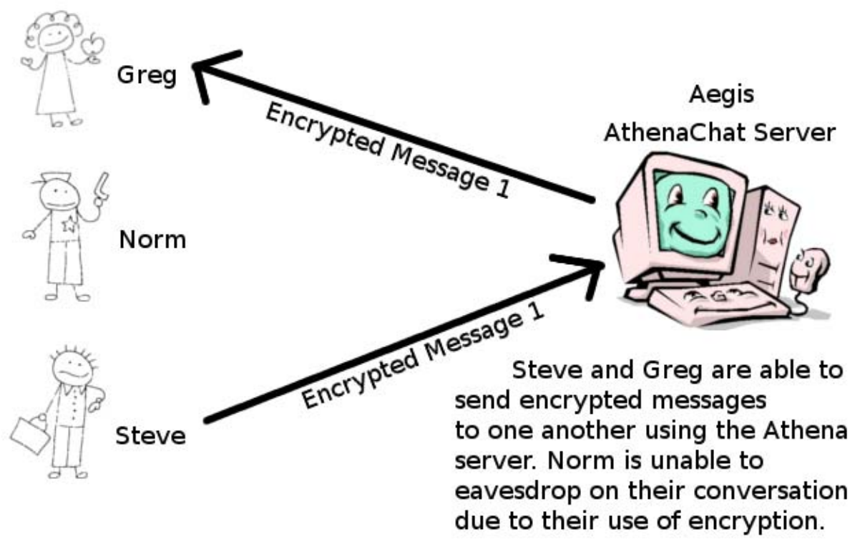
Athena and Encryption

Slide 5
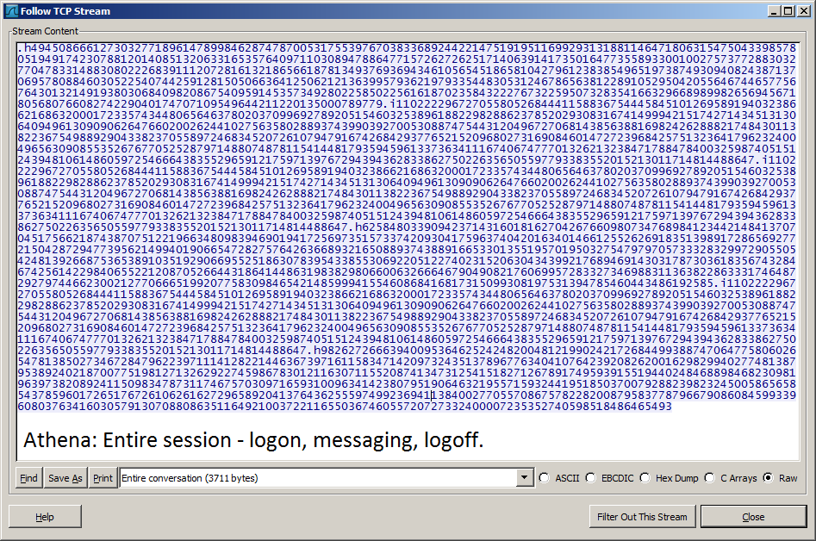
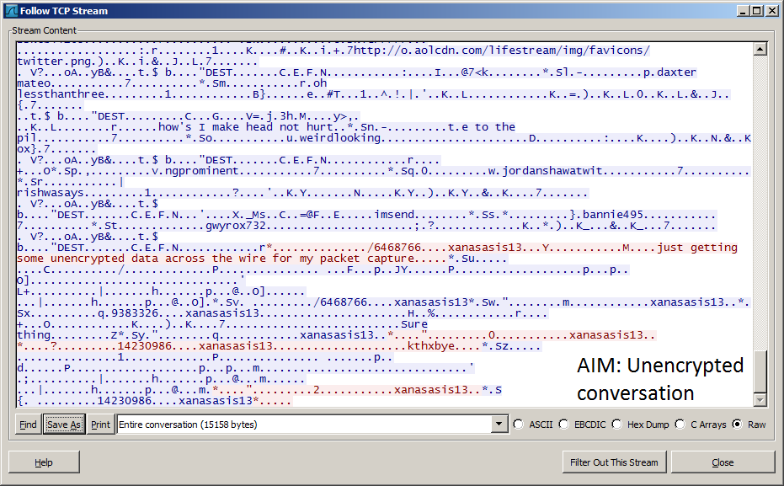
Wireshark TCP Stream Capture Comparison
AOL Instant Messenger
Vs.
Athena

Slide 6

The Future of Athena
File Transfer
Group Chat
Inline Image Transfer
Contact List Enhancement
Contact status :: Alias :: Grouping
“Direct-Protect” with AES
Similar to AIM’s “Direct Connect”
Interface and Setting Upgrades and Additions
General UI :: Theme :: Font :: Navigation

Slide 7
For More Information
www.athenachat.org
admins@athenachat.org
Questions?
Comments?

