Slide 1

Athena Encrypted Chat Program
Engineered by Team OlympuSoft:
Norman Maclennan, BCNS
Gregory LeBlanc, BCNS
Stephen Failla, BCOS

Slide 2
An Introduction To Athena
Centralized instant messaging program
Similar to AIM, ICQ, MSN
Developed in Java for platform compatibility
Client and server messages encrypted with RSA, AES (Direct-Protect)
Local files are encrypted with DES
Integrates a single-window user interface
Easy-to-use and secure communication for home, personal, or business use

Slide 3
Athena and Encryption
Message headers encrypted with Server public key
Message contents encrypted with recipient public key
Message is sent to Server where recipient name is processed and message is routed accordingly
Only recipient can read message
Server acts as an abstracting layer between clients

Slide 4
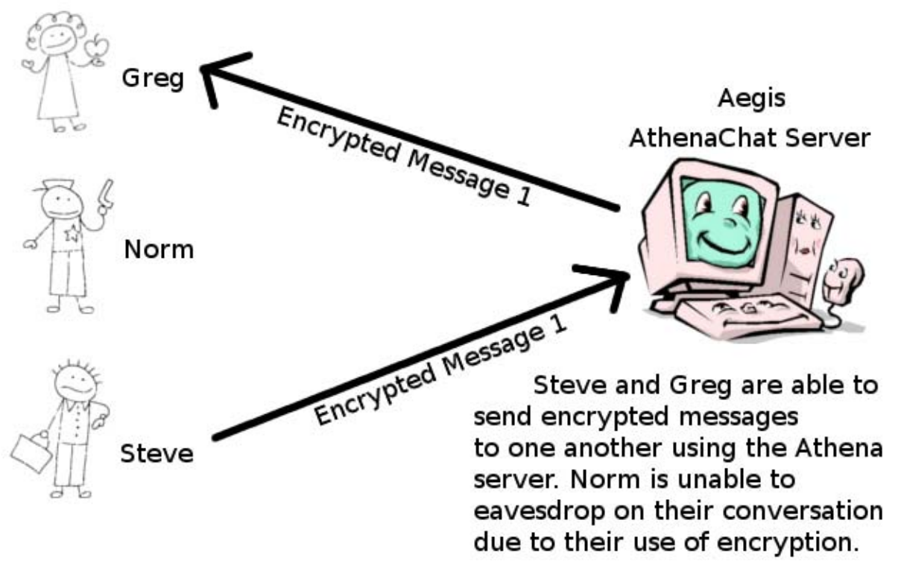
Athena and Encryption

Slide 5
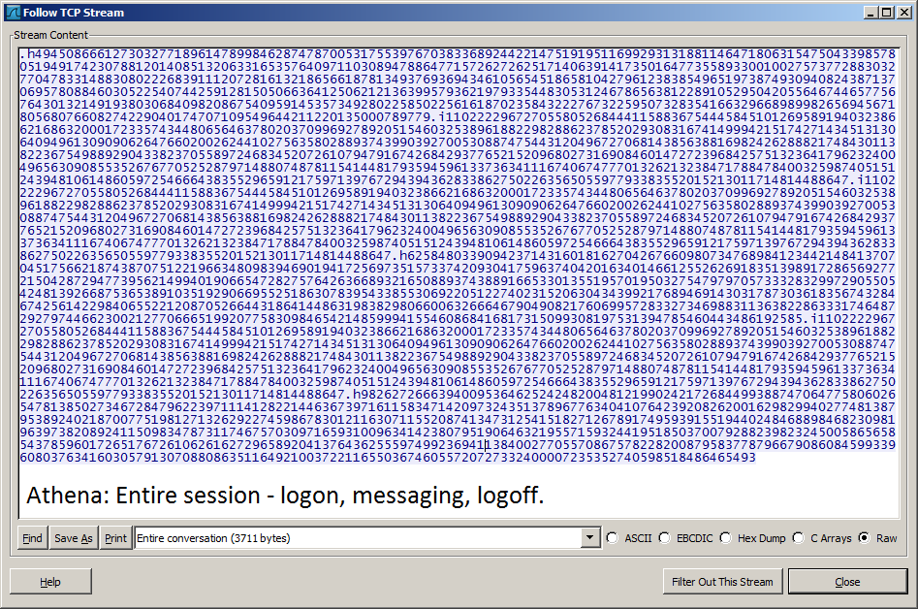
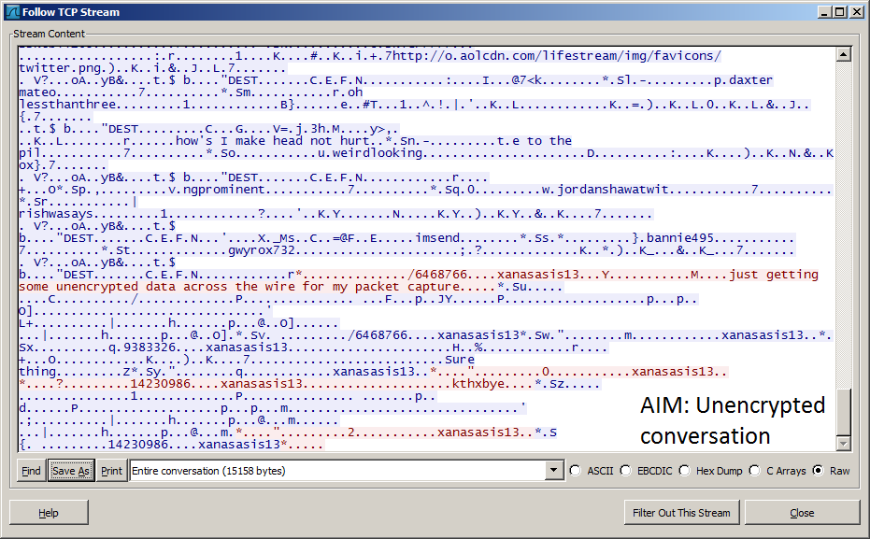
Wireshark TCP Stream Capture Comparison
AOL Instant Messenger
Vs.
Athena

Slide 6

Athena 1.0 Features
Single-window GUI
Client-to-client communication
RSA Encryption
Bug report system
User registration/password reset
User status updates
Communication interface menu
File, edit, encryption, view, help
Preferences interface
Notifications, themes, font format, system settings

Slide 7

New To Athena 1.1
Encrypted group chat
Encrypted file transfer
Real-time contact list alias system
Direct-Protect with AES encryption
GUI and navigation enhancements
Custom sounds, contact/chat lists, color scheme
Communication interface menu enhancements
Block/unblock user, secure email, alias view
Preference interface setting additions
Debug log, download location, aliases, sounds

Slide 8
