Slide 1
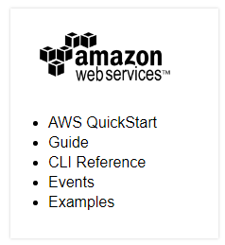
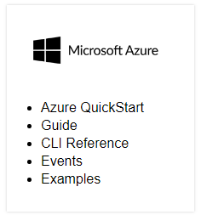
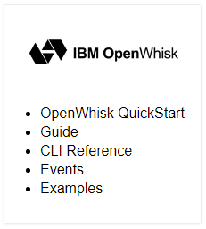
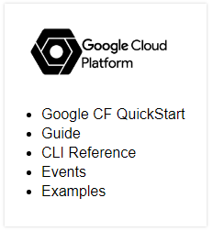
Different Providers
moving to serverless has a learning curve as well. You need to learn the intricacies of the platform you're using, including low-level details like format of the request input and the required shape of the response output. This can get in the way and slow your development process.
Deploy a REST API using Serverless, Express and Node.js

Slide 2
Serverless CLI and plugins:
The Serverless Framework is a CLI tool that allows users to build & deploy auto-scaling, pay-per-execution, event-driven functions.
Write your code, configure events(http etc) to trigger your functions, then deploy & run those functions to your cloud provider via the Serverless CLI.
The Framework uses new event-driven compute services, like AWS Lambda, Google CloudFunctions, and more. It's a command-line tool, providing scaffolding, workflow automation and best practices for developing and deploying your serverless architecture. It's also completely extensible via plugins
Plugins :
serverless-http – for express apps
serverless-offline – for running your app in local
serverless-step-functions – for managing states between lambda function
serverless-alexa-plugin - This plugins compiles the Alexa Skills Kit events to a CloudFormation resource.

Slide 3
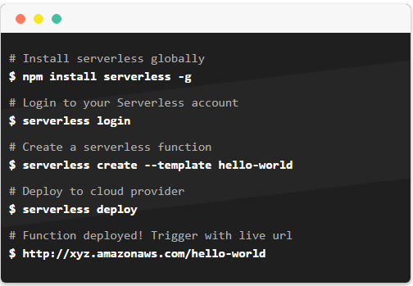
Quick Start :

Slide 4
Step function
When diving into the Function as a service (FAAS) world, a question that often pops up is
If serverless functions are stateless, how do I manage state?
There are a number of ways to manage state with backend data stores, tmp directories & building this logic into your existing lambda functions but there is a simpler alternative provided by AWS: Step functions.
Step Functions allows you to control complex workflows using Lambda functions without the underlying application managing and orchestrating the state. In essence, it's a state machine to help with complex workflows and aims at keeping your lambda functions free of this additional logic.

Slide 5
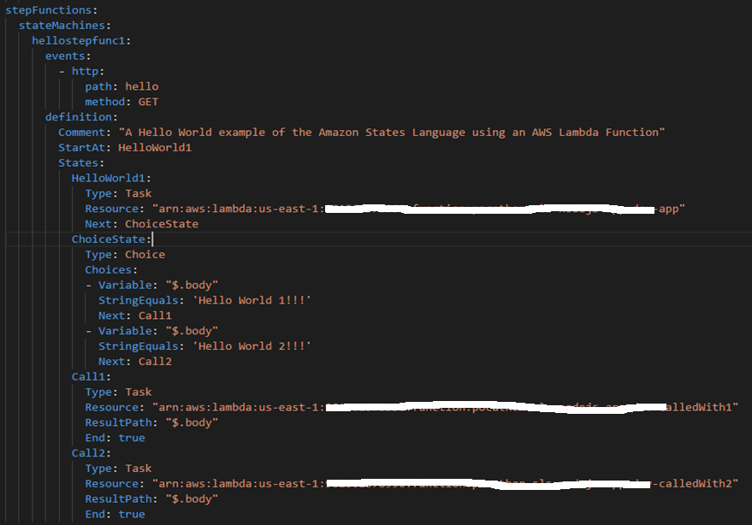
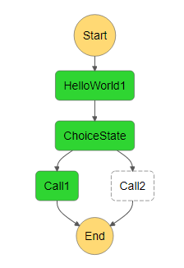
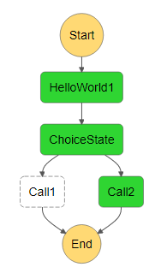
Step function Example :

