Slide 1


MongoDB
Introduction to
Girish Gupta
https://github.com/girishgupta211/MongoDBWithNode.js
Feb 6th 2017

Slide 2
What is MongoDB ?
• Scalable High-Performance Open-source, Document-orientated database.
• Built for Speed
• Rich Document based queries for Easy readability.
• Full Index Support for High Performance.
• Replication and Failover for High Availability.
• Auto Sharding for Easy Scalability.
• Map / Reduce for Aggregation.

Slide 3
Why use MongoDB?
• SQL was invented in the 70’s to store data.
• MongoDB stores documents (or) objects.
• Now-a-days, everyone works with objects (Python/Ruby/Java/etc.)
• And we need Databases to persist our objects. Then why not store objects directly ?
• Embedded documents and arrays reduce need for joins. No Joins and No-multi document transactions.

Slide 4
What is MongoDB great for?
• RDBMS replacement for Web Applications.
• Semi-structured Content Management.
• Real-time Analytics & High-Speed Logging.
• Caching and High Scalability
Web 2.0, Media, SAAS, Gaming
HealthCare, Finance, Telecom, Government

Slide 5









Some Companies using MongoDB in Production

Slide 6
Let’s Dive in !

Slide 7
RDBMS Vs MongoDB
• Collection vs. table
• Document vs. row
• Filed vs. Column

Slide 8
When I say
Think
Database
Database
• Made up of Multiple Collections.
• Created on-the-fly when referenced for the first time.

Slide 9
When I say
Think
Collection
Table
• Schema-less, and contains Documents.
• Indexable by one/more keys.
• Created on-the-fly when referenced for the first time.
• Capped Collections: Fixed size, older records get dropped after reaching the limit.

Slide 10
When I say
Think
Document
Record/Row
• Stored in a Collection.
• Can have _id key – works like Primary keys in MySQL.
• Supported Relationships – Embedded (or) References.
• Document storage in BSON (Binary form of JSON).

Slide 11
Understanding the Document Model.
var p = {
‘_id’: ‘3432’,
‘author’: DBRef(‘User’, 2),
‘title’: ‘Introduction to MongoDB’,
‘body’: ‘MongoDB is an open sources.. ‘,
‘timestamp’: Date(’01-04-12’),
‘tags’: [‘MongoDB’, ‘NoSQL’],
‘comments’: [{‘author’: DBRef(‘User’, 4),
‘date’: Date(’02-04-12’),
‘text’: ‘Did you see.. ‘,
‘upvotes’: 7, … ]
}
> db.posts.save(p);

Slide 12
Secondary Indexes
Create Index on any field in the document
// 1 means ascending, -1 means descending
> db.posts.ensureIndex({‘author’: 1});
//Index Nested Documents
> db.posts.ensureIndex(‘comments.author’: 1);
// Index on tags
> db.posts.ensureIndex({‘tags’: 1});
// Geo-spatial Index
> db.posts.ensureIndex({‘author.location’: ‘2d’});

Slide 13
What about Queries? So Simple
// find posts which has ‘MongoDB’ tag.
> db.posts.find({tags: ‘MongoDB’});
// find posts by author’s comments.
> db.posts.find({‘comments.author’: DBRef(‘User’,2)}).count();
// find posts written after 31st March.
> db.posts.find({‘timestamp’: {‘gte’: Date(’31-03-12’)}});
// find posts written by authors around [22, 42]
> db.posts.find({‘author.location’: {‘near’:[22, 42]});
$gt, $lt, $gte, $lte, $ne, $all, $in, $nin, count, limit, skip, group, etc…

Slide 14
What about Updates? Atomic Operations makes it simple
db.posts.update({_id: ‘3432’},
{‘title’: ‘Introduction to MongoDB (updated)’,
‘text’: ‘Updated text’,
${addToSet: {‘tags’: ‘webinar’}});
$set, $unset
$push, $pull, $pop, $addToSet
$inc, $mul, $rename, $min , $max many more…
Where are my joins and transactions? !!!

Slide 15
Some Cool features
• Geo-spatial Indexes for Geo-spatial queries.
$near, $within_distance, Bound queries (circle, box)
• GridFS
Stores Large Binary Files.
• Map/Reduce
GROUP BY in SQL, map/reduce in MongoDB.

Slide 16
Deployment
& Scaling

Slide 17
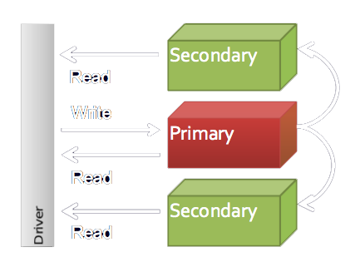
Replica Sets

Slide 18
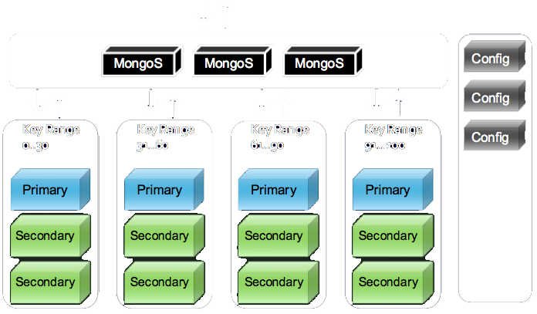
Sharding

