Slide 1

C++ Learnings
By Girish Lande

Slide 2
Rule of Five
The rule of three and rule of five are rules of thumb in C++ for the building of exception-safe code and for formalizing rules on resource management. The rules prescribe how the default members of a class should be used to achieve these goals systematically.
if a class defines any of the following then it should probably explicitly define all three:[1]
destructor
copy constructor
copy assignment operator
move constructor
move assignment operator

Slide 3
Re-entrant function
A thread-safe function can be called simultaneously from multiple threads, even when the invocations use shared data, because all references to the shared data are serialized.
A re-entrant function can also be called simultaneously from multiple threads, but only if each invocation uses its own data.
Hence, a thread-safe function is always re-entrant, but a re-entrant function is not always thread-safe.

Slide 4
Re entrant class
a class is said to be re-entrant if its member functions can be called safely from multiple threads, as long as each thread uses a different instance of the class. The class is thread-safe if its member functions can be called safely from multiple threads, even if all the threads use the same instance of the class

Slide 5
Example of re-entrant class
class Counter
{
public:
Counter() { n = 0; }
void increment() { ++n; }
void decrement() { --n; }
int value() const { return n; }
private:
int n;
};
Class Counter is re-entrant.
The class isn't thread-safe, because if multiple threads try to modify the data member n, the result is undefined. This is because the ++ and -- operators aren't always atomic. Indeed, they usually expand to three machine instructions:

Slide 6
Search datafiles in current project directory
void search(const fs::path& file_name)
{
const fs::path pathToShow { fs::current_path() };
const fs::path parentpath = pathToShow.parent_path();
auto d = fs::recursive_directory_iterator(parentpath);
fs::path absPath;
auto found = std::find_if(d, end(d), [&file_name, &absPath](const auto& dir_entry) {
if (dir_entry.path().filename() == file_name) {
absPath = dir_entry.path();
return true;
}
return false;
});
if (found != end(d)) {
// we have found what we were looking for
cout << "We have found file:" << absPath;
} else {
cout << "We didn't find file";
}
}

Slide 7
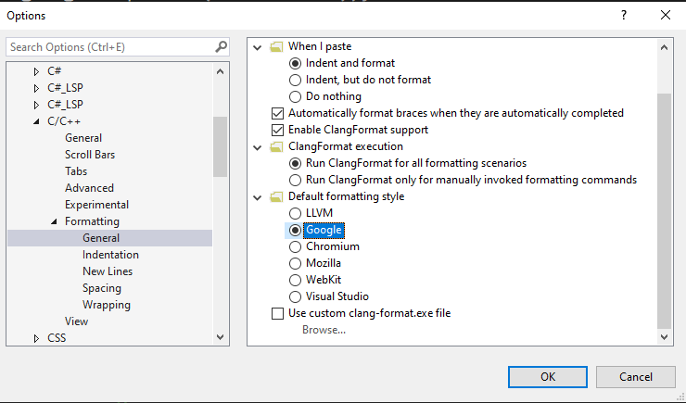
Updating coding style
Different standards of c++ code styling

Slide 8
About Templates
You cannot have templates in source file .cpp
You should add all source code in header only. Because templates are expanded at compile time

Slide 9
emplace_back() vs push_back()
push_back() copies a string into a vector. First, a new string object will be implicitly created initialized with provided char*. Then push_back will be called which will copy this string into the vector using the move constructor because the original string is a temporary object. Then the temporary object will be destroyed.
emplace_back() constructs a string in-place, so no temporary string will be created but rather emplace_back() will be called directly with char* argument. It will then create a string to be stored in the vector initialized with this char*. So, in this case, we avoid constructing and destroying an unnecessary temporary string object.

Slide 10
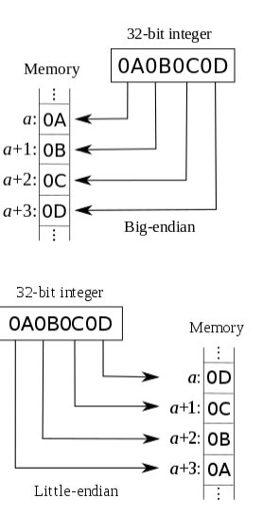
Little endian vs Big Endian
#define SWAP_INT16(x) (((x) >> 8) | ((x) << 8))
void memory_represent(char *value, int n) {
int i;
for (i = 0; i < n; i++) printf(" %.2x", value[i]);
}
int main() {
{
unsigned short x = 32000;
unsigned short y;
cout << "The little endian value is: ";
memory_represent((char *)&x, sizeof(x));
cout << endl;
y = _byteswap_ushort(x);
y = SWAP_INT16(x);
cout << "The Big endian value after conversion is: ";
memory_represent((char *)&y, sizeof(y));
cout << endl;
}
Convert between little endian and big endian

Slide 11
2 ways to pass pointer and allocate memory to it.
void func(int** ptr) { *ptr = new int(10); }
int* f1() { return new int(20); }
int main(int argc, const char* argv[]) {
int* ptr = nullptr;
int* p2 = f1();
func(&ptr);
std::cout << *ptr << "\n";
std::cout << *p2 << "\n";
}

Slide 12
Yoda conditions
The main reason to do this (so-called "Yoda conditional") is to prevent accidents whereby you accidentally use an assignment operator (=) instead of the equal comparison operator (==).
That is, if you made the mistake of doing:
$foo = 5;
if ($foo = 1) {
// Stuff
}
The statement will evaluate to true (or, in the case of some languages—like PHP—a truthy value) and you'll have a hard-to-find bug.
But if you did:
$foo = 5;
if (1 = $foo) {
// Stuff
}
You'll receive a fatal error because you can't assign $foo to an integer.
But as you pointed out, reversing the order generally makes things less readable. So, many coding standards (but not all, including WordPress) suggest or require $foo == 1 despite the bug hunting benefits of 1 == $foo.

Slide 13
Header

Slide 14
Header

Slide 15
Header

Slide 16
Header

