Slide 1


Slide 2
C++

Slide 3
C++
Applications: Windows, Mac, Android, Adobe system, Google application, chrome, MYSQL server, Microsoft Office, IE, Visual studio, Facebook, Youtube, Amazon, Orable, SAP, MongoDB, IDEs, etc.
Features
STL containers
Templates
Exceptions
File IO
Multithreading
Rule of Five
Function pointers
Lambda expressions
Virtual functions
Operator overloading
Inheritance
Polymorphism

Slide 4
C++
STL containers
Vector (Dynamic array) size vs capacity
Lists (dynamic container)
Vector vs Lists (append, insert, delete, random access)
Maps (internally balanced Red black tree, keys are sorted)
Custom objects as Map values
Multimaps
Sorting vectors

Slide 5
C++
Templates
Template functions
template <typename T>
T myMax(T x, T y)
{
return (x > y)? x: y;
}
Template classes
template <typename T>
class Array {
private:
T *ptr;
int size;
public:
Array(T arr[], int s);
void print();
};
template <typename T>
Array<T>::Array(T arr[], int s) {
ptr = new T[s];
size = s;
for(int i = 0; i < size; i++)
ptr[i] = arr[i];
}
template <typename T>
void Array<T>::print() {
for (int i = 0; i < size; i++)
cout<<" "<<*(ptr + i);
cout<<endl;
}

Slide 6
C++
void performCheck(const string& testname, bool (*func)(int), int n)
{
cout << endl << testname << endl;
if (func(n)) {
cout << "Passed!!" << endl;
} else {
cout << "Failed!!" << endl;
}
}
int main()
{
int n = 5;
bool (*func)(int n);
performCheck("Check if number is prime", isPrime, 5);
performCheck("Check if number is Even", isEven, 5);
return 0;
}
Function pointers
bool isPrime(int n)
{
bool prime = true;
for (int i = 2; i < n; i++) {
if (n % i == 0)
return false;
}
return true;
}
bool isEven(int n)
{
return n % 2 == 0;
}

Slide 7
C++
Functor
class myFunc {
int arg;
public:
myFunc(int a)
: arg(a)
{
}
void operator()(int n)
{
cout << "\nThis is functor:" << (n/arg);
}
};
int main()
{
myFunc func(2);
func(5);
func(10);
cout << endl;
return 0;
}

Slide 8
C++
auto keyword
int main()
{
vector<int> a { 10, 20, 30, 40, 50 };
for (vector<int>::iterator it = a.begin(); it != a.end(); ++it) {
cout << *it <<endl;
}
for (auto it = a.begin(); it != a.end(); it++) {
cout << *it << endl;
}
for (auto x : a) {
cout << x << endl;
}
return 0;
}

Slide 9
C++
Lambda expressions
#include <algorithm>
#include <vector>
namespace {
struct f {
void operator()(int) {
// do something
}
};
}
void func(std::vector<int>& v) {
f f;
std::for_each(v.begin(), v.end(), f);
}
Syntax: []() { } // barebone lambda
void func3(std::vector<int>& v) {
std::for_each(v.begin(), v.end(), [](int) { /* do something here*/ });
}

Slide 10
C++
Rule of 5
that claims that if a class defines any of the following then it should probably explicitly define all five:
destructor
copy constructor
copy assignment operator
move constructor
move assignment operator

Slide 11
C++
int main()
{
int x = -1;
// Some code
cout << "Before try \n";
try {
cout << "Inside try \n";
if (x < 0)
{
throw x;
cout << "After throw (Never executed) \n";
}
}
catch (int x ) {
cout << "Exception Caught \n";
}
cout << "After catch (Will be executed) \n";
return 0;
}
Exceptions

Slide 12
C++
fstream stream;
stream.open("abc.txt", ios::out);
if (stream.is_open()) {
cout << "File is opened for write" << endl;
stream << "Hi This is one line \nThis is second line" << endl;
stream.close();
} else {
cout << "failed to open a stream.";
}
stream.open("abc.txt", ios ::in);
if (stream.is_open()) {
cout << "File is opened for read:" << endl;
string str;
while (stream) {
stream >> str;
cout << str << " ";
}
cout << "\n";
stream.close();
}
File IO

Slide 13
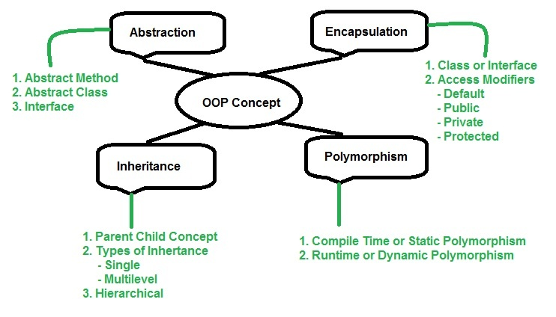
C++
Object Oriented programming

Slide 14
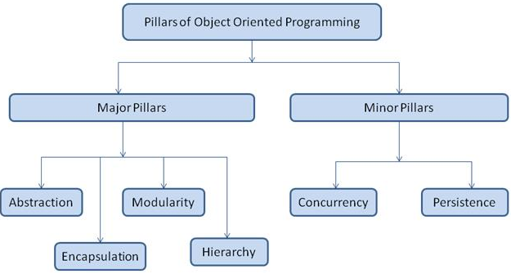
C++
Pillars of OOP

Slide 15
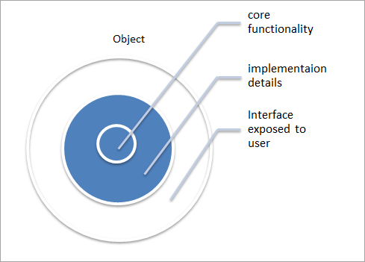

C++
Abstraction
interface, abstract class

Slide 16
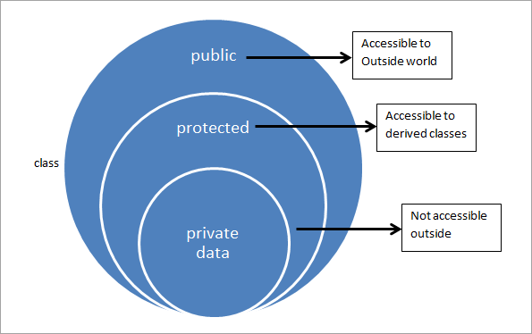
C++
Encapsulation
access specifiers

Slide 17
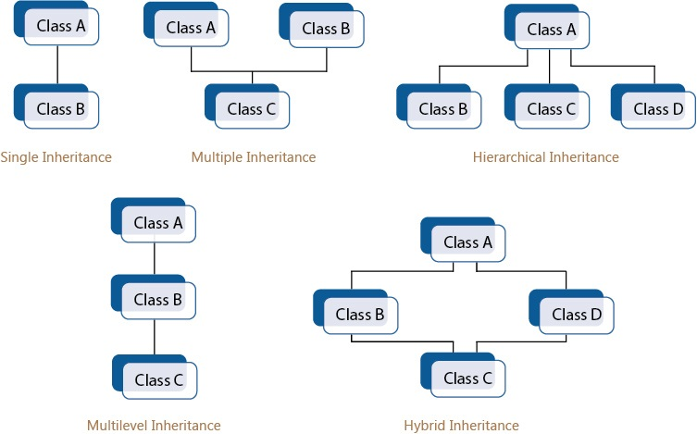
C++
Inheritance

Slide 18
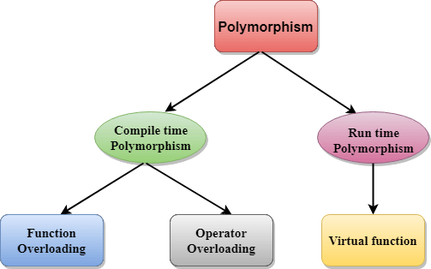
C++
Polymorphism

Slide 19
using ICadMarkModelPtr = std::shared_ptr<ICadMarkModel>;
using ICadMarkModelVector = std::vector<ICadMarkModelPtr>;

Slide 20


