Slide 1

C++ Learnings
By Girish Lande

Slide 2
Rule of Five
The rule of three and rule of five are rules of thumb in C++ for the building of exception-safe code and for formalizing rules on resource management. The rules prescribe how the default members of a class should be used to achieve these goals systematically.
if a class defines any of the following then it should probably explicitly define all five:
destructor
copy constructor
copy assignment operator
move constructor
move assignment operator

Slide 3
Re-entrant function
A thread-safe function can be called simultaneously from multiple threads, even when the invocations use shared data, because all references to the shared data are serialized.
A re-entrant function can also be called simultaneously from multiple threads, but only if each invocation uses its own data.
Hence, a thread-safe function is always re-entrant, but a re-entrant function is not always thread-safe.

Slide 4
Re entrant class
a class is said to be re-entrant if its member functions can be called safely from multiple threads, as long as each thread uses a different instance of the class. The class is thread-safe if its member functions can be called safely from multiple threads, even if all the threads use the same instance of the class

Slide 5
Example of re-entrant class
class Counter
{
public:
Counter() { n = 0; }
void increment() { ++n; }
void decrement() { --n; }
int value() const { return n; }
private:
int n;
};
Class Counter is re-entrant.
The class isn't thread-safe, because if multiple threads try to modify the data member n, the result is undefined. This is because the ++ and -- operators aren't always atomic. Indeed, they usually expand to three machine instructions:

Slide 6
Search datafiles in current project directory
void search(const fs::path& file_name)
{
const fs::path pathToShow { fs::current_path() };
const fs::path parentpath = pathToShow.parent_path();
auto d = fs::recursive_directory_iterator(parentpath);
fs::path absPath;
auto found = std::find_if(d, end(d), [&file_name, &absPath](const auto& dir_entry) {
if (dir_entry.path().filename() == file_name) {
absPath = dir_entry.path();
return true;
}
return false;
});
if (found != end(d)) {
// we have found what we were looking for
cout << "We have found file:" << absPath;
} else {
cout << "We didn't find file";
}
}

Slide 7
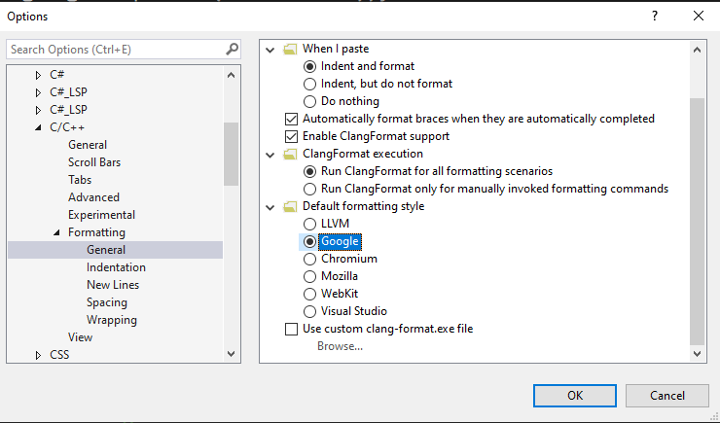
Updating coding style in Visual studio
Different standards of c++ code styling

Slide 8
About Templates
You cannot have templates in source file .cpp
You should add all source code in header only. Because templates are expanded at compile time

Slide 9
emplace_back() vs push_back()
push_back() copies a string into a vector. First, a new string object will be implicitly created initialized with provided char*. Then push_back will be called which will copy this string into the vector using the move constructor because the original string is a temporary object. Then the temporary object will be destroyed.
emplace_back() constructs a string in-place, so no temporary string will be created but rather emplace_back() will be called directly with char* argument. It will then create a string to be stored in the vector initialized with this char*. So, in this case, we avoid constructing and destroying an unnecessary temporary string object.

Slide 10
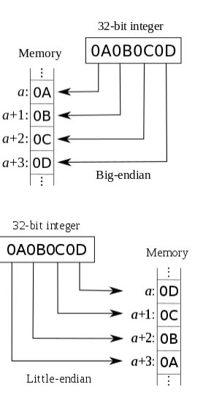
Little endian vs Big Endian
#define SWAP_INT16(x) (((x) >> 8) | ((x) << 8))
void memory_represent(char *value, int n) {
int i;
for (i = 0; i < n; i++) printf(" %.2x", value[i]);
}
int main() {
{
unsigned short x = 32000;
unsigned short y;
cout << "The little endian value is: ";
memory_represent((char *)&x, sizeof(x));
cout << endl;
y = _byteswap_ushort(x);
y = SWAP_INT16(x);
cout << "The Big endian value after conversion is: ";
memory_represent((char *)&y, sizeof(y));
cout << endl;
}
Convert between little endian and big endian

Slide 11
2 ways to pass pointer and allocate memory to it.
void func(int** ptr) { *ptr = new int(10); }
int* f1() { return new int(20); }
int main(int argc, const char* argv[]) {
int* ptr = nullptr;
int* p2 = f1();
func(&ptr);
std::cout << *ptr << "\n";
std::cout << *p2 << "\n";
}

Slide 12
Yoda conditions
The main reason to do this (so-called "Yoda conditional") is to prevent accidents whereby you accidentally use an assignment operator (=) instead of the equal comparison operator (==).
That is, if you made the mistake of doing:
$foo = 5;
if ($foo = 1) {
// Stuff
}
The statement will evaluate to true (or, in the case of some languages—like PHP—a truthy value) and you'll have a hard-to-find bug.
But if you did:
$foo = 5;
if (1 = $foo) {
// Stuff
}
You'll receive a fatal error because you can't assign $foo to an integer.
But as you pointed out, reversing the order generally makes things less readable. So, many coding standards (but not all, including WordPress) suggest or require $foo == 1 despite the bug hunting benefits of 1 == $foo.

Slide 13
Doxygen comments
@class PhantomDetector
@brief Main API class for Phantom type detection
/*!
@fn <function name>
@brief <function description>
\returns explain return value
@param[in] <input explanation>
@param[out] <output explanation>
*/
Should We have doxygen interface only for public interface ?
https://github.com/GalSim-developers/GalSim/issues/182
Do we really want to be doxygenizing private (and protected) methods and variables? My preference would be no, for two reasons:
They are implementation details that the user doesn't need to know about. We shouldn't be adding extra text in the documentation that they shouldn't ever need to read.
I find doxy comments less readable inline than regular comments. The extra markup just gets in the way, IMO. It's clearly worth it for documenting the public interface, since it makes nice web pages. But when you're just describing how something is working for the next developer that might come along and need to edit the code, I find regular comments to be more readable and thus more effective.

Slide 14
Open explorer from command prompt
In Bash, to view the current directory in Windows File Explorer just enter:
explorer.exe .
Don't leave out the ".".
This will open windows explorer at the current folder and you can see where everything is in relation to the rest of your Windows system.

Slide 15
Windows subsystem for Linux
What is Windows Subsystem for Linux (WSL)?
The Windows Subsystem for Linux (WSL) is a new Windows 10 feature that enables you to run native Linux command-line tools directly on Windows, alongside your traditional Windows desktop and modern store apps.
How do I access my C: drive?
Mount points for hard drives on the local machine are automatically created and provide easy access to the Windows filesystem.
/mnt/<drive letter>/
Example usage would be cd /mnt/c to access c:\

Slide 16
#pragma pack effect
https://stackoverflow.com/questions/3318410/pragma-pack-effect

Slide 17
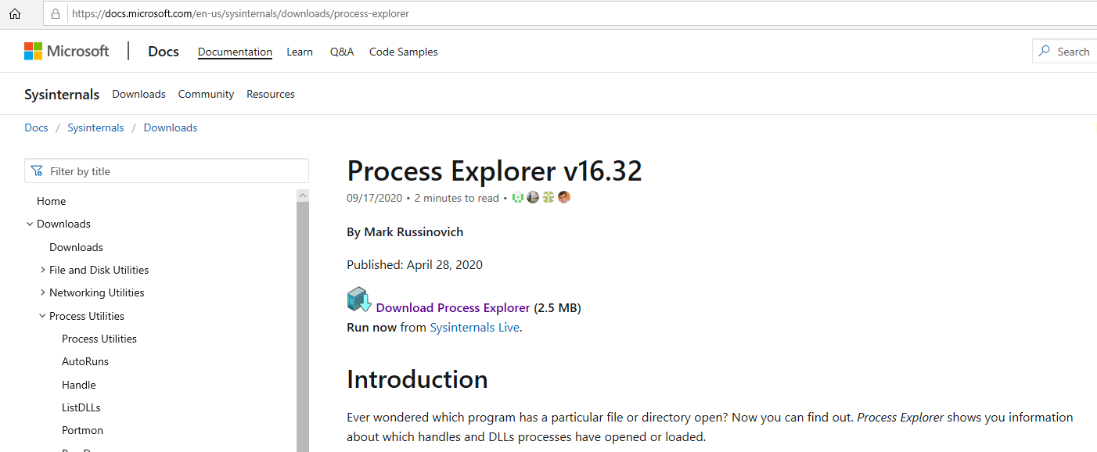
To check dll is being held by which process

Slide 18
Taskkill to kill process in windows
You can identify all processes using following command
> tasklist
> taskkill /F /PID 15720

Slide 19
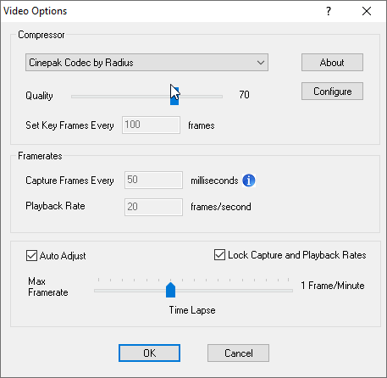

How to record a video tutorial using CamStudio
AS we know only CamStudio is free recording software.
You can use some codecs for recording a light weight videos.
Following are the basic settings that you need to do in Camtasia

Slide 20
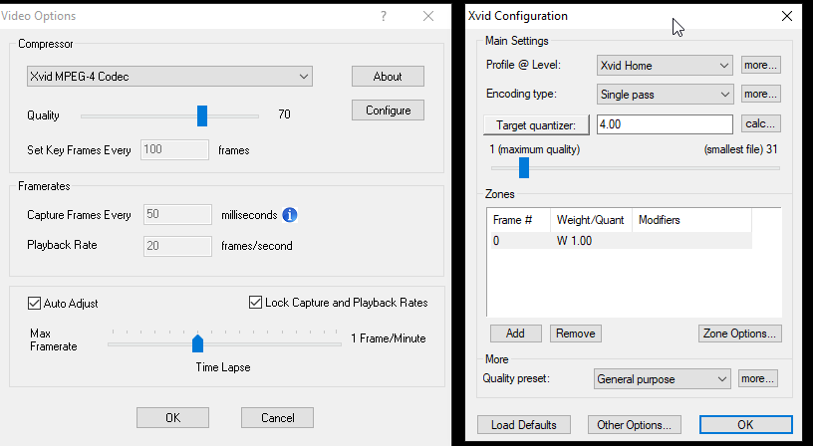
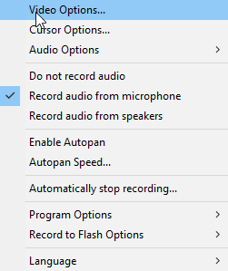
Use some codes to lower the size of recording file

Slide 21
You can use Screencast-O-Matic software for recording your videos. This is good one but antivirus software blocks it and hence you should try it on your personal computer.

Slide 22
Wizard comics
https://wizardzines.com/comics/

Slide 23
Header

Slide 24
Header

Slide 25
Header

