Slide 1
Ways to integrate C++ with QML
Subclassing QQuickItem: QQuickItem allows you to write your own visual and non-visual QML items using C++.
Registering C++ types with QML: C++ classes can be registered with the QML type system,
allowing them to be instantiated as QML types.
Registering Context Properties: QObjects can be registered with the QML context,
allowing their properties to be directly accessed.
Accessing QML objects through the QML object tree: All QML objects reside in a tree hierarchy and
can be accessed via the root of the tree.
Note: When you want to expose c++ class to QML you need to derive it from QObject and then you can register it with QML using following format. qmlRegisterType<ECGViewModel>("ECGViewModel",1,0,"ECGViewModel");
IF you want to have property as another class then you need to derive that class from Qobject as well.
Notes:
1

Slide 2
Reading item from the listmodel at given index
console.log(curvecolormodel.get(currentIndex).value);

Slide 3
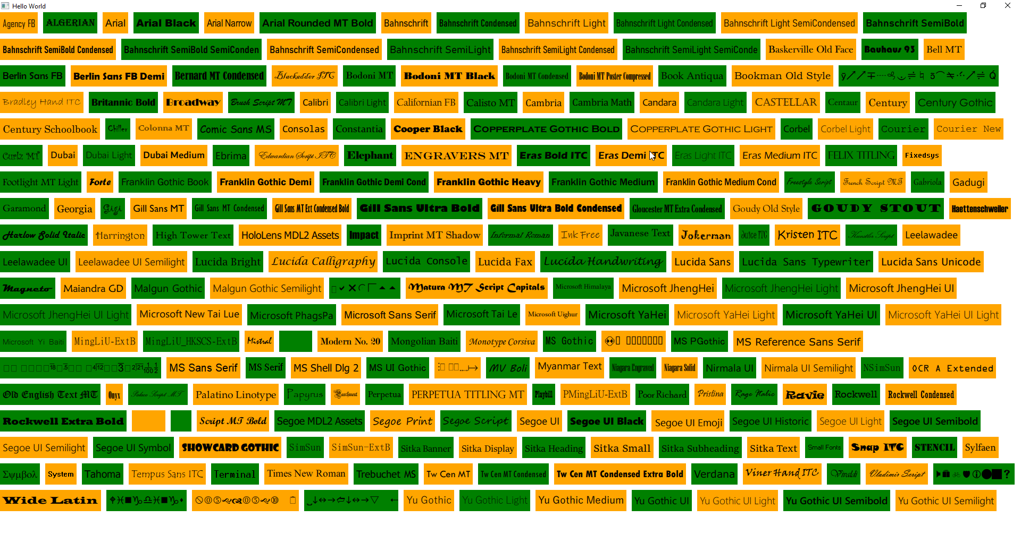
QML Supported Fonts

Slide 4
To Debug QML code you can use rectangle to check the QML element area
This can be done in following fashion. So lets say I want to test StatDisplay element then I can do the following
Rectangle{
width: s1.implicitWidth
height: s1.implicitHeight
color: "orange"
StatDisplay{
id: s1
}
}

Slide 5
You can set up binding of QML with C++ code as follows
Component.onCompleted: {
GameSettings.wWidth = Qt.binding(function() {return width})
GameSettings.wHeight = Qt.binding(function() {return height})
}
In this case when component is loaded then we are setting the binding of c++ object with the current width and height.
This is required in cases where we don’t know when the object will be created and how to setup the binding so that it works.

Slide 6
Properties in QML
// Colors
readonly property color backgroundColor: "#2d3037"
readonly property color buttonColor: "#202227"
readonly property color buttonPressedColor: "#6ccaf2“
// Float values
property real microFontSize: hugeFontSize * 0.2
property real tinyFontSize: hugeFontSize * 0.4

Slide 7
Settings class in QML
// following is how to use singleton class
import "."
Window {
id: wroot
visible: true
width: 720 * .7
height: 1240 * .7
color: GameSettings.b1
Component.onCompleted: {
GameSettings.wWidth = Qt.binding(function() {return width})
GameSettings.wHeight = Qt.binding(function() {return height})
}
Following is singleton class in QML
// GameSettings.qml
pragma Singleton
import QtQuick 2.5
Item {
property int wHeight
property int wWidth
property color b1: "#202227“
}
You need to create a file qmldir and add following line in it
singleton GameSettings 1.0 GameSettings.qml

Slide 8
How to load QML file using Loader component and how to handle signals
Loader {
id: splashLoader
anchors.fill: parent
source: "SplashScreen.qml"
asynchronous: false
visible: true
onStatusChanged: {
if (status === Loader.Ready) {
appLoader.setSource("App.qml");
}
}
}
// In following connection we hide the loader when we get the signal readyToGo() from the qml item which is loaded in splashLoader. We load another qml in another loader and set active focus to it.
Connections {
target: splashLoader.item
onReadyToGo: {
splashLoader.visible = false
splashLoader.setSource("")
appLoader.item.forceActiveFocus();
}
}

Slide 9
Controlling font size based on the Dialog size
property int wHeight // height of window
property int wWidth // width of the window
// Font sizes
property real microFontSize: hugeFontSize * 0.2
property real tinyFontSize: hugeFontSize * 0.4
property real smallTinyFontSize: hugeFontSize * 0.5
property real smallFontSize: hugeFontSize * 0.6
property real mediumFontSize: hugeFontSize * 0.7
property real bigFontSize: hugeFontSize * 0.8
property real largeFontSize: hugeFontSize * 0.9
property real hugeFontSize: (wWidth + wHeight) * 0.03
property real giganticFontSize: (wWidth + wHeight) * 0.04
// Uses
Text {
font.pixelSize: GameSettings.tinyFontSize
}

