Slide 1
Ways to integrate C++ with QML
Subclassing QQuickItem: QQuickItem allows you to write your own visual and non-visual QML items using C++.
Registering C++ types with QML: C++ classes can be registered with the QML type system,
allowing them to be instantiated as QML types.
Registering Context Properties: QObjects can be registered with the QML context,
allowing their properties to be directly accessed.
Accessing QML objects through the QML object tree: All QML objects reside in a tree hierarchy and
can be accessed via the root of the tree.
Note: When you want to expose c++ class to QML you need to derive it from QObject and then you can register it with QML using following format. qmlRegisterType<ECGViewModel>("ECGViewModel",1,0,"ECGViewModel");
IF you want to have property as another class then you need to derive that class from Qobject as well.
Notes:
1

Slide 2
Reading item from the listmodel at given index
console.log(curvecolormodel.get(currentIndex).value);

Slide 3
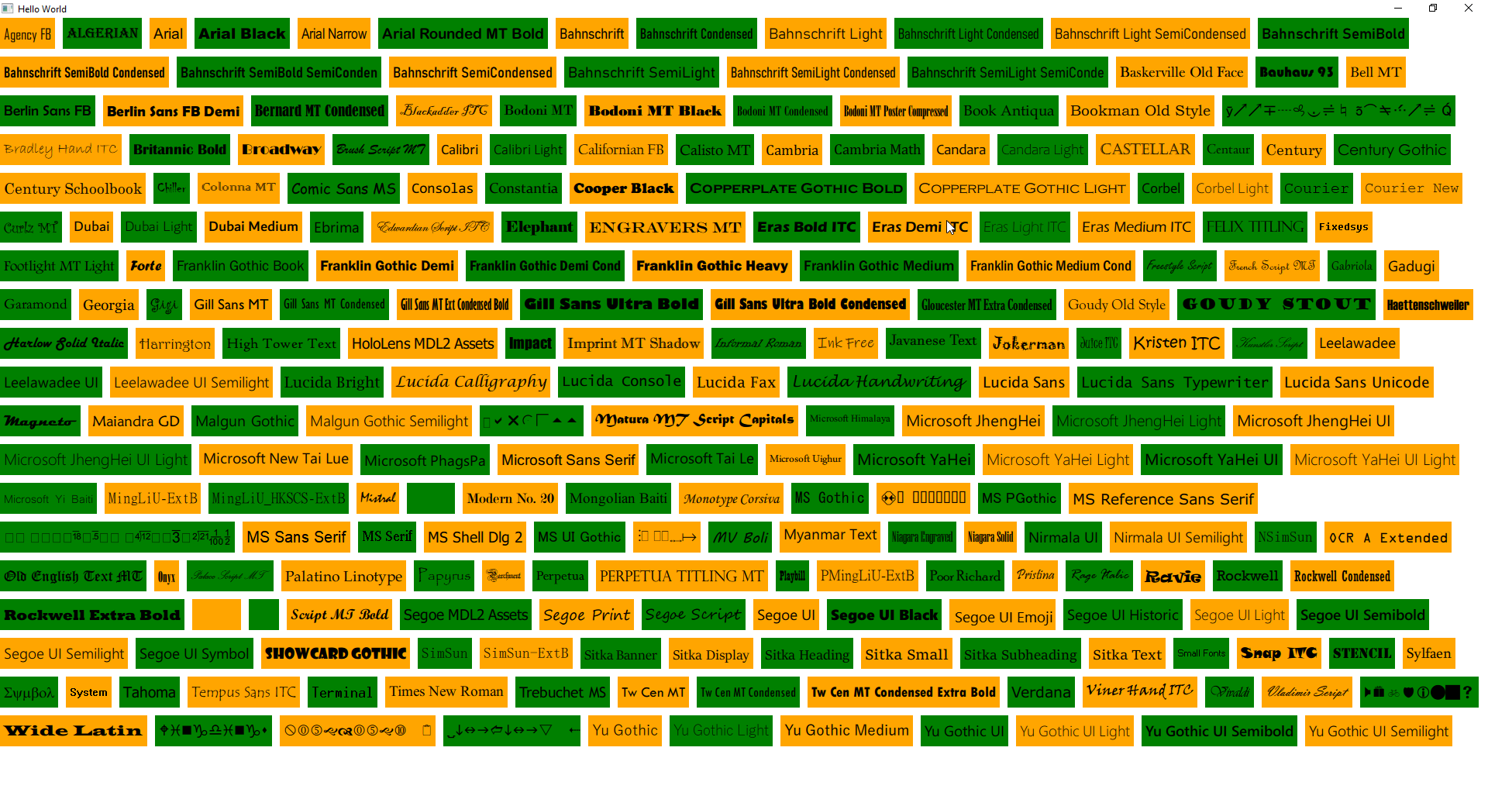
QML Supported Fonts

Slide 4
To Debug QML code you can use rectangle to check the QML element area
This can be done in following fashion. So lets say I want to test StatDisplay element then I can do the following
Rectangle{
width: s1.implicitWidth
height: s1.implicitHeight
color: "orange"
StatDisplay{
id: s1
}
}

Slide 5
Binding of QML with C++
You can set up binding of QML with C++ code as follows
Component.onCompleted: {
GameSettings.wWidth = Qt.binding(function() {return width})
GameSettings.wHeight = Qt.binding(function() {return height})
}
In this case when component is loaded then we are setting the binding of c++ object with the current width and height.
This is required in cases where we don’t know when the object will be created and how to setup the binding so that it works.

Slide 6
Properties in QML
// Colors
readonly property color backgroundColor: "#2d3037"
readonly property color buttonColor: "#202227"
readonly property color buttonPressedColor: "#6ccaf2“
// Float values
property real microFontSize: hugeFontSize * 0.2
property real tinyFontSize: hugeFontSize * 0.4

Slide 7
Settings class in QML
// following is how to use singleton class
import "."
Window {
id: wroot
visible: true
width: 720 * .7
height: 1240 * .7
color: GameSettings.b1
Component.onCompleted: {
GameSettings.wWidth = Qt.binding(function() {return width})
GameSettings.wHeight = Qt.binding(function() {return height})
}
Following is singleton class in QML
// GameSettings.qml
pragma Singleton
import QtQuick 2.5
Item {
property int wHeight
property int wWidth
property color b1: "#202227“
}
You need to create a file qmldir and add following line in it
singleton GameSettings 1.0 GameSettings.qml

Slide 8
How to load QML file using Loader component and how to handle signals
Loader {
id: splashLoader
anchors.fill: parent
source: "SplashScreen.qml"
asynchronous: false
visible: true
onStatusChanged: {
if (status === Loader.Ready) {
appLoader.setSource("App.qml");
}
}
}
// In following connection we hide the loader when we get the signal readyToGo() from the qml item which is loaded in splashLoader. We load another qml in another loader and set active focus to it.
Connections {
target: splashLoader.item
onReadyToGo: {
splashLoader.visible = false
splashLoader.setSource("")
appLoader.item.forceActiveFocus();
}
}

Slide 9
Controlling font size based on the Dialog size
property int wHeight // height of window
property int wWidth // width of the window
// Font sizes
property real microFontSize: hugeFontSize * 0.2
property real tinyFontSize: hugeFontSize * 0.4
property real smallTinyFontSize: hugeFontSize * 0.5
property real smallFontSize: hugeFontSize * 0.6
property real mediumFontSize: hugeFontSize * 0.7
property real bigFontSize: hugeFontSize * 0.8
property real largeFontSize: hugeFontSize * 0.9
property real hugeFontSize: (wWidth + wHeight) * 0.03
property real giganticFontSize: (wWidth + wHeight) * 0.04
// Uses
Text {
font.pixelSize: GameSettings.tinyFontSize
}

Slide 10
Custom controls are used for changing default controls based on the needs
Go to Itemdelegate help documentation. There is link for customize Itemdelegate. Follow that documentation and you will find that there is example of how to customize each control that’s available in QML.

Slide 11
Exposing C++ to QML (Creating objects as properties)
When you expose any c++ class to QML you derive it from QObject.
This class can have properties.
Property can be another class object. This Another class object must also be derived from QObject.
While you can have this another class object as member, you must return its pointer to QML world. (This is important because QML cannot take object reference and is not responsible for memory management of that property)
class Person : public QObject
{
Q_OBJECT
Q_PROPERTY(QString name READ name WRITE setName NOTIFY nameChanged)
Q_PROPERTY(ShoeDescription *shoe READ shoe CONSTANT)
public:
Person(QObject *parent = nullptr);
QString name() const;
void setName(const QString &);
ShoeDescription *shoe();
signals:
void nameChanged();
private:
QString m_name;
ShoeDescription m_shoe;
};
ShoeDescription *Person::shoe()
{
return &m_shoe;
}

Slide 12
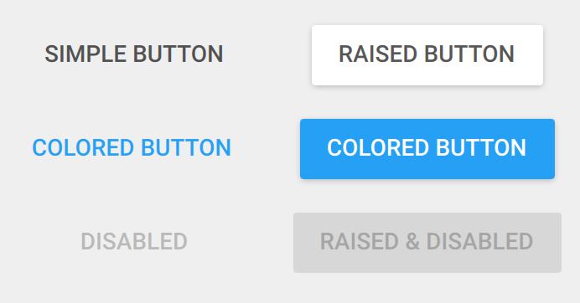
Third Party Material library for beautiful components
This is a library of QML widgets implementing Google's Material Design. It is completely cross platform, and runs on Linux, OS X, and Windows. It may also run on iOS and Android, though those platforms have not been tested and are not currently officially supported.

Slide 13
Qmake guide for creating subdir project and adding subprojects
https://www.toptal.com/qt/vital-guide-qmake
For a simple subdir project containing one application and one library following setup is good.
/project
../library
../application
TEMPLATE = subdirs
SUBDIRS = library application
application.depends = library
library.pri
LIBTARGET = library
BASEDIR = $${PWD}
INCLUDEPATH *= $${BASEDIR}
win32:CONFIG(release, debug|release): LIBS += -L$$OUT_PWD/../library/release/ -llibrary
else:win32:CONFIG(debug, debug|release): LIBS += -L$$OUT_PWD/../library/debug/ -llibrary
else:unix: LIBS += -L$$OUT_PWD/../library/ -llibrary
In the application.pro file add
include(../library/library.pri)

Slide 14
Adding dependency to third party library in .pro file
Since it's possible to build from different directory than project directory, relative path pointing to project directory should be prefixed with $$PWD/ (PWD qmake variable contains absolute path to directory with currently processed *.pro file).
Your line would look like:
LIBS += -L"$$PWD/sqlite3" -lsqlite3
If another library is your own library (just a subproject in the application)
You can add (library.pri) file in library project and add following lines in it
LIBTARGET = library
BASEDIR = $${PWD}
INCLUDEPATH *= $${BASEDIR}
win32:CONFIG(release, debug|release): LIBS += -L$$OUT_PWD/../library/release/ -llibrary
else:win32:CONFIG(debug, debug|release): LIBS += -L$$OUT_PWD/../library/debug/ -llibrary
else:unix: LIBS += -L$$OUT_PWD/../library/ -llibrary
Then link to it by adding following line in application.pro file
include(../library/library.pri)

Slide 15
Specify debug and release folders for application
For my Qt project, I use this scheme in *.pro file:
HEADERS += src/dialogs.h
SOURCES += src/main.cpp \
src/dialogs.cpp
Release:DESTDIR = release
Release:OBJECTS_DIR = release/.obj
Release:MOC_DIR = release/.moc
Release:RCC_DIR = release/.rcc
Release:UI_DIR = release/.ui
Debug:DESTDIR = debug
Debug:OBJECTS_DIR = debug/.obj
Debug:MOC_DIR = debug/.moc
Debug:RCC_DIR = debug/.rcc
Debug:UI_DIR = debug/.ui

Slide 16
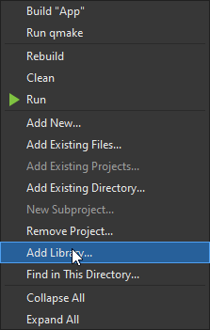
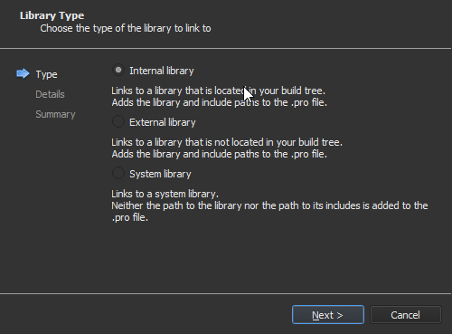
Specify debug and release folders for application
You can create subdir project in QTCreator. One will be application sub project and remaining can be library sub projects. Right click on application subproject and select add library. This will open wizard and you can select the library. This will add dependency in qmake file. As follows
win32:CONFIG(release, debug|release): LIBS += -L$$OUT_PWD/../lib1/release/ -llib1
else:win32:CONFIG(debug, debug|release): LIBS += -L$$OUT_PWD/../lib1/debug/ -llib1
else:unix: LIBS += -L$$OUT_PWD/../lib1/ -llib1
INCLUDEPATH += $$PWD/../lib1
DEPENDPATH += $$PWD/../lib1

Slide 17
Plugin Vs library
A static plugin is compiled into the exe. Otherwise, it would not be static :-)
A plugin is optional, a library is required (shortened view, one could construct examples where it is the other way round)
See it like the SQL support in Qt:
QtSql4.dll is the libraray, it provides the core functionality
libqsqlite.dll, libsqsqlmysql.dll are the drivers and work as plugins

Slide 18
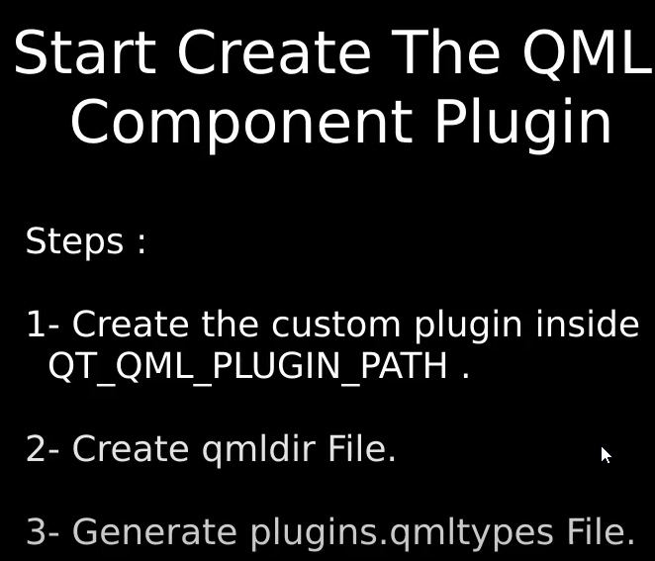
Creating custom QML components

