Slide 1
Ways to integrate C++ with QML
Subclassing QQuickItem: QQuickItem allows you to write your own visual and non-visual QML items using C++.
Registering C++ types with QML: C++ classes can be registered with the QML type system,
allowing them to be instantiated as QML types.
Registering Context Properties: QObjects can be registered with the QML context,
allowing their properties to be directly accessed.
Accessing QML objects through the QML object tree: All QML objects reside in a tree hierarchy and
can be accessed via the root of the tree.
Notes:
1

Slide 2
Reading item from the listmodel at given index
console.log(curvecolormodel.get(currentIndex).value);

Slide 3
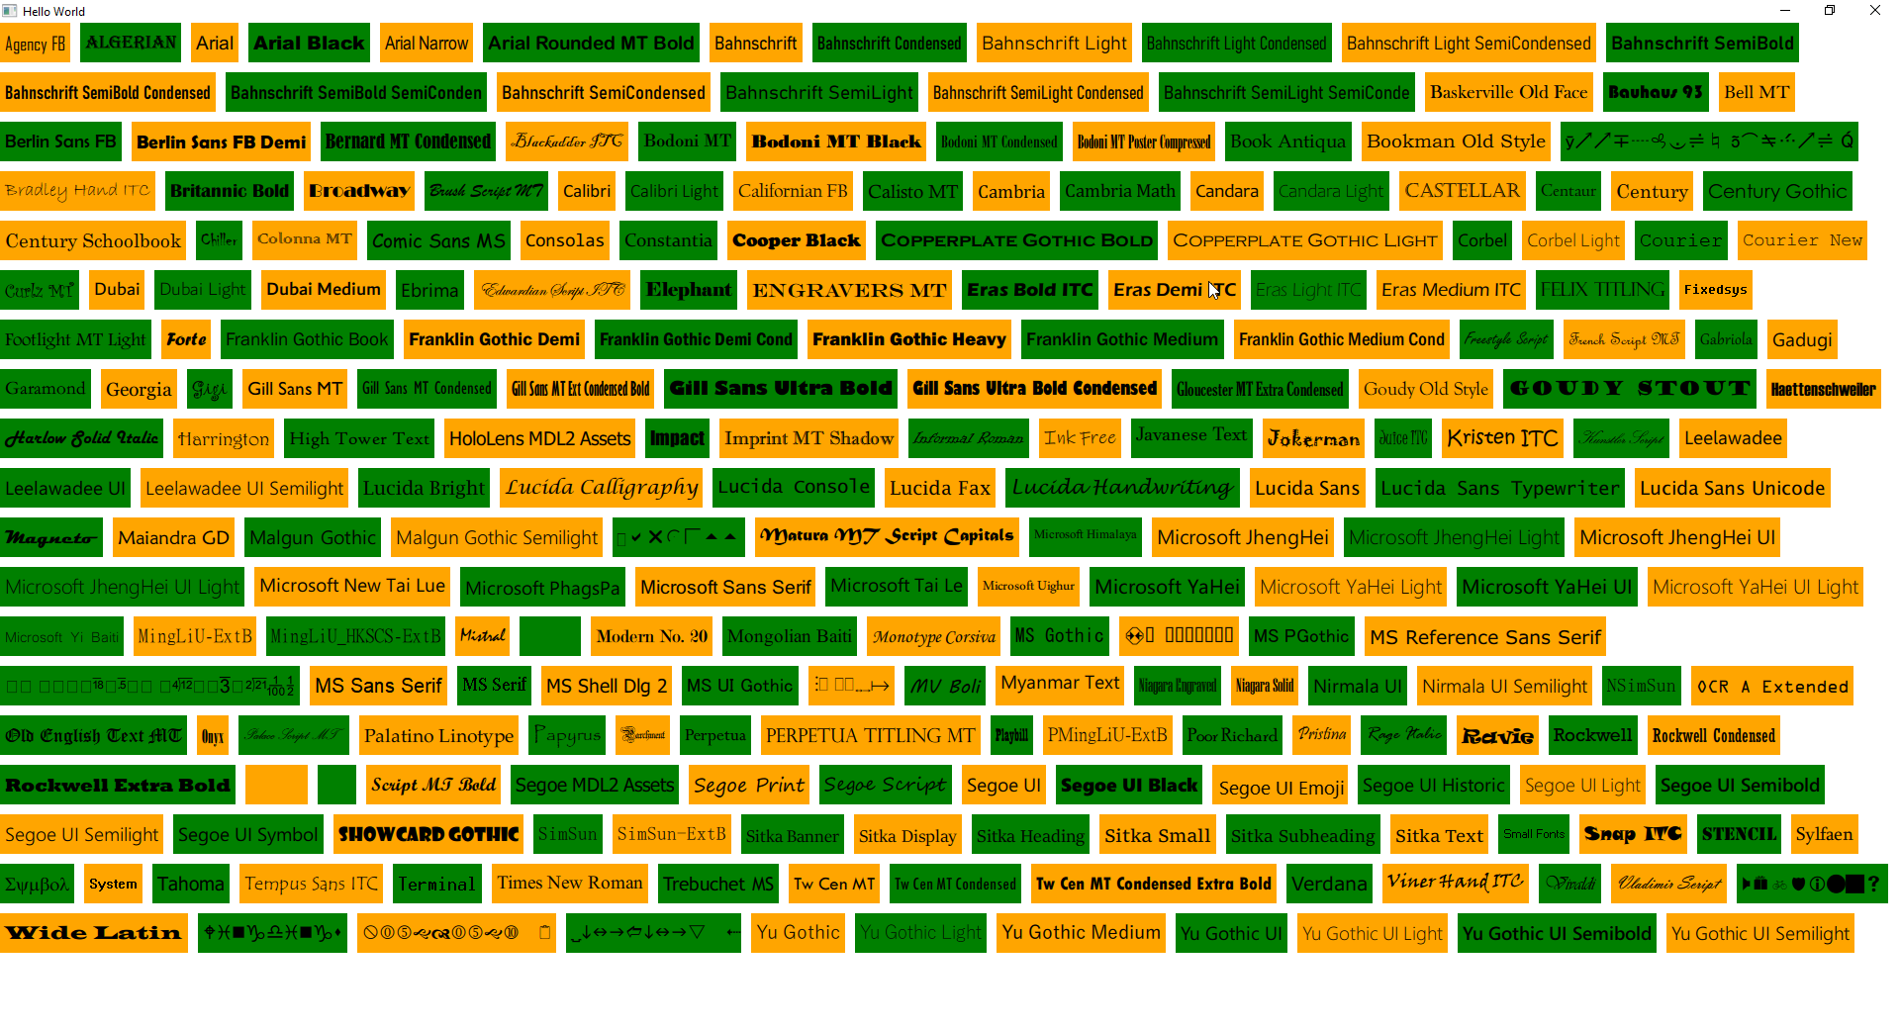
QML Supported Fonts

Slide 4
To Debug QML code you can use rectangle to check the QML element area
This can be done in following fashion. So lets say I want to test StatDisplay element then I can do the following
Rectangle{
width: s1.implicitWidth
height: s1.implicitHeight
color: "orange"
StatDisplay{
id: s1
}
}

