Slide 1


Slide 2
QML

Slide 3
QML (Qt Modelling language)
It is a mark-up language (similar to CSS and JSON) for designing user interface–centric applications.
Features
Components and Modules
Data Types ( int, color, bool, date, font, list, variant, rect )
Property Binding (Binding allows a property's value to be expressed as an JavaScript expression)
Component Layouts (Row, Column, Grid)
Layouts using Anchors (Anchors Top, Bottom, Left, Right, HorizontalCenter)
Mouse Events
Signal and Handler Event System

Slide 4
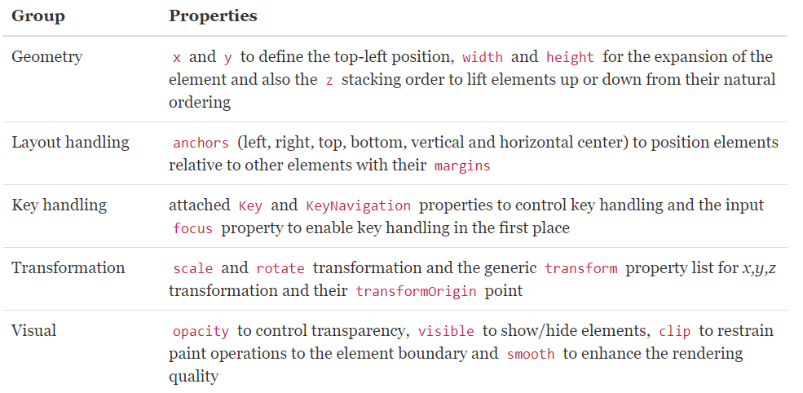
QML
Basic Element : Item
Item is the base element for all visual elements as such all other visual elements inherits from Item. It doesn’t paint anything by itself but defines all properties which are common across all visual elements:

Slide 5
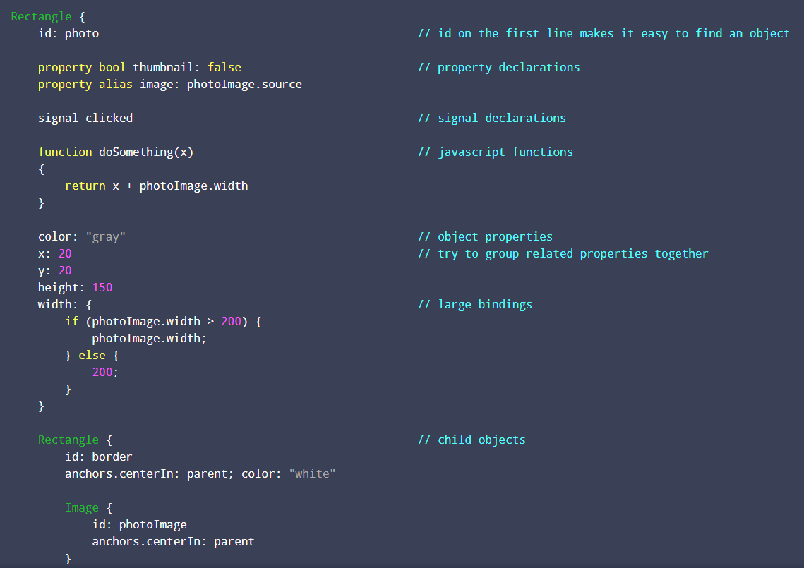
A Typical Qml Object

Slide 6
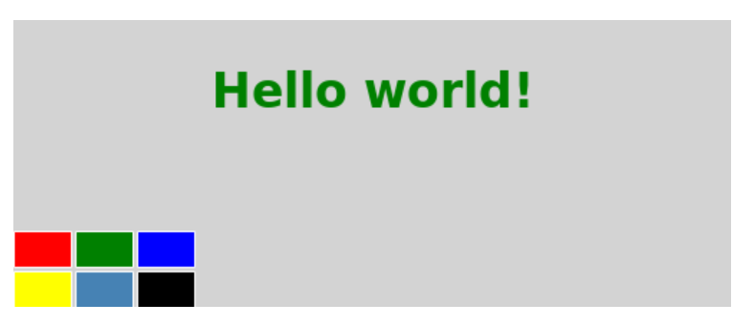
QML
Components
A component provides a way of defining a new type that we can re-use in other QML files.
e.g ColorPicker component

Slide 7
QML
QML Basic Types
The basic types supported natively in the QML language are listed below:
bool | Binary true/false value
double | Number with a decimal point, stored in double precision
enumeration | Named enumeration value
int | Whole number, e.g. 0, 10, or -20
list | List of QML objects
real | Number with a decimal point
string | Free form text string
url | Resource locator
var | Generic property type

Slide 8
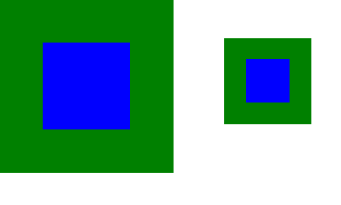
QML
Property Binding
Property bindings are a core feature of QML that lets developers specify relationships between different object properties.
Rectangle {
width: 200
height: 200
color : "green"
Rectangle {
anchors.centerIn: parent
width: parent.width / 2
height: parent.height / 2
color: "blue"
}
}

Slide 9
QML
Item Positioners
Positioner items are container items that manage the positions of items in a declarative user interface.
Column | Positions its children in a column
Flow | Positions its children side by side, wrapping as necessary
Grid | Positions its children in grid formation
LayoutMirroring | Property used to mirror layout behavior
Positioner | Provides attached properties that contain details on where an item exists in a positioner
Row | Positions its children in a row

Slide 10
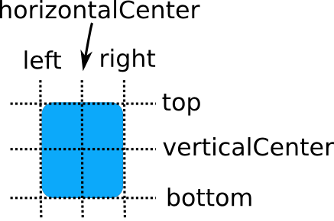
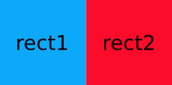
QML
Positioning with Anchors
In addition to the more traditional Grid, Row, and Column, Qt Quick also provides a way to layout items using the concept of anchors. Each item can be thought of as having a set of 7 invisible "anchor lines": left, horizontalCenter, right, top, verticalCenter, baseline, and bottom.
Rectangle { id: rect1; ... }
Rectangle {
id: rect2;
anchors.left: rect1.right;
...
}

Slide 11
QML
Signals and Handlers
Signals provide a way to notify other objects when an event has occurred. For example, the MouseArea clicked signal notifies other objects that the mouse has been clicked within the area
The syntax for defining a new signal is:
signal <name>[([<type> <parameter name>[, ...]])]
Rectangle {
signal trigger
signal send (string notice)
signal perform (string task, variant object)
}
Adding a signal to an item automatically adds a signal handler as well. The signal hander is named on<SignalName>, with the first letter of the signal in uppercase. The previous signals have the following signal handlers:
onTrigger: console.log("trigger signal emitted")
onSend: {
console.log("send signal emitted with notice: " + notice)
}
onPerform: console.log("perform signal emitted")

Slide 12
QML
QML Mouse Events
QML uses signals and handlers to deliver mouse interactions. Specifically, the MouseArea and MouseEvent elements provide QML components with signal handlers to accept mouse events within a defined area.
Rectangle {
id: button1
width: 100
height: 100
MouseArea {
anchors.fill: parent
onClicked: console.log("button clicked")
}
}
MouseArea {
anchors.fill: parent
onClicked: console.log("area clicked")
onDoubleClicked: console.log("area double clicked")
onEntered: console.log("mouse entered the area")
onExited: console.log("mouse left the area")
}

Slide 13
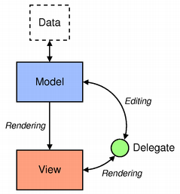
QML
Models and Views in Qt Quick
applications need to form data and display the data. Qt Quick has the notion of models, views, and delegates to display data. They modularize the visualization of data in order to give the developer or designer control over the different aspects of the data.
ListModel {
id: todomodel
ListElement {done: false;description:"wash the car"}
ListElement {done: false;description:"Buy milk and vegetables"}
ListElement {done: false;description:"do homework"}
}
ListView {
id: todoView
model: todomodel
delegate: Row {
CheckBox {checked: model.done}
TextInput { text: model.description}
}
}

Slide 14

QML
Animations
Animations are applied to property changes. An animation defines the interpolation curve when for property value changes to create smooth transitions from one value to another

Slide 15


