Slide 1

Qt Multithreading
By Girish Lande

Slide 2
Multithreading technologies in QT
Background: Threads in an operating system are a very simple thing. Write a function, maybe bundle it with some data and push it onto a newly created thread. Use a mutex or other method to safely communicate with the thread if necessary. Whether it are Win32, POSIX or other threads, they all basically work the same and are quite fool-proof. threads in Qt are just like this, and they would be right. However, there are several different ways to use threads in Qt, and it might not be obvious which approach to choose. The article, Multithreading Technologies in Qt, compares the different approaches.
Using QThread class
Multithreading in Qt
Subclass QThread
Worker object + QThread
Using QthreadPool
Using QtConcurrent

Slide 3
Qthread (read QT documentation of this class)
Managing threads
Thread will notifiy you via a signal when the thread is started(), finished(), and terminated(), or you can use isFinished() and isRunning() to query the state of the thread.
You can stop the thread by calling exit() or quit(). In extreme cases, you may want to forcibly terminate() an executing thread. However, doing so is dangerous and discouraged. Please read the documentation for terminate() and setTerminationEnabled() for detailed information.
From Qt 4.8 onwards, it is possible to deallocate objects that live in a thread that has just ended, by connecting the finished() signal to QObject::deleteLater().
Use wait() to block the calling thread, until the other thread has finished execution (or until a specified time has passed).
The static functions currentThreadId() and currentThread() return identifiers for the currently executing thread. The former returns a platform specific ID for the thread; the latter returns a QThread pointer.

Slide 4
Qthread (read QT documentation of this class)
Managing threads
The static functions currentThreadId() and currentThread() return identifiers for the currently executing thread. The former returns a platform specific ID for the thread; the latter returns a QThread pointer.
To choose the name that your thread will be given, you can call setObjectName() before starting the thread. If you don't call setObjectName(), the name given to your thread will be the class name of the runtime type of your thread object (for example, "RenderThread" in the case of the Mandelbrot Example, as that is the name of the QThread subclass). Note that this is currently not available with release builds on Windows.
QThread also provides static, platform independent sleep functions: sleep(), msleep(), and usleep() allow full second, millisecond, and microsecond resolution respectively.
Note: wait() and the sleep() functions should be unnecessary in general, since Qt is an event-driven framework. Instead of wait(), consider listening for the finished() signal. Instead of the sleep() functions, consider using QTimer.

Slide 5
Using Worker class (most favoured method)
This method is intended for use cases which involve event-driven programming and signals + slots across threads.
Worker object + QThread
Usage with Worker class
The main thing in this example to keep in mind when using a QThread is that it's not a thread. It's a wrapper around a thread object. This wrapper provides the signals, slots and methods to easily use the thread object within a Qt project. To use it, prepare a QObject subclass with all your desired functionality in it. Then create a new QThread instance, push the QObject onto it using moveToThread(QThread*) of the QObject instance and call start() on the QThread instance. That's all. You set up the proper signal/slot connections to make it quit properly and such, and that's all. Lets see the example in next slide.

Slide 6
Declare Worker class
For a basic example, check this class declaration for the Worker class:
class Worker : public QObject {
Q_OBJECT
public:
Worker();
~Worker();
public slots:
void process();
signals:
void finished();
void error(QString err);
private:
// add your variables here
};
We add at least one public slot which will be used to trigger the instance and make it start processing data once the thread has started.

Slide 7
define Worker class
Worker::Worker() { // Constructor
// you could copy data from constructor arguments to internal variables here.
}
Worker::~Worker() { // Destructor
// free resources
}
void Worker::process() { // Process. Start processing data.
// allocate resources using new here
qDebug("Hello World!");
emit finished();
}
Do your processing(probably time consuming operation) in this slot

Slide 8

one extremely important thing to note here is that you should NEVER allocate heap objects (using new) in the constructor of the QObject class as this allocation is then performed on the main thread and not on the new QThread instance, meaning that the newly created object is then owned by the main thread and not the QThread instance. This will make your code fail to work. Instead, allocate such resources in the main function slot such as process() in this case as when that is called the object will be on the new thread instance and thus it will own the resource.
When a QObject is moved to another thread, all its children will be automatically moved too. moveToThread() will fail if the QObject has a parent. If QObjects are created within QThread::run(), they cannot become children of the QThread object because the QThread does not live in the thread that calls QThread::run().

Slide 9
Create a new Worker instance
Now, let's see how to use this new construction by creating a new Worker instance and putting it on a QThread instance:
QThread* thread = new QThread;
Worker* worker = new Worker();
worker->moveToThread(thread);
connect(worker, SIGNAL (error(QString)), this, SLOT (errorString(QString)));
connect(thread, SIGNAL (started()), worker, SLOT (process()));
connect(worker, SIGNAL (finished()), thread, SLOT (quit()));
connect(worker, SIGNAL (finished()), worker, SLOT (deleteLater()));
connect(thread, SIGNAL (finished()), thread, SLOT (deleteLater()));
thread->start();
The connect() series here is the most crucial part.
The first connect() line hooks up the error message signal from the worker to an error processing function in the main thread. The second connects the thread's started() signal to the processing() slot in the worker, causing it to start.
Then the clean-up: when the worker instance emits finished(), as we did in the example, it will signal the thread to quit, i.e. shut down. We then mark the worker instance using the same finished() signal for deletion. Finally, to prevent nasty crashes because the thread hasn't fully shut down yet when it is deleted, we connect the finished() of the thread (not the worker!) to its own deleteLater() slot. This will cause the thread to be deleted only after it has fully shut down.

Slide 10
Method 2 (Subclassing Qthread)
Another way to make code run in a separate thread, is to subclass QThread and reimplement run(). For example:
class WorkerThread : public QThread
{
Q_OBJECT
void run() {
QString result;
/* expensive or blocking operation */
emit resultReady(result);
}
signals:
void resultReady(const QString &s);
};
void MyObject::startWorkInAThread()
{
WorkerThread *workerThread = new WorkerThread(this);
connect(workerThread, SIGNAL(resultReady(QString)), this, SLOT(handleResults(QString)));
connect(workerThread, SIGNAL(finished()), workerThread, SLOT(deleteLater()));
workerThread->start();
}
Subclass QThread

Slide 11
In that example, the thread will exit after the run function has returned. There will not be any event loop running in the thread unless you call exec().
It is important to remember that a QThread instance lives in the old thread that instantiated it, not in the new thread that calls run(). This means that all of QThread's queued slots will execute in the old thread. Thus, a developer who wishes to invoke slots in the new thread must use the worker-object approach; new slots should not be implemented directly into a subclassed QThread.
When subclassing QThread, keep in mind that the constructor executes in the old thread while run() executes in the new thread. If a member variable is accessed from both functions, then the variable is accessed from two different threads. Check that it is safe to do so.
Note: Care must be taken when interacting with objects across different threads. See Synchronizing Threads for details.
class WorkerThread : public QThread
{
Q_OBJECT
void run() {
QString result;
/* expensive or blocking operation */
emit resultReady(result);
}
signals:
void resultReady(const QString &s);
};
void MyObject::startWorkInAThread()
{
WorkerThread *workerThread = new WorkerThread(this);
connect(workerThread, SIGNAL(resultReady(QString)), this, SLOT(handleResults(QString)));
connect(workerThread, SIGNAL(finished()), workerThread, SLOT(deleteLater()));
workerThread->start();
}

Slide 12
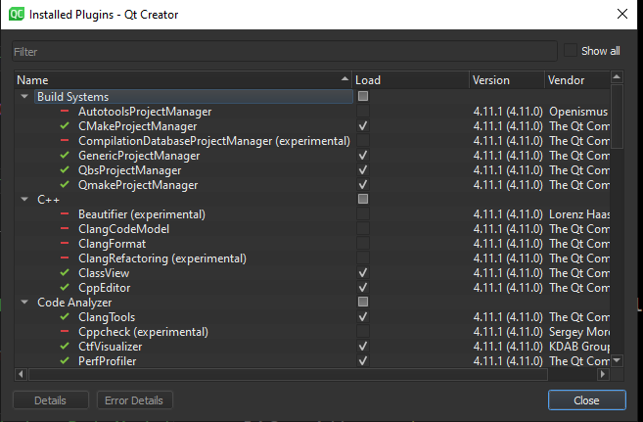
QT creator when used with visual studio compiler, Doesn’t support auto completion, Following symbol definition on CTRL+click.
When such behavior occurs then uncheck ClangCodeModel in QtCreator plugins Dialog.

Slide 13
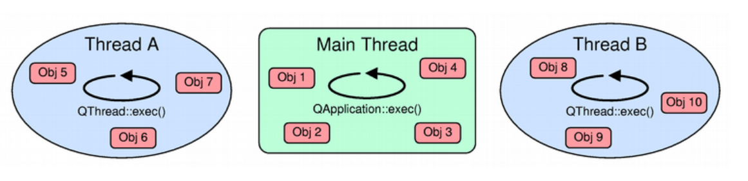
Threads and QObjects
QThread inherits QObject. It emits signals to indicate that the thread started or finished executing, and provides a few slots as well.More interesting is that QObjects can be used in multiple threads, emit signals that invoke slots in other threads, and post events to objects that "live" in other threads. This is possible because each thread is allowed to have its own event loop.
Each thread can have its own event loop. The initial thread starts its event loops using QCoreApplication::exec(); other threads can start an event loop using QThread::exec(). Like QCoreApplication, QThread provides an exit(int) function and a quit() slot.
An event loop in a thread makes it possible for the thread to use certain non-GUI Qt classes that require the presence of an event loop (such as QTimer, QTcpSocket, and QProcess). It also makes it possible to connect signals from any threads to slots of a specific thread. This is explained in more detail in the Signals and Slots Across Threads section below.
https://doc.qt.io/archives/qt-4.8/threads-qobject.html

