Slide 1

Qt Learnings
By Girish Lande

Slide 2
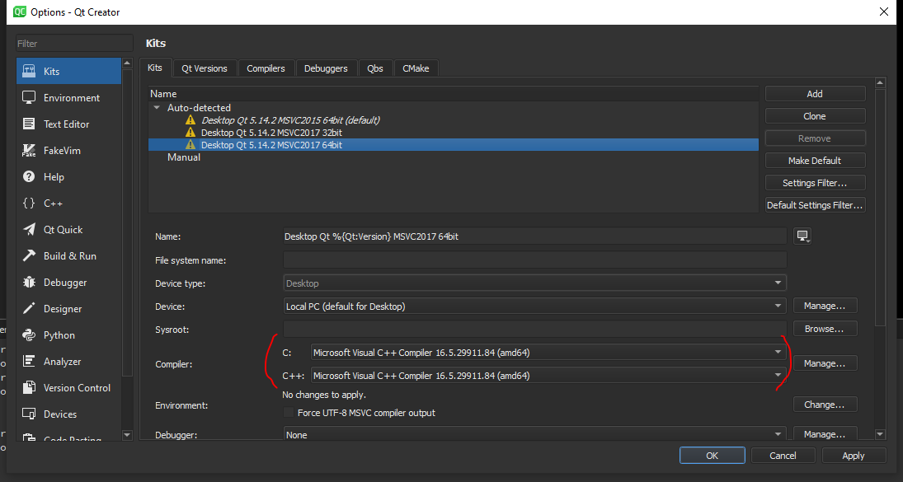
Visual Studio 2019 with Qt Creator as compiler
When using Visual studio 2019 for developing application using QT. Simply install QT opensource on your machine, Select MSVC 2017 64 in various options in QT installation. Once that is selected you can complete setup of QT.
Then Open Tools options and add a kit for visual studio.
Select settings as per following page.

Slide 3
qDebug() vs std::cout<<
In Qt project we often use qDebug() and rightly so.
Std::cout << “message” will send message to output stream but will not actually print on monitor.
Std::cout << std::flush is required to print message immediately. Otherwise you will see all messages printed at the end of program.
qDebug() on the other hand will output immediately and will also add newline feed.

Slide 4
Connect using macros vs method address
Following are 2 methods to connect signals to slots in QT.
connect(this,&Student::mySignal,this,&Student::mySlot); // new method
connect(this,SIGNAL(mySignal()),this,SLOT(mySlot())); // Old method IMP: Read https://wiki.qt.io/New_Signal_Slot_Syntax
Pros
Compile time check of the existence of the signals and slot, of the types, or if the Q_OBJECT is missing.
Argument can be by typedefs or with different namespace specifier, and it works.
Possibility to automatically cast the types if there is implicit conversion (e.g. from QString to QVariant)
It is possible to connect to any member function of QObject, not only slots.
Cons
More complicated syntax? (you need to specify the type of your object)
Very complicated syntax in cases of overloads? (see below)
Default arguments in slot is not supported anymore.

Slide 5
How to check if connection is successful
Connect(sender,signal,receiver,slot) is successful or not ?
Use qDebug() << connect() to print. If connection is successful it will print true.

Slide 6
QT SIGNALS AND SLOTS
There are some rules that make life with signals and slots easier and cover the most common reason for defective connections. If I forgot something please tell me.
1) Check the debug console output:
When execution errors occur, the debug output can show you the reason.
2) Use the full signature of signal and slot:
Instead of connect(that, SIGNAL(mySignal), this, SLOT(mySlot));
Write connect(that, SIGNAL(mySignal(int)), this, SLOT(mySlot(int)));
and check your spelling and capitalization.
3) Use existing overloads:
Carefully check if you are using the desired overloads of signal and slot and if the overloads you used actually exist.
4) Your signal and slot must be compatible:
This especially means the parameters must be of the same type (references are tolerated) and have the same order. Compile-time syntax also needs the same number of parameters. Old runtime syntax allows connecting signals to slots with less parameters.

Slide 7
5) Always check return value of connect method (programmers should never ignore return values):
Instead of
connect(that, SIGNAL(mySignal(int)), this, SLOT(mySlot(int)));
always use something like
bool success = connect(that, SIGNAL(mySignal(int)), this, SLOT(mySlot(int)));
Q_ASSERT(success);
Or if you like throw an exception or implement full error handling. You may also use a macro like that:
#ifndef QT_NO_DEBUG
#define CHECK_TRUE(instruction) Q_ASSERT(instruction)
#else
#define CHECK_TRUE(instruction) (instruction)
#endif
CHECK_TRUE(connect(that, SIGNAL(mySignal(int)), this, SLOT(mySlot(int))));
6) You need an event loop for queued connections:
I.e. when ever you connect signals/slots of two objects owned by different threads (so called queued connections) you need to call exec(); in the slot's thread!
The event loop also needs to be actually served. Whenever the slot's thread is stuck in some kind of busy loop, queued connections are NOT executed!

Slide 8
7) You need register custom types for queued connections:
So when using custom types in queued connections you must register them for this purpose.
First declare the type using the following macro:
Q_DECLARE_METATYPE(MyType)
Then use one of the following calls:
qRegisterMetaType<MyTypedefType>("MyTypedefType"); // For typedef defined types
qRegisterMetaType<MyType>(); // For other types
8) Prefer new compile time syntax over old run-time checked syntax:
Instead of
connect(that, SIGNAL(mySignal(int)), this, SLOT(mySlot(int)));
use this syntax
connect(that, &ThatObject::mySignal, this, &ThisObject::mySlot));
which checks signal and slot during compile time and even does not need the destination being an actual slot.
If your signal is overloaded use the following syntax:
connect(that, static_cast<void (ThatObject::*)(int)> &ThatObject::mySignal), this, &ThisObject::mySlot); // <Qt5.7
connect(that, qOverload<int>::of(&ThatObject::mySignal), this, &ThisObject::mySlot); // >=Qt5.7 & C++11
connect(that, qOverload<int>(&ThatObject::mySignal), this, &ThisObject::mySlot); // >=Qt5.7 & C++14
Also do not mix const/non-const signals/slots for that syntax (normally signals and slots will be non-const).

Slide 9
9) Your classes need a Q_OBJECT macro:
In classes where you are using "signals" and "slots" specifications you need to add a Q_OBJECT macro like this:
class SomeClass
{
Q_OBJECT
signals:
void MySignal(int x);
};
class SomeMoreClass
{
Q_OBJECT
public slots:
void MySlot(int x);
};
This macro adds necessary meta information to the class.

Slide 10
10) Your objects must be alive:
As soon as either the sender object or the receiver object is destroyed, Qt automatically discards the connection. If the signal isn't emitted: Does the sender object still exist? If the slot isn't called: Does the receiver object still exist?
To check the lifetime of both objects use a debugger break point or some qDebug() output in the constructors/destructors.
11) It still does not work:
To do a very quick and dirty check of your connection emit the signal by your self using some dummy arguments and see if it is called:
connect(that, SIGNAL(mySignal(int)), this, SLOT(mySlot(int)));
emit that->mySignal(0); // Ugly, don't forget to remove it immediately
Finally of course it is possible that the signal simply is not emitted. If you followed the above rules, probably something is wrong in your program's logic. Read the documentation. Use the debugger. And if there is now other way, ask at stackoverflow.

Slide 11
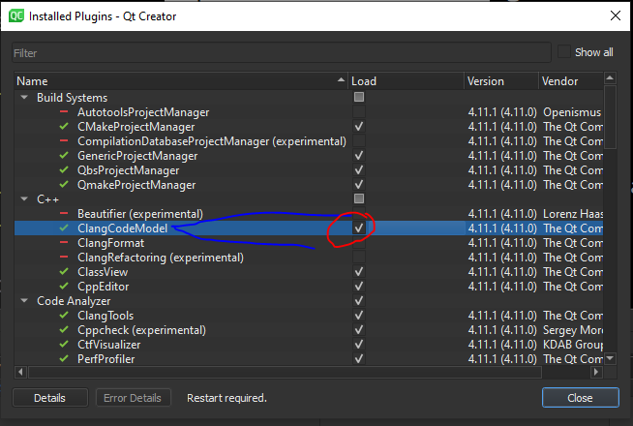
When using Visual studio, if clicking on methods, class names doesn’t take you to their definition, then check plugin dialog and uncheck, ClangCodeModel.

